Slide 1
.
Sequential decision analytics and modeling
ORF 411
Fall, 2018
Warren Powell
Princeton University
http://www.castlelab.princeton.edu
© 2017 Warren B. Powell, Princeton University

Slide 2

Week 2 - Wednesday
Thompson sampling
Knowledge gradient policies

Slide 3

Overview of policies

Slide 4
Learning policies
4
Heuristic learning policies
  Pure exploitation – Always make the choice that appears to be the best.
  Pure exploration – Make choices at random so that you are always learning more.
  Epsilon-greedy
    Explore with probability and exploit with probability
    Epsilon-greedy exploration – explore with probability . Goes to zero as , but not too quickly.
Discuss
  Convergence
  Applying to large problems
Notes:
4

Slide 5

Learning policies
Heuristic measurement policies
  Boltzmann exploration
    Explore choice x with probability
  Upper confidence bounding
  Thompson sampling – Highlight this
  Interval estimation (or upper confidence bounding)
    Choose x which maximizes
5
Notes:
5

Slide 6
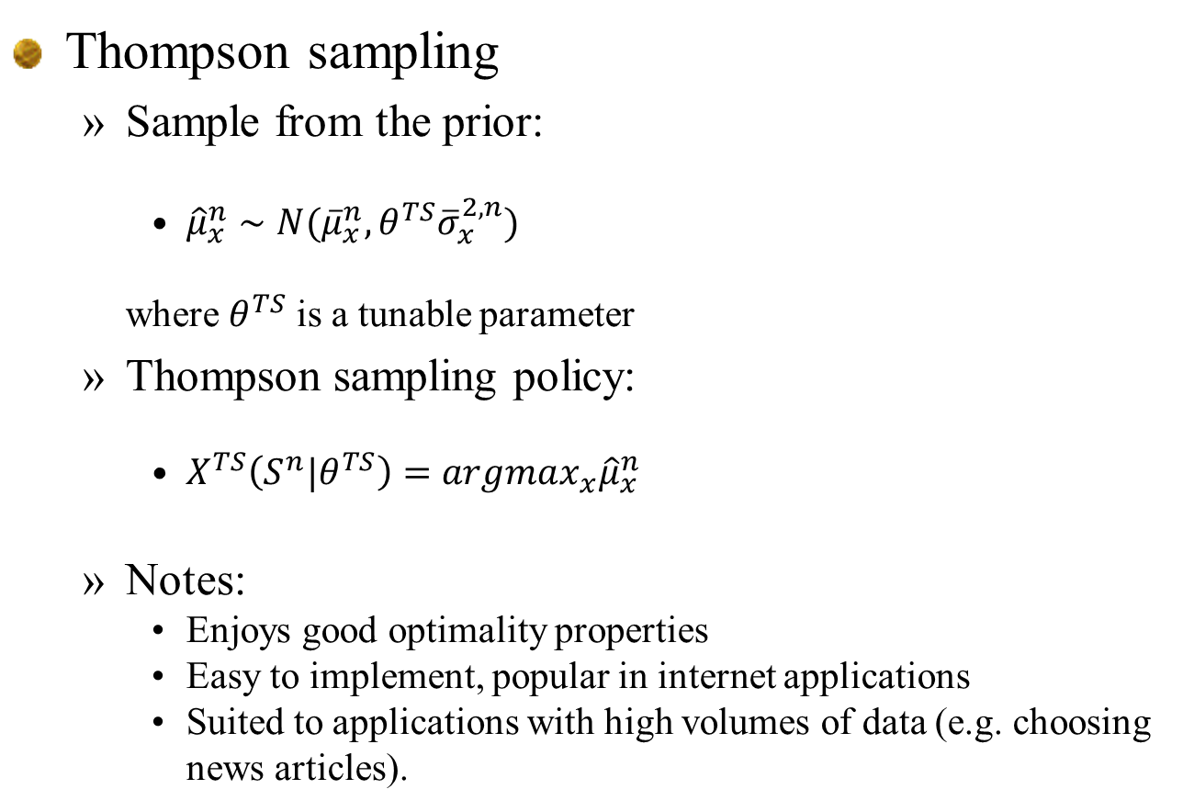
Thompson sampling
  Sample from the prior:
    ${\hat{μ}}_{x}^{n}∼N({\overline{μ}}_{x}^{n},θ^{TS}{\overline{σ}}_{x}^{2,n})$
    where $θ^{TS}$ is a tunable parameter
  Thompson sampling policy:
    $X^{TS}\left(S^{n}|θ^{TS}\right)=argmax_{x}{\hat{μ}}_{x}^{n}$
  Notes:
    Enjoys good optimality properties
    Easy to implement, popular in internet applications
    Suited to applications with high volumes of data (e.g. choosing news articles).

Slide 7
The knowledge gradient
Offline learning/final reward

Slide 8
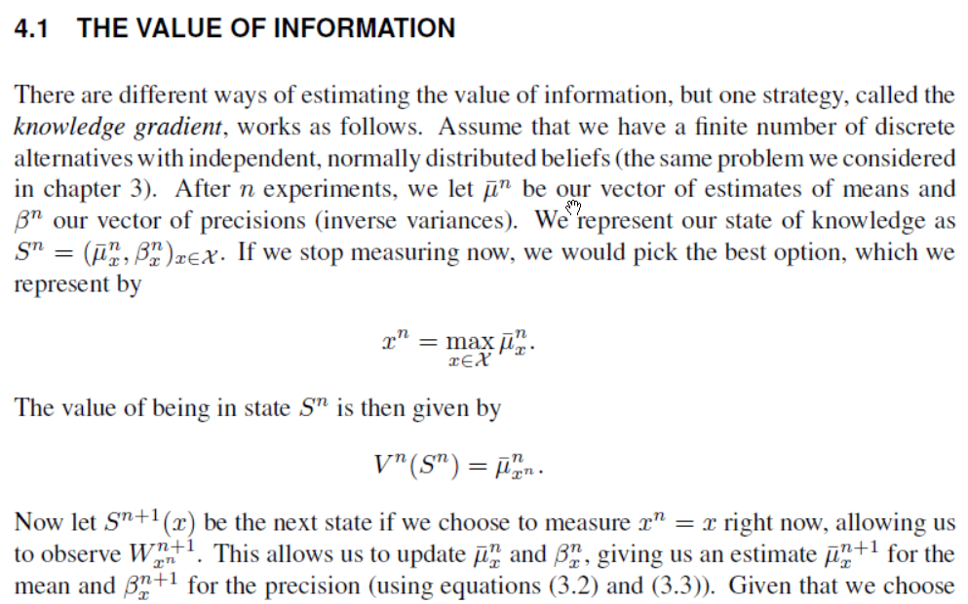

Slide 9
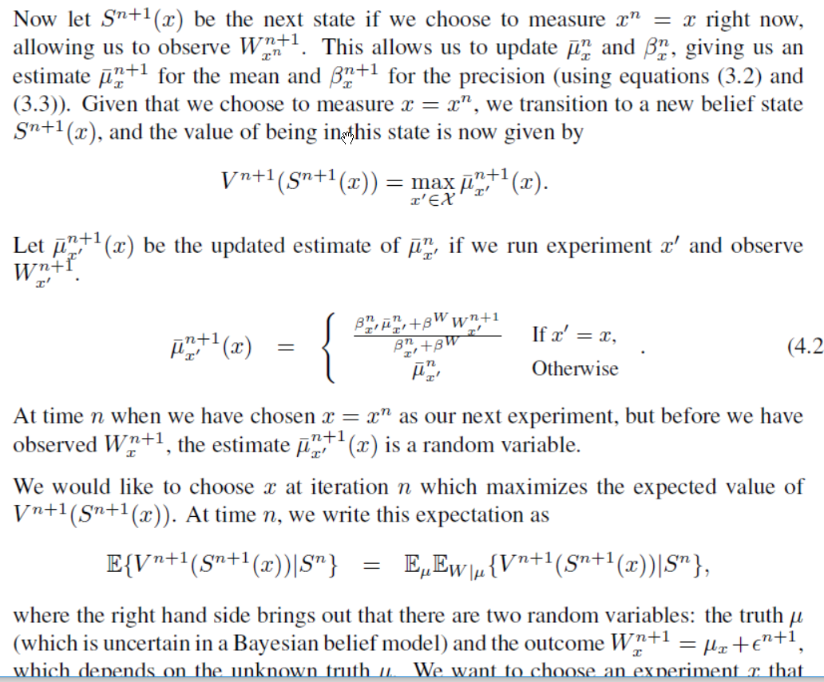

Slide 10
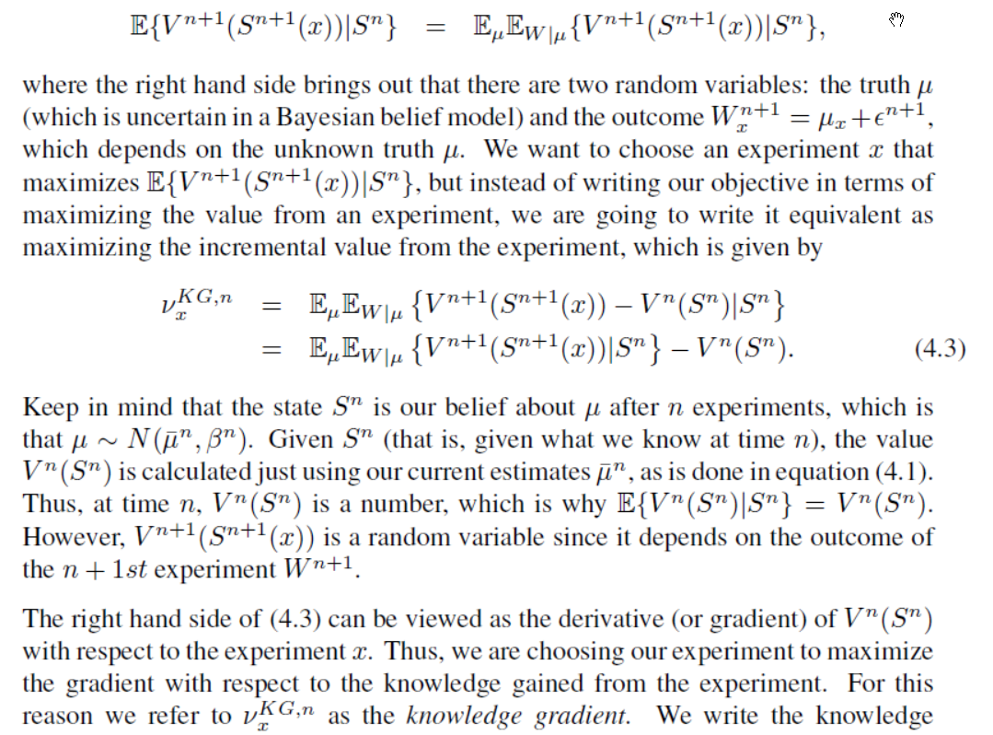

Slide 11
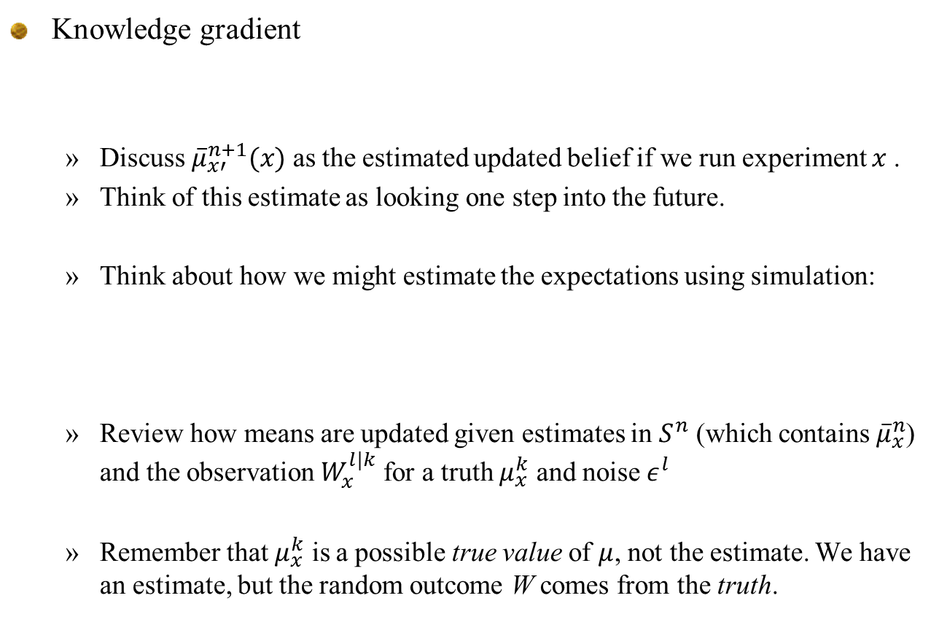
Knowledge gradient
  Discuss ${\overline{μ}}_{x′}^{n+1}(x)$ as the estimated updated belief if we run experiment $x$.
  Think of this estimate as looking one step into the future.
  Think about how we might estimate the expectations using simulation:
  Review how means are updated given estimates in $S^{n}$ (which contains ${\overline{μ}}_{x}^{n}$) and the observation $W_{x}^{l|k}$ for a truth $μ_{x}^{k}$ and noise $ε^{l}$
  Remember that $μ_{x}^{k}$ is a possible true value of $μ$, not the estimate. We have an estimate, but the random outcome W comes from the truth.

Slide 12
Ranking and selection
Knowledge gradient policy
  We want to measure the weighted area under the curve for option 5 that is over the value for option 4.
1
2
3
4
5

Slide 13
The knowledge gradient
13
Derivation
  Notation
  We update the precision using
  In terms of the variance, this is the same as
Notes:
13

Slide 14

The knowledge gradient
14
Derivation
  The change in variance can be found to be
  Next compute the normalized influence:
  Let
  Knowledge gradient is computed using
Notes:
14

Slide 15
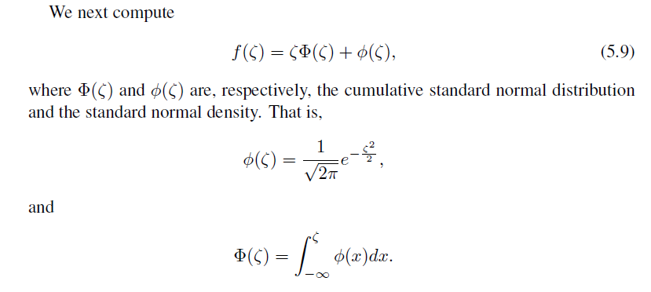
The knowledge gradient
The normal distribution
Computing the cdf
  Matlab – normcdf(x,mu,sigma)
  Excel – normdist(x,mu,sigma,prob) z = standard normal

Slide 16
The knowledge gradient
Knowledge gradient
1
2
3
4
5
16
Notes:
16

Slide 17
KG calculations
  To link to spreadsheet, click here.
Sigma^n |  | Decision | & | $\mu^n$ | & | $\beta^n$ | & | $\beta^{n+1}$ | & | $\sigmatilde$ | & | $max_x' x'$ | & | $\zeta$ | & | $f(z)$ | & | $\nu^{KG)_x$
5.00 |  | 1 | & | 3.0 | & | 0.0400 | & | 1.0400 | & | 4.9029 | & | 5 | & | -0.4079 | & | 0.2277 | & | 1.1165
8.00 |  | 2 | & | 4.0 | & | 0.0156 | & | 1.0156 | & | 7.9382 | & | 5 | & | -0.1260 | & | 0.3391 | & | 2.6920
8.00 |  | 3 | & | 5.0 | & | 0.0156 | & | 1.0156 | & | 7.9382 | & | 4.5 | & | -0.0630 | & | 0.3682 | & | 2.9232
9.00 |  | 4 | & | 4.5 | & | 0.0123 | & | 1.0123 | & | 8.9450 | & | 5 | & | -0.0559 | & | 0.3716 | & | 3.3241
10.00 |  | 5 | & | 3.5 | & | 0.0100 | & | 1.0100 | & | 9.9504 | & | 5 | & | -0.1507 | & | 0.3281 | & | 3.2646

Slide 18
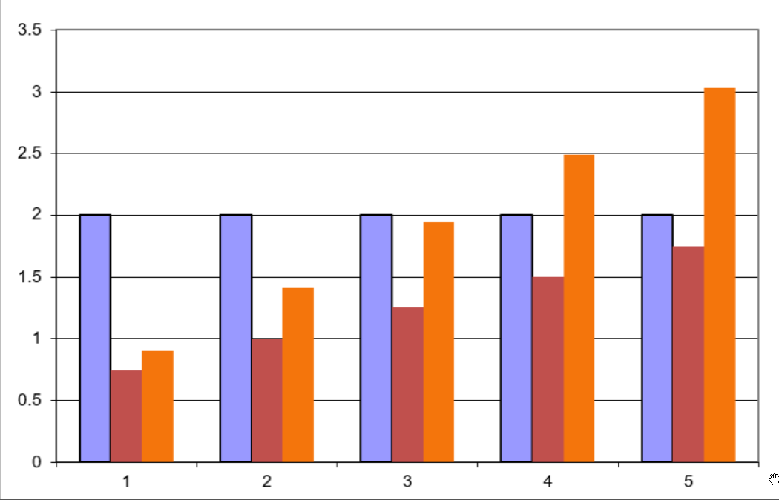

Slide 19
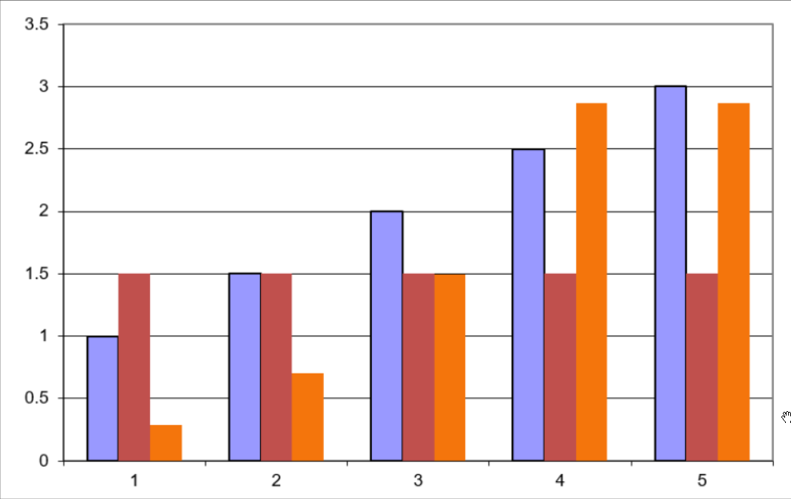

Slide 20
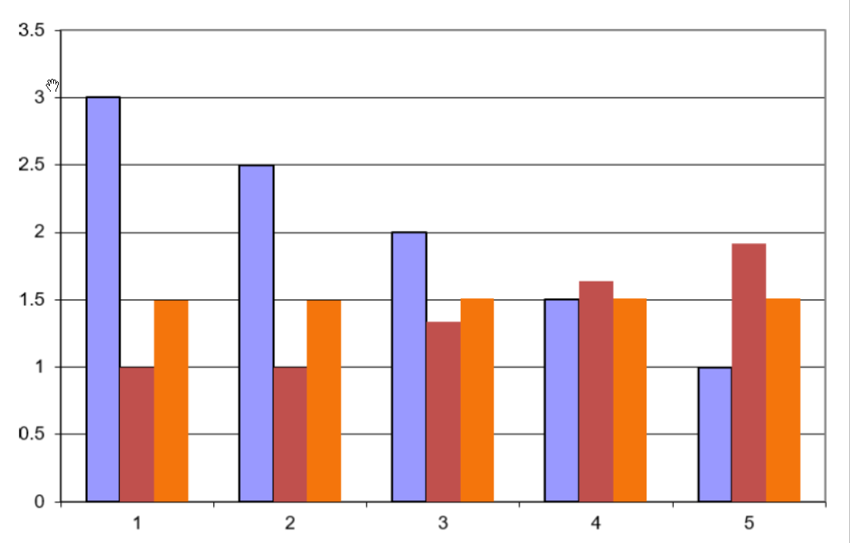

Slide 21
Knowledge gradient
The S-curve effect

Slide 22
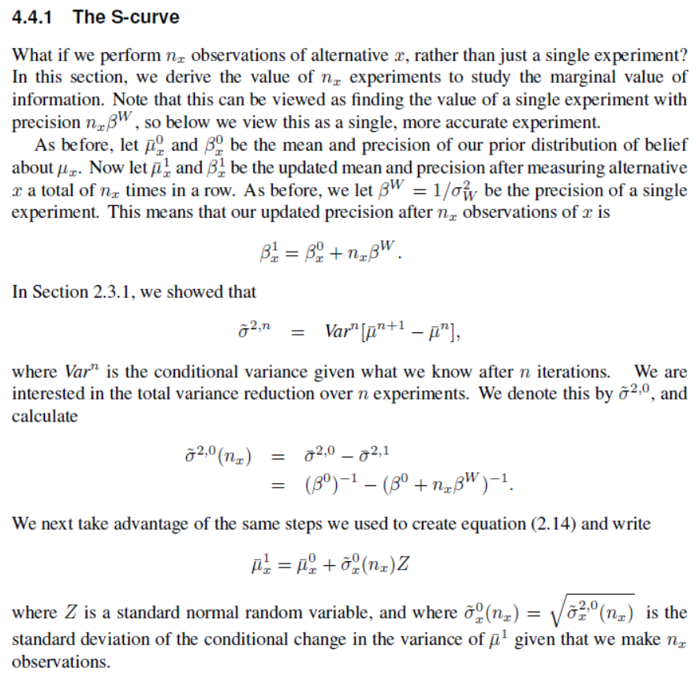

Slide 23
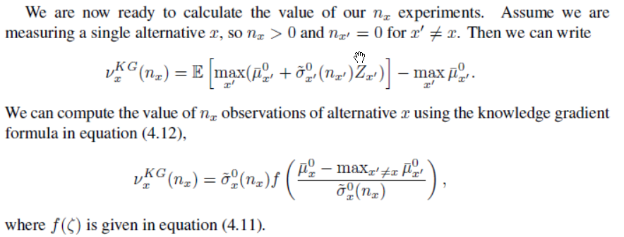

Slide 24
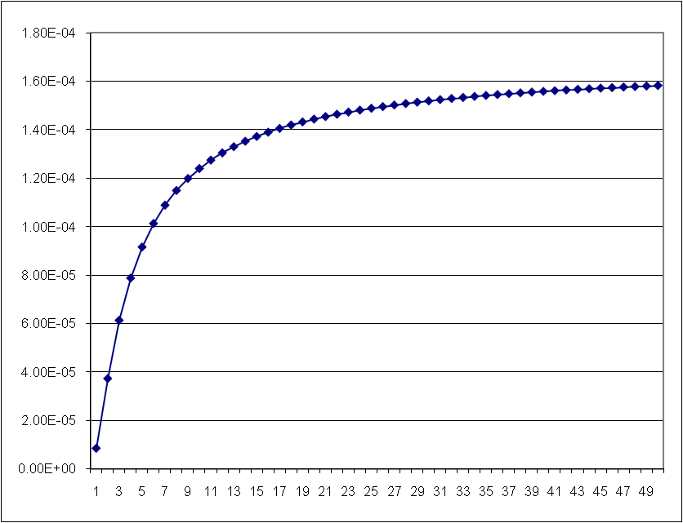
S-curve
The marginal value of information
  Imagine that we are choosing between an uncertain alternative we can measure, and a certain one. Click here for spreadsheet.

Slide 25
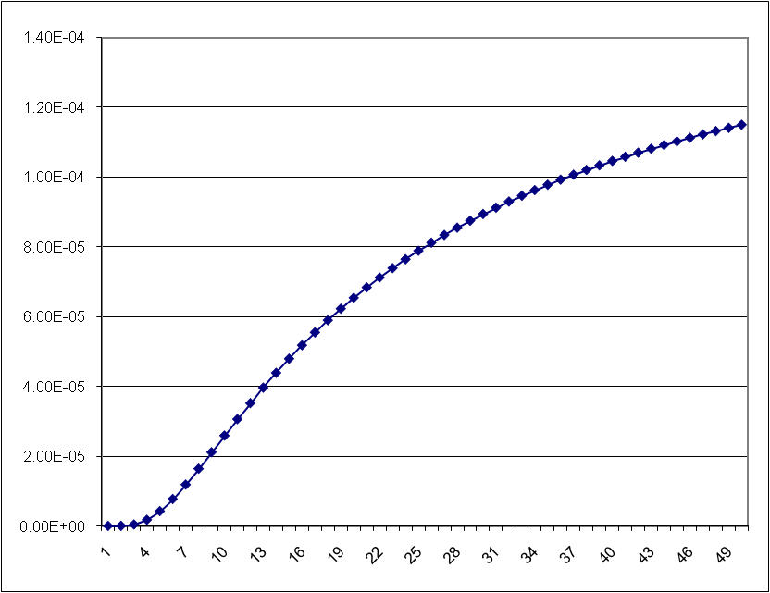
S-curve
The marginal value of information
  Imagine that we are choosing between an uncertain alternative we can measure, and a certain one. Click here for spreadsheet.

Slide 26
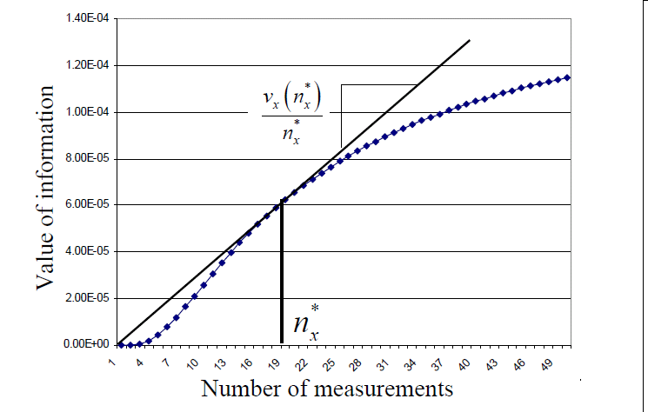
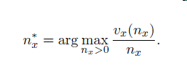
S-curve
The KG(*) policy
  Assume that we are going to make enough measurements to maximize the average value of an alternative:

Slide 27
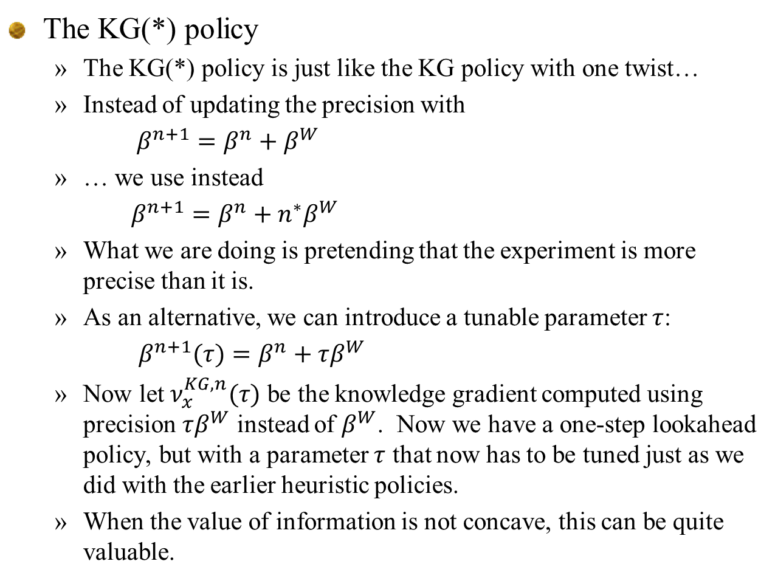
S-curve
The KG(*) policy
  The KG(*) policy is just like the KG policy with one twist…
  Instead of updating the precision with
  $β^{n+1}=β^{n}+β^{W}$
  … we use instead
  $β^{n+1}=β^{n}+n^{∗}β^{W}$
  What we are doing is pretending that the experiment is more precise than it is.
  As an alternative, we can introduce a tunable parameter $τ$:
  ${ β}^{n+1}(τ)=β^{n}+τβ^{W}$
  Now let $ν_{x}^{KG,n}(τ)$ be the knowledge gradient computed using precision $τβ^{W}$ instead of $β^{W}$. Now we have a one-step lookahead policy, but with a parameter $τ$ that now has to be tuned just as we did with the earlier heuristic policies.
  When the value of information is not concave, this can be quite valuable.

Slide 28
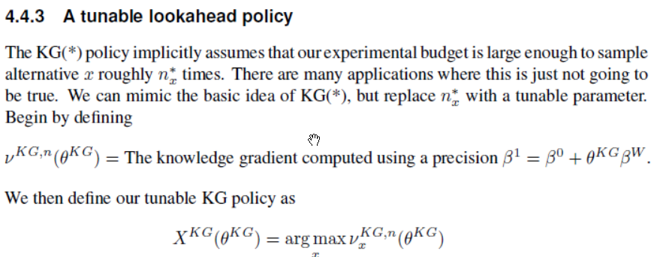
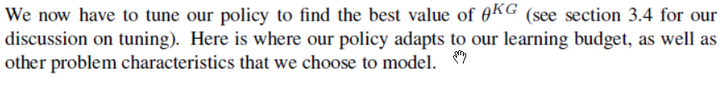

Slide 29
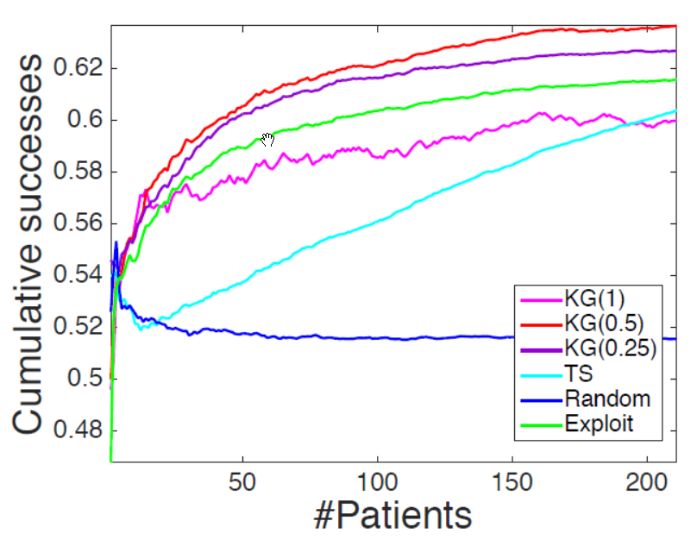
Comparison of policies on health application
  Patients arrive at random with a set of characteristics a
  Choice x is a medical decision
  y = 1 if medical episode is a “success”, 0 otherwise.

Slide 30
Knowledge gradient
Online learning/cumulative reward

Slide 31
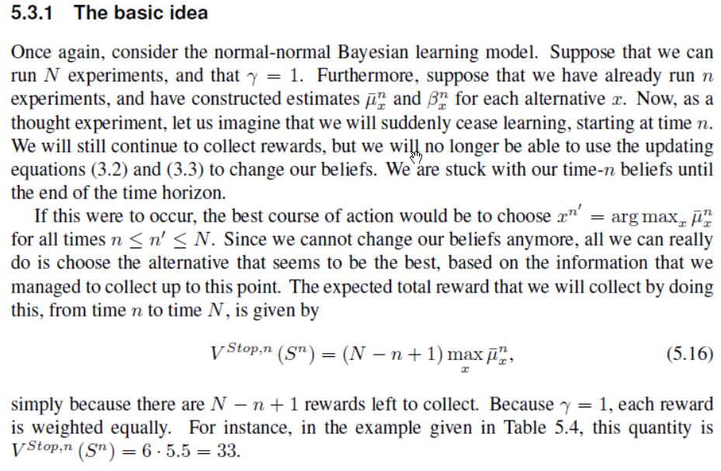
Knowledge gradient

Slide 32
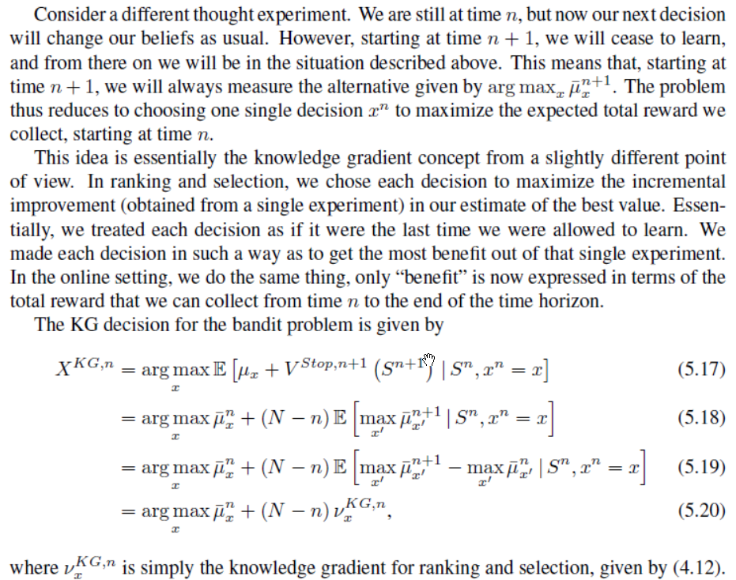
Knowledge gradient

Slide 33
Knowledge gradient
Notes:
  Asymptotically finds optimal arm as
  Knowledge gradient seems to be the only policy with distinct forms for offline (final reward) and online (cumulative reward):
Offline learning
Online learning

Slide 34



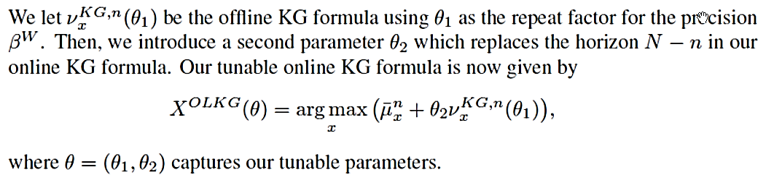
Knowledge gradient
Discounted finite horizon
Discounted infinite horizon
Tunable versions:

Slide 35
Knowledge gradient
Knowledge gradient policy
  For finite-horizon on-line problems:
  For infinite-horizon discounted problems:
Compare to Gittins indices for bandit problems
…interval estimation
… and UCB
Notes:
35

Slide 36
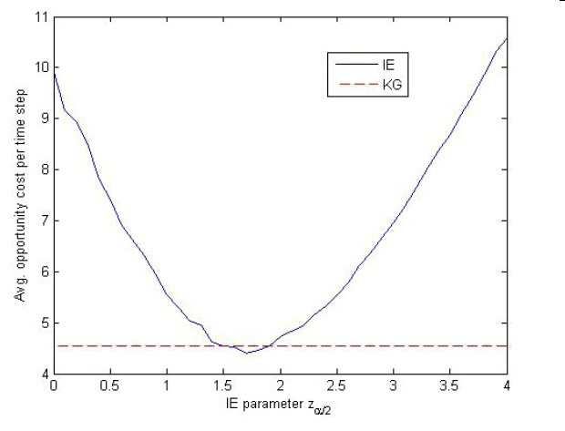
Knowledge gradient
KG versus interval estimation
  Recall that with IE, you choose the alternative with the highest:
Tunable parameter
IE
Opportunity cost
IE beats KG
KG

Slide 37
Lookahead learning model
Beta-Bernoulli belief

Slide 38
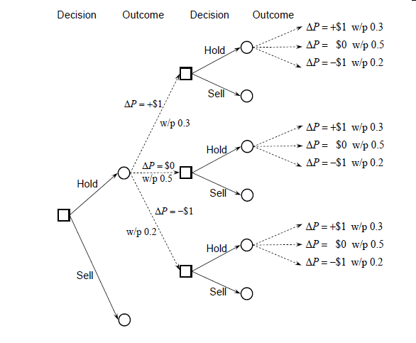
Learning using decision trees
Decision tree without learning

Slide 39
Learning using decision trees
Some vocabulary:
  Square nodes are:
    Decision nodes – Links emanating from the squares are decisions
    Also represents the state of our system (it implicitly captures all the information we need to make a decision).
    Also known as the “pre-decision state.”
  Circle nodes are:
    Outcome nodes – Links emanating from circles represent random events.
    Represents the state after a decision is made.
    Also known as the “post-decision state.”
  Nodes in a decision tree always imply the information in the entire path leading up to the node.
  We receive a reward whenever we sell.

Slide 40
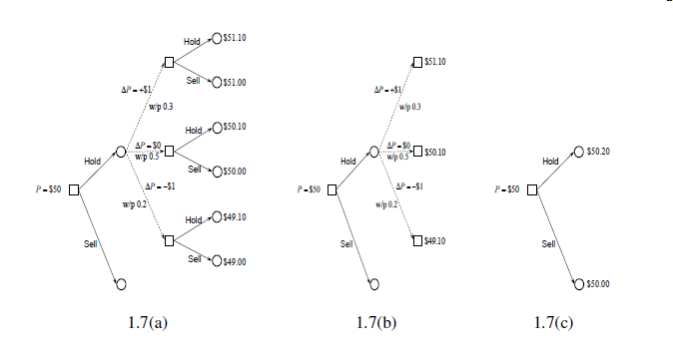
Learning using decision trees
Rolling back the tree

Slide 41
Choose hitter
Hit?
Choose hitter
Hit?
.366
Hidden in each node is the updated belief state after new observations are made.
We could assume that we do not learn, but here we are learning, and new observations produce updated estimates of probabilities.
.333
1
.318
.360
.356
0
.640
.333
.318
A
.360
.500
1
.318
B
.333
0
.360
.667
.250
.318
C
.360
.333
1
.348
.318
0
.360
.682
.333
.304

Slide 42
.366
.333
1
.360
.318
0
.356
.640
.333
A
.318
.360
1
.500
B
.333
.318
0
.360
.667
.250
C
.318
.360
1
.333
.318
.348
0
.360
.682
.333
.304

Slide 43
.366
1
.360
0
.640
.356
A
1
.500
B
.333
0
.667
.360
C
1
.360
.318
0
.682
.360

Slide 44
Notes:
  We choose player B, who does not have the highest average.
  Discuss the impact of the uncertainty about player B.
  What if all the players had 100’s of at bats?
.720 =
.360(1+.366)+
.640(0+.356)
A
B
.740
C
.678

Slide 45
0/1 outcomes
  Does an internet customer click on a link or buy a product.
  Did the baseball player get a hit?
  Did the drug work for the patient?
  Did the student accept our offer of admission?

Slide 46
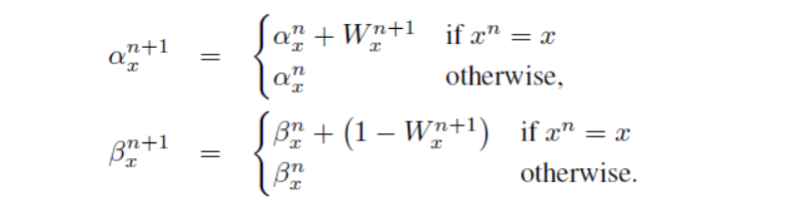
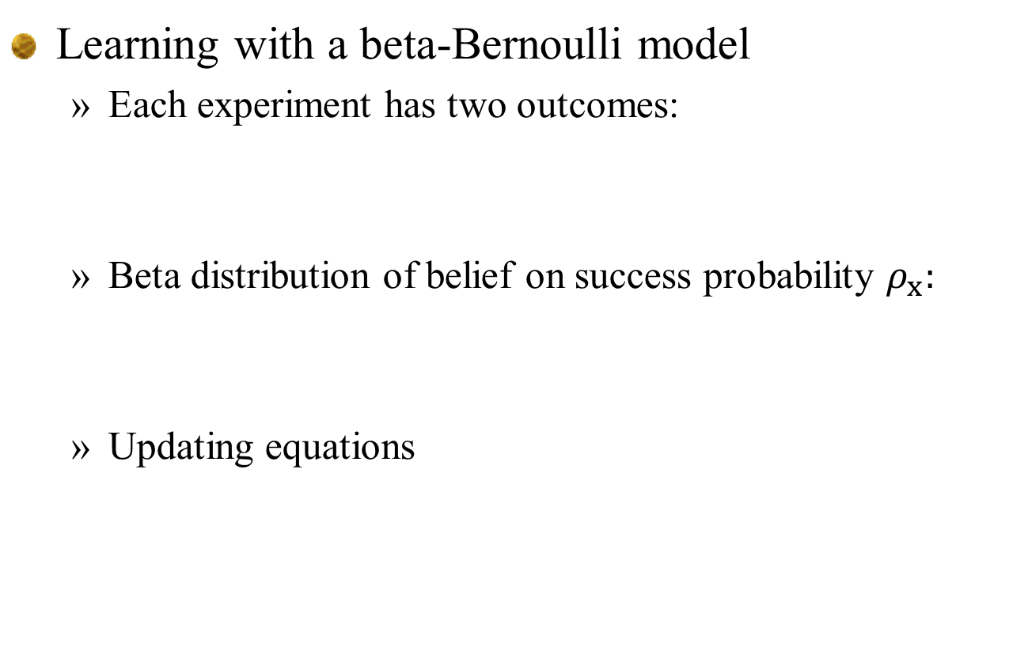
Multi-step lookahead policies
Learning with a beta-Bernoulli model
  Each experiment has two outcomes:
  Beta distribution of belief on success probability $ρ_{x}:$
  Updating equations

Slide 47
Decision Outcome Decision Outcome
Continue
Continue
Stop
Stop
Continue
Continue
Stop
Continue
Stop
Stop
As a decision tree (some states are duplicated)

Slide 48
Decision Outcome Decision Outcome
Continue
Continue
Stop
Stop
Continue
Continue
Stop
Continue
Stop
Stop
As a dynamic program (duplicate states removed)

Slide 49
Decision Outcome Decision Outcome Decision

Slide 50
Discrete MDPs
Decision trees:
  Discuss the concept of a “state” in a decision tree.
  Implicit in a decision node is the entire history leading up to the decision, which is unique.
  We may not need the entire history, but we do not need to articulate this.
  The complexity of a decision tree is independent of the complexity of the state variable. Instead, it depends on the number of possible decisions (actions) and outcomes.

Slide 51
Decision Outcome Decision Outcome Decision Outcome
Decision node
Outcome node

