Slide 1
.
Sequential decision analytics and modeling
ORF 411
Fall, 2018
Warren Powell
Princeton University
http://www.castlelab.princeton.edu
© 2017 Warren B. Powell, Princeton University

Slide 2

Week 1 - Wednesday
Machine learning

Slide 3
Three core approximation architectures
  Lookup tables
  Parametric models
    Linear in the parameters
    Nonlinear (in the parameters)
  Nonparametric

Slide 4
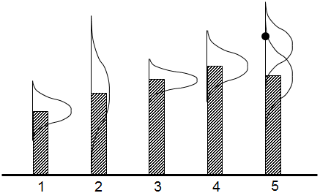
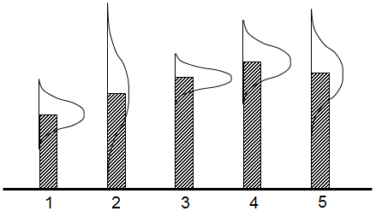
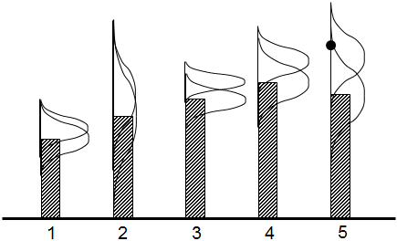
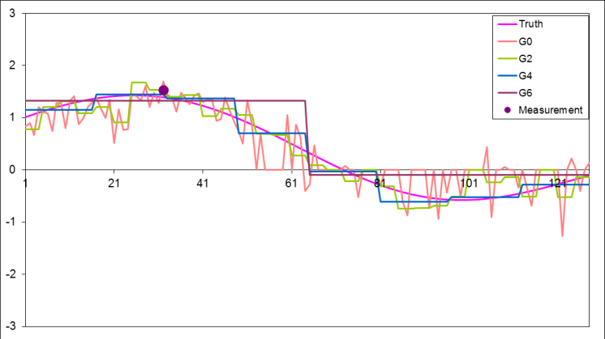
Approximating strategies
Lookup tables
  Independent beliefs
  Correlated beliefs
    A few dozen observations can teach us about thousands of points.
  Hierarchical models
    Create beliefs at different levels of aggregation and then use weighted combinations

Slide 5
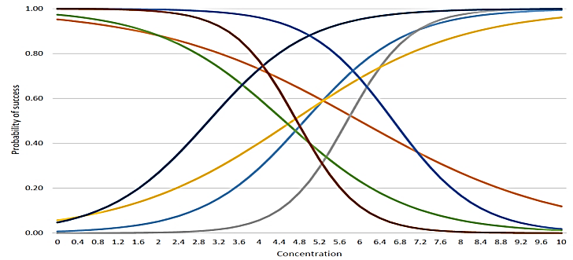
Approximating strategies
Parametric models
  Linear models
    Might include sparse-additive, where many parameters are zero.
  Nonlinear models
    (Shallow) Neural networks, …

Slide 6
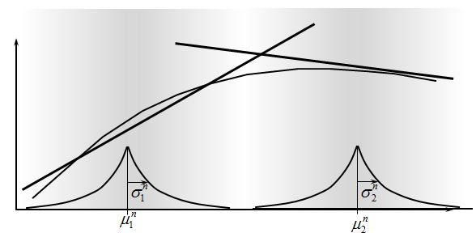
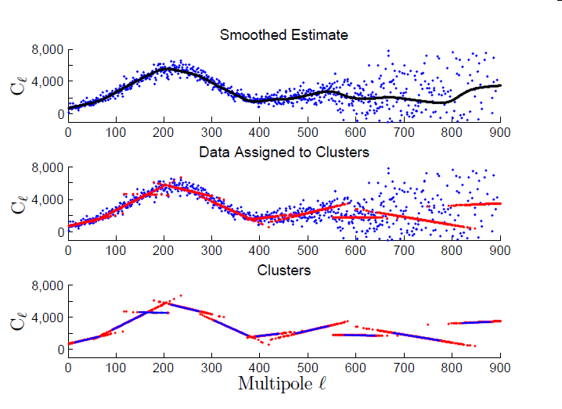
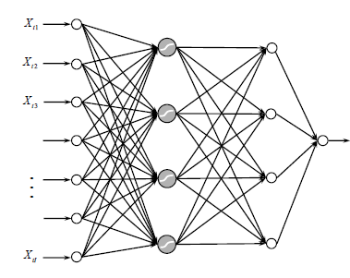
Approximating strategies
Nonparametric models
  Kernel regression
    Weighted average of neighboring points
    Limited to low dimensional problems
  Locally linear methods
    Dirichlet process mixtures
    Radial basis functions
  Splines
  Support vector machines
  Deep neural networks

Slide 7

Lookup tables
Frequentist
Bayesian – Independent
Bayesian - correlated

Slide 8
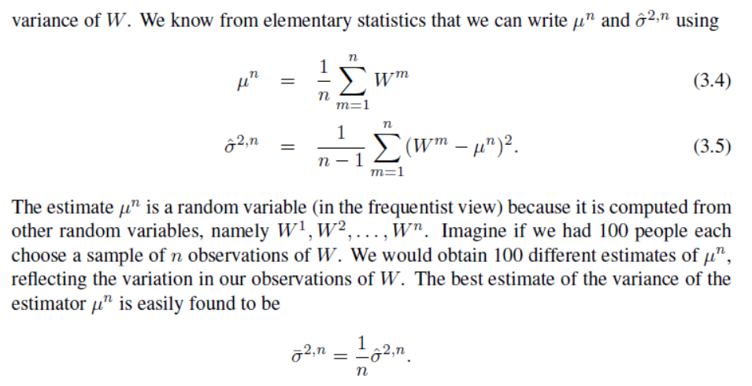
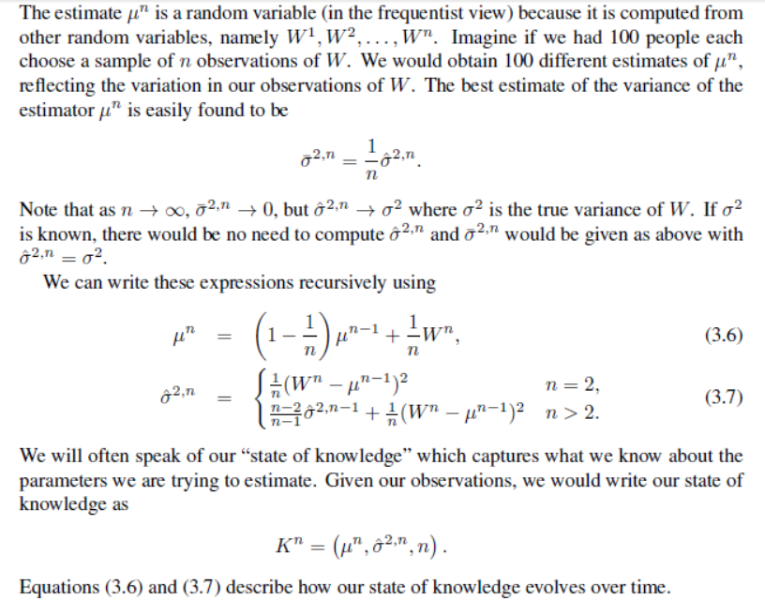
Lookup tables
Frequentist updating - Batch

Slide 9
Lookup tables
Frequentist updating - Recursive

Slide 10

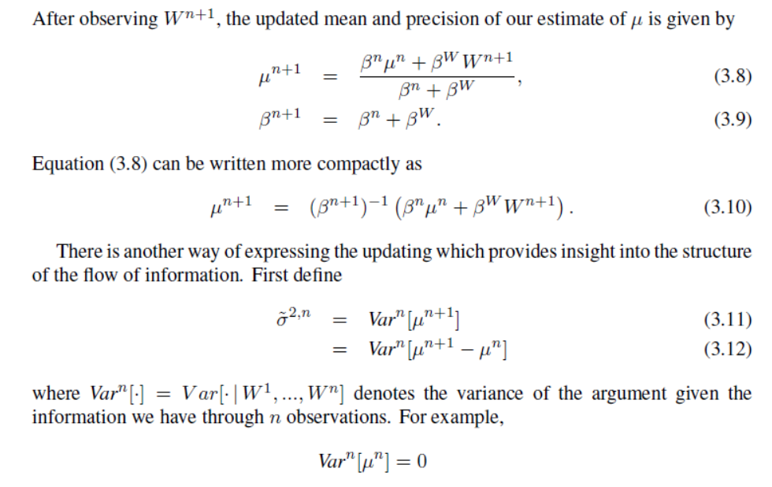
Lookup tables
Bayesian – independent beliefs
  Discuss Bayesian setting

Slide 11
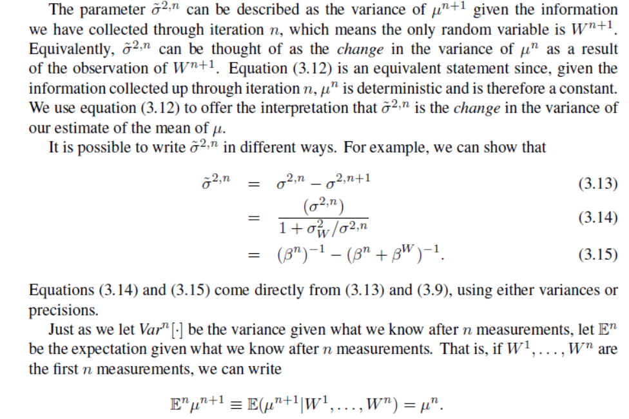
Lookup tables
Bayesian – independent beliefs

Slide 12
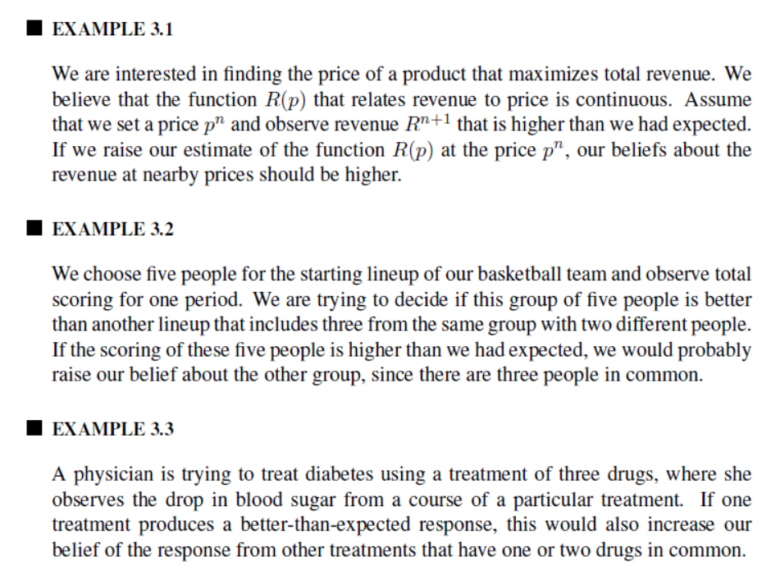
Lookup tables
Bayesian updating – correlated beliefs

Slide 13
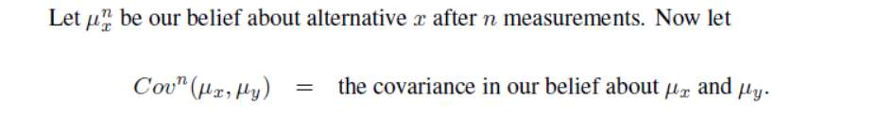
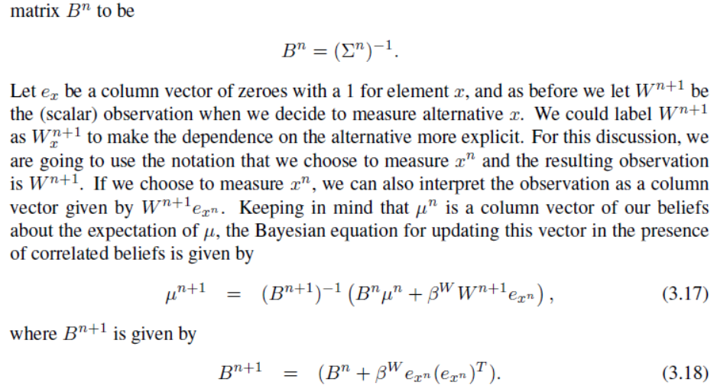
Lookup tables
Bayesian updating – correlated beliefs

Slide 14
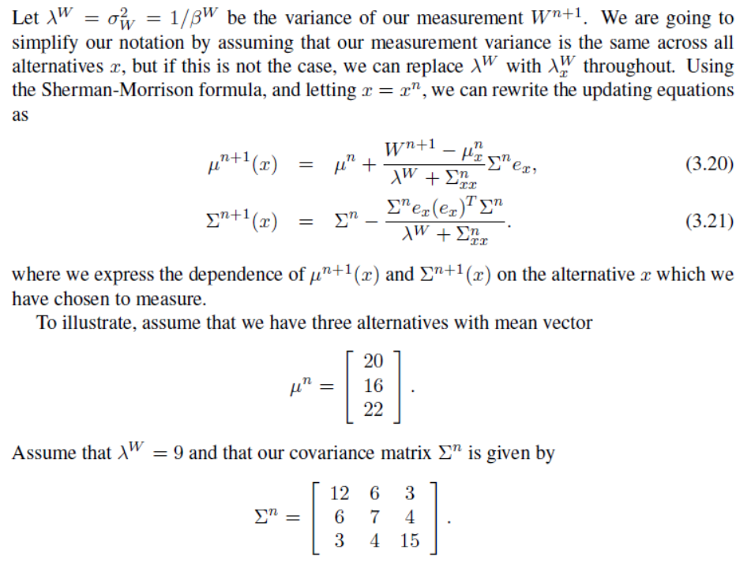
Lookup tables
Bayesian updating – correlated beliefs

Slide 15
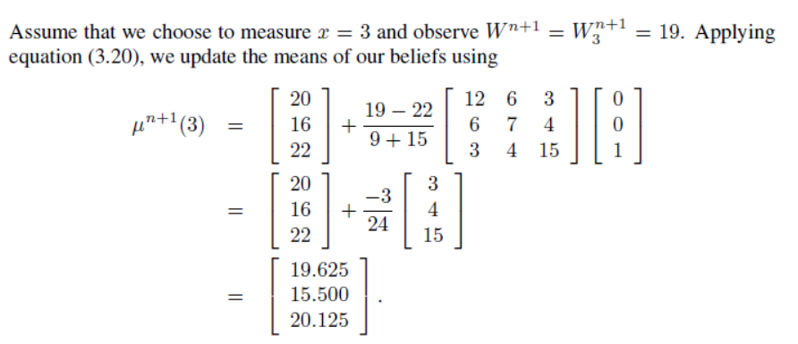
Lookup tables
Bayesian updating – correlated beliefs

Slide 16
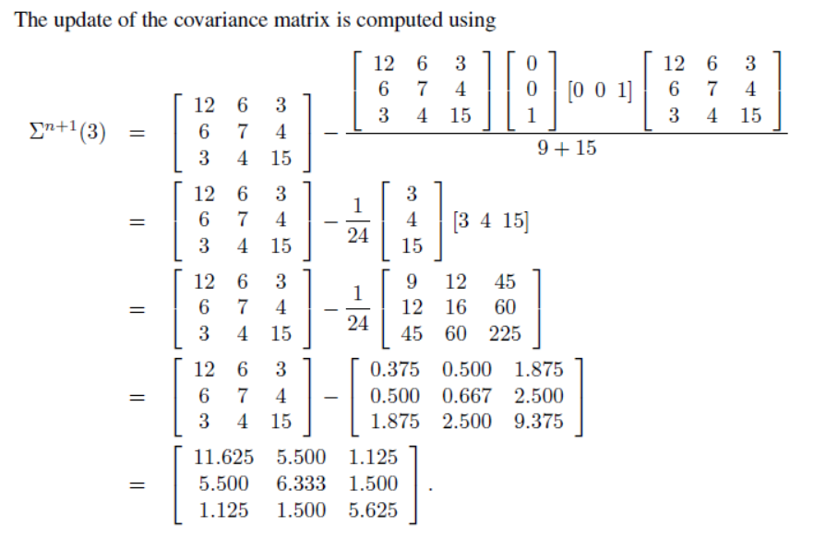
Lookup tables
Bayesian updating – correlated beliefs

Slide 17
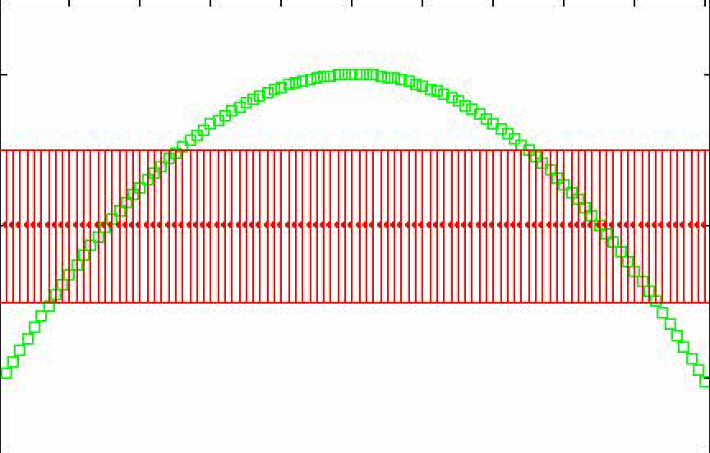
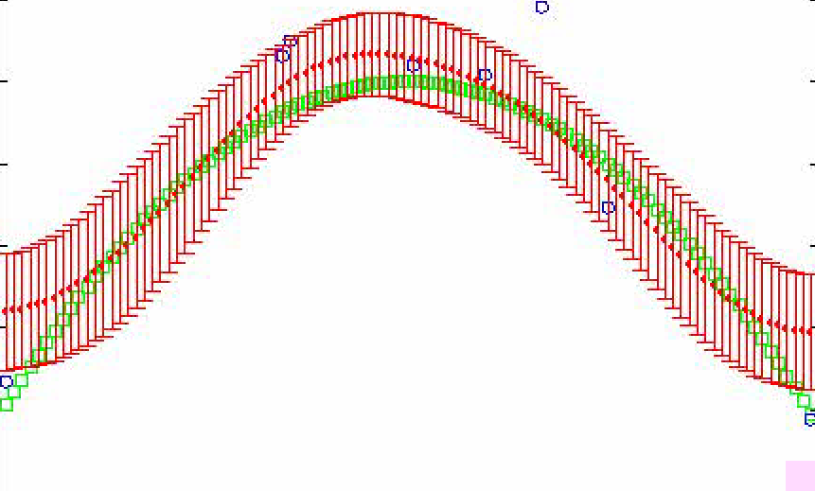
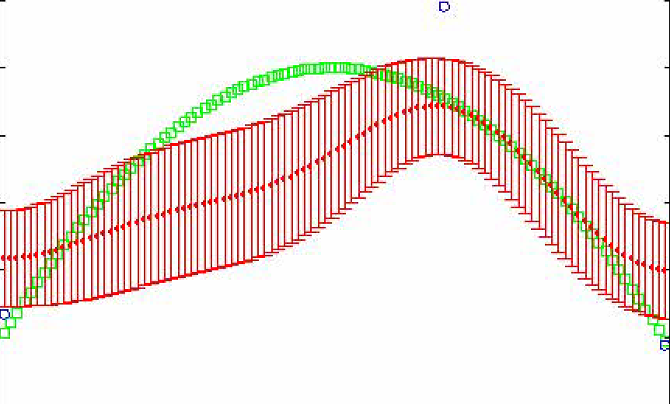
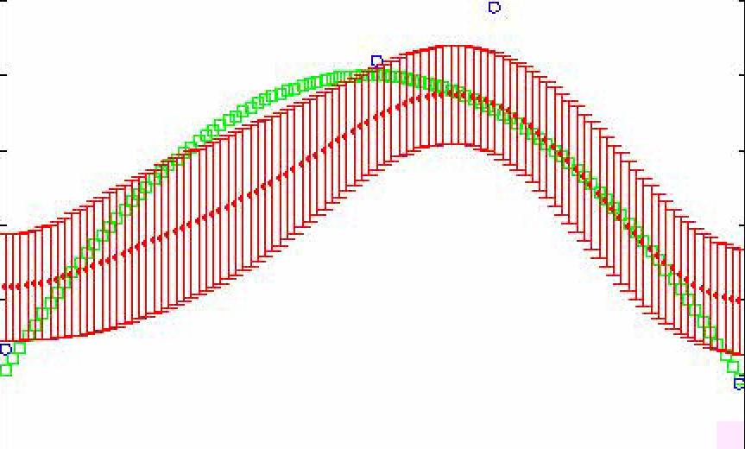
Correlated beliefs

Slide 18
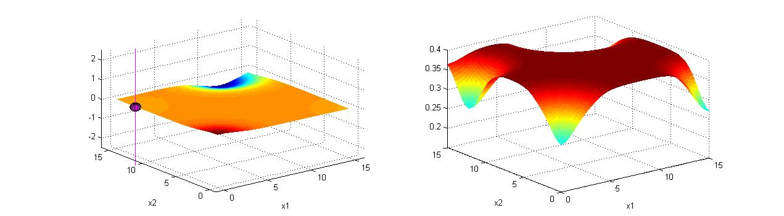
Correlated beliefs
After four measurements:
  Whenever we measure at a point, the value of another measurement at the same point goes down. The knowledge gradient guides us to measuring areas of high uncertainty.
Estimated concentration
Knowledge gradient
Value of another measurement at same location.
Measurement
New optimum
Notes:
18

Slide 19
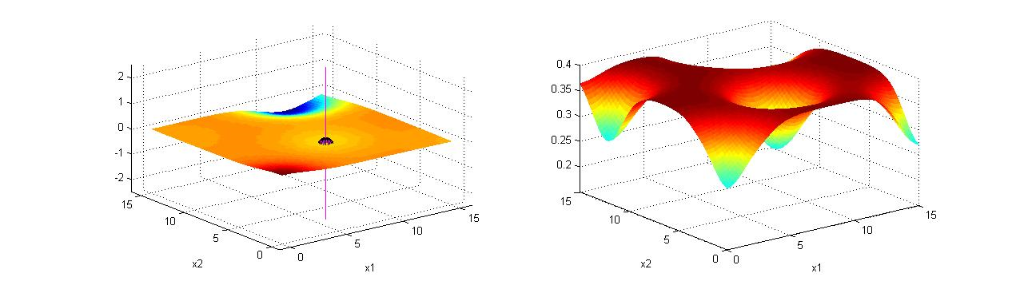
Correlated beliefs
After five measurements:
Estimated concentration
Knowledge gradient
Notes:
19

Slide 20
Linear models

Slide 21
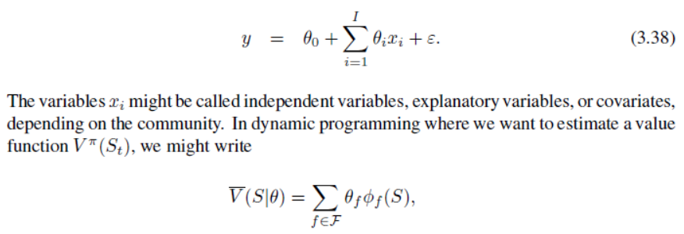
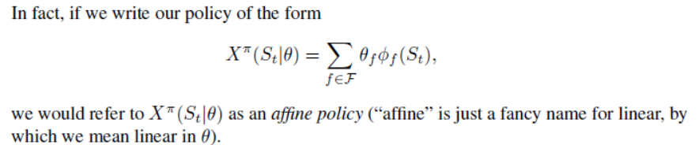
Linear models
Examples:
  Independent variables, covariates, basis functions

Slide 22
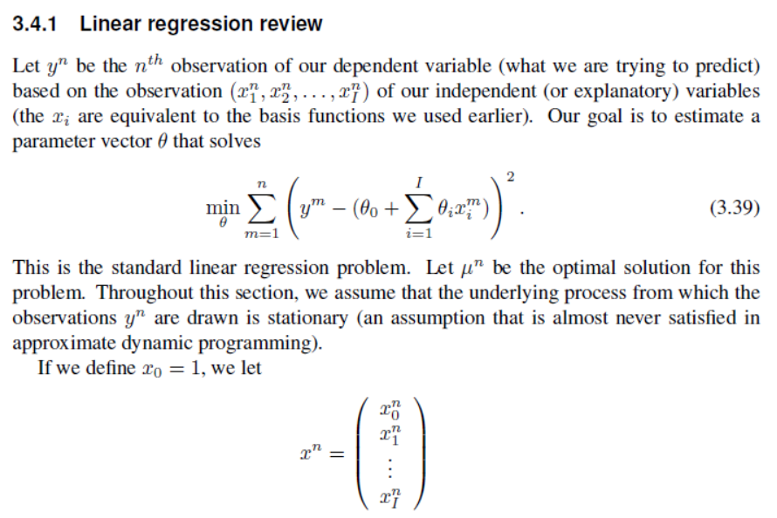
Linear models

Slide 23
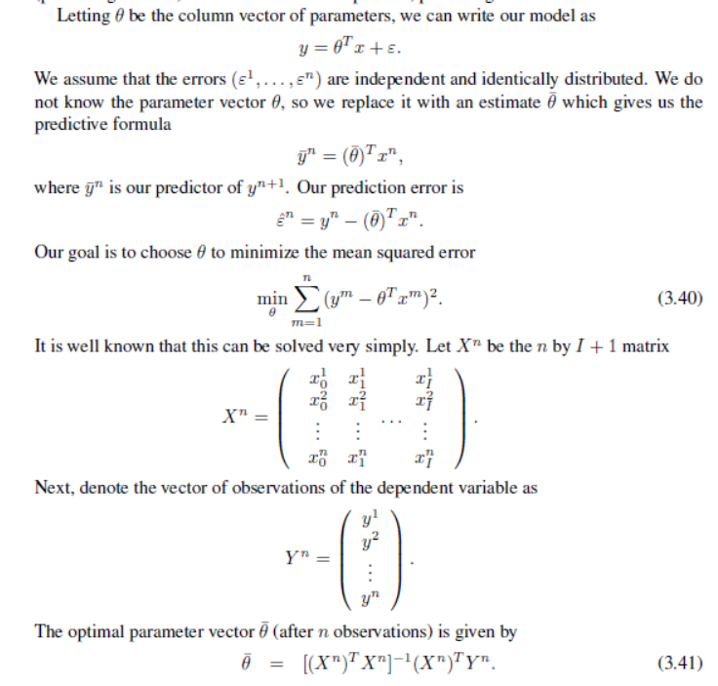
Linear models

Slide 24
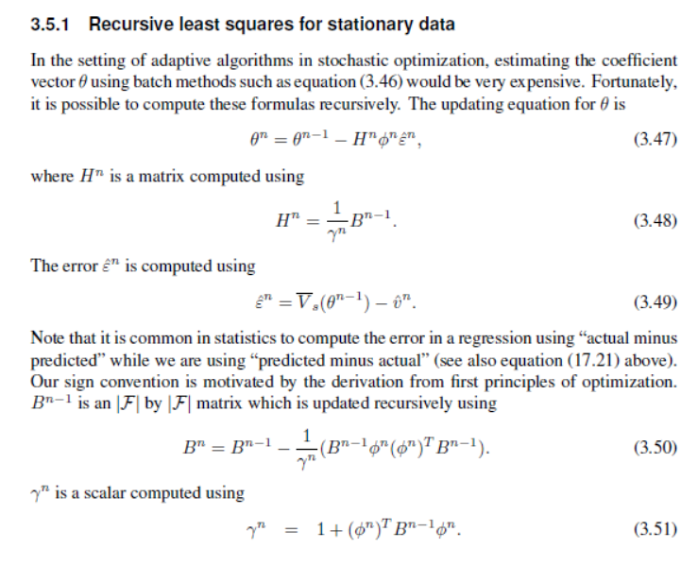
Linear models
Recursive least squares-Stationary data

Slide 25
Nonlinear models
Sampled nonlinear models

Slide 26
Nonlinear models
  This means “nonlinear in the parameters”
  Examples:
    Logistic regression
    Parametric rules (energy storage)

Slide 27
Fitting a nonlinear model.
  Solving the fitting problem of a linear model is easy
  Solving nonlinear problems is much harder (see next slide).

Slide 28
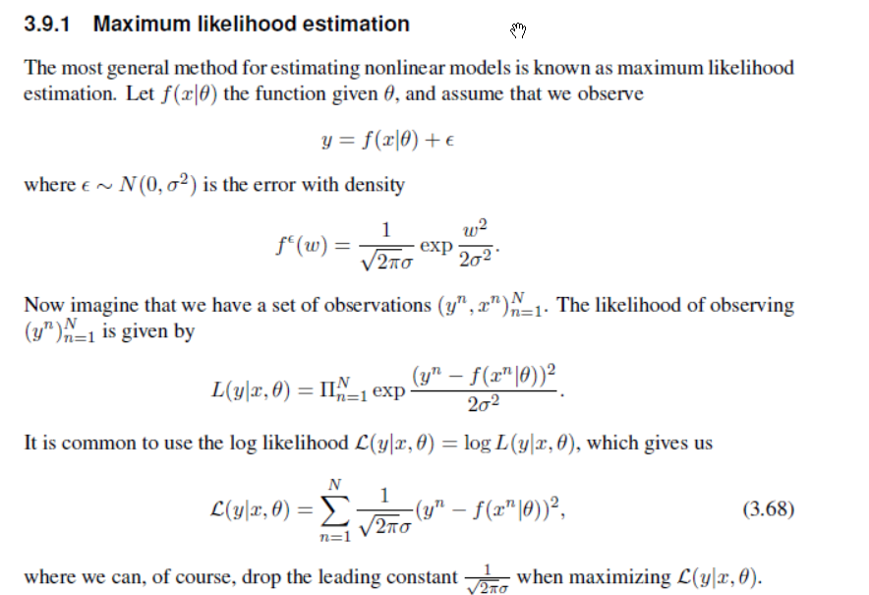
Maximum likelihood estimation for nonlinear problems

Slide 29
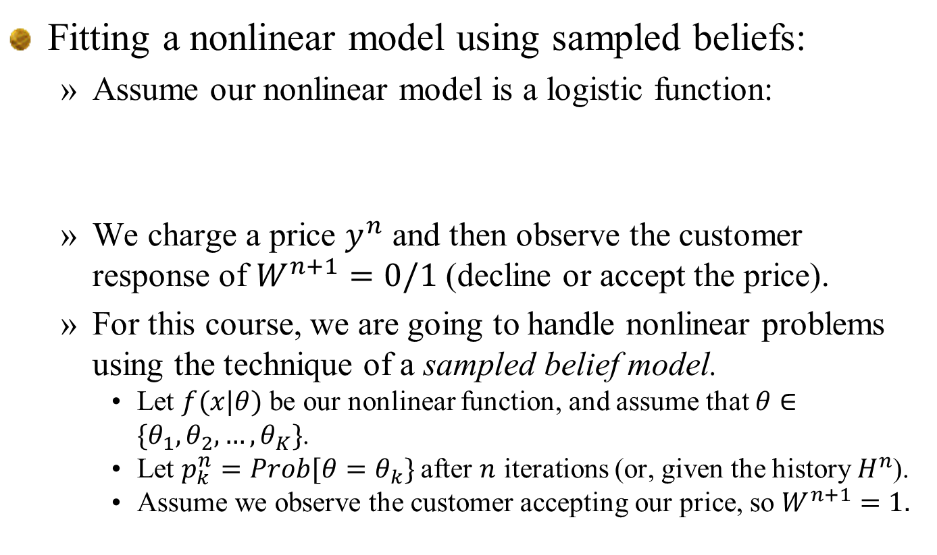
Fitting a nonlinear model using sampled beliefs:
  Assume our nonlinear model is a logistic function:
  We charge a price $y^{n}$ and then observe the customer response of $W^{n+1}=0/1$ (decline or accept the price).
  For this course, we are going to handle nonlinear problems using the technique of a sampled belief model.
    Let $f(x|θ)$ be our nonlinear function, and assume that $θ∈\{θ_{1},θ_{2},…, θ_{K}\}$.
    Let $p_{k}^{n}=Prob[θ=θ_{k}\}$ after $n$ iterations (or, given the history $H^{n}$).
    Assume we observe the customer accepting our price, so $W^{n+1}=1.$

Slide 30
Fitting a nonlinear model using sampled beliefs:
  Update probabilities using Bayes theorem:
  It is often the case that the denominator of Bayes theorem can be hard to compute. By using our sampled belief model, it is relatively easy.

Slide 31
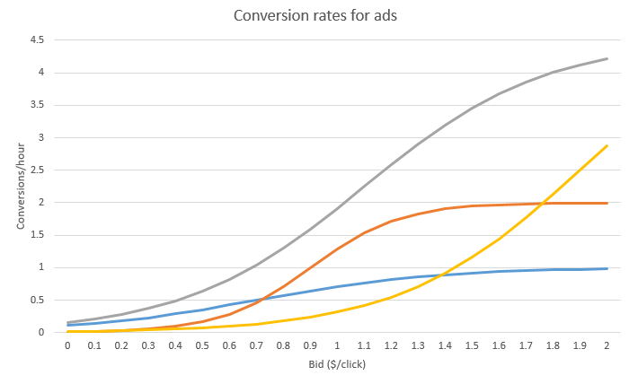
Learning with a sampled belief model
A sampled belief model
Response
Concentration/temperature

Slide 32
Learning with a sampled belief model
Possible experimental outcomes
Response
Possible
responses
Concentration/temperature

Slide 33
Learning with a sampled belief model
Running an experiment – here we see the actual realization
Response
Actual response
Concentration/temperature

Slide 34
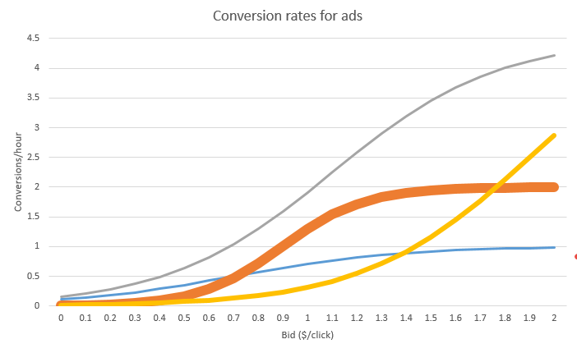
Learning with a sampled belief model
Updated posterior reflects proximity to each curve
Response
Concentration/temperature

Slide 35
Nonparametric models

Slide 36
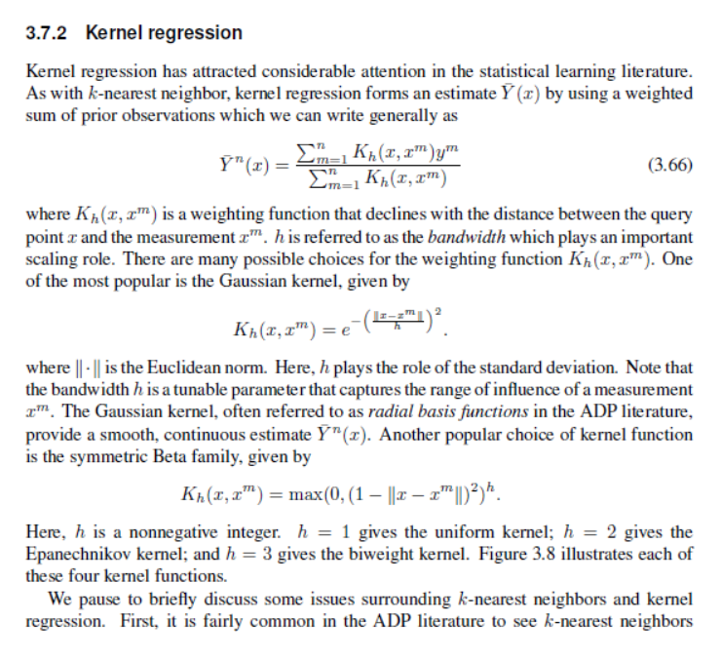
Nonparametric methods

Slide 37
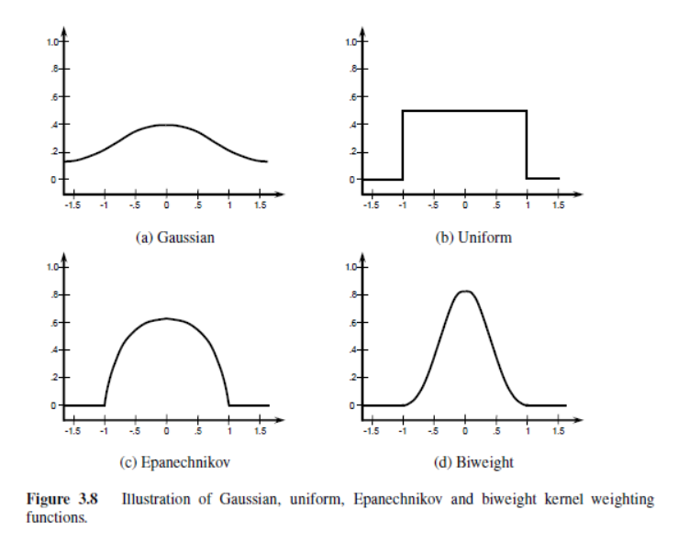
Nonparametric methods
Kernels

Slide 38
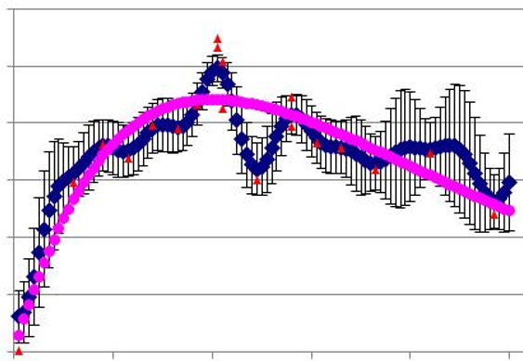
Approximating a function
Parametric vs. nonparametric
  Robust CFAs are parametric
  Scenario trees are nonparametric
Observations
Nonparametric fit
Total revenue
Parametric fit
True function
Price of product

Slide 39
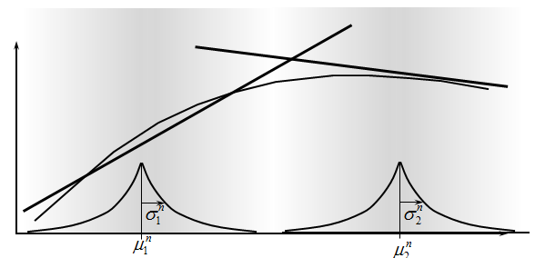
Nonparametric methods
Lookup table belief models (Frazier)
  Independent beliefs
  Correlated beliefs
Linear, parametric belief models (Frazier)
Nonparametric models
  Hierarchical aggregation (Mes)
  Kernel regression (Barut)
Local parametric models
  Dirichlet clouds with RBF (Jamshidi)
  KG derivation (Harvey Cheng)
Generalized linear models
  KG derivation (Si Chen)
1
2
3
4
5

Slide 40
Locally parametric approximations
Dirichlet process mixtures of generalized linear regression models (Hannah, Blei and WBP, 2011).
  Very general, but very slow.
  Cannot be implemented recursively.
Dirichlet clouds using radial basis functions (Jamshidi and WBP, 2012)
  Local parametric approximations.
  Produces variable order approximation that adapts to the function.

Slide 41
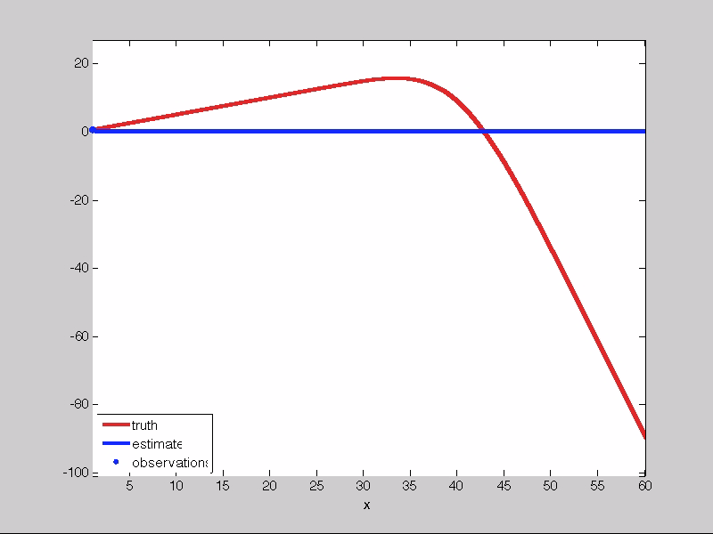
Locally parametric approximations

Slide 42
Nonparametric methods
Discussion:
  Local smoothing methods struggle with curse of dimensionality. In high dimensions, no two data points are ever “close.”
  Nonparametric representations are very high-dimensional, which makes it hard to “store” a model.

Slide 43
Nonparametric methods
More advanced methods
  Deep neural networks
    Before, we described neural networks as a nonlinear parametric model.
    Deep neural networks, which have the property of being able to approximate any function, are classified as nonparametric.
    These have proven to be very powerful on image processing and voice recognition, but not in stochastic optimization.
  Support vector machines (classification)
  Support vector regression (continuous)
    We have had surprising but limited success with SVM, but considerably more empirical research is needed.

