Slide 1
.
Sequential decision analytics and modeling
ORF 411
Fall, 2018
Warren Powell
Princeton University
http://www.castlelab.princeton.edu
© 2017 Warren B. Powell, Princeton University

Slide 2

Week 12 – Wednesday
Summary lecture

Slide 3
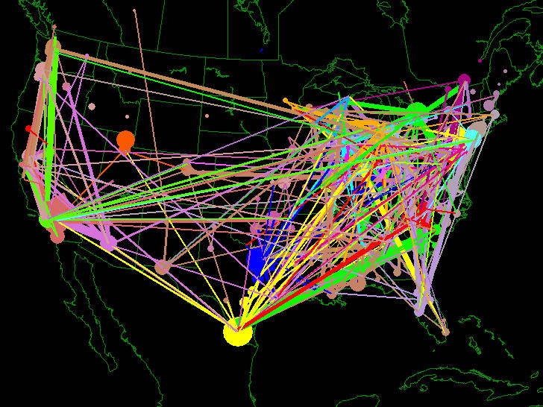
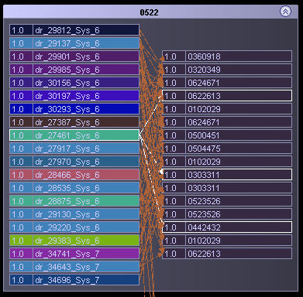
Fleet management
Fleet management problem
  Optimize the assignment of drivers to loads over time.
  Tremendous uncertainty in loads being called in

Slide 4
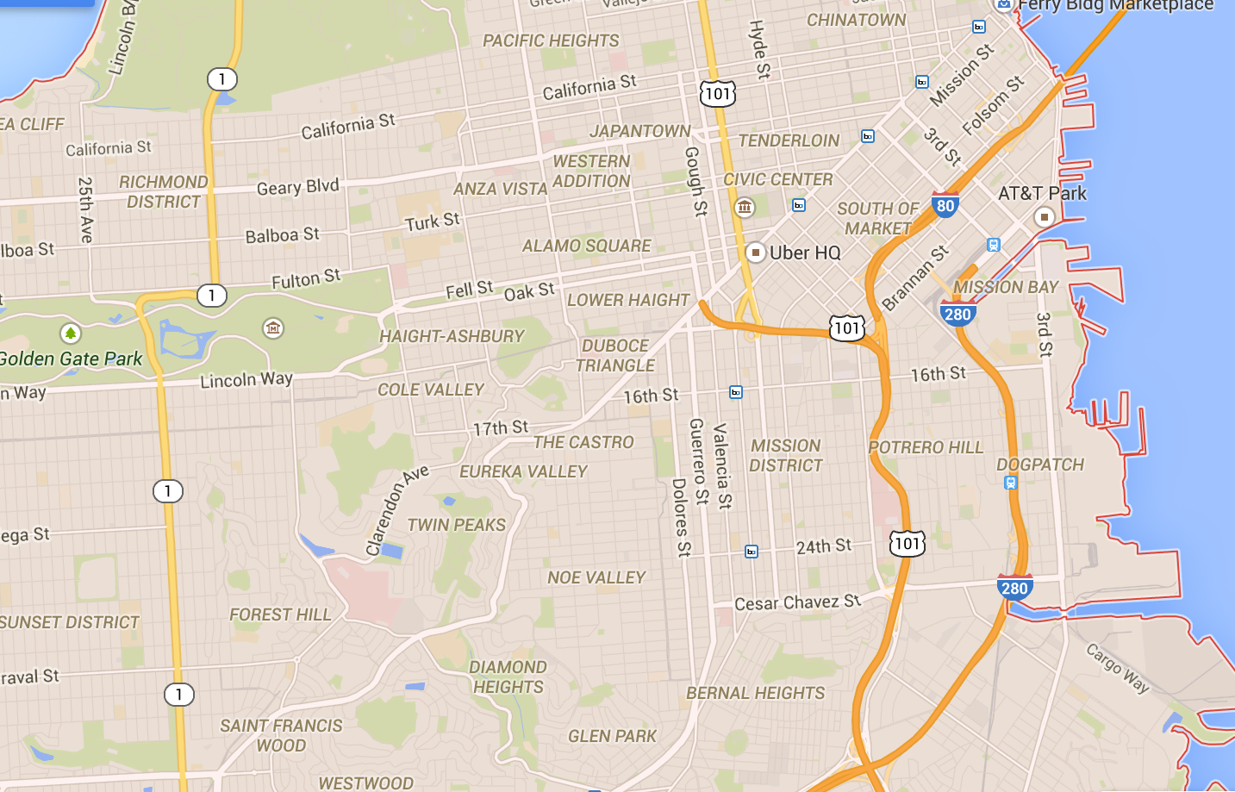

Cost function approximations
Cars
Riders
Notes:
… to tasks (loads, trains, flights).

Slide 5
Optimizing over time
t
t+1
t+2

Slide 6
Optimizing over time
t
t+1
t+2

Slide 7
Optimizing over time
t
t+1
t+2
The assignment of cars to riders evolves over time, with new riders arriving, along with updates of cars available.

Slide 8
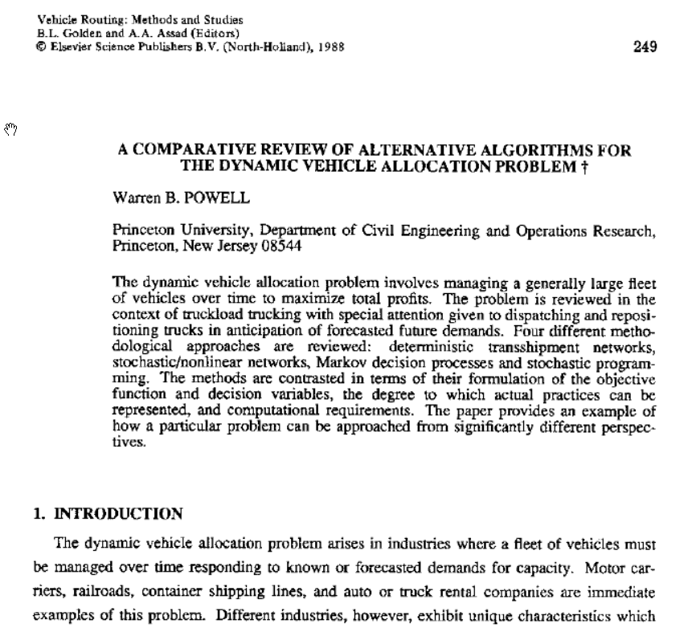
A bit of history
  The dynamic assignment problem (assigning drivers to loads) in truckload trucking.
  Today, we would recognize this as the problem faced by Uber and Lyft.
  The challenge was sequencing decisions (assigning drivers to loads) and information (e.g. new customers calling in).
  Four completely different models, and none came close to allowing me to solve the problem.

Slide 9
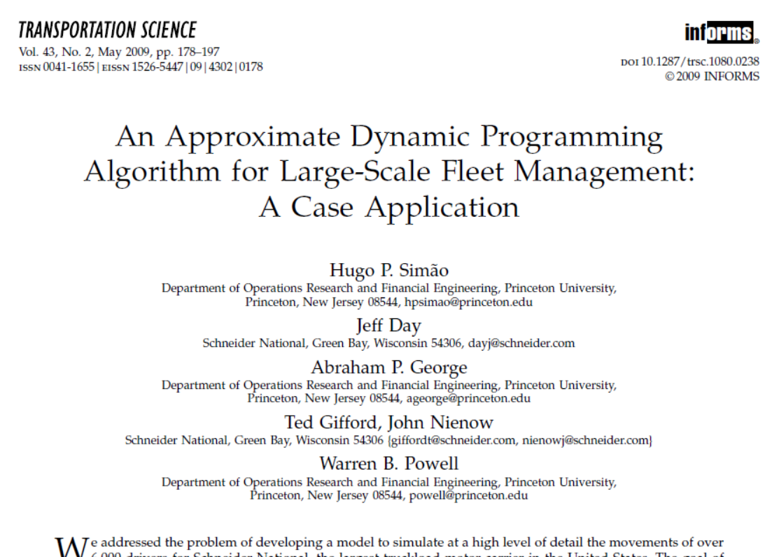
Over 20 years later:
  Winner, 2009 Daniel H. Wagner Prize.
  Winner, 2010 Best paper prize in Transportation Science and Logistics.
  2016, licensed to Optimal Dynamics where it is being marketed as SMART-TL.

Slide 10
Driverless fleets of EVs
t
t+1
t+2

Slide 11
Driverless fleets of EVs

Slide 12
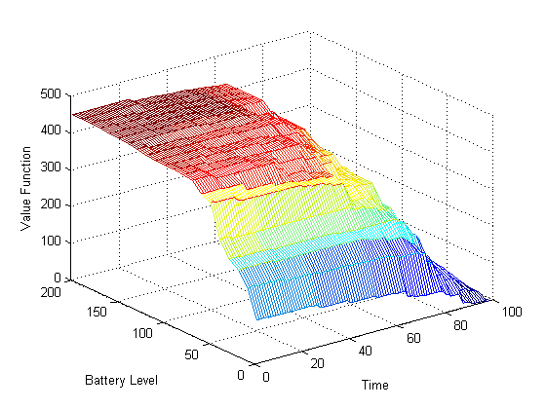
Driverless fleets of EVs using ADP
The value of a vehicle in the future
  Value function approximation captures charge level, as well as time and location.
  Hierarchical aggregation accelerated the learning process
Marginal value
Battery level
Time

Slide 13
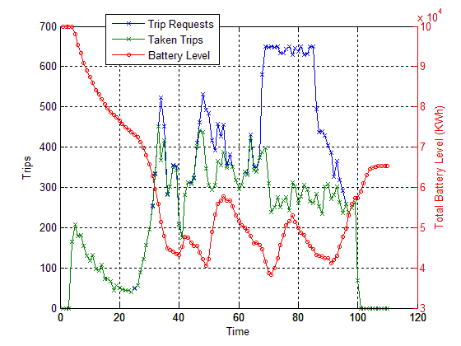
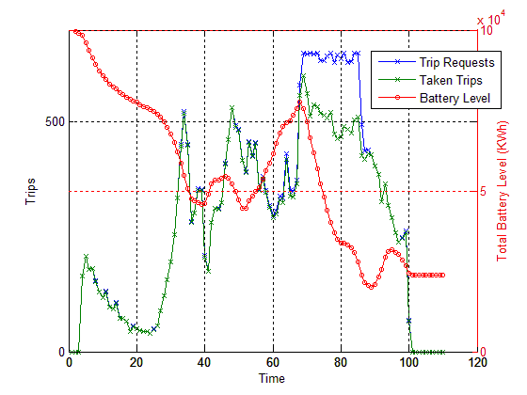
Driverless fleets of EVs using ADP
Heuristic dispatch vs. ADP-based policies
  Effect of value function approximations on recharging
Recharging controlled by
approximate dynamic programming
Heuristic recharging logic
Trip requests
Peak
Peak
Actual trips
Total battery charge
Recharging during peak period
No recharging during
peak period

Slide 14
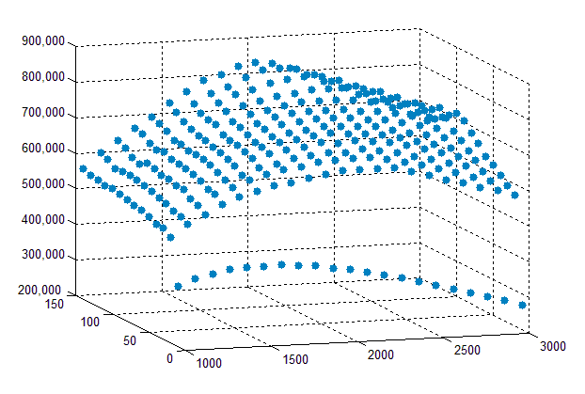
The economics of driverless fleets
Profit ($)
Battery (KWh)
Fleet Size
We can simulate different fleet sizes and battery capacities, properly modeling recharging behaviors given battery capacity.

Slide 15
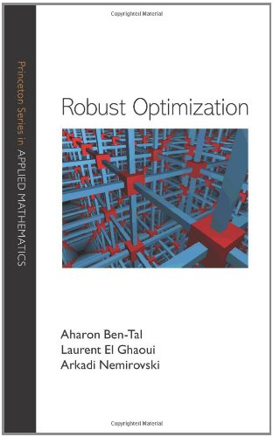

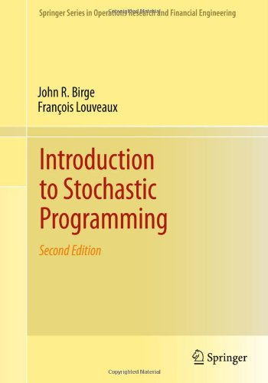
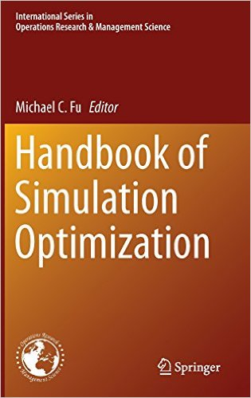
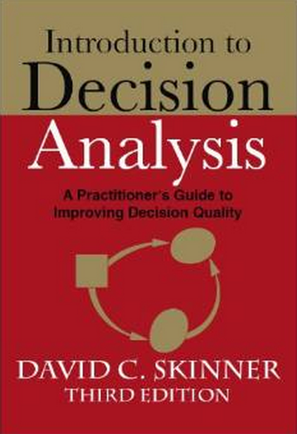
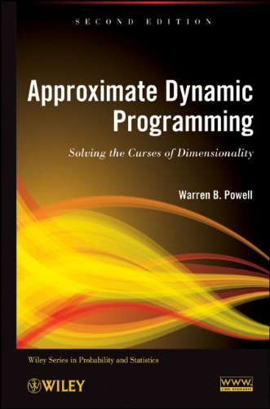
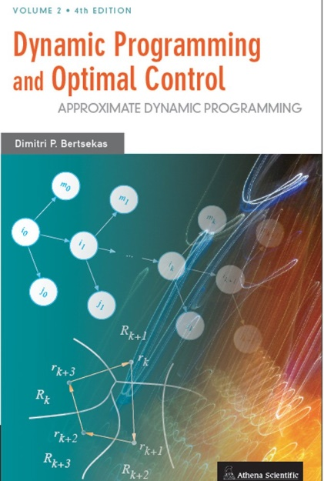
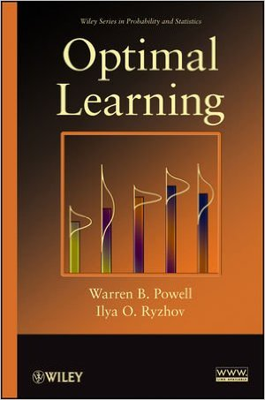

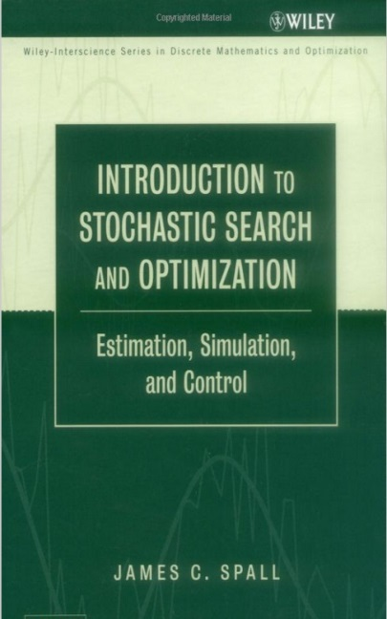
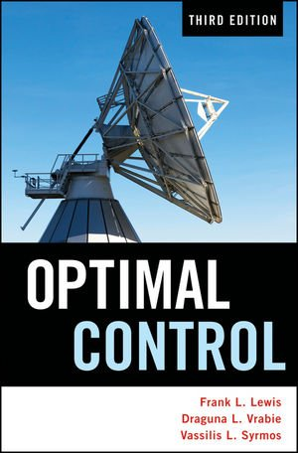

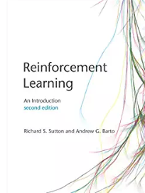
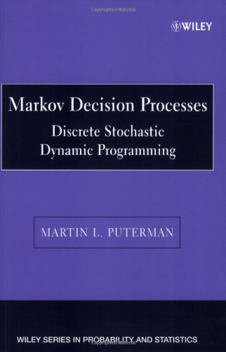


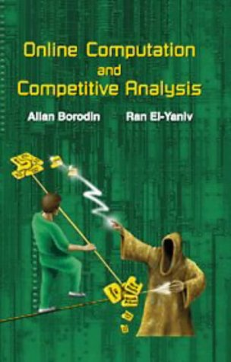
Stochastic
programming
Approximate
dynamic
programming
Robust
optimization
Decision
analysis
Simulation
optimization
Optimal
learning
Dynamic
Programming
and
control
Model
predictive
control
Stochastic
search
Optimal
control
Bandit
problems
Reinforcement
learning
Online
computation
Markov
decision
processes
Stochastic
control
Simulation
optimization
Notes:
Clearing the Jungle of Stochastic optimization – Professor Warren Powell in the Department of Operations Research and Financial Engineering has developed a unified framework for modeling virtually every problem involving optimization under uncertainty. More than just a purely theoretical characterization, he has identified four (meta)classes of policies which provide a clear path to computation (although there is still a lot of work to do for most problems). The framework has identified new problem classes, as well as novel computational strategies. For example, modeling and algorithmic strategies that have long been viewed as competitive (for example, dynamic programming versus stochastic programming) are actually complementary. By building on this integrated framework, we can spend less time focusing on optimizing (making decisions), and more time on an overlooked dimension of stochastic optimization, which is modeling uncertainty.

Slide 16

Stochastic Optimization
and Learning:
A Unified Framework
Warren B Powell

Slide 17
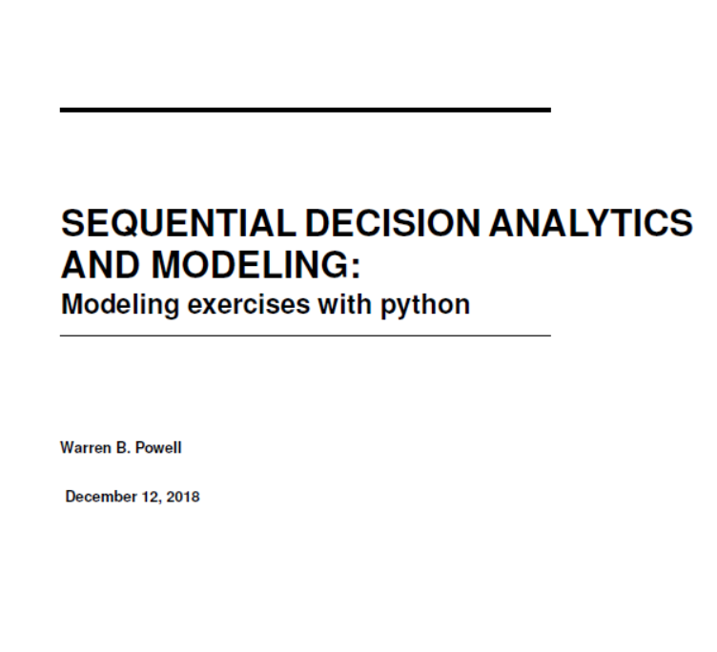

Slide 18
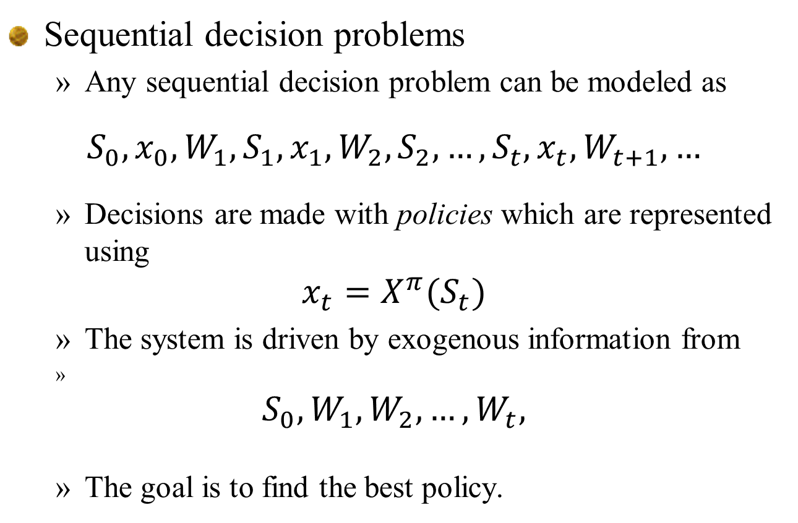
Sequential decision problems
  Any sequential decision problem can be modeled as
$$S_{0},x_{0},W_{1},S_{1},x_{1},W_{2},S_{2},…,S_{t},x_{t},W_{t+1},…$$
  Decisions are made with policies which are represented using
$$x_{t}=X^{π}(S_{t})$$
  The system is driven by exogenous information from
$$S_{0},W_{1},W_{2},…, W_{t},$$
  The goal is to find the best policy.

Slide 19
Elements of a dynamic model
All sequential decision problems can be modeled using five core components:
  State variables
    What do we need to know at time t?
  Decision variables
    What are our decisions?
  Exogenous information
    What do we learn for the first time between t and t+1?
  Transition function
    How do the state variables evolve over time?.
  Objective function
    What are our performance metrics?

Slide 20
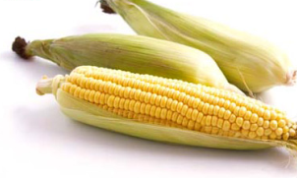
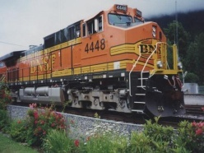
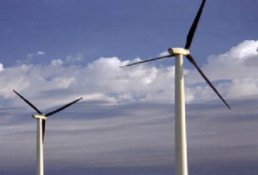
Elements of a dynamic model
The state variable:
Notes:
20

Slide 21
Elements of a dynamic model
Decisions:
Notes:
21

Slide 22
Elements of a dynamic model
Exogenous information:
Note: Any variable indexed by t is known at time t. This convention, which is not standard in control theory, dramatically simplifies the modeling of information.
Notes:
22

Slide 23
Elements of a dynamic model
The transition function
Also known as the:
“System model”
“State transition model”
“Plant model”
“Plant equation”
“State equation”
“Transfer function”
“Transformation function”
“Law of motion”
“Model”
“transition function”
For many applications, these equations are unknown. This is known as “model-free” dynamic programming.
Notes:
23

Slide 24
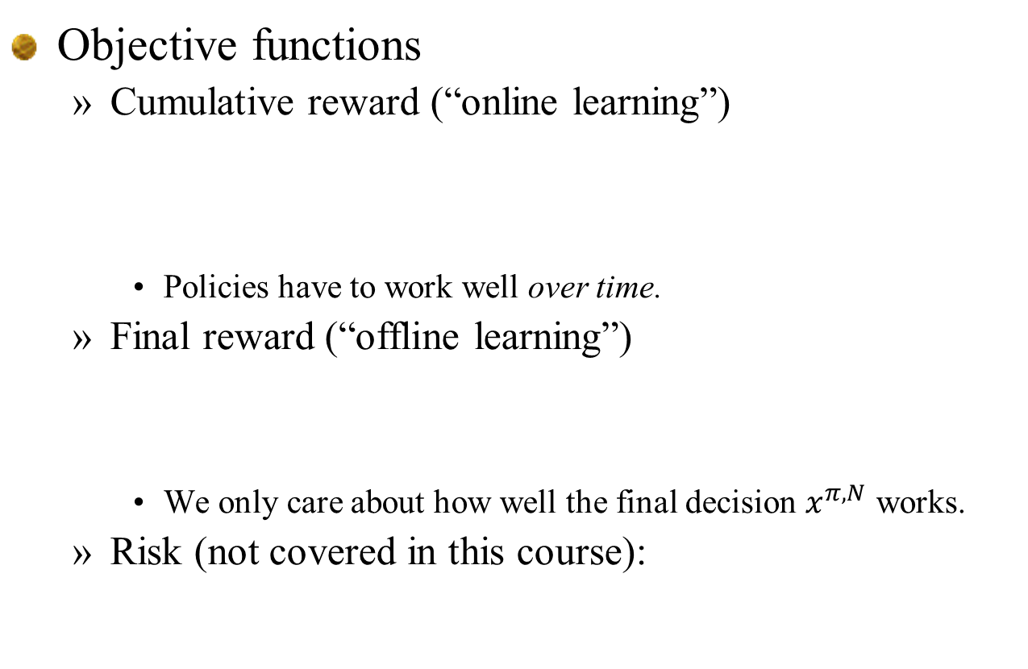
Elements of a dynamic model
Objective functions
  Cumulative reward (“online learning”)
    Policies have to work well over time.
  Final reward (“offline learning”)
    We only care about how well the final decision $x^{π,N}$ works.
  Risk (not covered in this course):

Slide 25
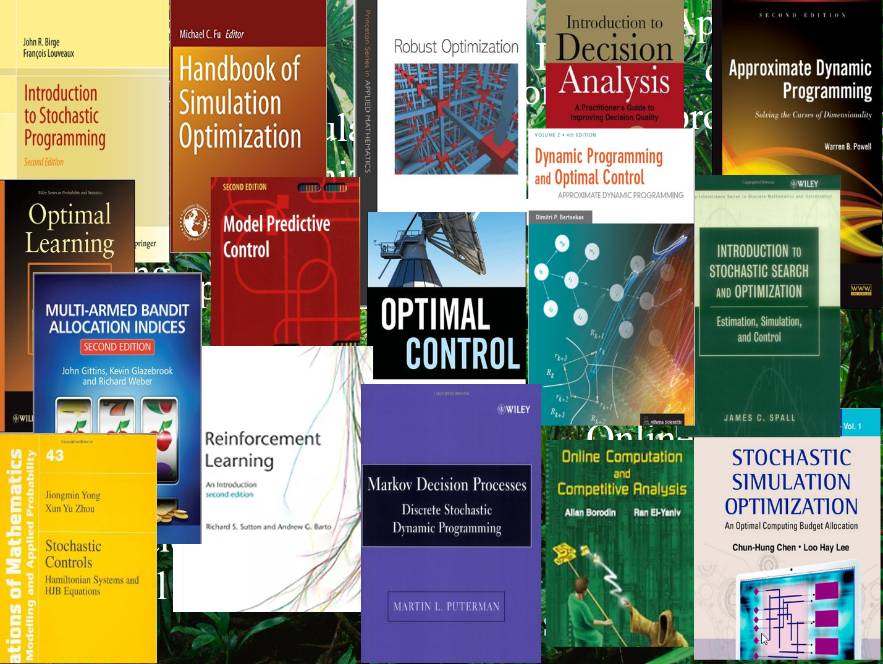
Elements of a dynamic model
The complete model:
  Objective function
    Cumulative reward (“online learning”)
    Final reward (“offline learning”)
    Risk:
  Transition function:
  Exogenous information:

Slide 26
Problem classes
State independent problems
  The problem does not depend on the state of the system.
  The only state variable is what we know (or believe) about the unknown function .
State dependent problems
  Now the problem may depend on what we know at time t:

Slide 27
Problem classes
Offline (final reward)
  We can iteratively search for the best solution.
  We only care about the final solution.
  Asymptotic formulation:
  Finite horizon formulation:
Online (cumulative reward)
  We have to learn as we go

Slide 28
Elements of a dynamic model
The modeling process
  I conduct a conversation with a domain expert to fill in the elements of a problem:
State
variables
Decision
variables
New
information
Transition
function
Objective
function
Performance metrics
How the state variables evolve
What we didn’t know
when we made our decision
What we control
What we need to know
(and only what we need)

Slide 29
Course themes
  The universal modeling framework
    The five elements of any sequential decision problem.
    “Model first, then solve.”
  Statistical learning
    Five classes of learning problems
  Uncertainty modeling
    What are the types of uncertainty?
    How to model them?
  Designing policies
    Policy search class (PFAs and CFAs)
    The lookahead class (VFAs and DLAs)
    Hybrids
  Teach by example style …
    Need to learn how to transfer methods from one setting to the next.

Slide 30

Basic energy modeling problem

Slide 31
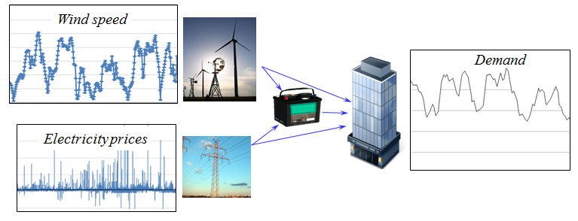
An energy storage problem
Consider a basic energy storage problem:
  We are going to show that with minor variations in the characteristics of this problem, we can make each class of policy work best.

Slide 32
Notes:
  We are going to describe three variations of our energy storage problem:
    No learning
    Passive learning
    Active learning

Slide 33
An energy storage problem
A model of our problem
  State variables
  Decision variables
  Exogenous information
  Transition function
  Objective function

Slide 34
An energy storage problem
State variables
  Lay out the five columns of the modeling framework and work through the model.
L
E
B
G

Slide 35
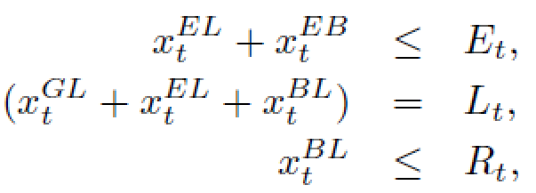
An energy storage problem
Decision variables
  Constraints;
L
E
B
G

Slide 36
An energy storage problem
Exogenous information
L
E
B
G

Slide 37
An energy storage problem
Transition function
L
E
B
G

Slide 38
An energy storage problem
Objective function
L
E
B
G

Slide 39
An energy storage problem
State variables
  Cost function
  Decision function
    Constraints:
  Transition function

Slide 40
Basic energy modeling problem
Passive learning of price model

Slide 41

An energy storage problem
Types of learning:
  No learning ($θ^{′}s$ are known)
  Passive learning (learn $θs$ from price data)
  Active learning (“bandit problems”)

Slide 42

Learning in stochastic optimization
Updating the demand parameter
  Let $p_{t+1}$ be the new price and let
  We update our estimate ${\overline{θ}}_{t}$ using our recursive least squares equations:

Slide 43
An energy storage problem
State variables
  Cost function
  Decision function
    Constraints:
  Transition function

Slide 44
Basic energy modeling problem
Active learning of price model

Slide 45
An energy storage problem
Types of learning:
  No learning ($θ^{′}s$ are known)
  Passive learning (learn $θs$ from price data)
  Active learning (“bandit problems”)
Buy/sell decisions

Slide 46
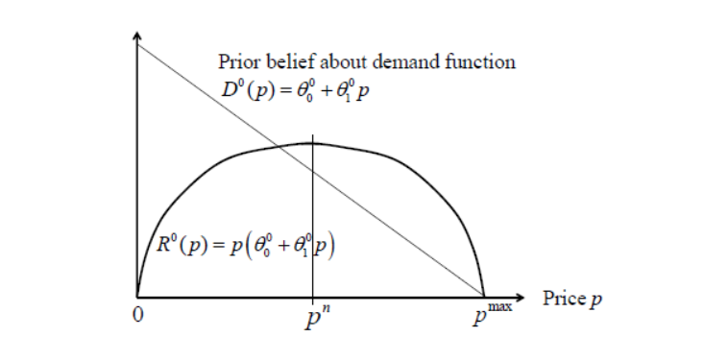
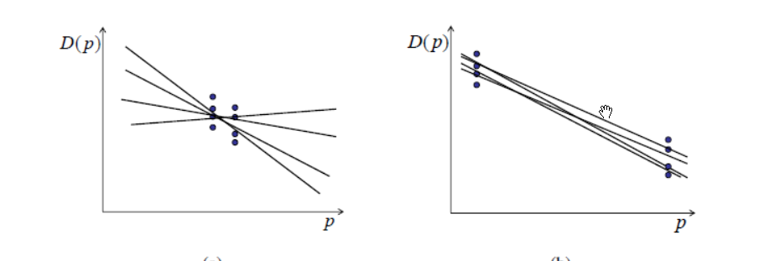
Linear belief models
Dynamic pricing
  Need to balance exploration and exploitation.
Sampling behavior focusing on exploitation
Sampling behavior focusing on explortation

Slide 47
Notes:
  The addition of an active learning component does not change the basic model, but it changes the policies that will work best.
  The ability of decisions to affect what we learn makes it possible to encourage more variability in the data.
  If we are doing online learning (maximizing cumulative reward), we have to balance the costs of trying choices that do not appear to be best against the potential future benefits.
  This tradeoff depends on how long the future is.

Slide 48
Policies
  PFA
    Take what appears to be best, and add in a noise term.
  CFA
    Use UCB policy to search over discretized set of actions
  VFA
    Solve using dynamic programming, but it is hard to capture the belief state in the value function.
  DLA
    Use a decision tree that can capture entire state variable.
  Hybrid:
    VFA plus noise term
    DLA to handle a forecast, with noise added to costs (or the optimal decisions) to encourage exploration.

Slide 49
Learning

Slide 50
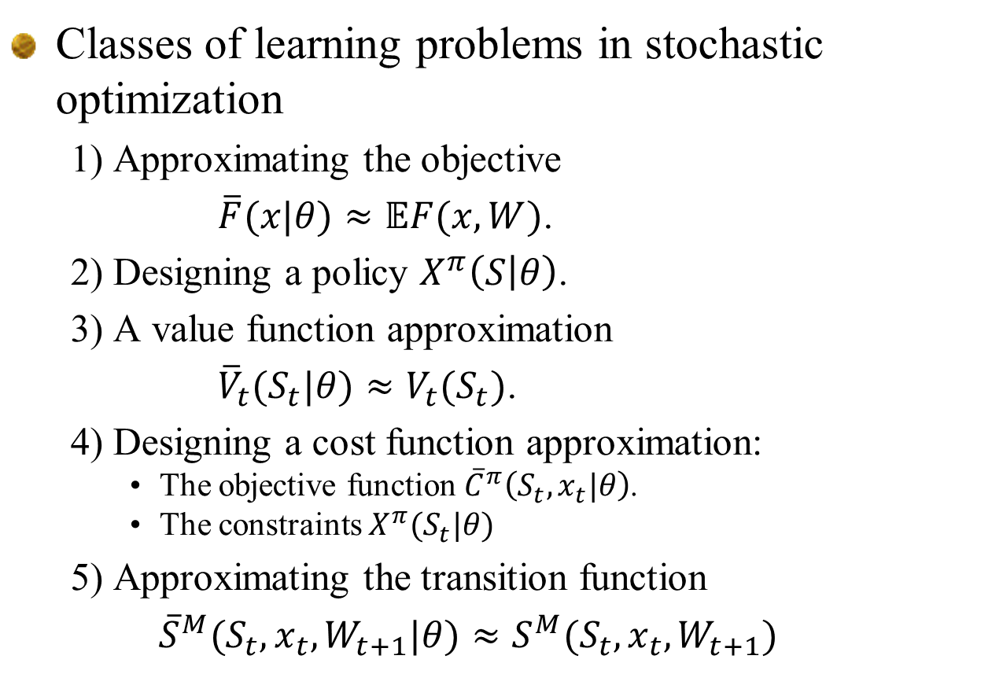
Learning problems
Classes of learning problems in stochastic optimization
  1) Approximating the objective
  $\overline{F}(x|θ)≈𝔼F(x,W)$.
  2) Designing a policy $X^{π}\left(S | θ\right)$.
  3) A value function approximation
  ${{\overline{V}}_{t}(S_{t}|θ)≈V}_{t}(S_{t})$.
  4) Designing a cost function approximation:
    The objective function ${\overline{C}}^{π}\left(S_{t},x_{t}|θ\right)$.
    The constraints $X^{π}(S_{t}|θ)$
  5) Approximating the transition function
  ${\overline{S}}^{M}(S_{t},x_{t},W_{t+1}|θ)≈S^{M}(S_{t},x_{t},W_{t+1})$

Slide 51
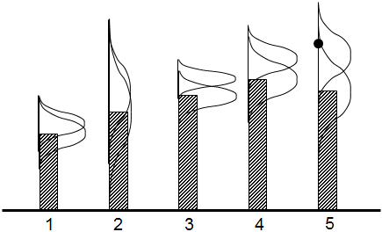
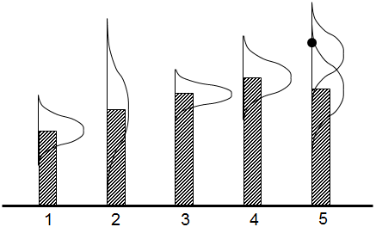
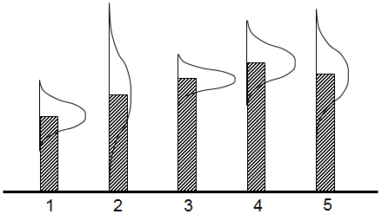
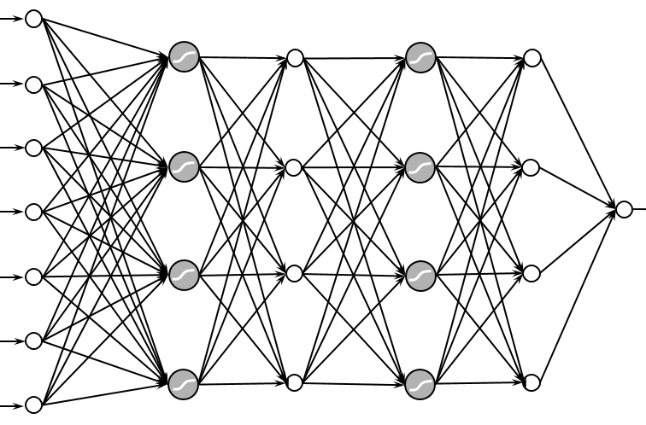
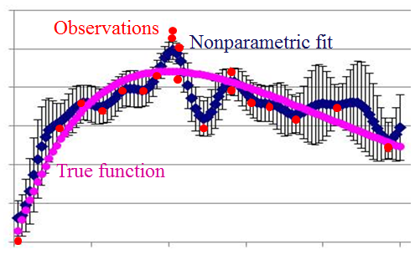
Approximation strategies
Approximation strategies
  Lookup tables
    Independent beliefs
    Correlated beliefs
  Linear parametric models
    Linear models
    Sparse-linear
    Tree regression
  Nonlinear parametric models
    Logistic regression
    Neural networks
  Nonparametric models
    Gaussian process regression
    Kernel regression
    Support vector machines
    Deep neural networks

Slide 52
Notes:
  In the context of adaptive search algorithms, we need to do online learning, which means starting with little or no data (perhaps just a belief) and transitioning to more data.
  This means starting with low-dimensional models and transitioning to higher dimensional models.

Slide 53
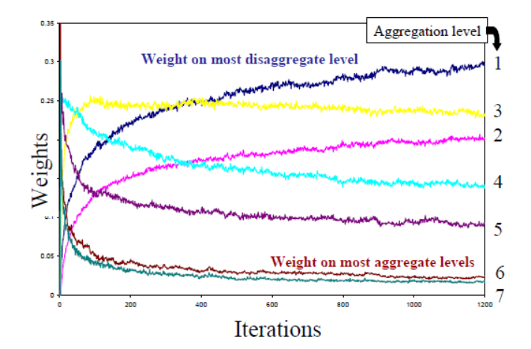
Learning challenges
Variable-dimensional learning

Slide 54
Uncertainty modeling

Slide 55
Notes:
  Think of “learning” as the problem of creating a point estimate.
  Uncertainty modeling can be viewed as the error in the point estimate.

Slide 56
Modeling uncertainty
Classes of uncertainty:
  Observational uncertainty
    Noise in estimate of how many people carry a disease
    Observation of how well an energy storage policy works
  Exogenous uncertainty
    Changes in weather, prices, economy
  Prognostic uncertainty (forecasting)
    Difference between actual and forecasted quantities
  Inferential uncertainty
    Difference between an estimate of a parameter (e.g. demand response to price) and the actual.
  Experimental noise/variability
    Variation between successive experiments
  Model uncertainty
    Uncertainty in the structure of a model (e.g. transition function)
    Uncertainty in the parameters of a model
    Uncertainty in the parameters of a probability distribution (e.g. arrival rate)
    Uncertainty in the objective function

Slide 57
Modeling uncertainty
Classes of uncertainty:
  Transitional uncertainty
    Difference between the expected state that a control takes you to, and what actually happens (e.g. wind pushing a rocket)
  Control/implementation uncertainty
    Difference between the decision you make and what gets implemented.
  Communication errors/biases
    For multiagent systems, there can be noise introduced when communicating, along with biases.
  Algorithmic instability
    Noise due to multiple optima, pre-mature stopping (epsilon-optimality)
    Errors due to model truncation
  Goal uncertainty
    Difference between the utility function we are using, and the objectives of a real system
  Political/regulatory uncertainty
    Uncertainty in the regulatory environment

Slide 58
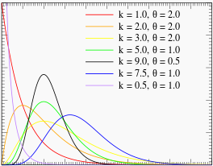
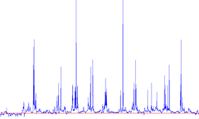
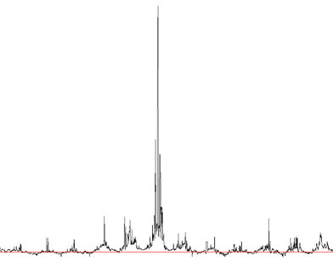
Distributions
Types of distributions
  Exponential families
    Normal, log-normal
    Exponential
    Gamma
    ….
  Heavy-tailed distributions
    Jump diffusion (mixed normals)
    Cauchy
  Frequency:
    Spikes
    Bursts
    Rare events

Slide 59
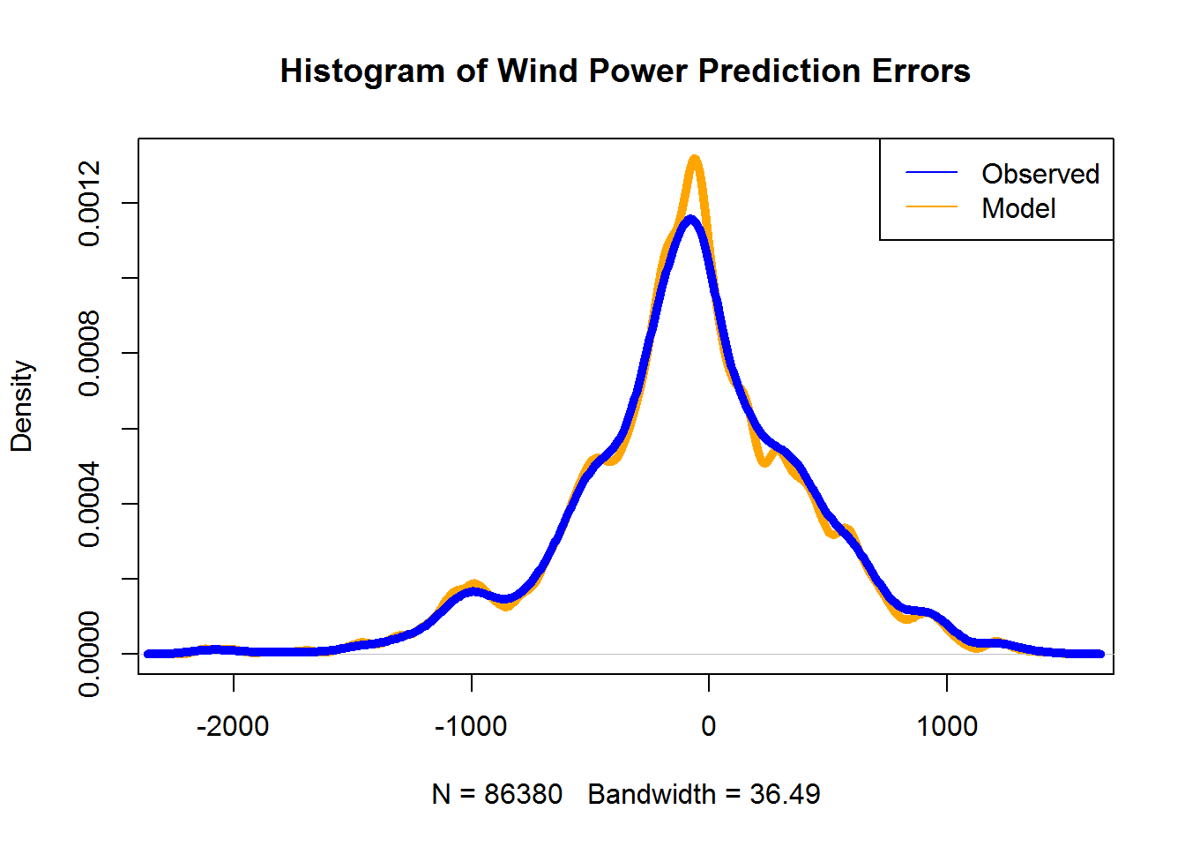
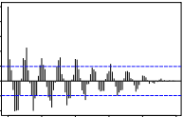
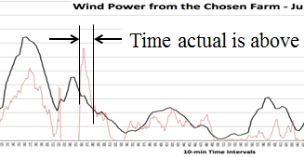
Distributions
Statistical features
  Error distributions
    Distribution of deviation from forecast.
  Autocorrelation functions (ACF)
    Correlation between observations at different times.
  Crossing times
    Distribution of time simulated is above or below the forecast.

Slide 60
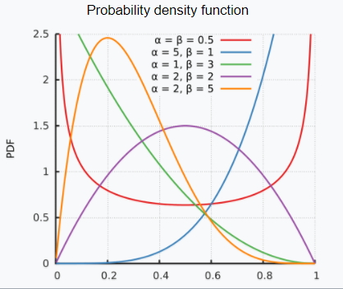
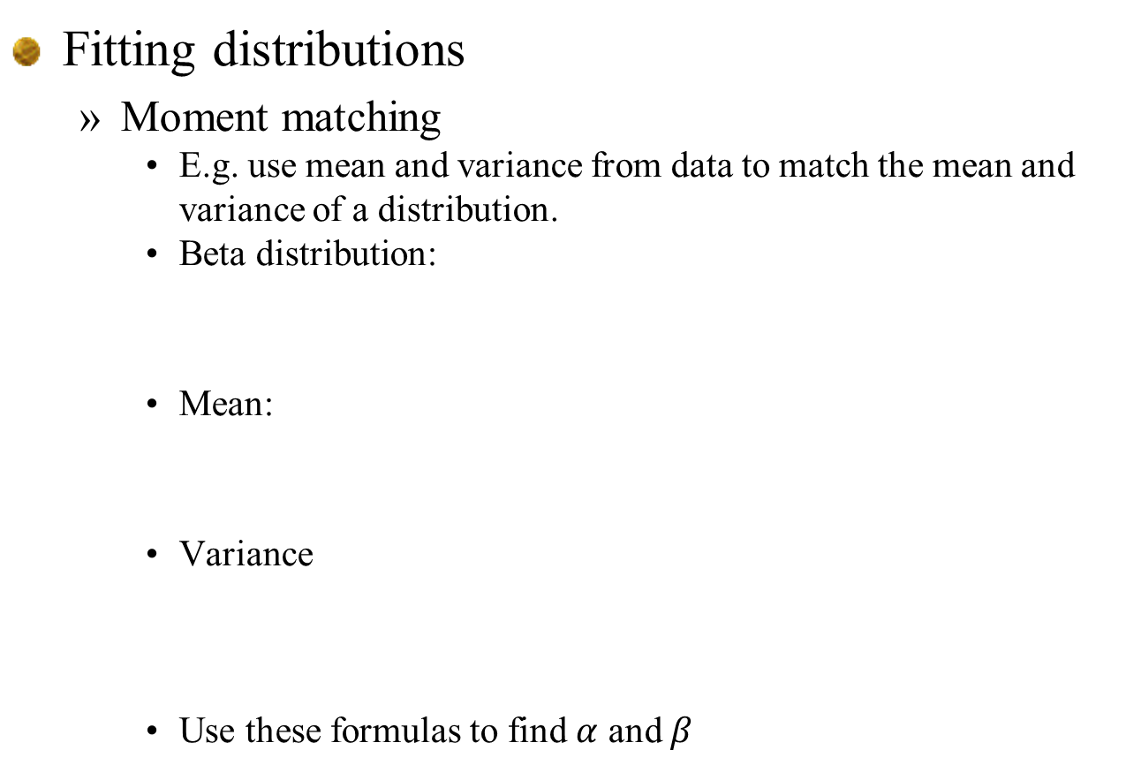
Modeling uncertainty
Fitting distributions
  Moment matching
    E.g. use mean and variance from data to match the mean and variance of a distribution.
    Beta distribution:
    Mean:
    Variance
    Use these formulas to find $α$ and $β$

Slide 61
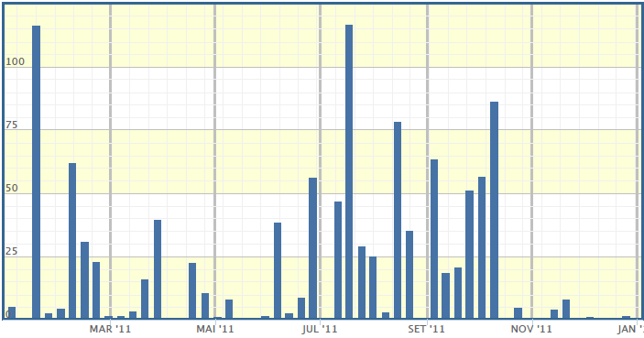
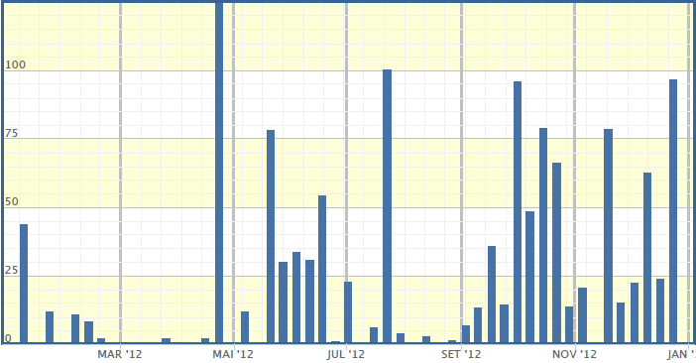



Distributions
Sampling from history
  We can create a probability distribution of the randomness of stochastic processes (e.g. wind, solar) by simply using samples drawn from different periods in history.
  Sampling from history retains complex intertemporal relationships.
Rainfall
Wind
Prices

Slide 62

Modeling uncertainty
Some data can be very heavy tailed
  Snapshot of electricity prices for New Jersey:

Slide 63

Modeling uncertainty
Transforming distributions
  There are many problems where the distribution may be hard to fit. It can be useful to transform observations into normally distributed random variables, model these transformed variables, and then transform them back.
  Let U be a random variable that is uniformly distributed over [0,1], and let X be an arbitrary random variable with cumulative distribution $F_{X}\left(x\right)=Prob\left[X≤x\right]$. Let $F_{X}^{−1}(u)$ be the inverse of the cumulative distribution. It is possible to show that
    $F_{X}\left(X\right)\sim U$ and $F_{X}^{−1}\left(U\right)\sim X$

Slide 64


Modeling uncertainty
Transforming distributions
  Observed errors are transformed to normally distributed errors using quantile mapping:
  Very useful for representing unusual distributions (e.g. heavy tailed, bimodal, …)
Historical cumulative distn
Standard normal distn
1.0
1.0
0.0
0.0
Observation X
Standard normal deviate Z

Slide 65
Policies

Slide 66
Policies:
  Review four classes
  Policy search class:
    just requires that you simulate; complex state variables are not an issue.
    With online learning, you do not even need a model – you just need the ability to fix parameters and observe a noisy estimate of how well the policy is working.
    S imulators are nice to have, but can be a lot of work to build. And ultimately, they are never perfect.
  Lookahead class:
    Need to have a model, and then need to approximate the future:
      Either through a lookahead model
      … or through a value function approximation.

Slide 67
Designing policies
We have to start by describing what we mean by a policy.
  Definition:
  A policy is a mapping from a state to an action.
  … any mapping.
How do we search over an arbitrary space of policies?

Slide 68
Designing policies
Two fundamental strategies:
  1) Policy search – Search over a class of functions for making decisions to optimize some metric.
  2) Lookahead approximations – Approximate the impact of a decision now on the future.

Slide 69
Designing policies
Policy search:
  1a) Policy function approximations (PFAs)
    Lookup tables
      “when in this state, take this action”
    Parametric functions
      Order-up-to policies: if inventory is less than s, order up to S.
      Affine policies -
      Neural networks
    Locally/semi/non parametric
      Requires optimizing over local regions
  1b) Cost function approximations (CFAs)
    Optimizing a deterministic model modified to handle uncertainty (buffer stocks, schedule slack)

Slide 70
Designing policies
Lookahead approximations – Approximate the impact of a decision now on the future:
  An optimal policy (based on looking ahead):
  2a) Approximating the value of being in a downstream state using machine learning (“value function approximations”)

Slide 71
Designing policies
The ultimate lookahead policy is optimal

Slide 72
Designing policies
The ultimate lookahead policy is optimal
  2b) Instead, we have to solve an approximation called the lookahead model:
  A lookahead policy works by approximating the lookahead model.

Slide 73
Lookahead policies
Lookahead models use five classes of approximations:
  Horizon truncation – Replacing a longer horizon problem with a shorter horizon
  Stage aggregation – Replacing multistage problems with two-stage approximation.
  Outcome aggregation/sampling – Simplifying the exogenous information process
  Discretization – Of time, states and decisions
  Dimensionality reduction – We may ignore some variables (such as forecasts) in the lookahead model that we capture in the base model (these become latent variables in the lookahead model).

Slide 74

Notes:
  The imbedded optimization over policies can take a variety of forms:
    Lookup table (as is done with a decision tree).
    Parameterized policy
      Parameters may depend on the state ${\tilde{S}}_{t,t+1}$ (in theory, it should).
      We may fix the parameter and determine it as a parameter of the overall policy $X^{π}(S_{t}|θ)$ in the usual way.

Slide 75
Designing policies
Types of lookahead approximations
  One-step lookahead – Widely used in pure learning policies:
    Bayes greedy/naïve Bayes
    Expected improvement
    Value of information (knowledge gradient)
  Multi-step lookahead
    Deterministic lookahead, also known as model predictive control, rolling horizon procedure
    Stochastic lookahead:
      Two-stage (widely used in stochastic linear programming)
      Multistage
        Monte carlo tree search (MCTS) for discrete action spaces
        Multistage scenario trees (stochastic linear programming) – typically not tractable.

Slide 76
Four (meta)classes of policies
1) Policy function approximations (PFAs)
  Lookup tables, rules, parametric/nonparametric functions
2) Cost function approximation (CFAs)
3) Policies based on value function approximations (VFAs)
4) Direct lookahead policies (DLAs)
  Deterministic lookahead/rolling horizon proc./model predictive control
  Chance constrained programming
  Stochastic lookahead /stochastic prog/Monte Carlo tree search
  “Robust optimization”
Policy search
Lookahead approximations

Slide 77
Designing policies
Finding the best policy
  We have to first articulate our classes of policies
  So minimizing over means:
  We then have to pick an objective such as
    or

Slide 78
Applications
… and policies

Slide 79
Topics
  Asset selling
  Adaptive market planning
  Diabetes problem
  Static shortest path
  Dynamic shortest path
  Energy storage problem (all four variations)
  Newsvendor problem (single/two agent, beer game)
  Blood management problem
  Clinical trials

Slide 80
  PFA for asset selling (sell on drops, surges)
  PFAs for stepsize policies
  CFA (UCB, IE) for diabetes)
  VFA for shortest paths
  DLA/Knowledge gradient for diabetes
  Dynamic shortest paths
  Parameterized stochastic shortest path
  MDP for energy storage
  Lookahead for energy storage
  PFA for newsvendor problem
  CFA for blood management I – parameterized myopic
  VFA for blood management II – VFAs
  Lookaheads for clinical trials
  All parameter search problems

Slide 81



Asset selling
  Sell signal:
  or
  or

Slide 82


Adaptive market planning
Stepsize policies
  Harmonic stepsize formula (deterministic
  Kesten’s rule (stochastic)
  Discuss:
    Scaling
    Handling bias (learning) vs. noise (smoothing)

Slide 83

Choosing diabetes medication
  Upper confidence bounding policies
  Interval estimation
  Knowledge gradient

Slide 84


Shortest paths – static/stationary
  Deterministic, or stochastic (but we see costs after we choose the link):
  Stochastic (we see costs before we make a decision)
  $$X^{π}(S_{t})=argmax_{j} ({\hat{c}}_{ij}+{\overline{V}}_{tj}^{x,n−1})$$

Slide 85
Imagine that the lookahead is just a black box:
  Solve the optimization problem
  subject to
  This is a deterministic shortest path problem that we could solve using Bellman’s equation, but for now we will just view it as a black box optimization problem.

Slide 86

The $θ−$percentile policy.
  Solve the linear program (shortest path problem):
  subject to
  This is a deterministic shortest path problem that we could solve using Bellman’s equation, but for now we will just view it as a black box optimization problem.

Slide 87
Energy storage problem
  PFA version
    Use basic policy search:

Slide 88
Designing policies
Matching problems to policies

Slide 89


Slide 90




Choosing a policy
Robust cost function approximation
Lookahead policy
Policy function approximation
Policy based on value function approximation

Slide 91


Choosing a policy
Which policy to use?
  PFAs are best for low-dimensional problems where the structure of the policy is apparent from the problem.
  CFAs work for high-dimensional problems, where we can get desired behavior by manipulating the cost function.

Slide 92


Choosing a policy
Which policy to use?
  VFAs work best when the lookahead model is easy to approximate
  Lookahead models should be used only when all else fails (which is often)

Slide 93
Evaluating policies

Slide 94
“Offline learning”
  Evaluate policies in a simulator
  Requires building a simulator
  Much faster than online, but you have to accept the errors implicit in any simulator.
“Online learning”
  Learning in the field
  Does not require a simulator…
  … but it is very slow (takes a day to simulate a day).

Slide 95

Policy search class
Finding the best policy
  We need to maximize
  We cannot compute the expectation, so we run simulations:
Notes:
95

Slide 96
There are two settings for doing policy search:
  Offline
    In a computer simulation
    In a lab where we do not mind making mistakes
    We look to optimize the performance of the final design after a series of experiments
  Online
    This means in the field, where we care about how well we do while we are learning.
    We look to optimize performance along the way, which means we are maximizing cumulative reward.
  Caution: “offline” and “online” are terms used in the machine learning community:
    “offline” means batch learning
    “online” means continuous updating

Slide 97

Offline (“final reward”) objective
  The final reward process works as follows:
    States, decisions and exogenous information evolve according to
    $(S^{0},x^{0},W^{1},S^{1},x^{1},W^{2},…S^{n},x^{n},W^{n+1},…)$
    Decisions are made according to a policy $x^{n}=X^{π}\left(S^{n}\right)$.
    States are updated using
    $$S^{n+1}=S^{M}(S^{n},x^{n},W^{n+1})$$
    After $N$ experiments, we call our final decision $x^{π,N}$, since it depends on our policy $π$ and the budget $N$.
    Once we have the final design, we then have to stop and test the design using new observations that we call $\hat{W}.$

Slide 98

The value of the policy
  We can start by writing
  $$F^{π}=𝔼F(x^{π,N},\hat{W})$$
  … but this is not very clear.
  There are up to three different sources of uncertainty:
    The initial state $S^{0}$, which might have a Bayesian prior about the performance of the different diabetes drugs.
    The observations $W^{1},W^{2},…, W^{N}$
    The observations made during the final testing $\hat{W}.$
  We can write the value of a policy more clearly as
  $$F^{π}=𝔼_{S^{0}}𝔼_{{W^{1},W^{2},…,W^{N}|S}^{0}}𝔼_{{\hat{W}|S}^{0}}F(x^{π,N},\hat{W})$$
  This is better, but we won’t really understand it until we know how to compute it.

Slide 99

The value of the policy (cont’d)
  To compute
  $$F^{π}=𝔼_{S^{0}}𝔼_{{W^{1},W^{2},…,W^{N}|S}^{0}}𝔼_{{\hat{W}|S}^{0}}F(x^{π,N},\hat{W})$$
  We have to simulate the expectations. Let’s break down each one:
  $𝔼_{S^{0}}$: Imagine that $S^{0}$ includes a Bayesian prior such as the belief about how a patient responds to a diabetes medication. Let $μ={\left(μ_{x}\right)}_{x∈X}$ be the truth of the performance of each drug $x$. Let’s just sample $k=1,…, K$ samples of the vector $μ$ to get $(μ^{1},μ^{2},…, μ^{k},…, μ^{K})$ samples of what each of the truths might be, and let’s let $p^{0}={\left(p_{k}^{0}\right)}_{k=1}^{K}$ be the prior probabilities on these samples (perhaps 1/K).

Slide 100

The value of the policy (cont’d)
  To compute
  $$F^{π}=𝔼_{S^{0}}𝔼_{{W^{1},W^{2},…,W^{N}|S}^{0}}𝔼_{{\hat{W}|S}^{0}}F(x^{π,N},\hat{W})$$
  $𝔼_{{W^{1},W^{2},…,W^{N}|S}^{0}}$: Given $S^{0}$ means picking one of the $μ^{k}={\left(μ_{x}^{k}\right)}_{x∈X}$ as the true truth for each drug. Now let’s try drug $x=x^{n}$ after the nth trial, and then observe
  $$W_{x}^{n+1}=μ_{x}^{k}+ε_{x}^{n+1}$$
  where $ε_{x}^{n+1}$ is the noise in an observation.
  Let $W=(W^{1},W^{2},…,W^{N})$ be a sequence of realizations. Again assume we have a series of samples that we will call $W^{\left(1\right)},W^{\left(2\right)},{…W}^{(ℓ)},…,W^{(L)}$ a sample of all the observations (actually a sample of $ε$).

Slide 101

The value of the policy (cont’d)
  To compute
  $$F^{π}=𝔼_{S^{0}}𝔼_{{W^{1},W^{2},…,W^{N}|S}^{0}}𝔼_{{\hat{W}|S}^{0}}F(x^{π,N},\hat{W})$$
  $𝔼_{{\hat{W}|S}^{0}}$: At this point we have our final design $x^{π,N}$ which depends on the truth $μ^{k}$ and the experimental outcomes $W^{1},W^{2},…,W^{L}$. We write this as $x^{π,N}(k,l)$.
  Now we have to test it by observing a new outcome $\hat{W}.$ Again assume we sample this, and observe ${\hat{W}}^{1}{,\hat{W}}^{2},…,{\hat{W}}^{m}$,…, ${\hat{W}}^{M}$ outcomes.
  Now simulate $F^{π}$ using
  ${\overline{F}}^{π}=\frac{1}{K}\sum_{k=1}^{K}{\frac{1}{L}\sum_{l=1}^{L}{\sum_{m=1}^{M}{F}}}$ $(x^{π,N}(k,l),{\hat{W}}^{m})$

Slide 102

Online (“cumulative reward”) objective
  This is how we evaluated our diabetes policy. Rather than evaluating at the end, we evaluate as we proceed, which makes the formula a bit simpler.
  The expected performance of a policy would be written
  $F^{π}=𝔼_{S^{0}}𝔼_{{W^{1},W^{2},…,W^{N}|S}^{0}}\sum_{n=0}^{N−1}{F(X^{π}(S^{n}),W_{x^{n}}^{n+1})}$
  Using samples to approximate the expectations is just as we did for the offline case. The only difference is that we sum our performance, and we do not have to separate the “learning” from the “evaluating.”
  A more difficult issue is how we do learning in a field situation. This is active research!

Slide 103
Tuning environments
  In a simulator
    Requires building a mathematical model of the dynamic process and, most important, the uncertainties.
    Your policy will only be as good as your model of uncertainty.
  In the real world
    No longer need a stochastic model…
    But it takes a day to simulate a day. This can be very slow.
    Examples:
      FAA
      Grid operators

