Slide 1
.
Sequential decision analytics and modeling
ORF 411
Fall, 2018
Warren Powell
Princeton University
http://www.castlelab.princeton.edu
© 2017 Warren B. Powell, Princeton University

Slide 2

Week 8 - Monday
Two-agent newsvendor

Slide 3

Logistics!

Slide 4

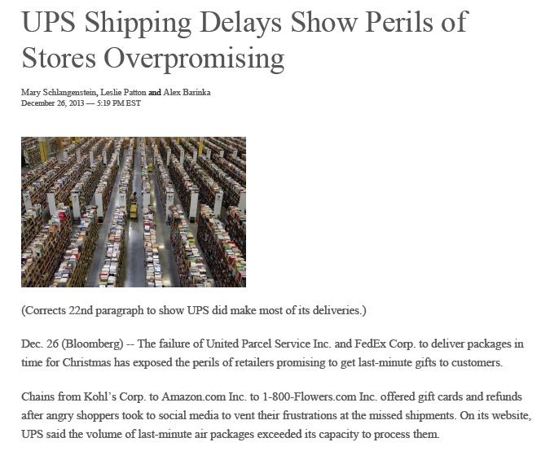
Supply chain management
Amazon-UPS meltdown, Christmas, 2013
  Amazon promised 2-day service (based on UPS service guarantees). UPS was overwhelmed.

Slide 5
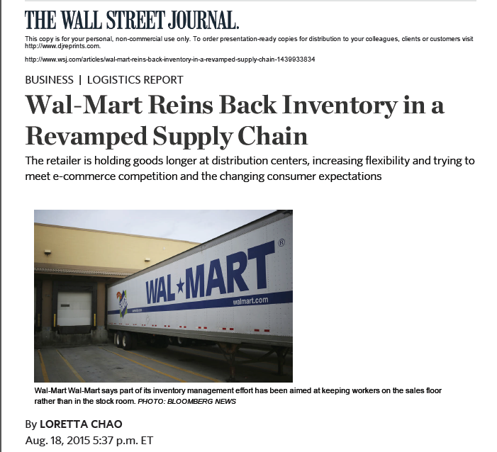
Supply chain management
Why?

Slide 6
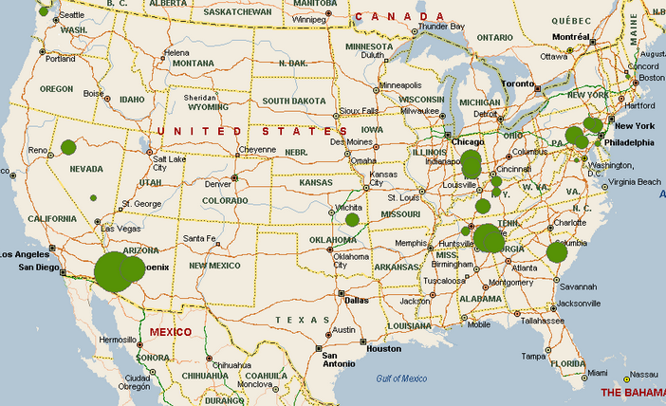
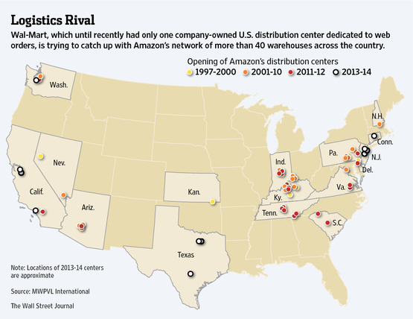
Amazon distribution network
  Small number of DC’s
  Uses UPS, FedEx, for final distribution
Walmart distribution network
  Extensive retail network
  Limited need for distribution centers
  Increasing role of internet sales

Slide 7
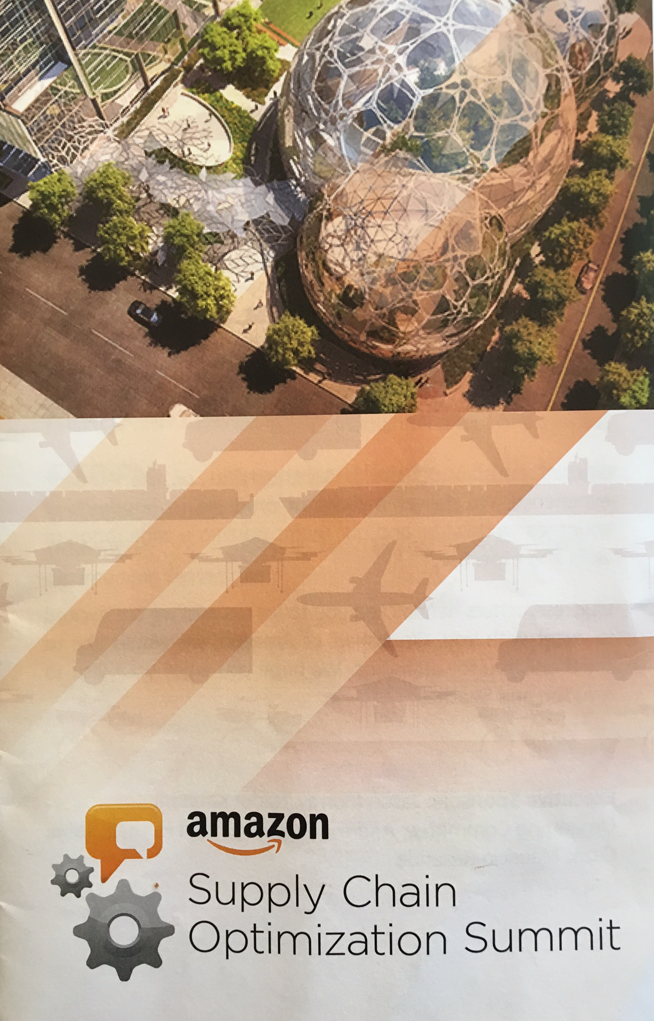
Amazon
First supply chain logistics conference in 2015
Still running off of spreadsheets developed by Jeff Bezos
Numerous instances where uncertainty is an important element.
Exclusively using deterministic optimization tools at that time.

Slide 8
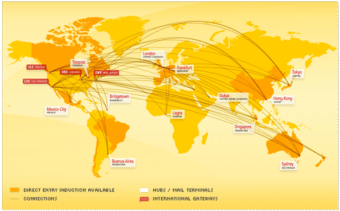
Global logistics
Apple, Inc.
Notes:
Who is Tim Cook – CEO of Apple
What was his job before taking over from Steve Jobs? Head of global logistics
Apple has gained a significant advantage over its competitors through logistics, largely in the form of contracts that lock up supplies of materials and components, blocking out competitors.

Slide 9
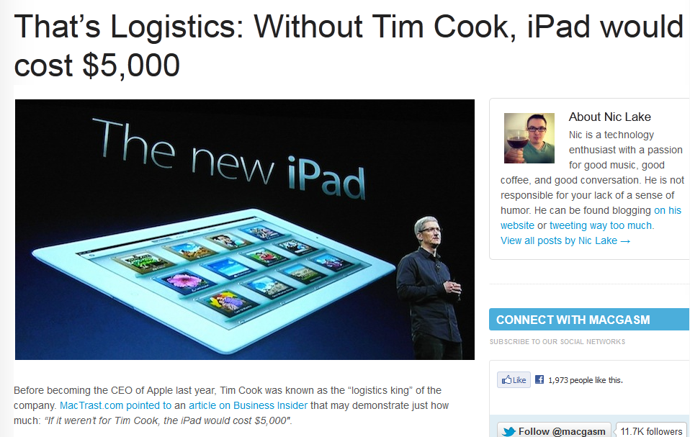

Notes:
http://www.macgasm.net/2012/03/24/logistics-tim-cook/

Slide 10
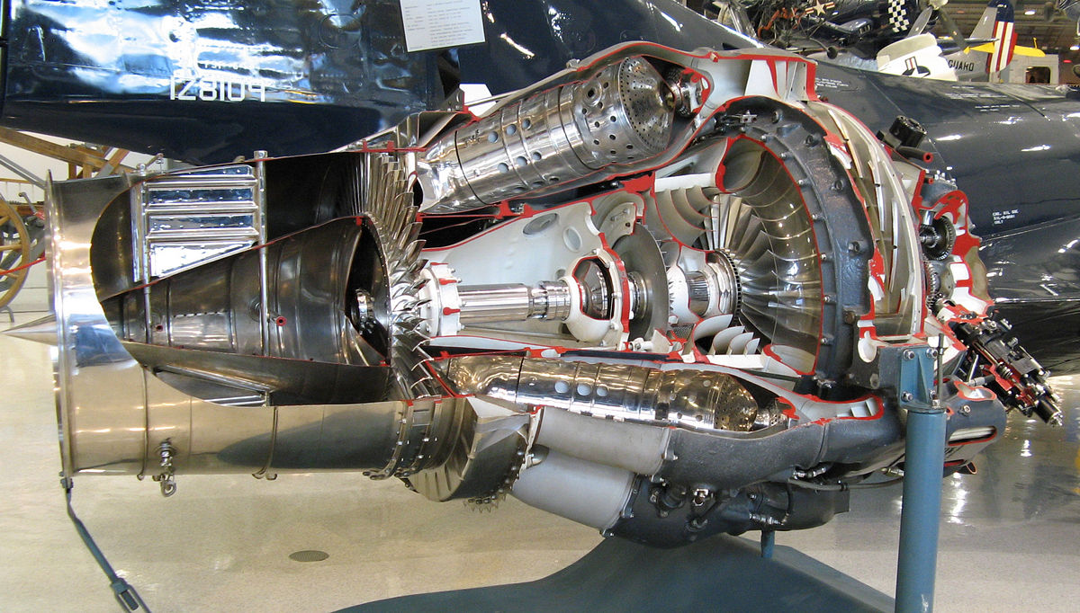
Pratt&Whitney jet engines

Slide 11
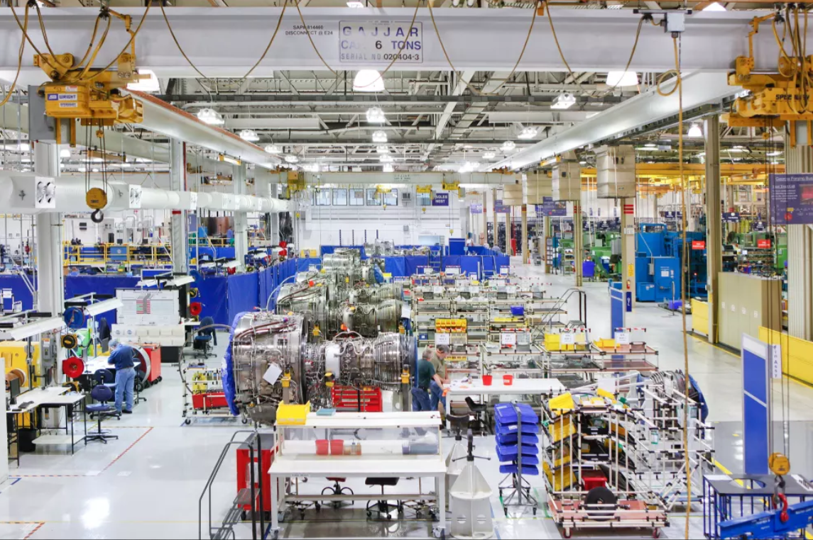
Pratt&Whitney jet engines

Slide 12
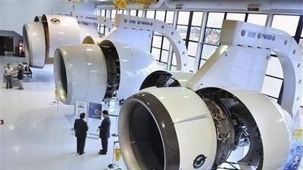
Pratt&Whitney jet engines

Slide 13
Information exchange problems

Slide 14
Sample problems
  Pricing IPO’s:
    Situation:
      Bank wishes to bring an IPO to market.
    Decision:
      How should the bank price the IPO?
    Behavior:
      Bank solicits information from investment banks, who indicate a price lower than they are willing to pay.
    Outcome:
      If the bank goes to market with too low of a price, it leaves money on the table.
      If bank goes to market with too high of a price, it will not clear the market and is left with shares on hand.

Slide 15
Sample problems
  IT department:
    Situation:
      Request for programming
    Decision:
      IT department requests 3000 hours to complete a programming assignment.
    Behavior:
      Big penalty for not finishing on time, so estimate is inflated.
    Outcome:
      Project takes only 2000 hours.
        If IT brings the project early, business unit may learn that IT inflates estimates by 50 percent.
        IT pads project by checking, documentation, adding features, cleaning code, etc. etc.

Slide 16
Sample problems
  Spending a budget:
    Situation:
      You have a $1.2 million budget for the year. After three months, you have spent $200,000.
    Decision:
      You receive a request to spend $500,000.
    Behavior:
      You have the money in the budget, but have to think about future expenses.
    Outcome:
      You only allow $400,000 of the request. You did not satisfy the demand, but you have money left over.

Slide 17
Sample problems
  Military exercise:
    Situation:
      Civilian leadership initiates a military action.
    Decision:
      Armed forces evaluate situation and ask for resources:
        Soldiers
        Military equipment
        Supporting people and equipment
        Airlift capability
    Outcome:
      If too few resources are provided:
        Conflict is prolonged
      If too many resources are provided:
        Resources are spread around activities.

Slide 18
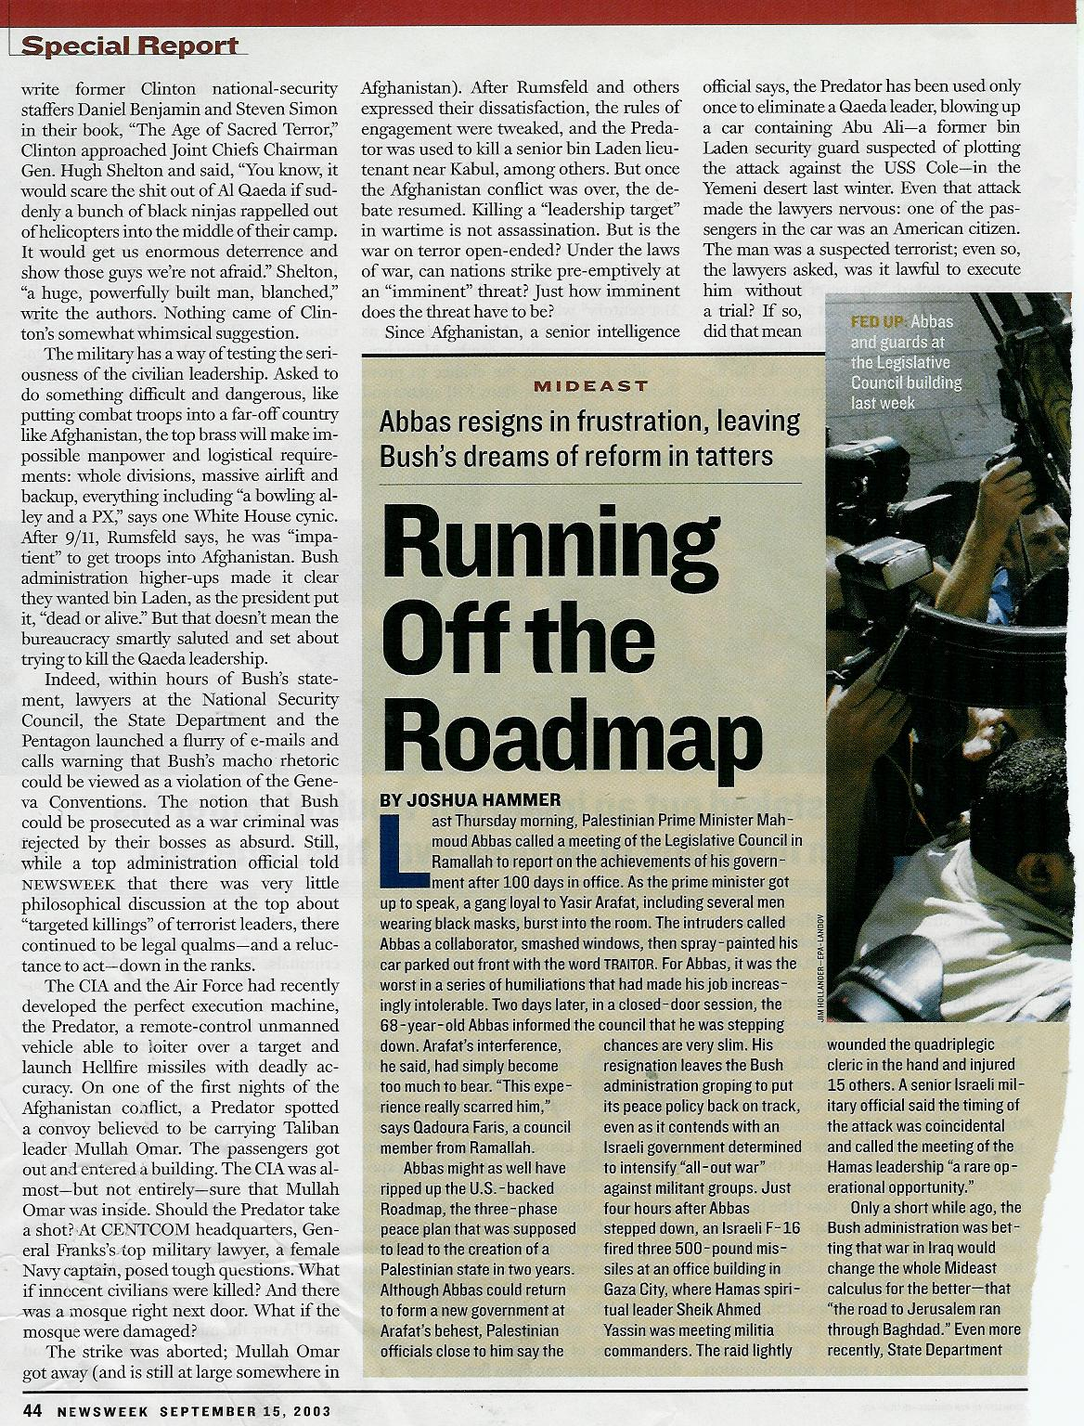
The military has a way of testing the seriousness of the civilian leadership. Asked to do something difficult and dangerous, like putting combat troops into a far-off country like Afghanistan, the top brass will make impossible manpower and logistical requirements: whole divisions, massive airlift and backup, everything including “a bowling alley and a PX,” says one White House cynic.

Slide 19
Sample problems
  IMF makes loans to countries:
    Situation:
      A country has a financial crisis and requests a loan from the IMF.
    Decision:
      IMF evaluates the need and (potentially) makes a loan.
    Behavior:
      There is an international incentive to make sure that all economies get past problem periods.
    Outcome:
      IMF loans too much:
        Country becomes dependent on external funding and/or money may be used for other purposes.
      IMF loans too little:
        Country remains in crisis and/or has to ask for more.

Slide 20
Narrative

Slide 21
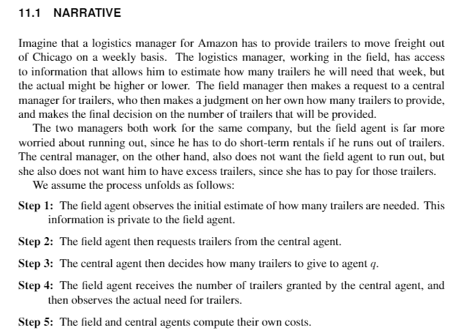

Slide 22
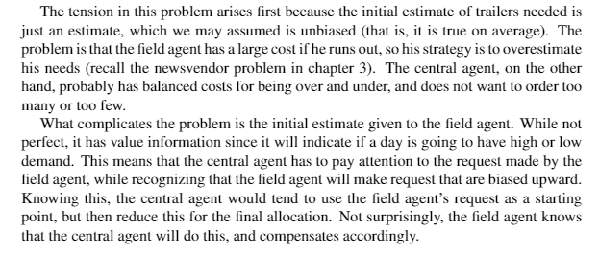

Slide 23
Two-agent resource allocation
Original newsvendor problem:
  Single “agent” requests resources, and gets whatever is requested.
  Has to live with the outcome.
Two-agent newsvendor problem:
  “Field agent” requests resources from a “central command”.
  Request represents information to the central command. Central command may decide to a different amount from what was requested.

Slide 24
Two-agent resource allocation
Problem characteristics:
  Central command’s cost of underage is typically lower than that for the field.
  Field agent has better (potentially perfect) information about actual requirements.
  After the event, the field agent may know what was really required.
  What does the central command learn?
    Case A: Exactly what was required.
    Case B: An unbiased but noisy estimate of what was required.
    Case C: A biased (and possibly noisy) estimate of what was required.

Slide 25
Two-agent resource allocation
Rules
  Field agent gets to see information that provides an estimate of what is required.
  Field agent requests resources from central command.
  Central command thinks about it and decides how much to give the field.
  Central command and field get to see what was really required.

Slide 26
Two-agent newsvendor game
Distribute sheets

Slide 27
Two-agent resource allocation
Problem characteristics:
  Central command’s cost of underage is typically lower than that for the field.
  Field agent has better (potentially perfect) information about actual requirements.
  After the event, the field agent may know what was really required.
  What does the central command learn?
    Case A: Exactly what was required.
    Case B: An unbiased but noisy estimate of what was required.
    Case C: A biased (and possibly noisy) estimate of what was required.

Slide 28
Two-agent resource allocation
Rules
  Field agent gets to see information that provides an estimate of what is required.
  Field agent requests resources from central command.
  Central command thinks about it and decides how much to give the field.
  Central command and field get to see what was really required.

Slide 29
Two-agent resource allocation
The two-agent resource game:

Slide 30
The resource allocation game
Now you do it:
  Divide into pairs. Each pair will play the game twice.
  For the first round, one takes the role of central command and the second is the field. The field takes the sheet marked “field – round 1.”
  The field looks at the “estimate” (which is confidential) and makes a request to the central command. The central command then makes an allocation. The central command faces equal costs for underage and overage (5). The field faces a cost of 10 for being under vs. 2 for being over.
  After making decisions, wait for instructor to reveal the actual.
  Record decisions, actual, and overage/underage.
  Maintain a running total of costs.
  For round 2, switch roles, and use “field/central – round 2” sheet.

Slide 31
Basic model

Slide 32
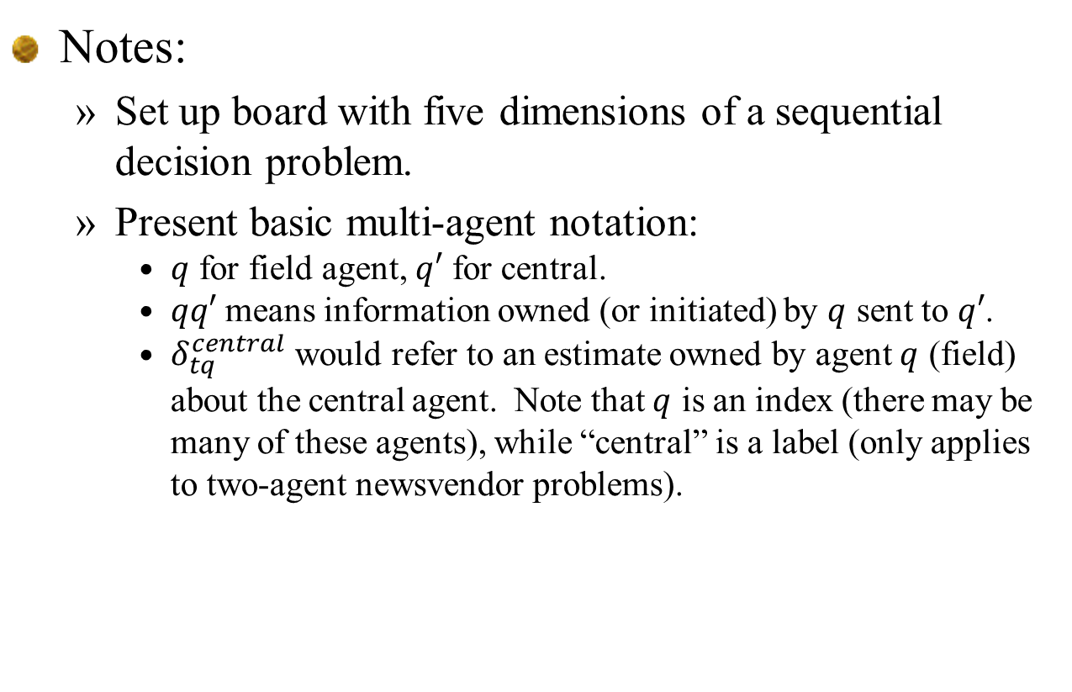
Notes:
  Set up board with five dimensions of a sequential decision problem.
  Present basic multi-agent notation:
    $q$ for field agent, $q′$ for central.
    $qq′$ means information owned (or initiated) by $q$ sent to $q′$.
    $δ_{tq}^{central}$ would refer to an estimate owned by agent $q$ (field) about the central agent. Note that $q$ is an index (there may be many of these agents), while “central” is a label (only applies to two-agent newsvendor problems).

Slide 33
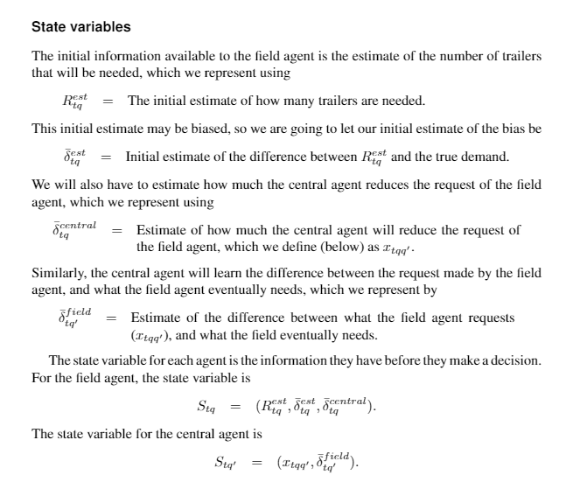

Slide 34
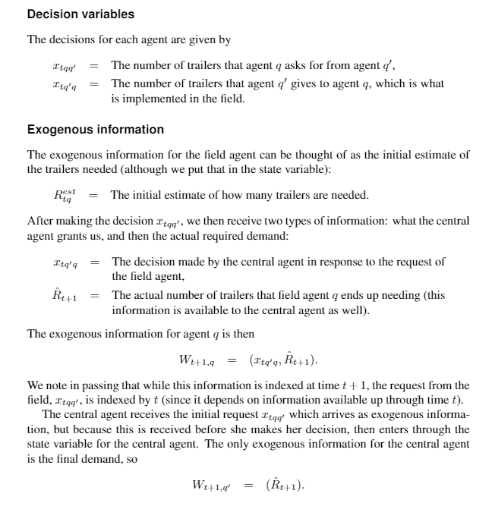

Slide 35
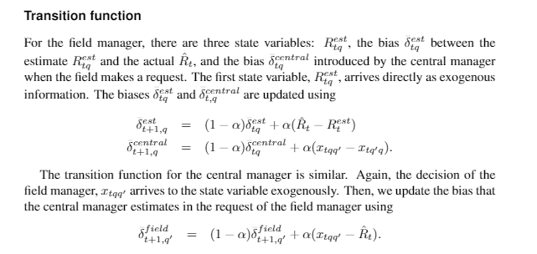

Slide 36
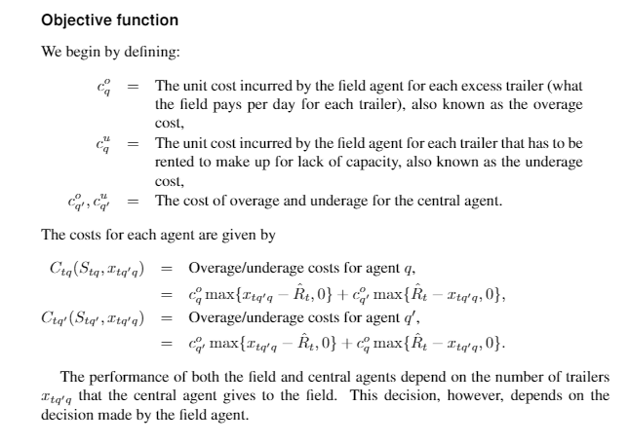

Slide 37
Designing policies

Slide 38
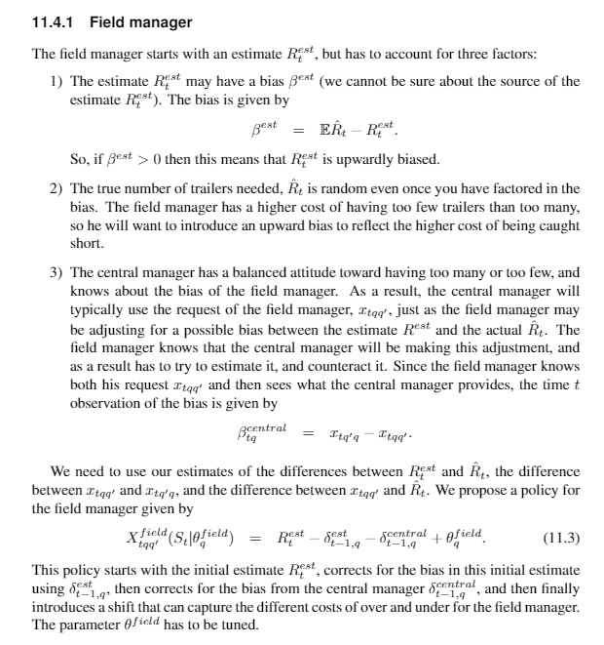

Slide 39
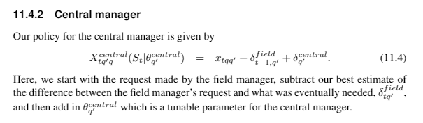

Slide 40
Extensions

Slide 41
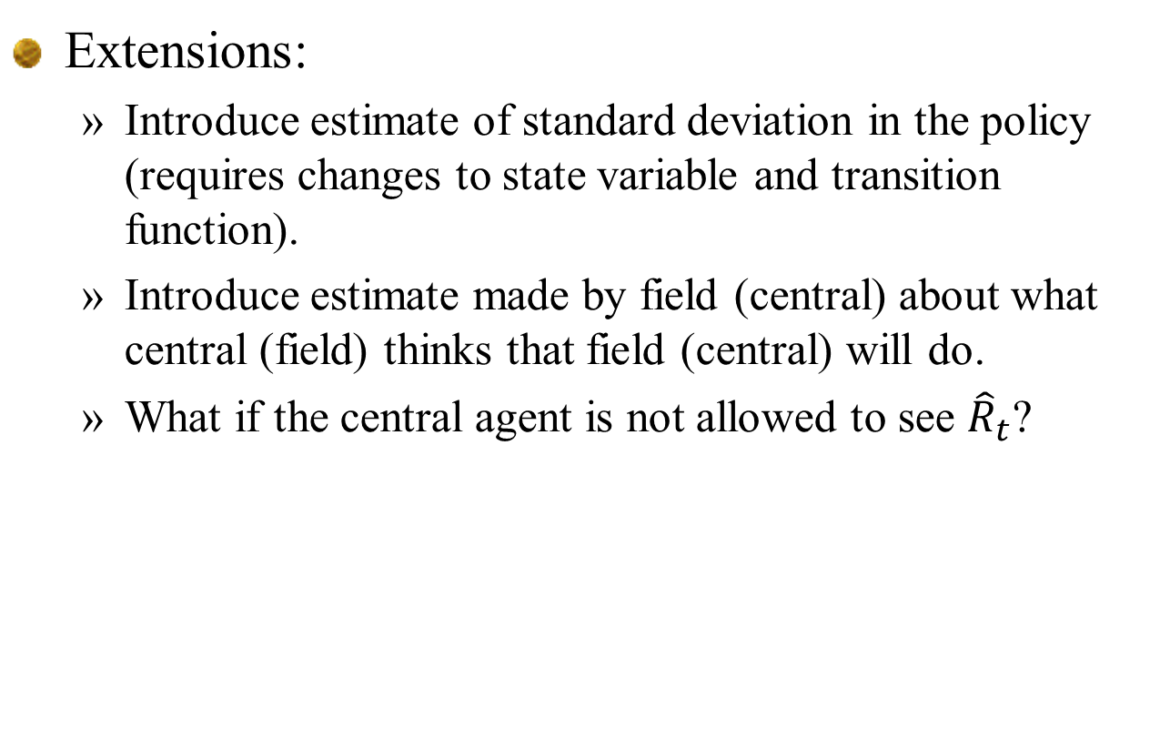
Extensions:
  Introduce estimate of standard deviation in the policy (requires changes to state variable and transition function).
  Introduce estimate made by field (central) about what central (field) thinks that field (central) will do.
  What if the central agent is not allowed to see ${\hat{R}}_{t}$?

