Slide 1
.
Sequential decision analytics and modeling
ORF 411
Fall, 2018
Warren Powell
Princeton University
http://www.castlelab.princeton.edu
© 2017 Warren B. Powell, Princeton University

Slide 2

Week 7 – Wednesday
Uncertainty modeling

Slide 3

Modeling uncertainty
Types of uncertainty

Slide 4
Modeling uncertainty
Observational uncertainty
Prognostic uncertainty (forecasting)
Experimental noise/variability
Transitional uncertainty
Inferential uncertainty
Model uncertainty
Systemic exogenous uncertainty
Control/implementation uncertainty
Algorithmic noise
Goal uncertainty
Modeling uncertainty in the context of stochastic optimization is a relatively untapped area of research.

Slide 5
Modeling uncertainty
Types of uncertainty
  Observational uncertainty – Errors in our observations of the state of the system:
    What is the CO2 content of the atmosphere?
    What is inventory of oil in the U.S.?
  Prognostic uncertainty – Uncertainty in the forecast of a future event.
    Forecasting demands
    Forecasting the weather

Slide 6
Modeling uncertainty
Types of uncertainty
  Experimental noise – This is the variability that arises when running repeated experiments (either in a lab or in the field)
    Testing the impact of a new flu drug.
    Testing the effect of a new material on battery lifetimes
  Transitional uncertainty – We have a model of how a (presumably) deterministic system evolves, but there is still noise:
    Modeling the location of an aircraft moving at a certain speed from a known location.
    Predicting the time of arrival of a car at a downstream node

Slide 7
Modeling uncertainty
Types of uncertainty
  Inferential uncertainty
    Uncertainty in parameters estimated from observational data
    Sometimes known as diagnostic uncertainty which might arise in the context of estimating a condition such as disease or the reason for a malfunction (in an engine). Such an assessment would an inference based on indirect observations.
  Model uncertainty – This is uncertainty about the model itself, which comes in two forms:
    Uncertainty about the structure of the model:
      Linear approximation of a nonlinear model
      Different sets of equations describing the climate
    Parameters characterizing the model

Slide 8
Modeling uncertainty
Types of uncertainty
  Systemic exogenous uncertainty - Errors in the model of exogenous information that occur on long time scales:
    Modeling the effect of long-term drops in oil consumption due to conservation
    Modeling the effect of increased cloud cover due to climate change
Low frequency noise (“scenarios”)
High frequency noise
Base signal (forecasted)

Slide 9
Modeling uncertainty
Types of uncertainty
  Control uncertainty
    You ask for but you get
    Wiley sets a wholesale price of $80, but Amazon sells at some random price above that (limits Wiley’s ability to set prices).
    You order 10 items, but only get 8 due to a stockout.
    You try to drive at 70 mph, but there is variability due to your inability to hold a speed perfectly, along with the effect of traffic.
    Uber would like 50 drivers on duty, but can only influence their behavior through surge pricing.
  Algorithmic uncertainty
    Run the same algorithm twice, and you may get different answers (depends on the algorithm and the nature of the compute environment).

Slide 10
Modeling uncertainty
Types of uncertainty
  Goal uncertainty
    There are many settings where decisions are being made by a group of people:
      Dispatchers for a trucking company
    What are we trying to achieve?
    Maximize revenue? Minimize costs? Maximize profits?
    Best customer service?
    Lowest risk?

Slide 11
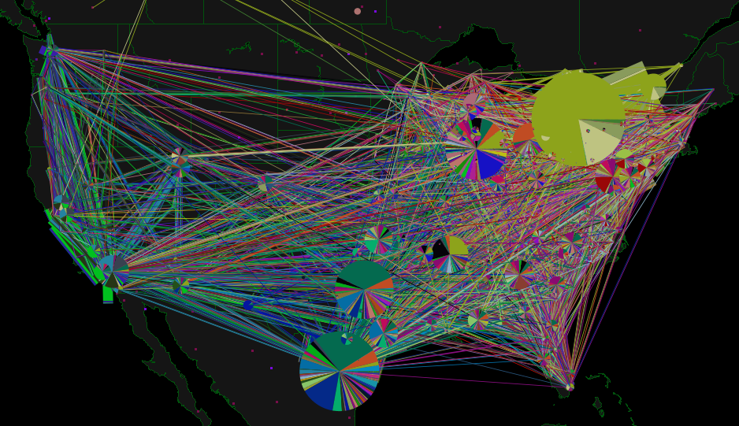
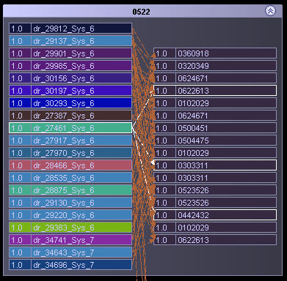
Schneider National

Slide 12
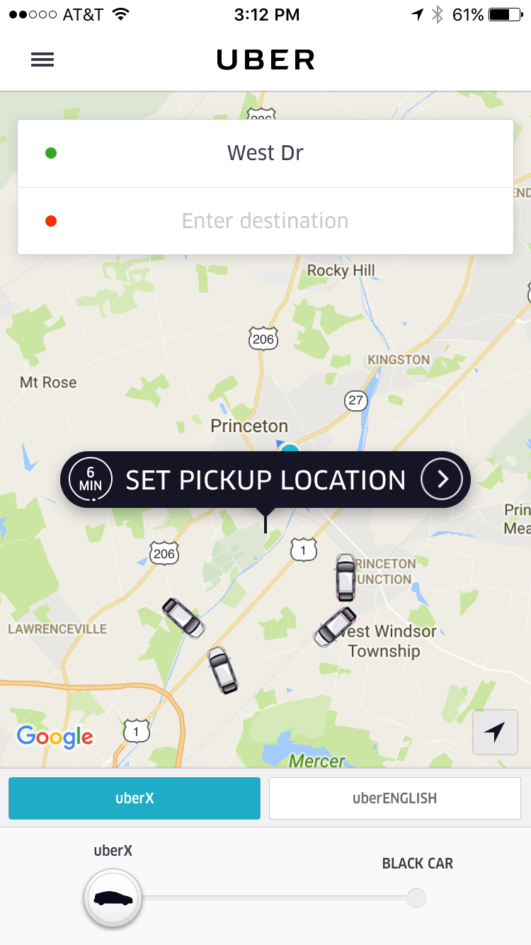
Goal uncertainty
Uber
  Provides real-time, on-demand transportation.
  Drivers are encouraged to enter or leave the system using pricing signals and informational guidance.
Decisions:
  How to price to get the right balance of drivers relative to customers.
  Assigning and routing drivers to manage Uber-created congestion.
  Real-time management of drivers.
  Pricing (trips, new services, …)
  Policies (rules for managing drivers, customers, …)

Slide 13
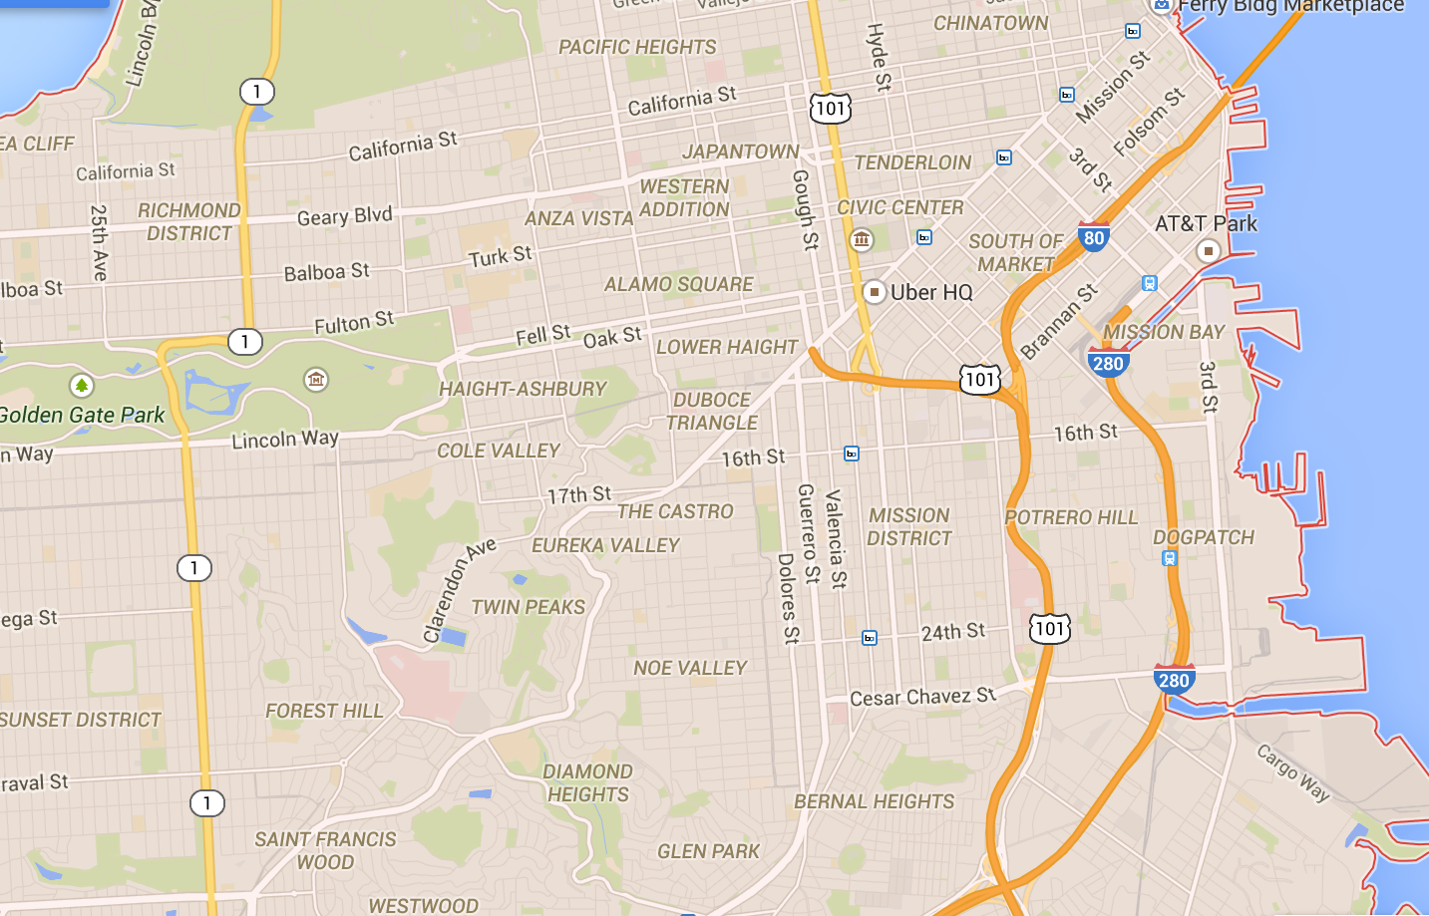

Goal uncertainty
Cars
Riders
Notes:
… to tasks (loads, trains, flights).

Slide 14
Goal uncertainty
t
t+1
t+2

Slide 15
Goal uncertainty
t
t+1
t+2

Slide 16
Goal uncertainty
t
t+1
t+2
The assignment of cars to riders evolves over time, with new riders arriving, along with updates of cars available.

Slide 17
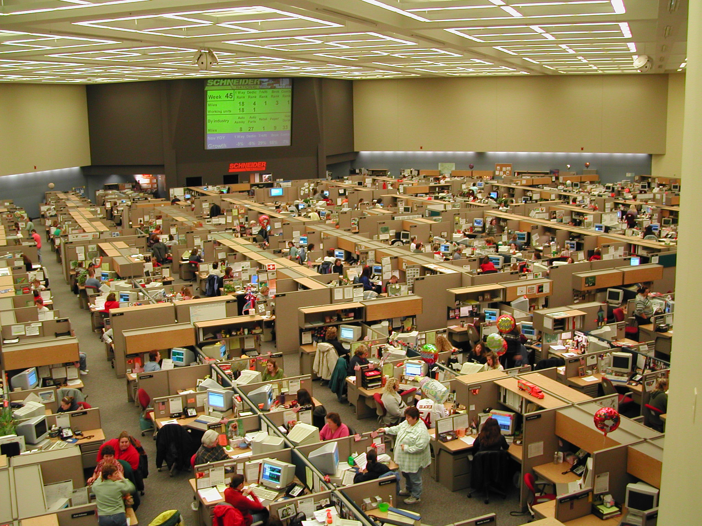
Slide 17
Notes:
17
This is the dispatch room for Schneider National, one of the largest truckload motor carriers in the U.S.

Slide 18
Goal uncertainty
We can find one model that balances everyone’s wishes (badly):

Slide 19
Goal uncertainty
Formulating a model is like fitting a line through a set of users:

Slide 20
Goal uncertainty
Formulating a model is like fitting a line through a set of users:

Slide 21
Goal uncertainty
Should we customize the model (somewhat) for each user?

Slide 22
Modeling uncertainty

Slide 23
Modeling uncertainty
There are two information processes that drive the system:
  Decisions – This is the endogenously controllable information process.
  Exogenous information - This comes from the initial state , and the exogenous information process .
To figure out how to make good decisions, you need:
  The system model
  The initial state and the exogenous information process

Slide 24
Modeling uncertainty
The initial state . This contains:
  All deterministic parameters needed by the system. This is static data, so it is not modeled as part of the dynamic state .
  “State of knowledge” – probabilistic information about uncertain parameters. This information is always represented as a probability distribution of some form:
    Normally distributed uncertain parameters – This might be:
      Estimated age of a power transformer
      Estimated growth rate of a stock
      The blood sugar of a patient
    Discrete distributions – Examples include
      Whether a patient has an infection
      Probabilities of a discretized distribution of demand

Slide 25
Modeling uncertainty
The exogenous information process which might include:
  Passive information – This is information that arrives regardless of any actions we may take. Examples:
    Purely exogenous – Information that is not influenced by the state of the system or any actions we take. Examples:
      Rainfall, traffic
      Traffic congestion
      Stock prices (if we are a small player)
    Exogenous distributions are influenced by states and/or actions.
  Active information – This is information we choose to collect
    Running a laboratory experiment
    Purchasing a report

Slide 26
Modeling uncertainty
Bayesian vs. frequentist uncertainty
  Bayesian uncertainty is captured by a distribution of belief derived from prior information:
    Expert judgment
    Information collected from different settings
    Past experience
    Bayesian uncertainty is always communicated through
  Frequentist uncertainty
    This is uncertainty derived from statistical analysis of the variability inherent in the exogenous information

Slide 27
Modeling uncertainty
Examples of stochastic processes

Slide 28
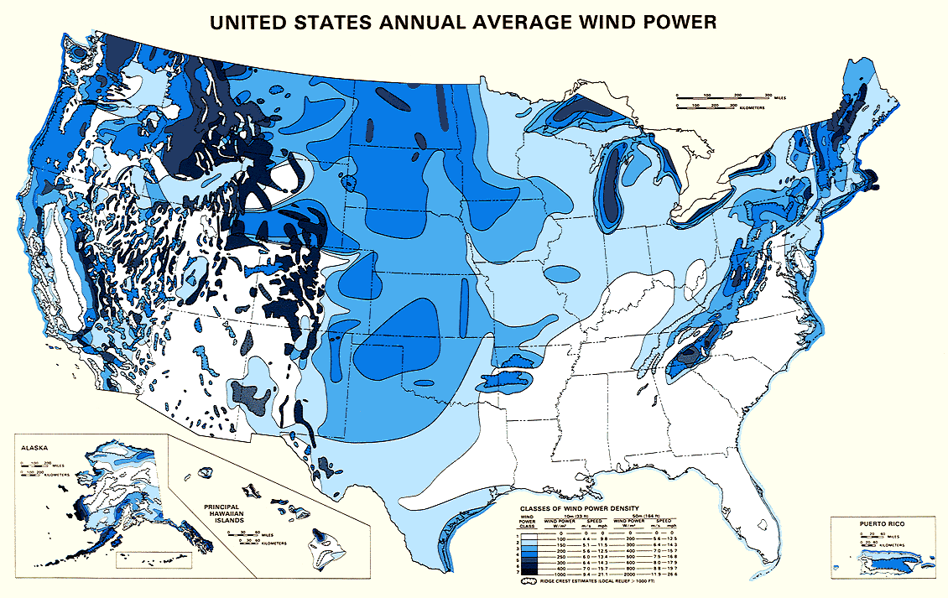
Wind in the U.S.

Slide 29
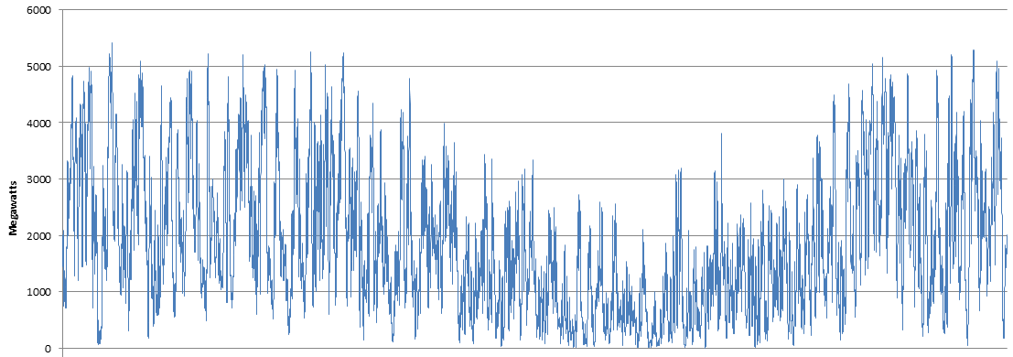
Energy from wind
Wind power from all PJM wind farms
1 year
Jan Feb March April May June July Aug Sept Oct Nov Dec
Notes:
Discuss fine-grained and coarser-grained (yearly) patterns.

Slide 30
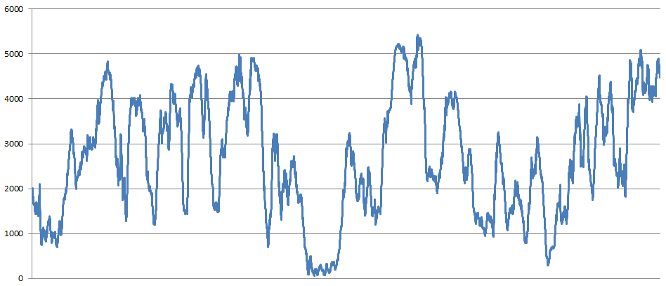
Energy from wind
Wind from all PJM wind farms
30 days
Notes:
Discuss fine-grained and coarser-grained (yearly) patterns.

Slide 31
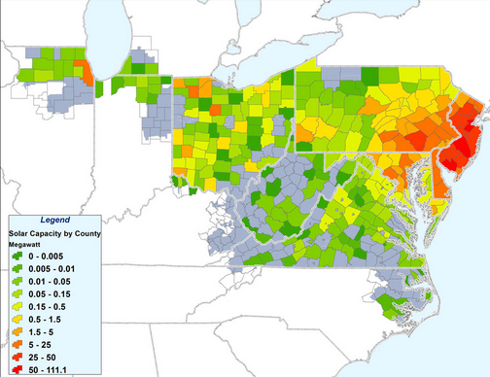
Solar energy
Princeton solar array

Slide 32
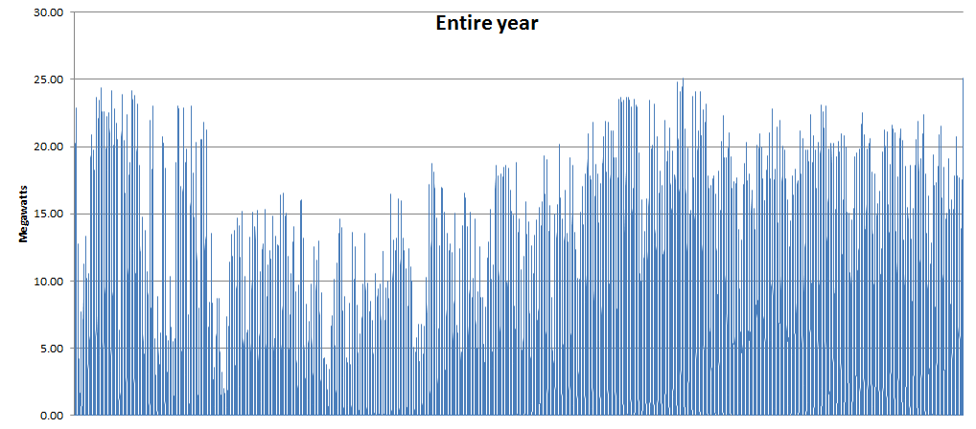
Energy from solar
Solar output over entire year (all farms)
Sept Oct Nov Dec Jan Feb March April May June July Aug

Slide 33
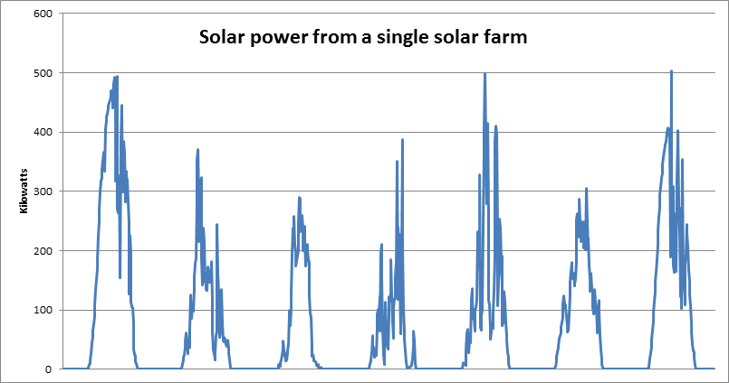
Energy from solar
Solar from a single solar farm

Slide 34
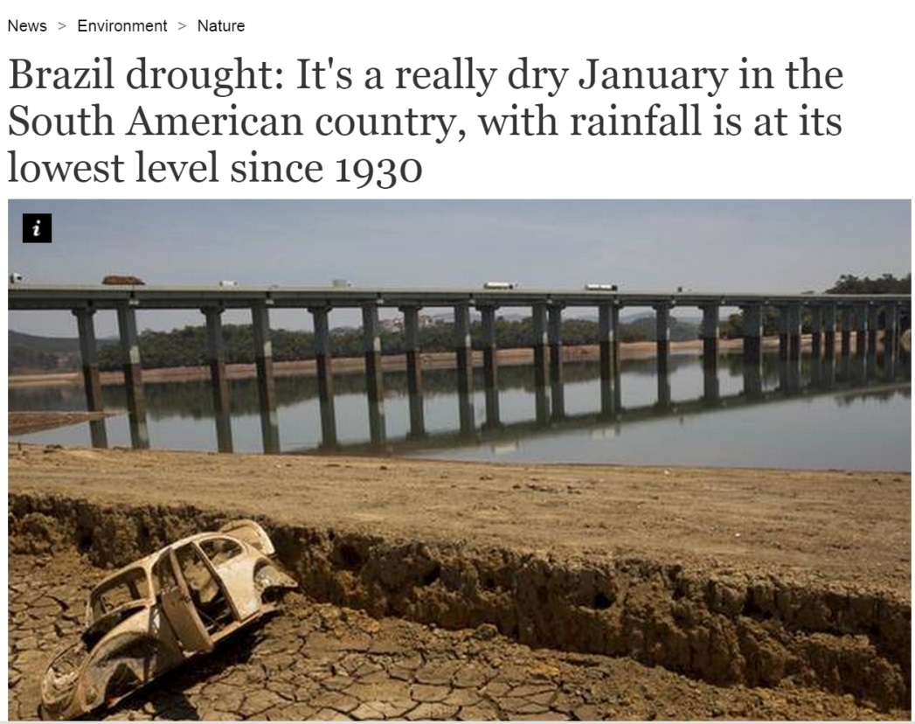
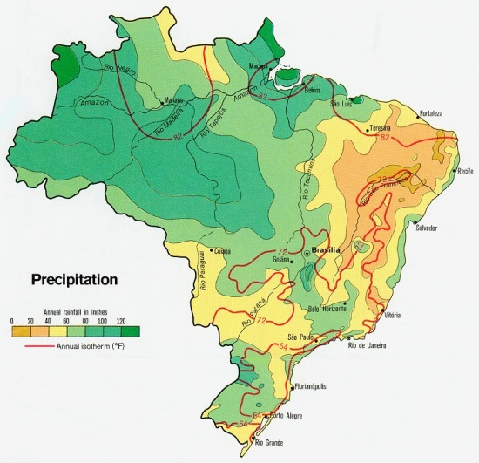
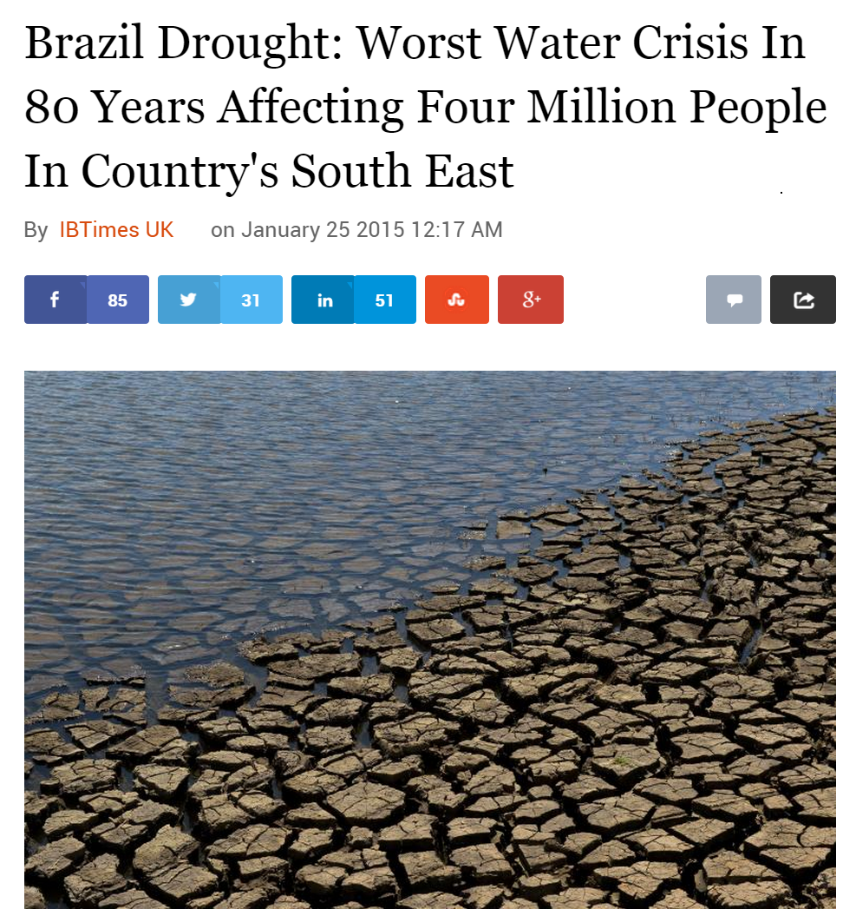
Brazil

Slide 35
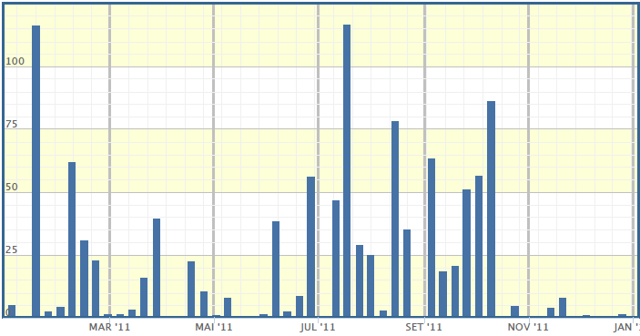
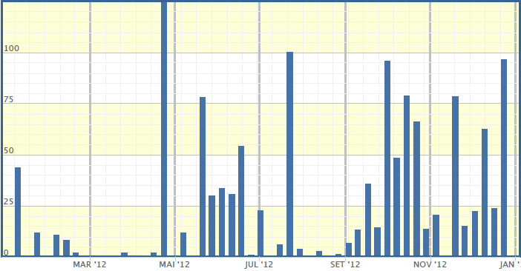
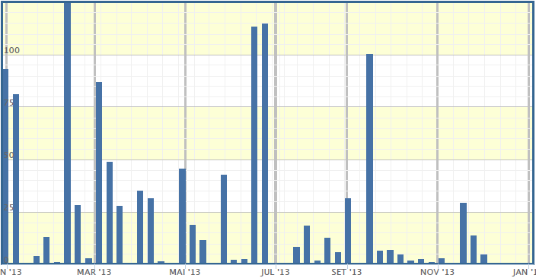
Rainfall
Rainfall over 3 years in Brazil
2011 2012 2013

Slide 36
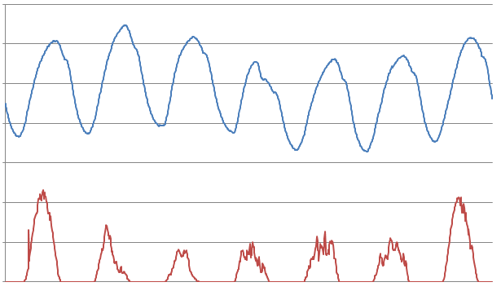
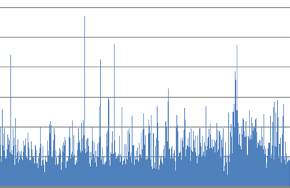
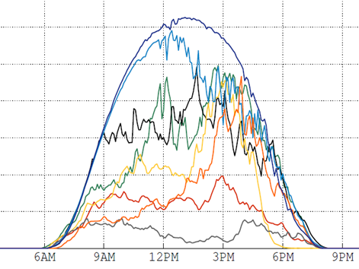
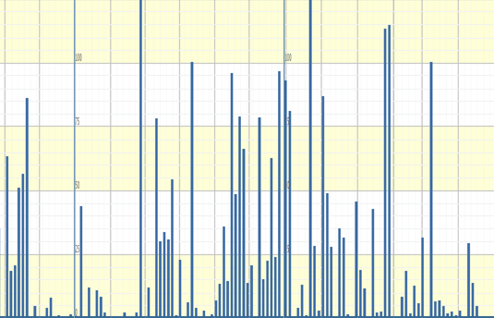
Uncertainty
It is important to separate:
  Predictable variability
    Diurnal cycles
    Large weather patterns
    Major human events (Super bowl)
  Stochastic uncertainty
    Temperature deviations from forecast
    Late/early arrival of a storm
    Generator failures
    Wind shifts
PJM load
Aggregate solar

Slide 37
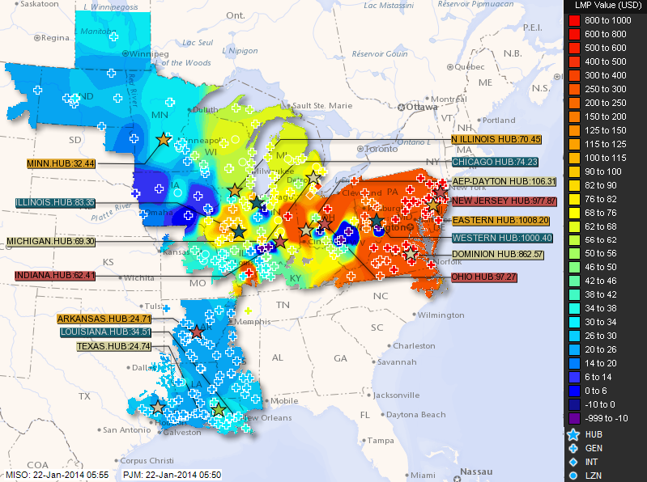
Locational marginal prices on the grid

Slide 38
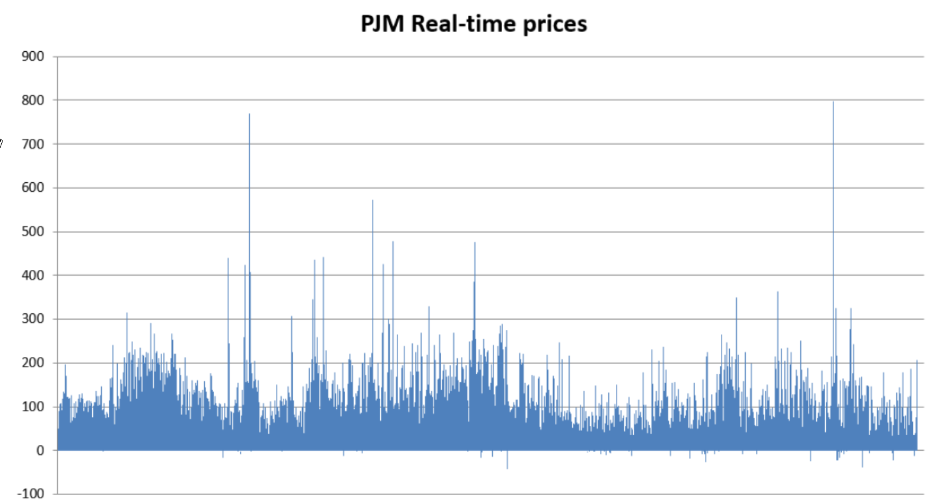
Locational marginal prices on the grid

Slide 39
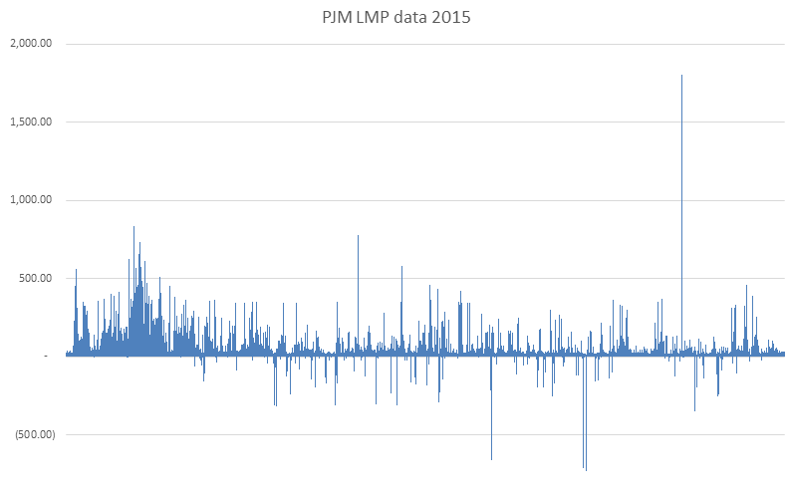
Locational marginal prices on the grid
$22/MWhr

Slide 40
Time series modeling

Slide 41
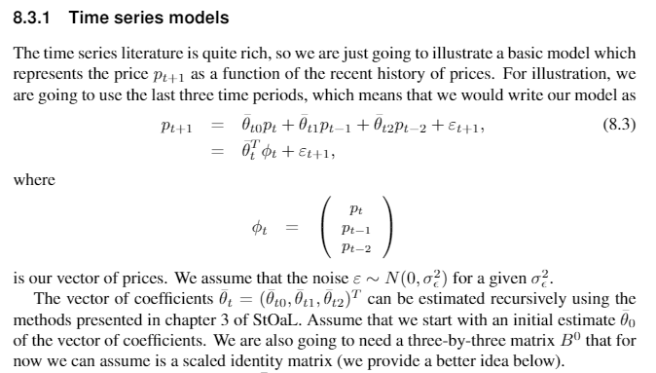

Slide 42
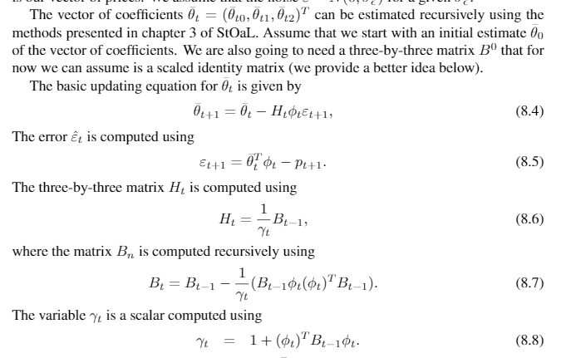

Slide 43
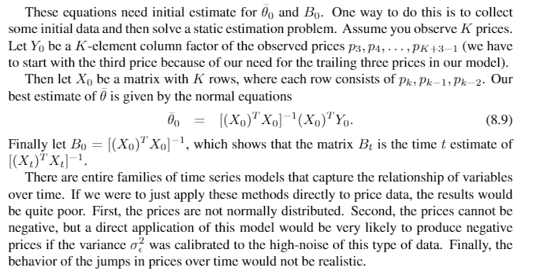

Slide 44
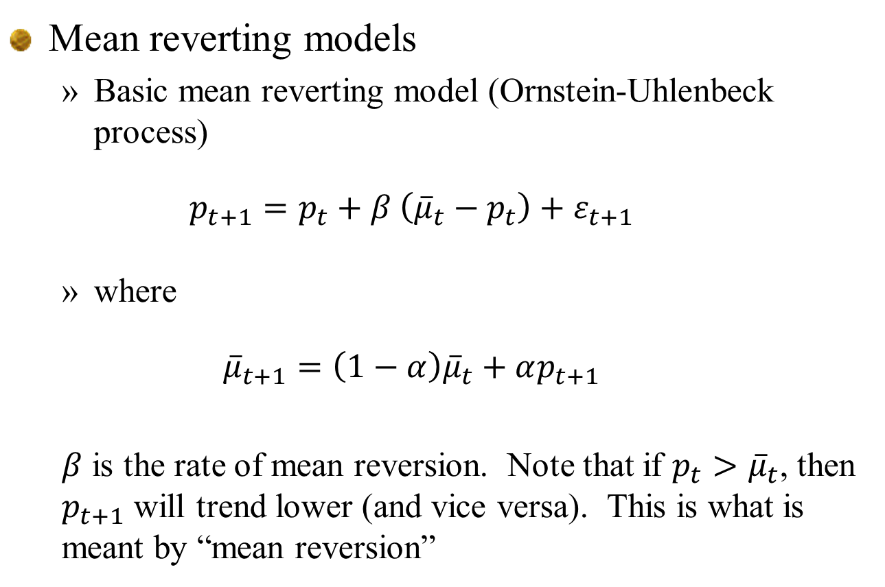
Mean reverting models
  Basic mean reverting model (Ornstein-Uhlenbeck process)
  $$p_{t+1}=p_{t}+β \left({\overline{μ}}_{t}−p_{t}\right)+ε_{t+1}$$
  where
  $${\overline{μ}}_{t+1}=\left(1−α\right){\overline{μ}}_{t}+αp_{t+1}$$
  $β$ is the rate of mean reversion. Note that if $p_{t}>{\overline{μ}}_{t}$, then $p_{t+1}$ will trend lower (and vice versa). This is what is meant by “mean reversion”

Slide 45
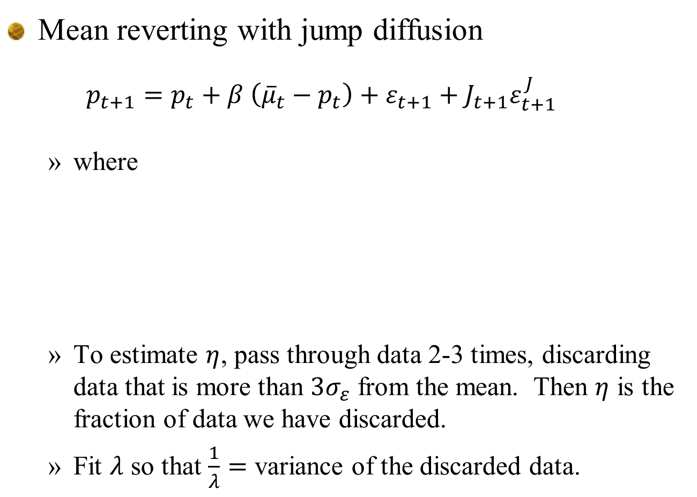
Mean reverting with jump diffusion
  $$p_{t+1}=p_{t}+β \left({\overline{μ}}_{t}−p_{t}\right)+ε_{t+1}+J_{t+1}ε_{t+1}^{J}$$
  where
  To estimate $η$, pass through data 2-3 times, discarding data that is more than $3σ_{ε}$ from the mean. Then $η$ is the fraction of data we have discarded.
  Fit $λ$ so that $\frac{1}{λ}=$ variance of the discarded data.

Slide 46
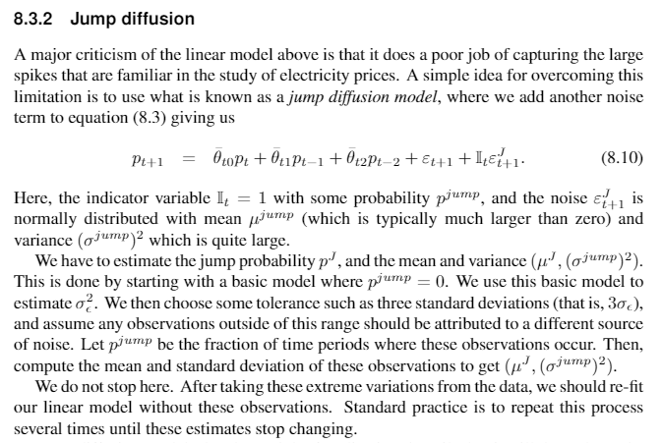

Slide 47
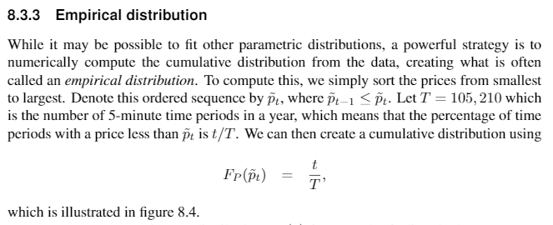

Slide 48
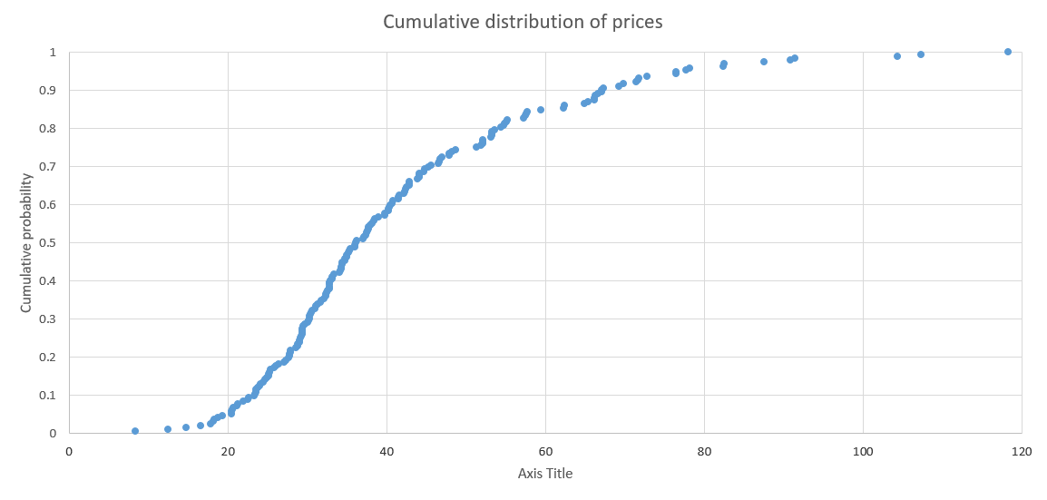
(Click to bring up spreadsheet)

Slide 49
NORTA
Normal to anything

Slide 50
Modeling wind forecasting errors
Wind power from all PJM wind farms
1 year
Jan Feb March April May June July Aug Sept Oct Nov Dec
Notes:
Discuss fine-grained and coarser-grained (yearly) patterns.

Slide 51
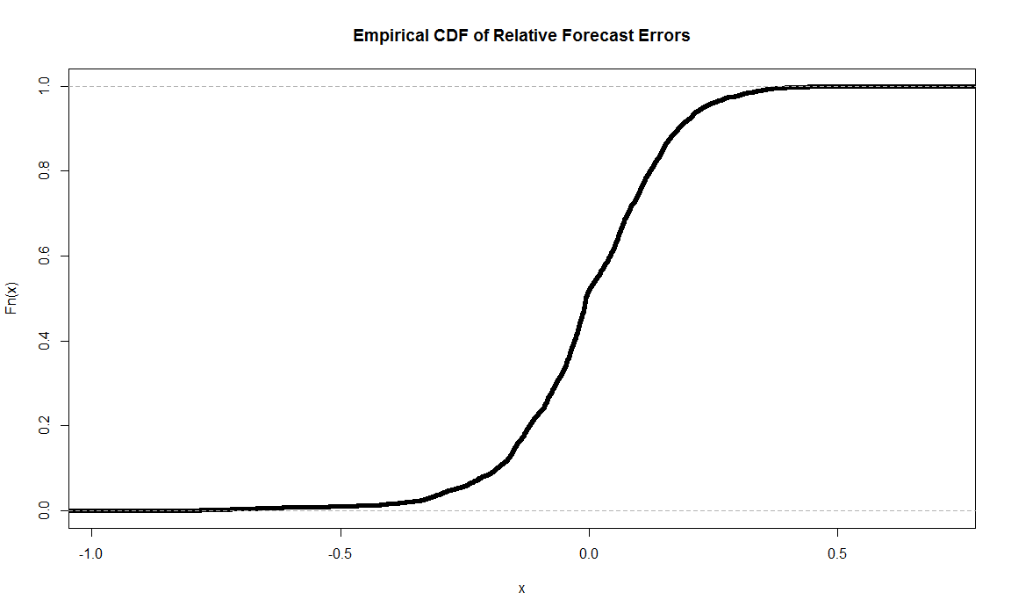
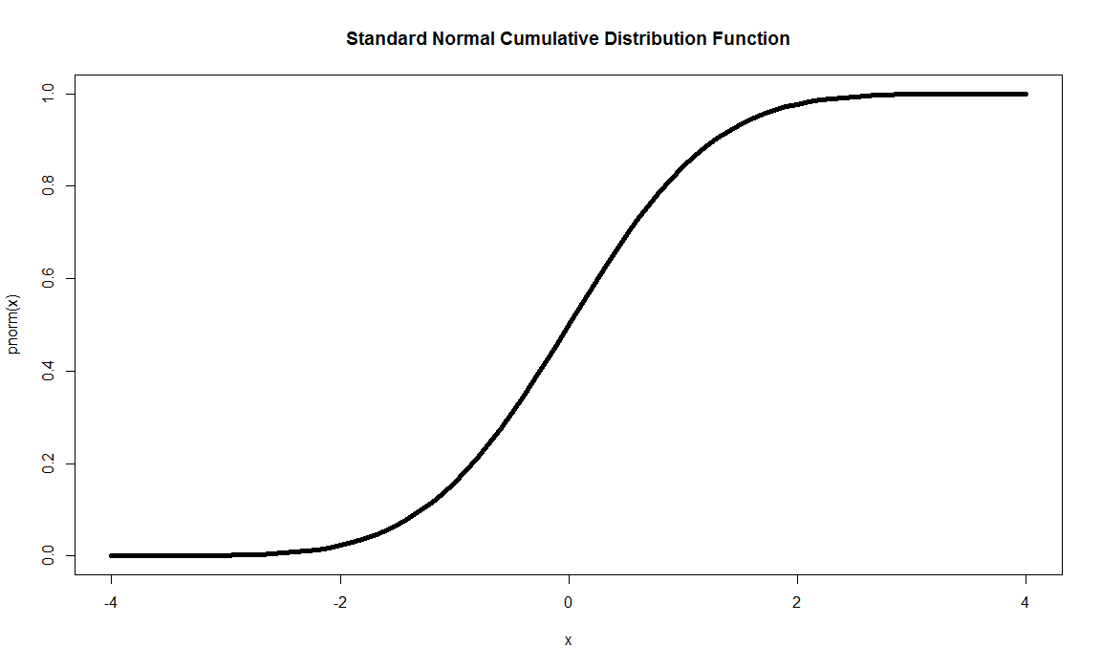
Modeling wind forecasting errors
Data transformation
  Observed errors are transformed to normally distributed errors using quantile mapping:
Historical cumulative distn
Standard normal distn
1.0
1.0
0.0
0.0
Observed forecast error
Standard normal deviate Z

Slide 52
Talk through problem set

Slide 53
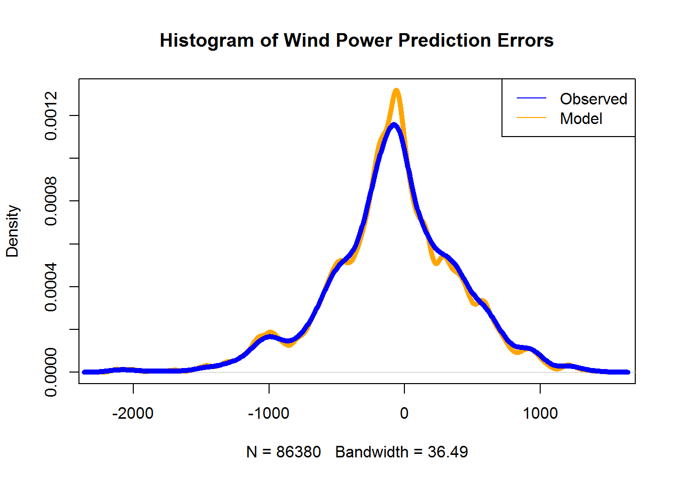
Simulating onshore wind
Modeling errors
Simulated
Error distribution
Observed

Slide 54
Modeling uncertainty
Probability distributions

Slide 55
Modeling uncertainty
Types of distributions
  Probability distributions come in different forms:
    Classical “thin tailed” distributions –
      Exponential family
        Normal, exponential, gamma
        Uniform
      Discrete variants
    Heavy-tailed distributions
      Cauchy distribution (may have infinite variance)
      “Jump diffusion” – Sum of low-variance normally distributed error, plus a high-variance error that occurs with low probability
    Spikes
    Bursts
    Rare events

Slide 56
Capturing distributions
  Data driven
    Just use observations rather than a mathematical model
    Implies on-line process
  Parametric models
    Exponential family – Fitting parameters
    Capturing uncertainty in parameters
  Sampled representations
  Ranges (“robust optimization”)
    95% confidence ranges for random variables
    How to handle simultaneous distributions for multiple random variables?

Slide 57
Data driven

Slide 58
Parametric models – known parameters

Slide 59
Parametric distribution
Uncertain parameters – fitting Poisson to actual data

Slide 60
Booking process
Error distributions:
  Ways of estimating the error distribution:
    Relative to the forecast (presumably made before any bookings have been made, but we can define a forecast at any time up to the stay date).
    Relative to a base average (which loses the benefit of seasonal adjustments (this would be the worst case).
  Best case, with a perfect forecast, is that we should observe an error distribution that follows a Poisson.
    This assumes we can perfectly predict the booking rate.
    Of course, we cannot perfectly predict the booking rate, so the observed error distribution will show a variance higher than that predicted by a Poisson.

Slide 61
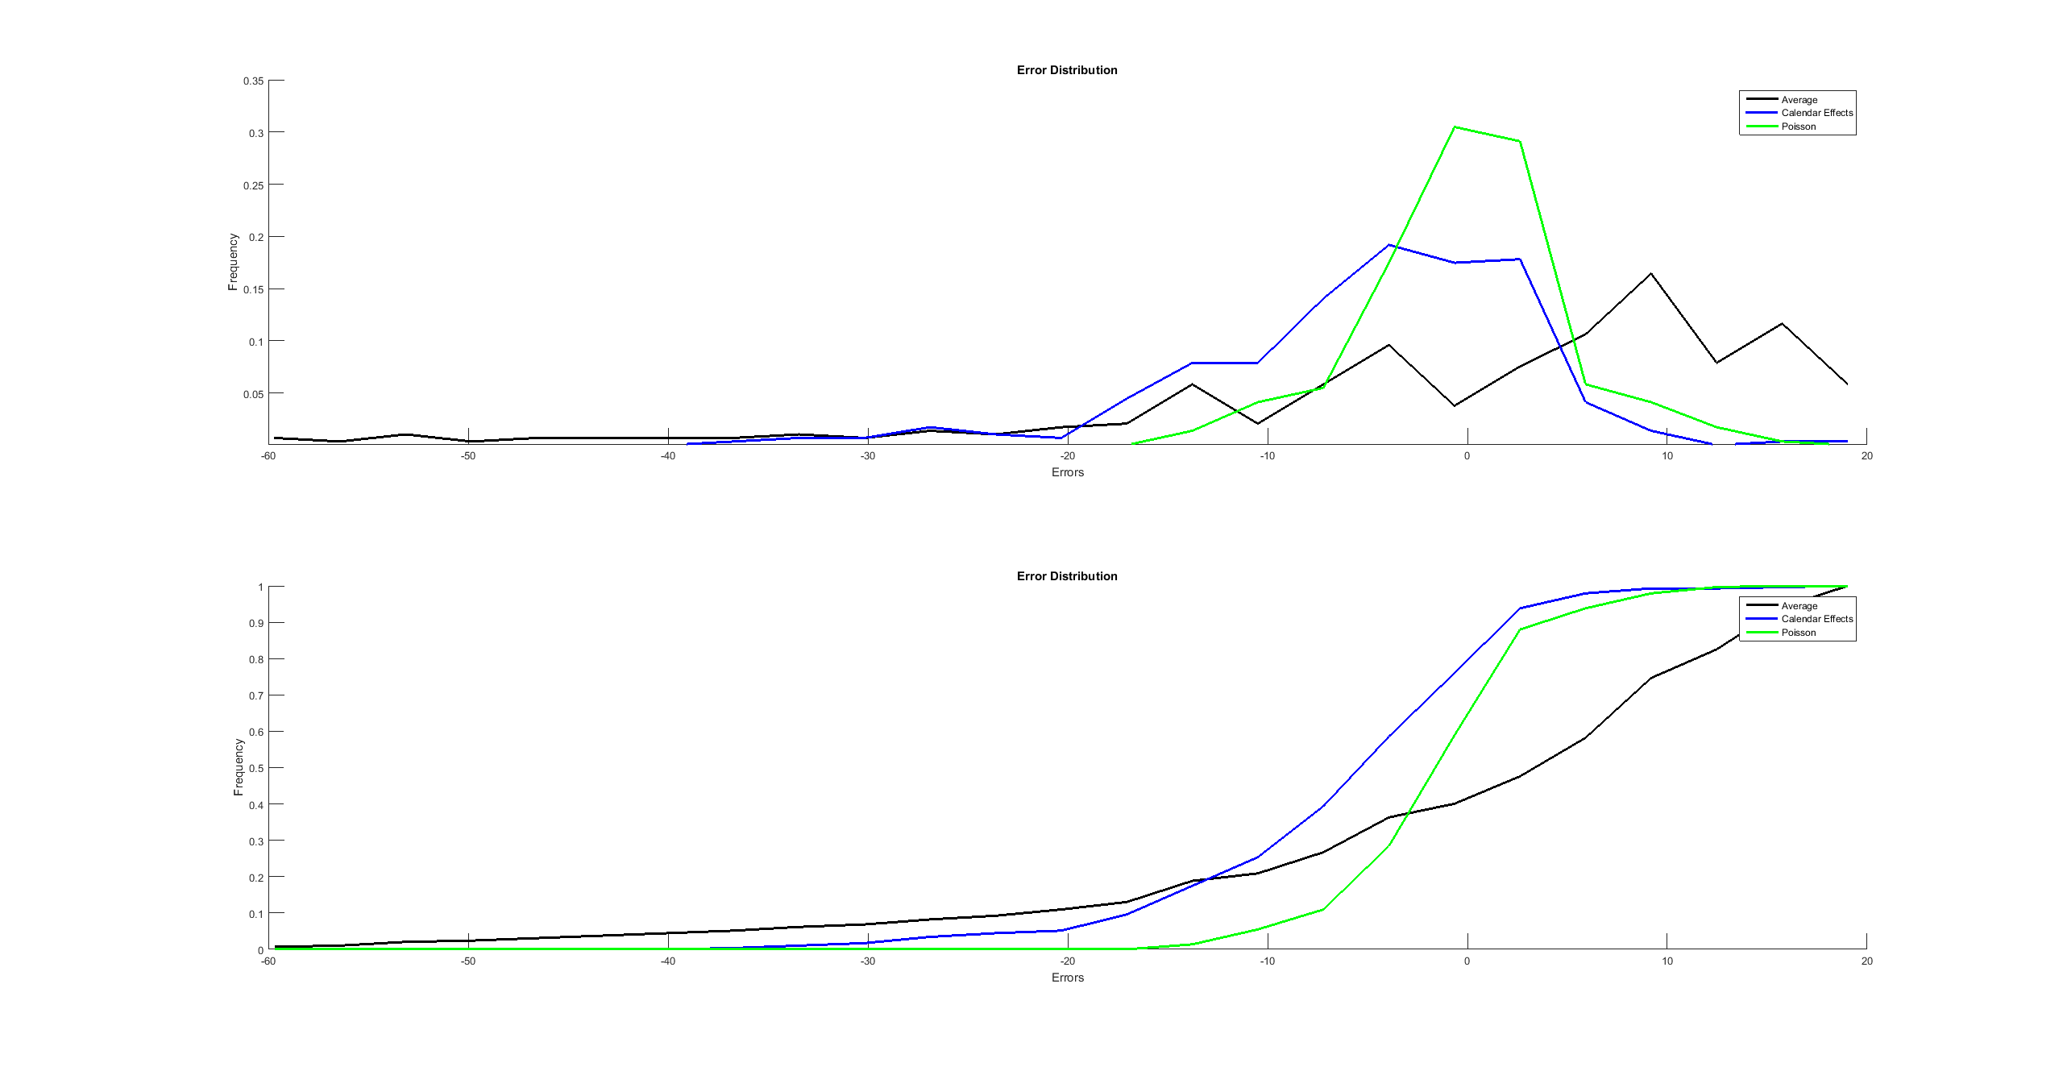
Booking process
Error distributions
Marginal
Poisson
Average
Accounting for calendar effects
Cumulative

Slide 62
Booking process
Fixing the variability
  We need a booking model that produces the same degree of variability as we observe in real data.
  Assuming a Poisson distribution does not introduce enough variability (but we still have to assume Poisson arrivals for our Bayesian updating formula).
  We are going to introduce additional variability by randomizing the arrival rate .
  You will work this out on your problem set!

Slide 63
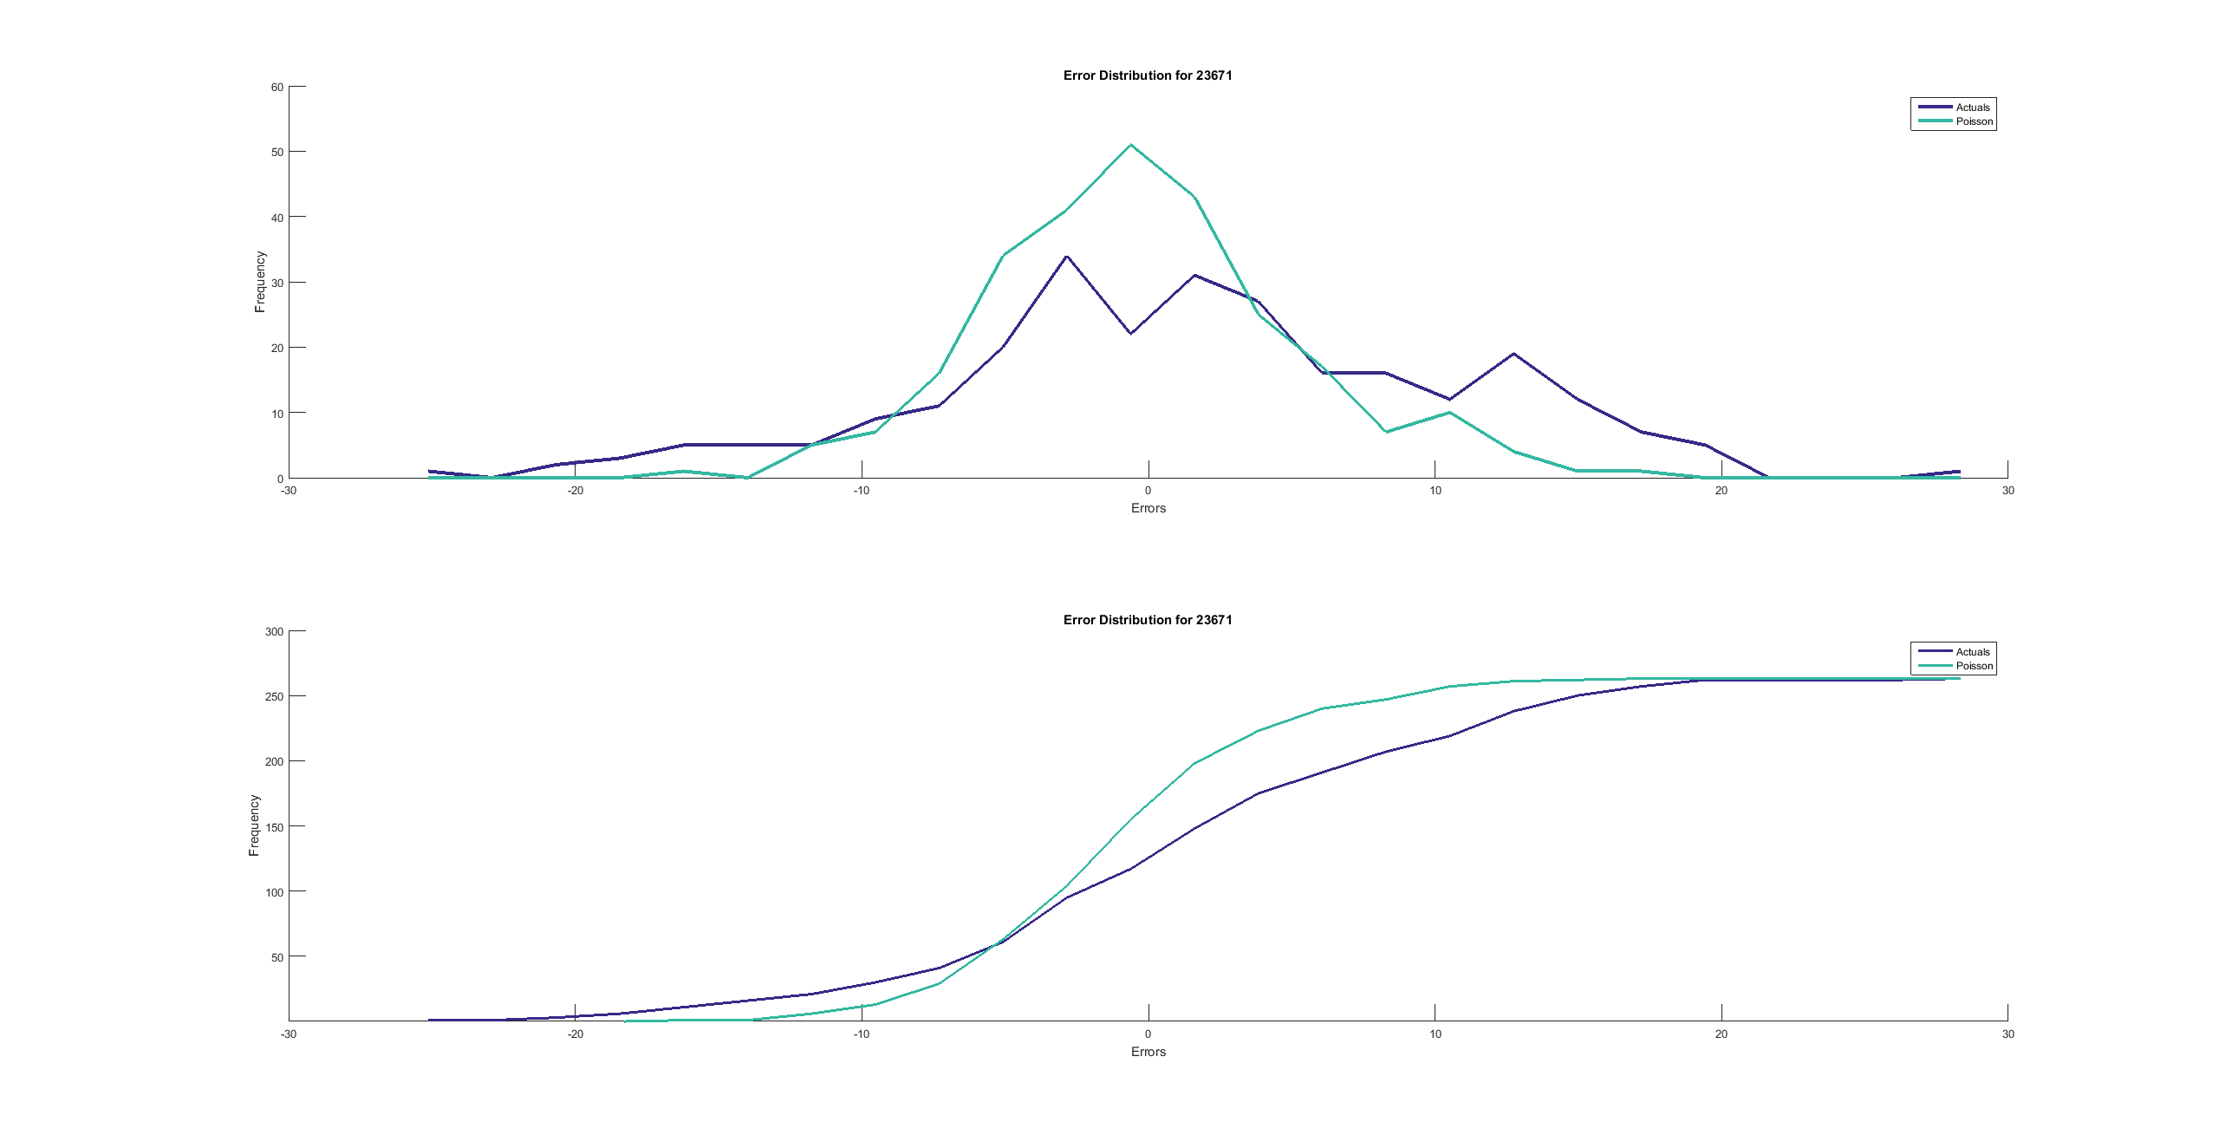
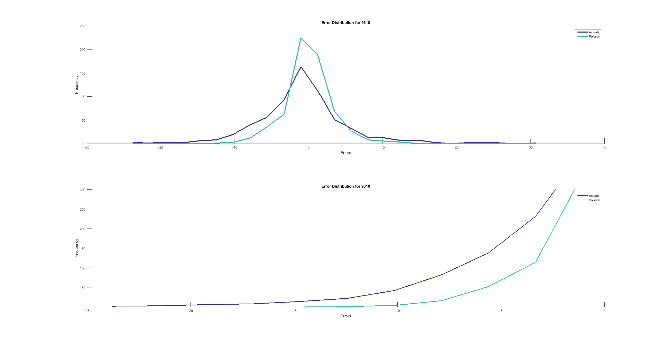
Booking process
Actual error compared to Poisson error
Poisson-distributed errors
Marginal
Actual errors
Poisson-distributed errors
Cumulative
Actual errors

Slide 64
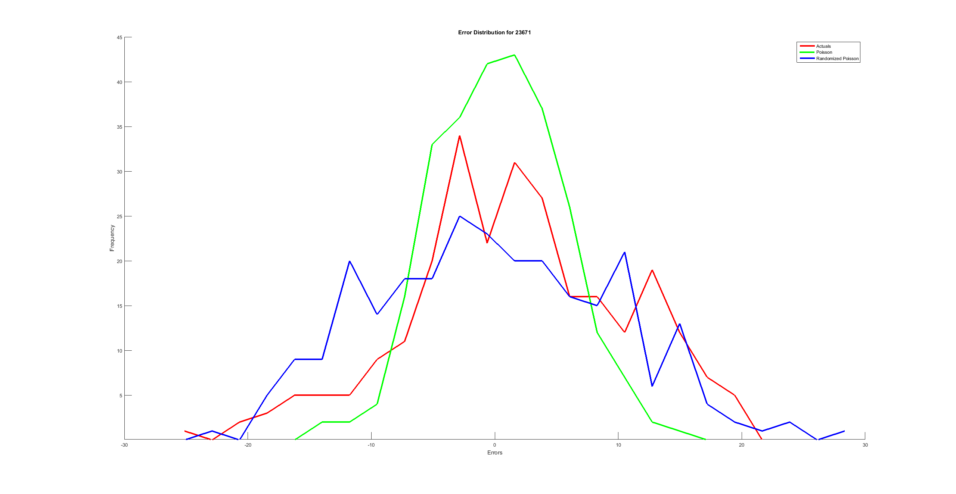
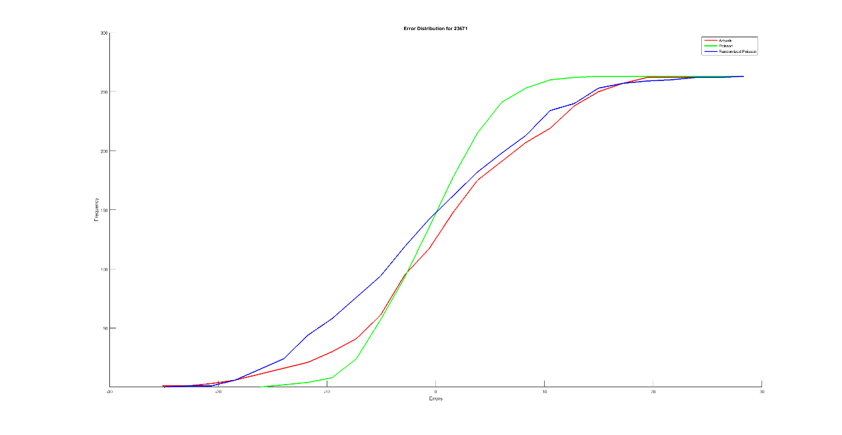

Booking process
Fix using uniformly distributed $λ$
Poisson
Poisson
Actuals
Actuals
Uniform
Uniform

Slide 65
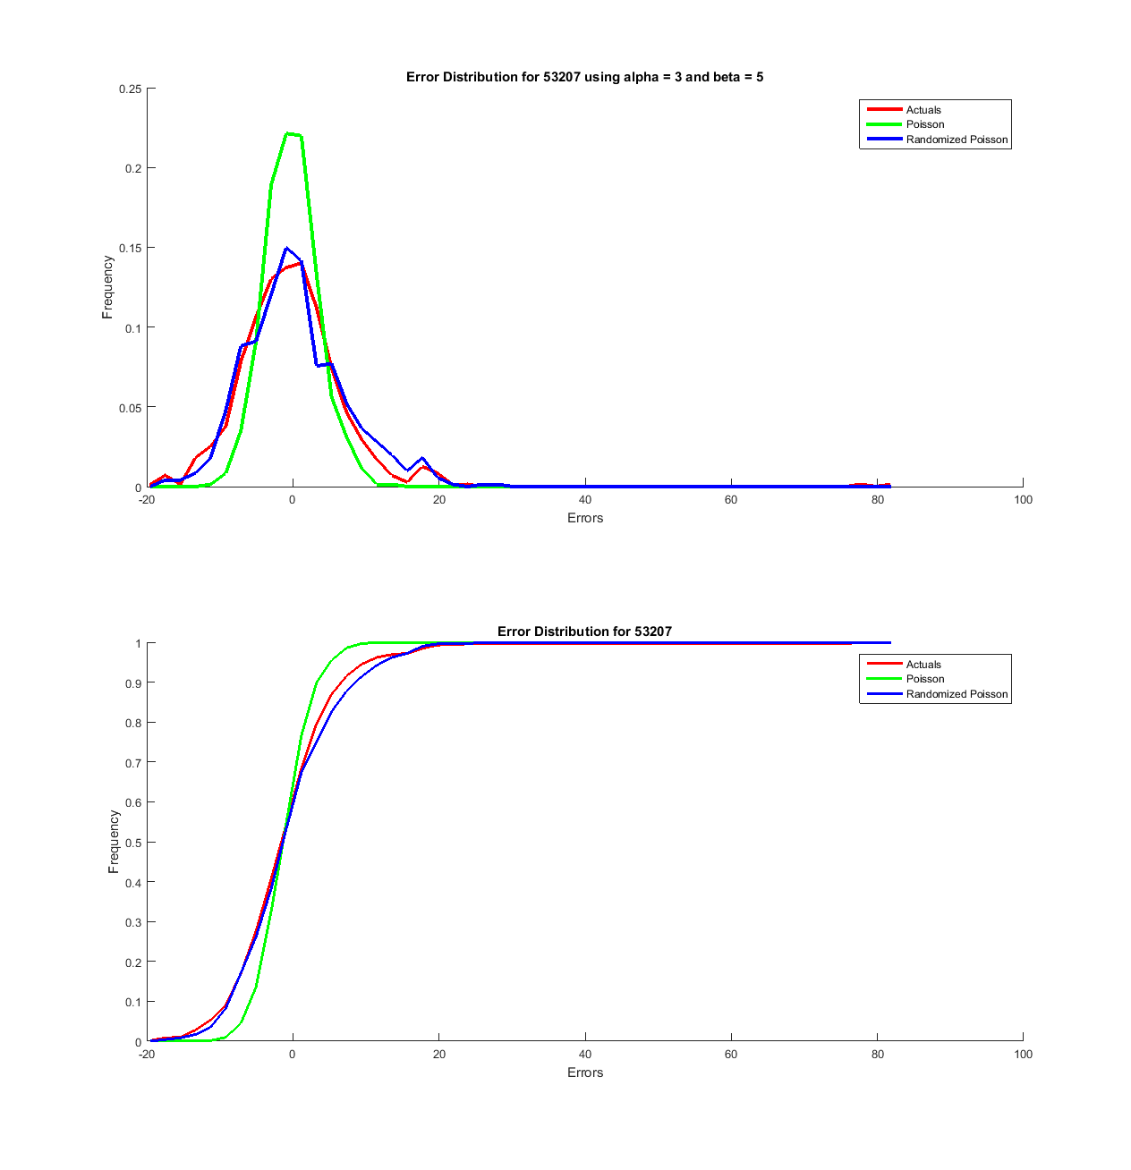
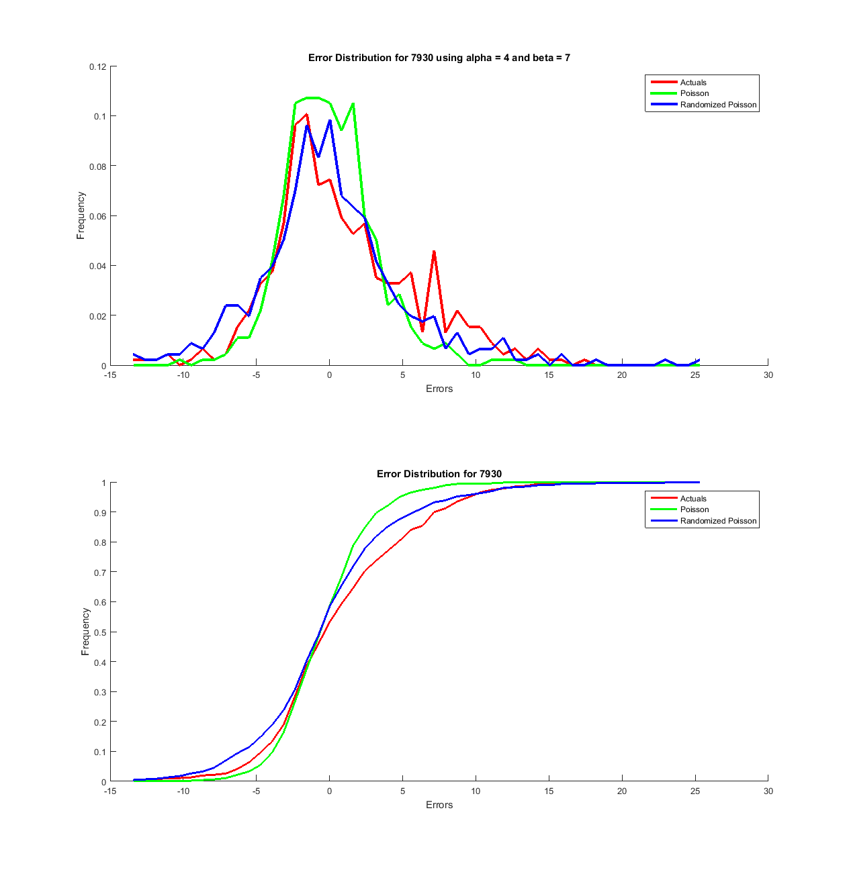

Booking process
Fix using beta-distributed $λ$

Slide 66
Sampled distributions

Slide 67
Sampled distributions

Slide 68
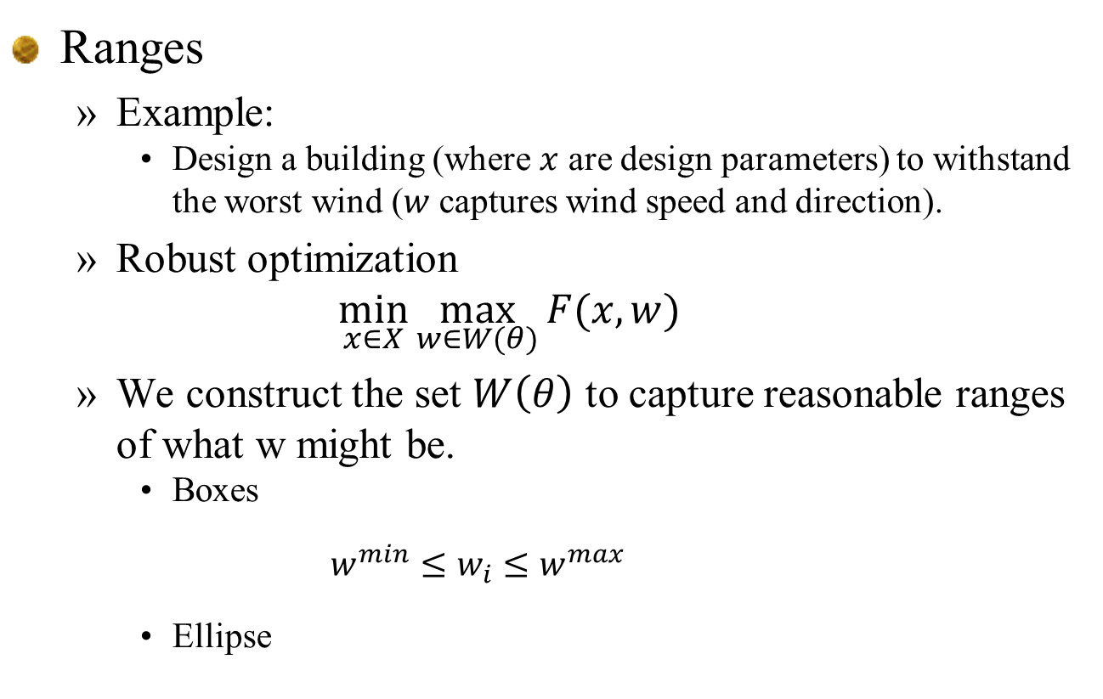
Ranges
  Example:
    Design a building (where $x$ are design parameters) to withstand the worst wind ($w$ captures wind speed and direction).
  Robust optimization
  $$\min_{x∈X}{\max_{w∈W(θ)}{F(x,w)}}$$
  We construct the set $W\left(θ\right)$ to capture reasonable ranges of what w might be.
    Boxes
    $$w^{min}≤w_{i}≤w^{max}$$
    Ellipse

Slide 69
Gaussian process regression (GPR)

Slide 70
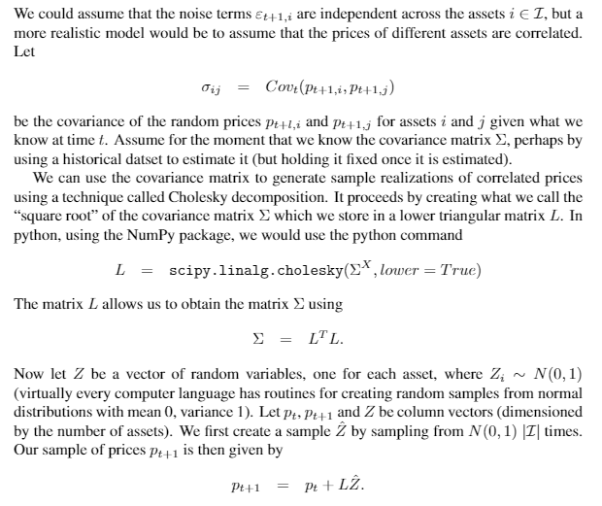
Gaussian process regression
Cholesky decomposition

Slide 71
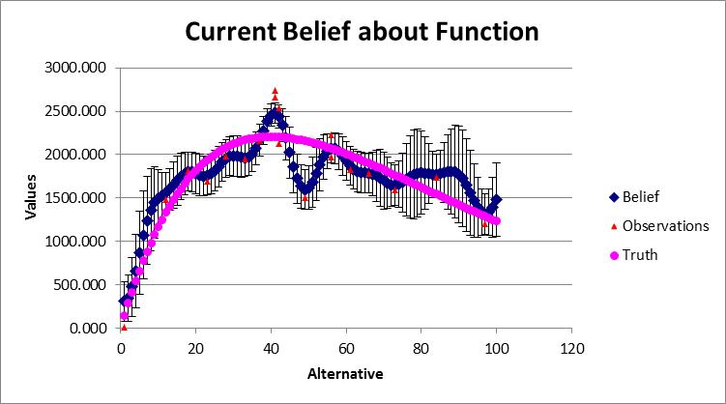
Gaussian process regression
Cholesky decomposition
  Useful for simulating smooth surfaces

Slide 72
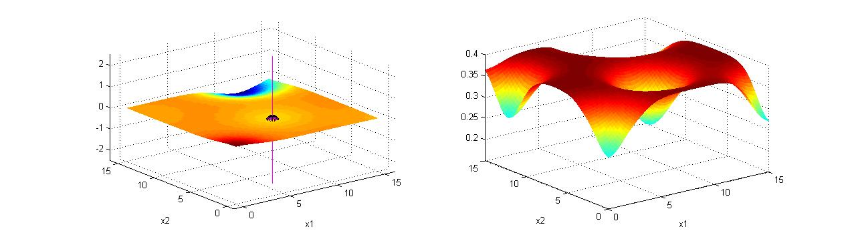
Gaussian process regression
After five measurements:
Estimated concentration
Knowledge gradient
Notes:
72

Slide 73
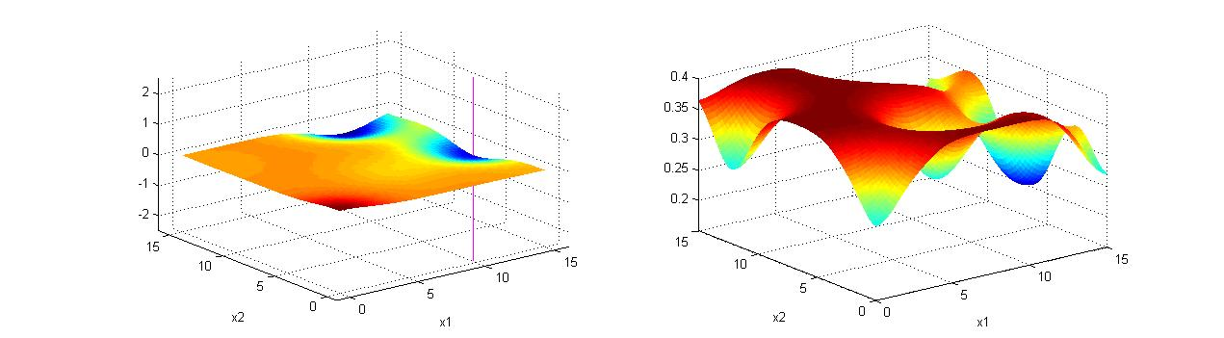
Gaussian process regression
After six samples
Estimated concentration
Knowledge gradient
Notes:
73

Slide 74
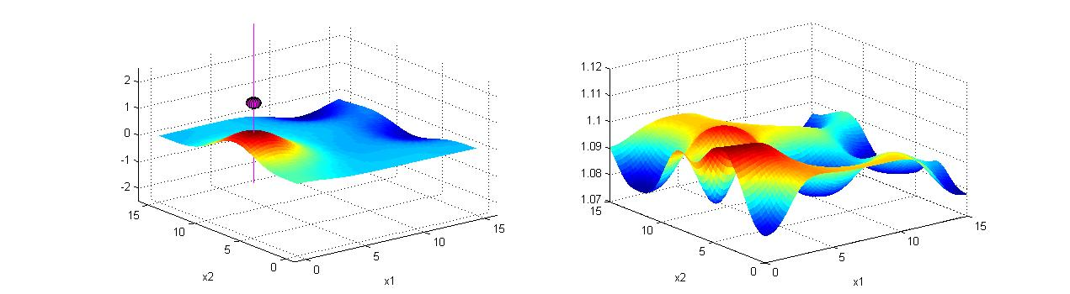
Gaussian process regression
After seven samples
Estimated concentration
Knowledge gradient
Notes:
74
Fred – remaining slides you should click through fairly quickly.

Slide 75
Hidden semi-Markov
Crossing times

Slide 76


Modeling wind forecasting errors
Cumulative histogram of the # of consecutive time intervals the observed/simulated time series is above the forecasted one (chosen farm only):
Observed
Simulated
Time actual is above forecast

Slide 77


Modeling wind forecasting errors
Cumulative histogram of the # of consecutive time intervals the observed/simulated time series is below the forecasted one (chosen farm only):
Simulated
Observed
Time actual is below forecast

Slide 78
Modeling wind forecasting errors
Challenges
  We would like to replicate:
    Error distribution
    Upcrossing distribution
    Downcrossing distribution
  We would like to replicate performance at two levels:
    Each wind farm
    All wind farms when aggregated together
What has not worked:
  ARMA, ARIMA, GARCH, even when using quantile transformation to handle non-normality of wind errors
    Times series models struggle to capture the longer-term behavior

Slide 79


Slide 80
Hidden semi-Markov model (HSMM)
  We use a hybrid Markov chain model with two stage variables:
    The crossing state :
    A/B means above or below
    S/M/L means a short, medium or long crossing distribution
    The wind speed given the crossing state:

Slide 81
Numerical example
  Imagine sequence of A/B (above/below) intervals (which alternate), combined with S/M/L (short/medium/long):
  (A,S), (B,M), (A,S), (B,L), (A,L), (B,S), (A,M), (B,M), (A,S) …
  Now set up matrix and count how many times each transition happens:
  Now normalize rows so they sum to 1.
(A,S) (A,M) (A,L) (B,S) (B,M) (B,L)
(A,S)
(A,M)
(A,L)
(B,S)
(B,M)
(B,L)

Slide 82

Notes:
  After computing $P(S_{t+1}^{C}|S_{t}^{C})$, next need to get conditional distribution of change in wind given the aggregated wind speed $W_{t}^{g}$.
    For each $(W_{t},W_{t+1})$ pair, get the change in wind speed $W_{t+1}−W_{t}$, and then compute the distribution conditioned on $W_{t}^{g}$.
    This gives us
    We can now simulate the process moving forward in time. Not that we are simulating whether an interval is S/M/L, but we would not know this in advance. This is why it is a hidden state.

Slide 83

Simulating onshore wind
Conditional cumulative distribution of wind error
  Conditioned on the aggregated wind state
Cumulative probability
Decreasing
wind speeds
-1.0 -0.5 0.0 0.5 1.0
Change in wind speed

Slide 84


Modeling wind forecasting errors
Error distribution and crossing times
Simulated
Error distribution
Observed
Upcrossing distribution
Downcrossing distribution
Observed
Observed
Simulated
Simulated

