Slide 1
.
Sequential decision analytics and modeling
ORF 411
Fall, 2018
Warren Powell
Princeton University
http://www.castlelab.princeton.edu
© 2017 Warren B. Powell, Princeton University

Slide 2

Week 6 – Monday
Energy storage III

Slide 3

Designing policies
VFA-backward ADP

Slide 4
Backward ADP
Classical backward dynamic programming
  Uses lookup table representations of value functions
  Assumes the one-step transition matrix can be computed (which is also lookup table).
  “Dynamic programming” does not suffer from the curse of dimensionality (as we show below), but lookup tables do.
  There are three curses of dimensionality, but often it is the state variable that causes the most problems.
  Before we jump to forward ADP, consider doing backward ADP.

Slide 5
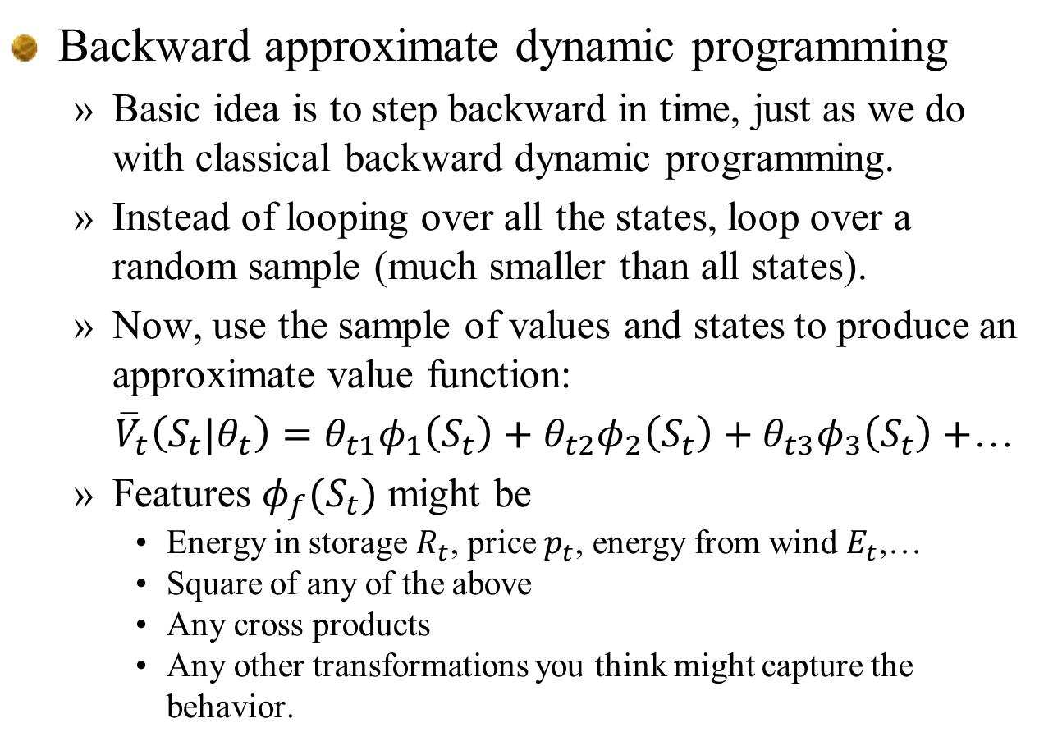
Backward ADP
Backward approximate dynamic programming
  Basic idea is to step backward in time, just as we do with classical backward dynamic programming.
  Instead of looping over all the states, loop over a random sample (much smaller than all states).
  Now, use the sample of values and states to produce an approximate value function:
  ${\overline{V}}_{t}\left(S_{t}|θ_{t}\right)=θ_{t1}φ_{1}\left(S_{t}\right)+θ_{t2}φ_{2}\left(S_{t}\right)+θ_{t3}φ_{3}\left(S_{t}\right)+$…
  Features $φ_{f}(S_{t})$ might be
    Energy in storage $R_{t}$, price $p_{t}$, energy from wind $E_{t}$,…
    Square of any of the above
    Any cross products
    Any other transformations you think might capture the behavior.

Slide 6
Optimizing a multi-dimensional problem
Backward ADP
${\overline{V}}_{t+1}\left(S_{t+1}|θ_{t+1}\right)=θ_{t+1,1}φ_{1}\left(S_{t+1}\right)+θ_{t+1,2}φ_{2}\left(S_{t+1}\right)+θ_{t+1,3}φ_{3}\left(S_{t+1}\right)+$…

Slide 7
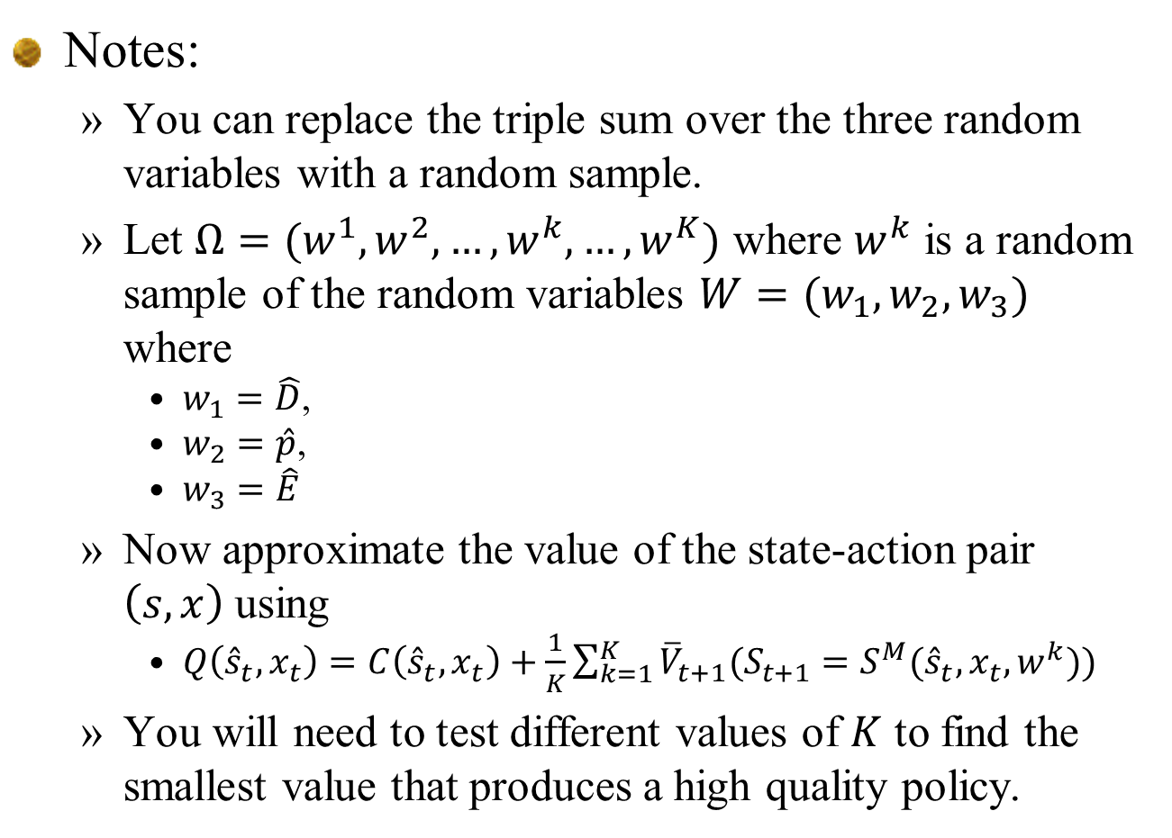
Notes:
  You can replace the triple sum over the three random variables with a random sample.
  Let $Ω=(w^{1},w^{2},…,w^{k},…, w^{K})$ where $w^{k}$ is a random sample of the random variables $W=(w_{1},w_{2},w_{3})$ where
    $w_{1}=\hat{D}$,
    $w_{2}=\hat{p}$,
    $w_{3}=\hat{E}$
  Now approximate the value of the state-action pair $\left(s,x\right)$ using
    $Q\left({\hat{s}}_{t},x_{t}\right)=C\left({\hat{s}}_{t},x_{t}\right)+\frac{1}{K}\sum_{k=1}^{K}{{\overline{V}}_{t+1}({S_{t+1}=S}^{M}({\hat{s}}_{t},x_{t},w^{k}}))$
  You will need to test different values of $K$ to find the smallest value that produces a high quality policy.

Slide 8
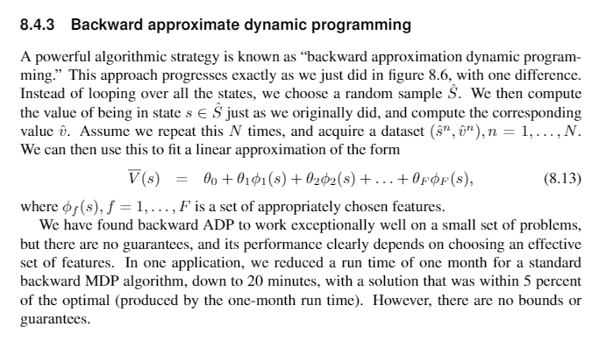

Slide 9
Notes:
  We have been using backward ADP for the past few years with surprisingly good results – around 95 percent of the optimal policy computed using classical backward MDP.
  Backward ADP can be quite fast. In one application, it reduced CPU times from a month for classical backward MDP, to 20 minutes, with a solution only 4-5 percent below optimal.
  We have no theory to support these results.

Slide 10
Designing policies
VFA-forward ADP exploiting convexity

Slide 11
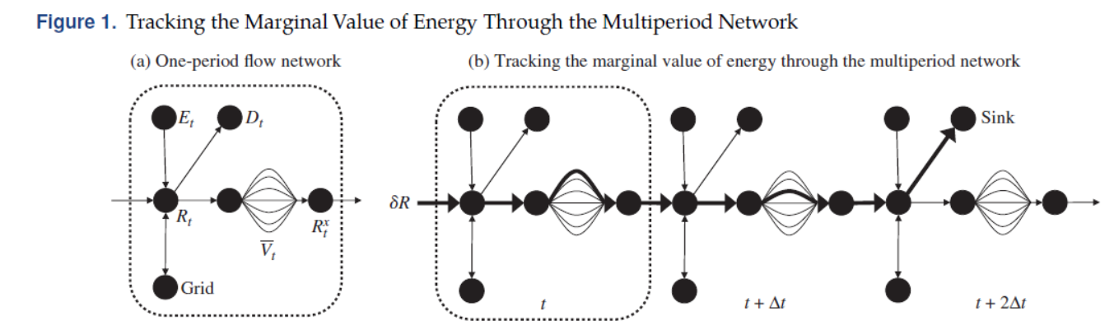
Exploiting concavity
  For a single storage device, we can optimize the decision to store/charge/discharge by fixing the VFA, simulating forward in time, and then asking what we would do with a marginal increment of energy in storage.

Slide 12
Exploiting concavity
Derivatives are used to estimate a piecewise linear approximation, where we maintain concavity at each step.
Function
Slopes

Slide 13

Exploiting concavity
Maintaining monotonicity in the slopes
$$×$$
Sampled slope
Updated estimate
Slopes

Slide 14

Exploiting concavity
Maintaining monotonicity in the slopes.
  If there is a montonicity violation, keep smoothing the observation to the left (or right as necessary) until monotonicity is restored.
$$×$$
$$×$$
Sampled slope
Updated estimate
Slopes

Slide 15
Exploiting concavity
Derivatives are used to estimate a piecewise linear approximation, where we maintain concavity at each step.

Slide 16
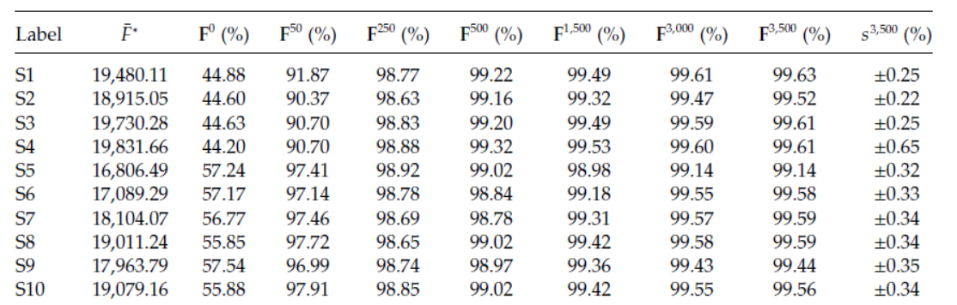
Forward ADP exploiting concavity
  If our only state variable is energy in the battery, we can exploit this when computing the value function approximation.
  Results are consistently near optimal:
250 iterations
1500 iterations

Slide 17
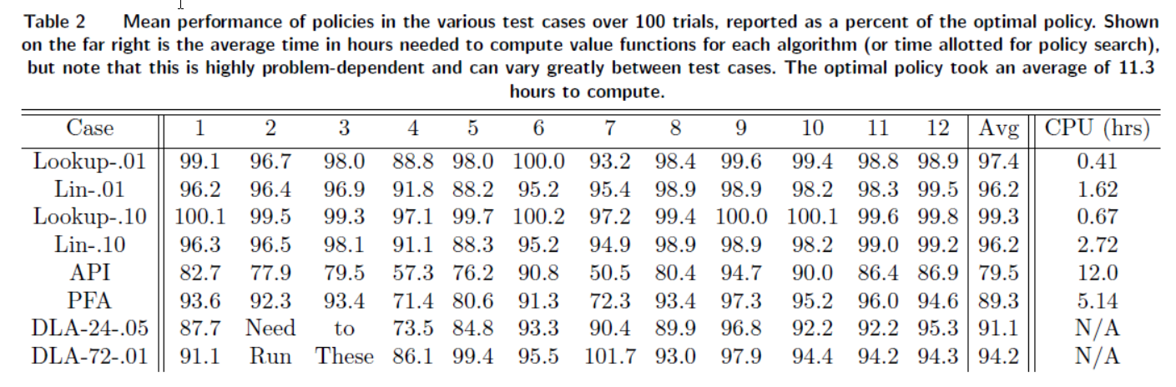
Benchmarking of ADP
  Backward ADP is first four lines:
    Lookup = lookup table approximation for VFA
    Linear = linear model
    .01 or .10 refers to the discretization
    Backward MDP (which produced optimal policy) took over 10 hours to compute.

Slide 18
Slides that follow illustrate exploiting concavity on a network of storage devices for the grid.
We will revisit this method later in the course to show that we can use this method to solve high-dimensional problems.
For now, we are just showing off.

Slide 19
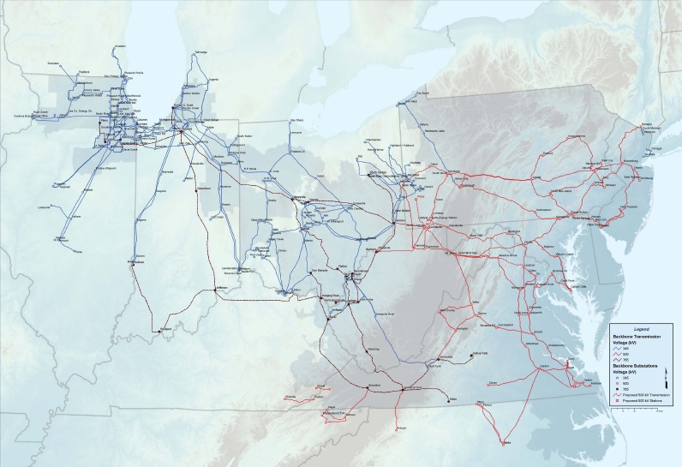
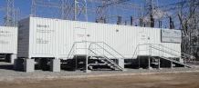
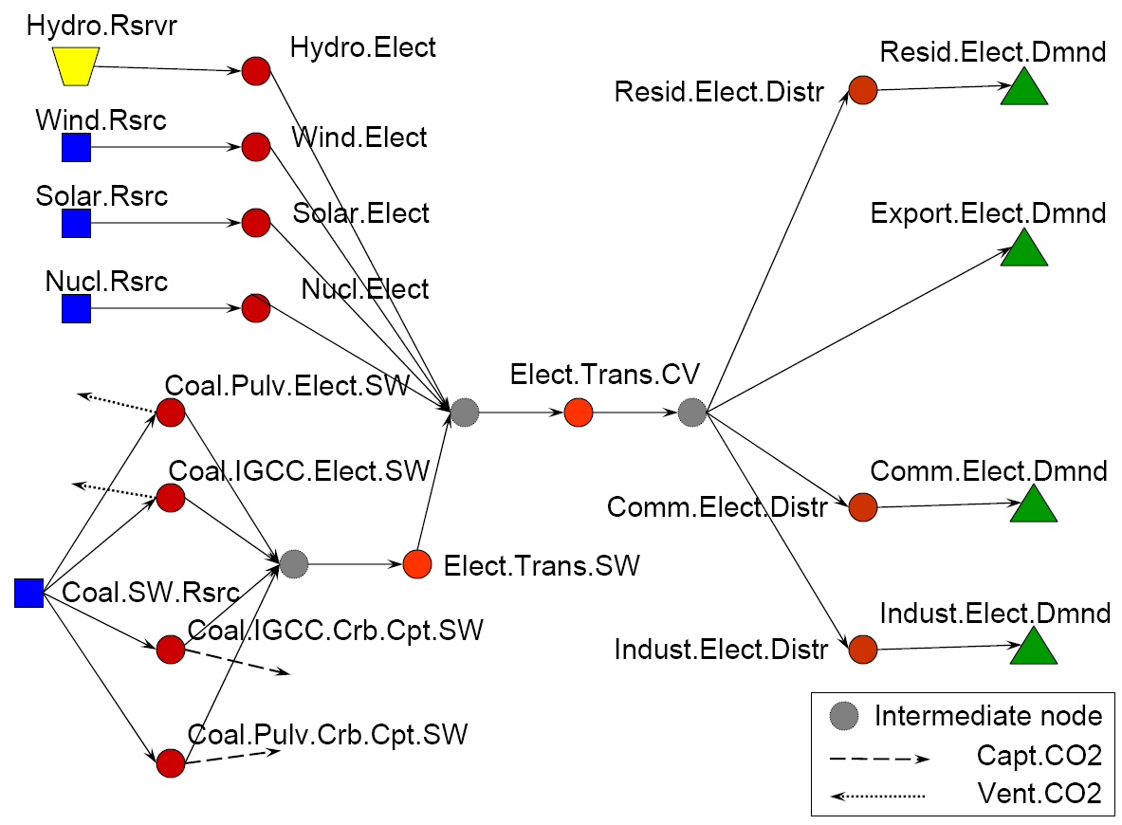
Grid level storage
Imagine 25 large storage devices spread around the PJM grid:
Slide 19
Notes:
19
This slide is animated to show how we are graphically depicting the hourly dispatch problem. Transition to next slide.

Slide 20
Grid level storage
Imagine 25 large storage devices spread around the PJM grid:
Slide 20
Notes:
20
This slide is animated to show how we are graphically depicting the hourly dispatch problem. Transition to next slide.

Slide 21
Value function approximations
Slide 21
Notes:
21
This slide is animated to show how we are graphically depicting the hourly dispatch problem. Transition to next slide.

Slide 22
Value function approximations
Monday
Time
:05
:10
:15
:20
Slide 22
Notes:
22
This slide and next illustrate how we solve this for every hour, in sequence, so we also properly handle storage.

Slide 23
Value function approximations
Monday
Time
:05
:10
:15
:20
Slide 23
Notes:
23
This slide and next illustrate how we solve this for every hour, in sequence, so we also properly handle storage.

Slide 24
Value function approximations
Monday
Time
:05
:10
:15
:20
Slide 24
Notes:
24
This slide and next illustrate how we solve this for every hour, in sequence, so we also properly handle storage.

Slide 25
Exploiting concavity
Derivatives are used to estimate a piecewise linear approximation

Slide 26
Approximate dynamic programming
Objective function
Iterations
With luck, your objective function improves

Slide 27
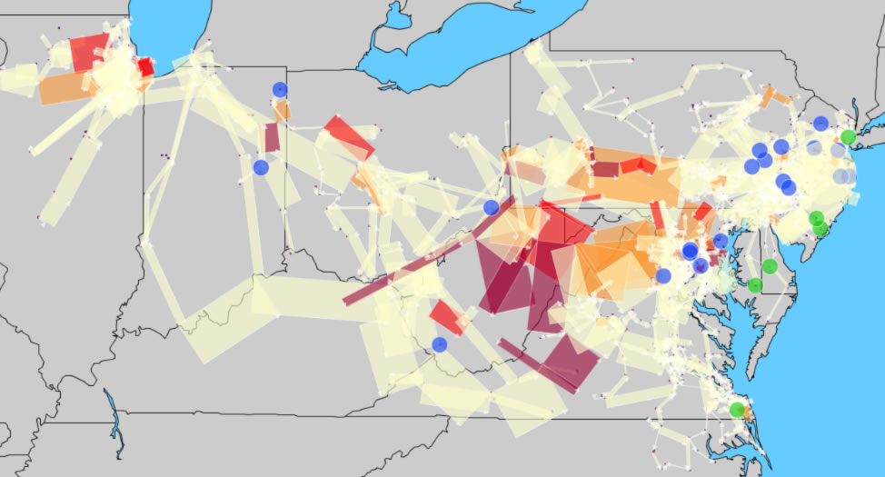
Grid level storage
Congested grid:
  Green and blue circles indicate energy storage

Slide 28
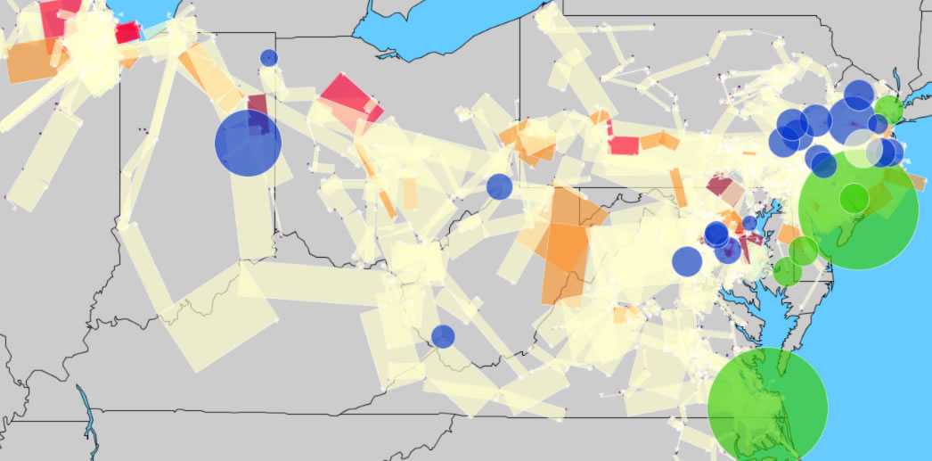
SMART-Solar
Congested grid:
  Green and blue circles indicate energy storage

Slide 29
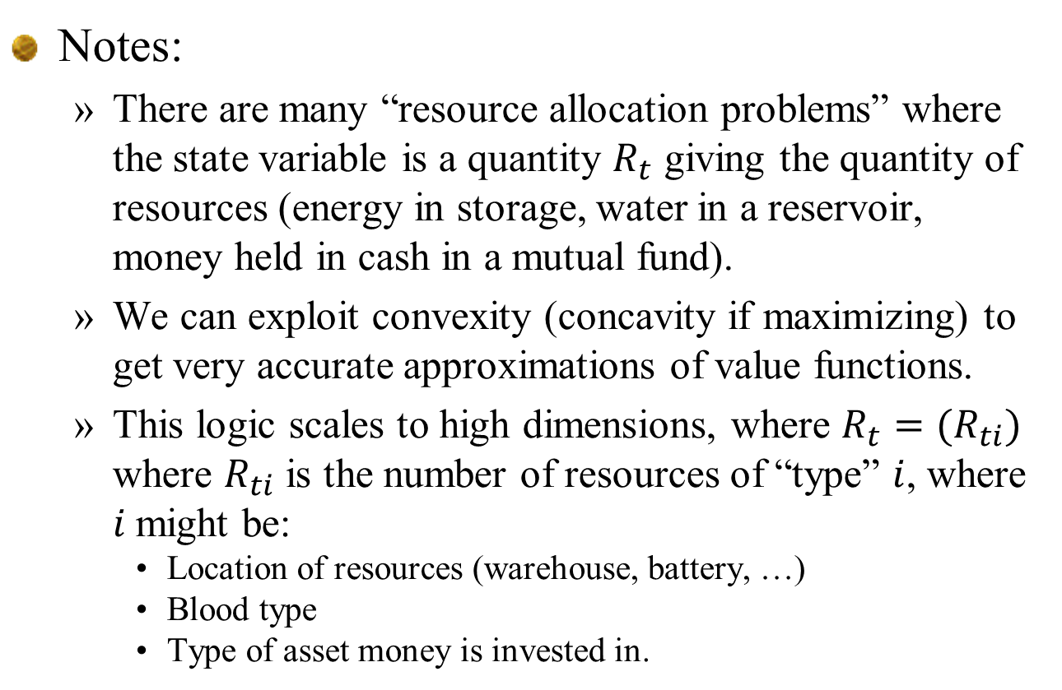
Notes:
  There are many “resource allocation problems” where the state variable is a quantity $R_{t}$ giving the quantity of resources (energy in storage, water in a reservoir, money held in cash in a mutual fund).
  We can exploit convexity (concavity if maximizing) to get very accurate approximations of value functions.
  This logic scales to high dimensions, where $R_{t}=(R_{ti})$ where $R_{ti}$ is the number of resources of “type” $i$, where $i$might be:
    Location of resources (warehouse, battery, …)
    Blood type
    Type of asset money is invested in.

Slide 30
Designing policies
VFA-forward ADP

Slide 31
Approximate value iteration
  Step 1: Start with a pre-decision state
  Step 2: Solve the deterministic optimization using
  an approximate value function:
  to obtain .
  Step 3: Update the value function approximation
  Step 4: Obtain Monte Carlo sample of and
  compute the next pre-decision state:
  Step 5: Return to step 1.
Deterministic
optimization
Recursive
statistics
Simulation
Notes:
31

Slide 32
Approximate policy iteration
Forward ADP using general statistical models (ignores problem structure)
Approximation methods
  SVR - Support vector regression with Gaussian radial basis kernel
  LBF – Weighted linear combination of polynomial basis functions
  GPR – Gaussian process regression with Gaussian RBF
  LPR – Kernel smoothing with second-order local polynomial fit
  DC-R – Dirichlet clouds – Local parametric regression.
  TRE – Regression trees with constant local fit.

Slide 33
Notes:
  None of these statistical models explicitly captures structure such as convexity/concavity.
  We ran thousands of iterations to test all of these machine learning methods to approximate the value function.
  The results were then compared against an optimal policy using value functions computed using classical MDP.

Slide 34
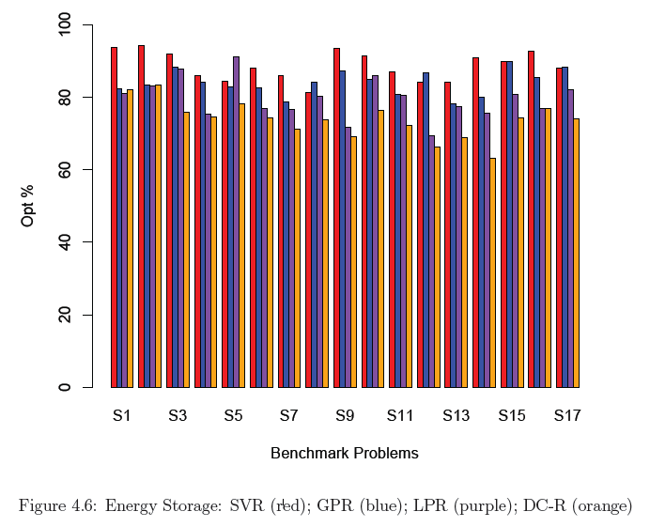
Energy storage applications
100
80
60
40
20
0
Percent of optimal
DC-R – local parametric regression
LPR – kernel smoothing
GPR - Gaussian process regression
SVR - Support vector regression

Slide 35
Approximate policy iteration
A tale of two distributions
  The sampling distribution, which governs the likelihood that we sample a state.
  The learning distribution, which is the distribution of states we would visit given the current policy
State S
Notes:
35

Slide 36
Forward ADP
The story changes when we exploit structure…
  The value function is concave in the resource variable.
  But we have no structural properties with respect to the other dimensions of the state variable.

Slide 37
Designing policies
Direct lookahead

Slide 38
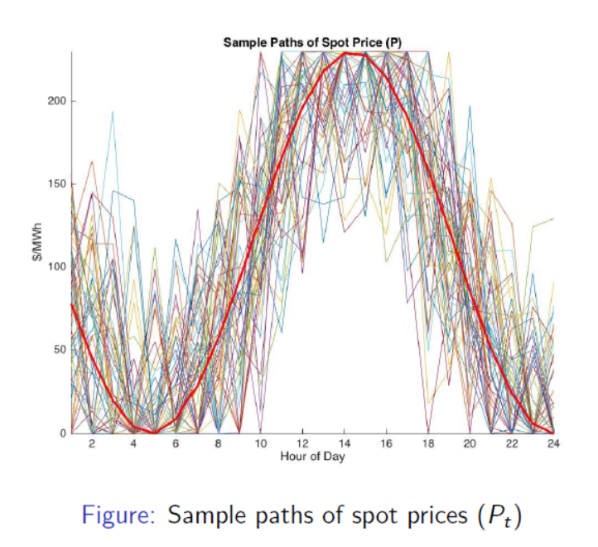
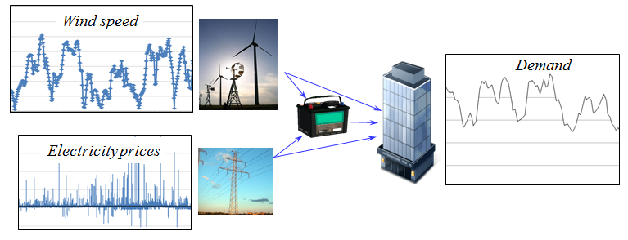
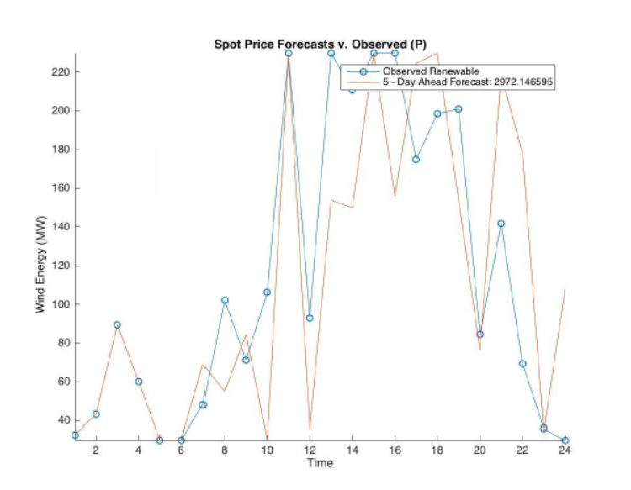

Parametric cost function approximation
An energy storage problem:
The state of our system is given by:
$S_{t}=\left(R_{t},E_{t},P_{t},D_{t},f_{t}^{E}\right)$
where
$R_{t}=$Energy in storage
$E_{t}^{W}=$Energy available from wind
$P_{t}=$Grid price
$D_{t}=$Demand
$f_{t}^{E}=\left(f_{tt^{′}}^{E}\right), t^{′}≥t,$ = Forecasts

Slide 39
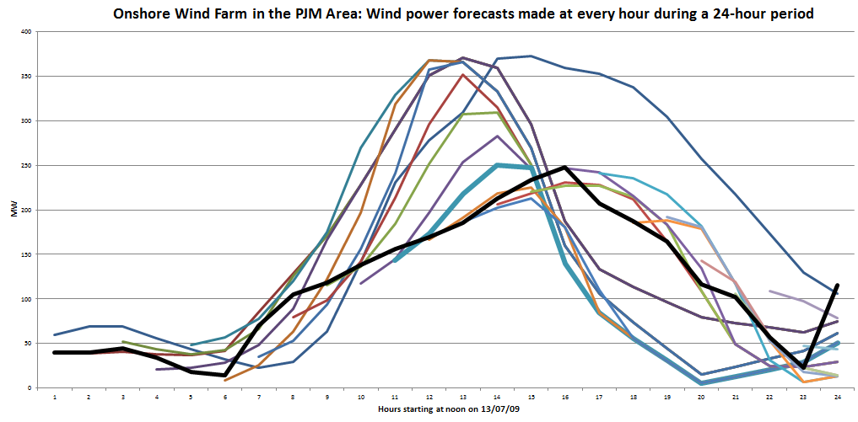
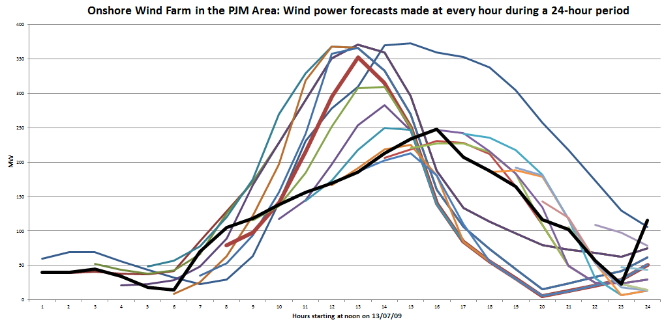
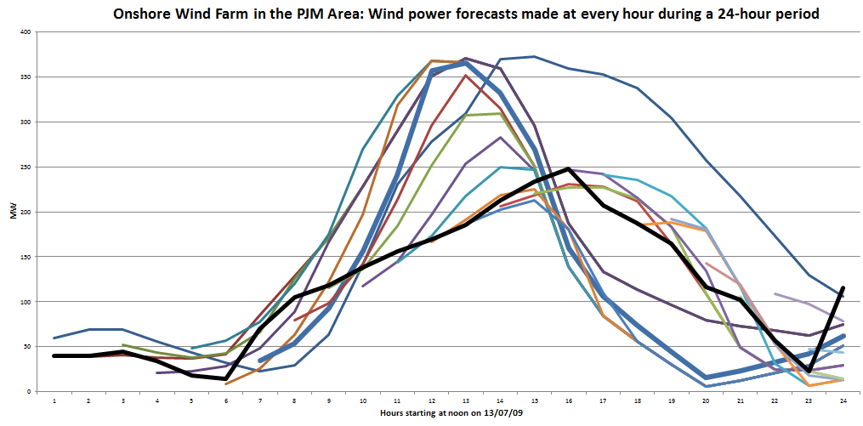
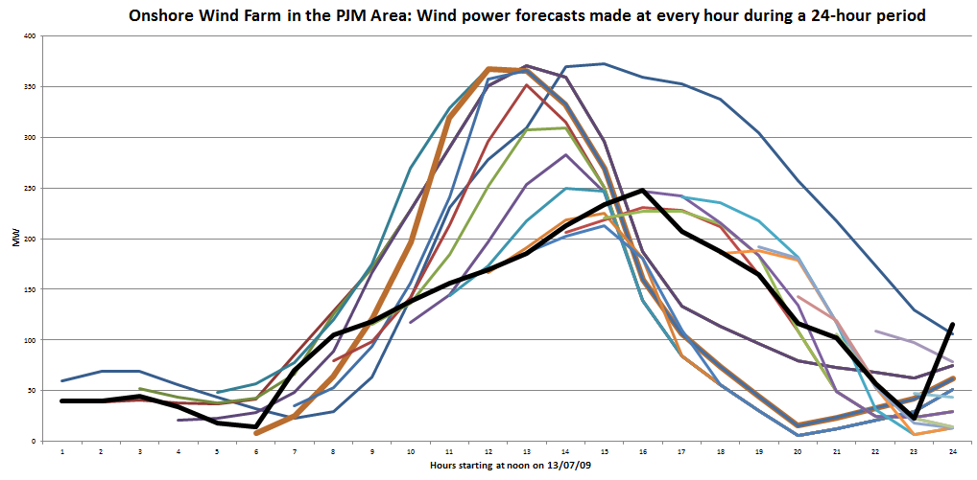
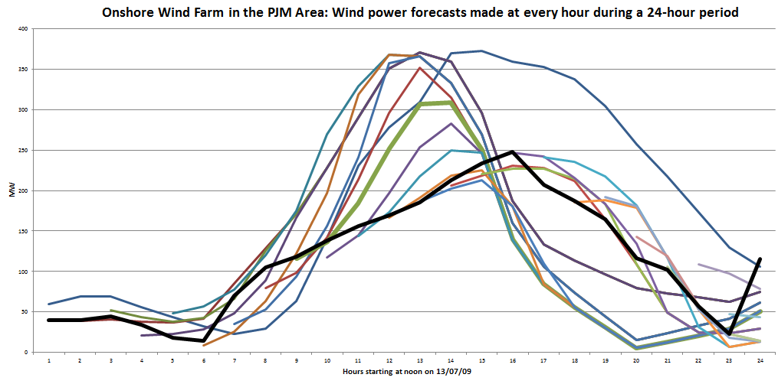
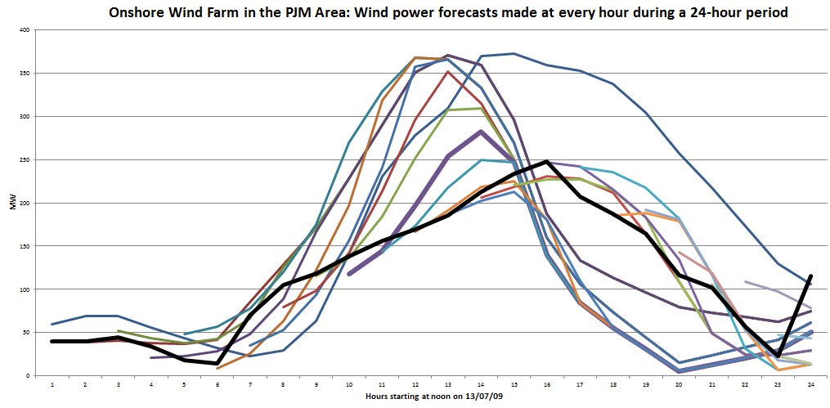
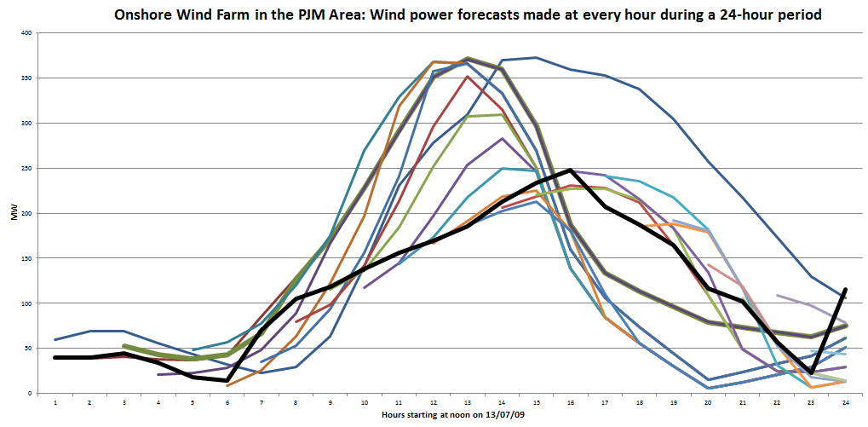
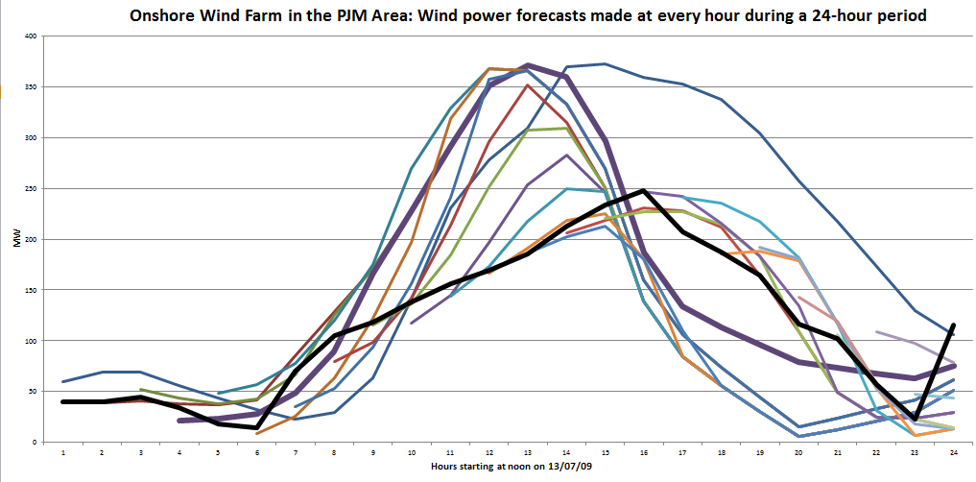
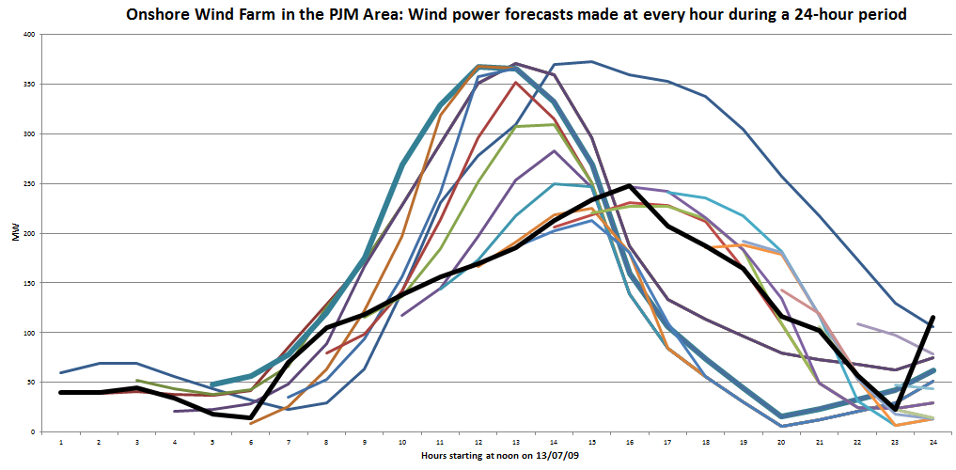
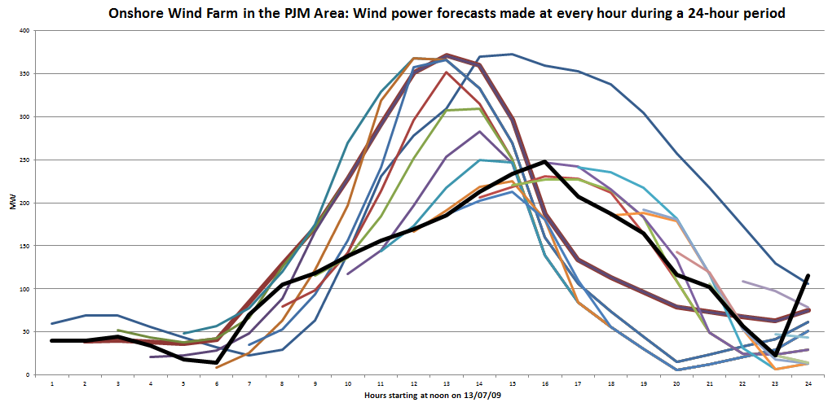
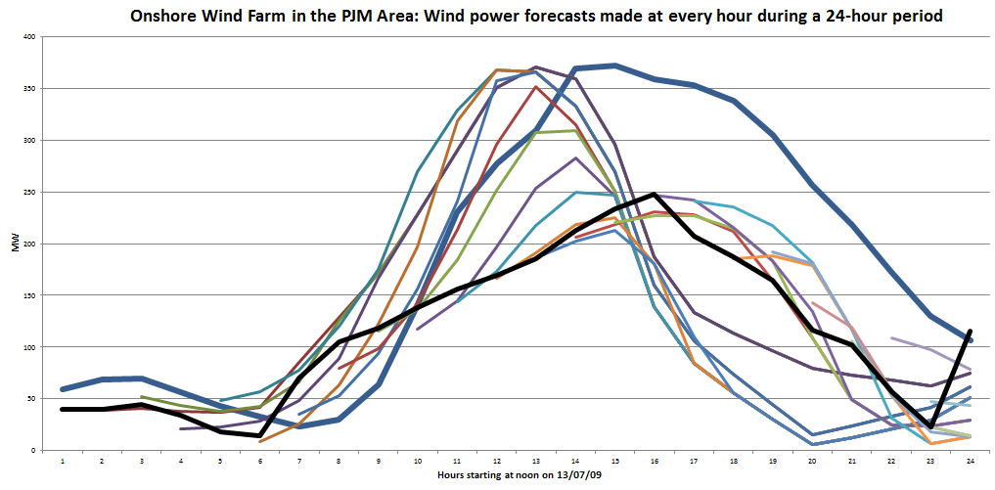
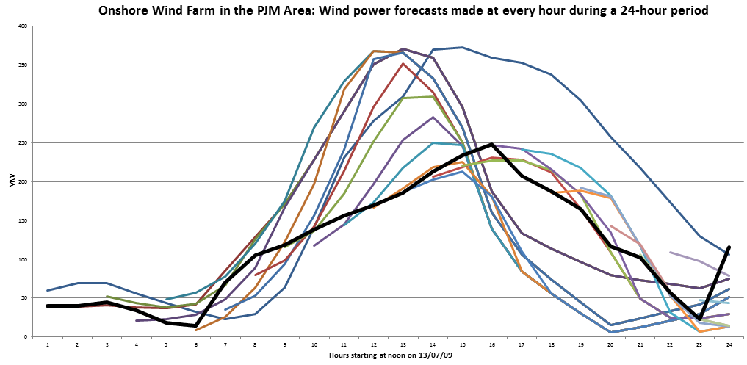
Parametric cost function approximation
Forecasts evolve over time as new information arrives:
Rolling forecasts, updated each hour.
Forecast made at midnight:
Actual

Slide 40
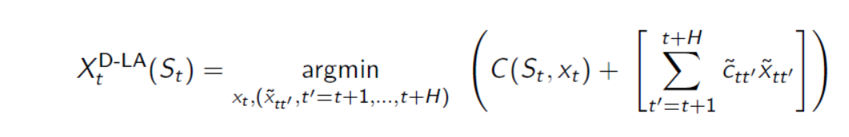
Parametric cost function approximation
Benchmark policy – Deterministic lookahead

Slide 41
Lookahead policies
Lookahead policies peek into the future
  Optimize over deterministic lookahead model
The lookahead model
. . . .
The real process

Slide 42

Lookahead policies
Lookahead policies peek into the future
  Optimize over deterministic lookahead model
The lookahead model
. . . .
The real process

Slide 43

Lookahead policies
Lookahead policies peek into the future
  Optimize over deterministic lookahead model
The lookahead model
. . . .
The real process

Slide 44

Lookahead policies
Lookahead policies peek into the future
  Optimize over deterministic lookahead model
The lookahead model
. . . .
The real process

Slide 45

Hybrid policies
Simulating the policy:
  Let $\overline{F}(ω)$ be a simulation of our policy following sample path $ω:$
  where
  $$S_{t+1}(ω)=S^{M}(S_{t}\left(ω\right),X_{t}^{π}\left(S_{t}\right),W_{t+1})$$

Slide 46
Designing policies
Hybrid – parameterized lookahead
(CFA/DLA)

Slide 47
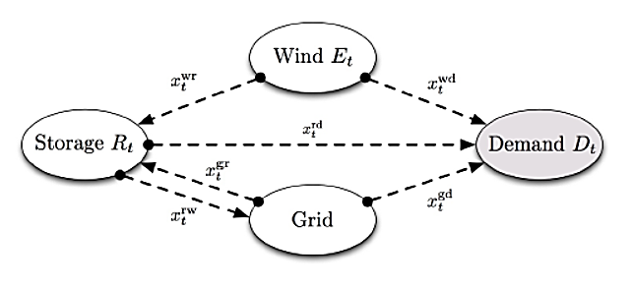

Parametric cost function approximation
Parametric cost function approximations
  Replace the constraint
with:
  Lookup table modified forecasts (one adjustment term for each time in the future):
  Exponential function for adjustments (just two parameters)
  Constant adjustment (one parameter)

Slide 48
Hybrid policies
Optimizing the CFA:
  Let be a simulation of our policy given by
  We then compute the gradient with respect to
  The parameter is found using a classical stochastic gradient algorithm:
    We tested several stepsize formulas and found that ADAGRAD worked best:

Slide 49
Simulating the numerical derivative

Slide 50
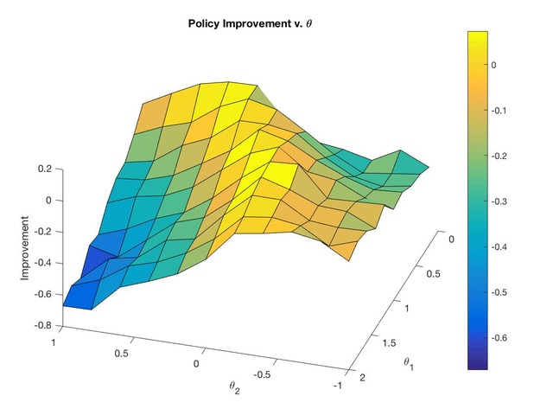

Slide 51
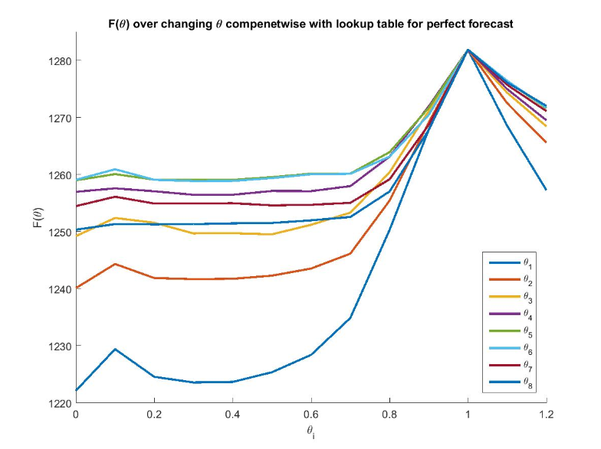

Perfect forecasts:
  When the forecast is perfect, the optimal coefficients $θ=1$.
  Below we fix all $θs=1$, but then vary each $θ_{i}$ one at a time.

Slide 52

Notes
  In the slides that follow, we optimized the $θs$, fixed each $θ_{i}$ to the optimized point we found, and then varied each $θ_{i}$, one at a time.
  The results were somewhat unexpected…

Slide 53


One-dimensional contour plots – perfect forecast
  $θ_{i}$ for i=1,…, 8 hours into the future.

Slide 54
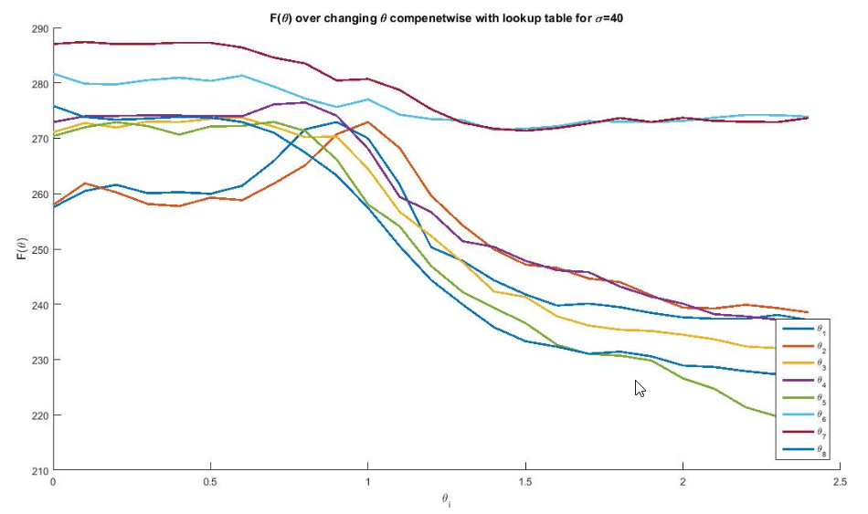

One-dimensional contour plots-uncertain forecast
  $θ_{i}$ for i=1,…, 8 hours into the future.

Slide 55
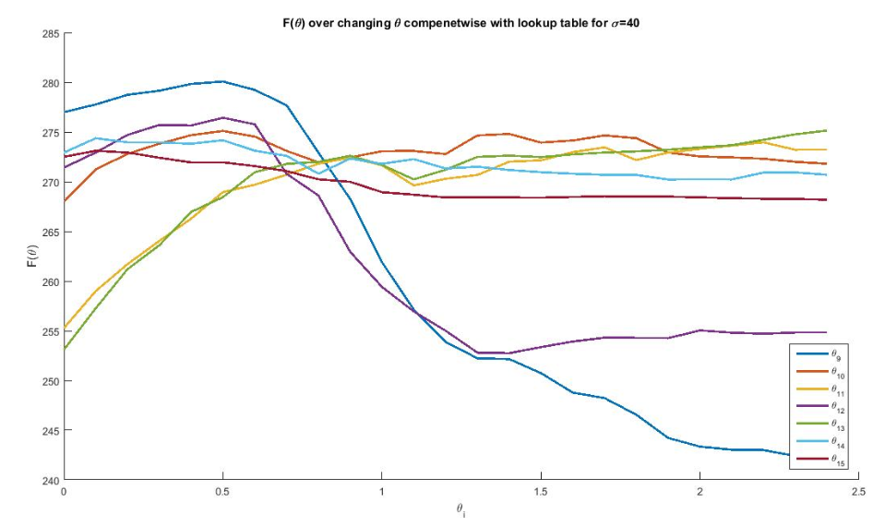

One-dimensional contour plots-uncertain forecast
  $θ_{i}$ for i=9,…, 15 hours into the future

Slide 56
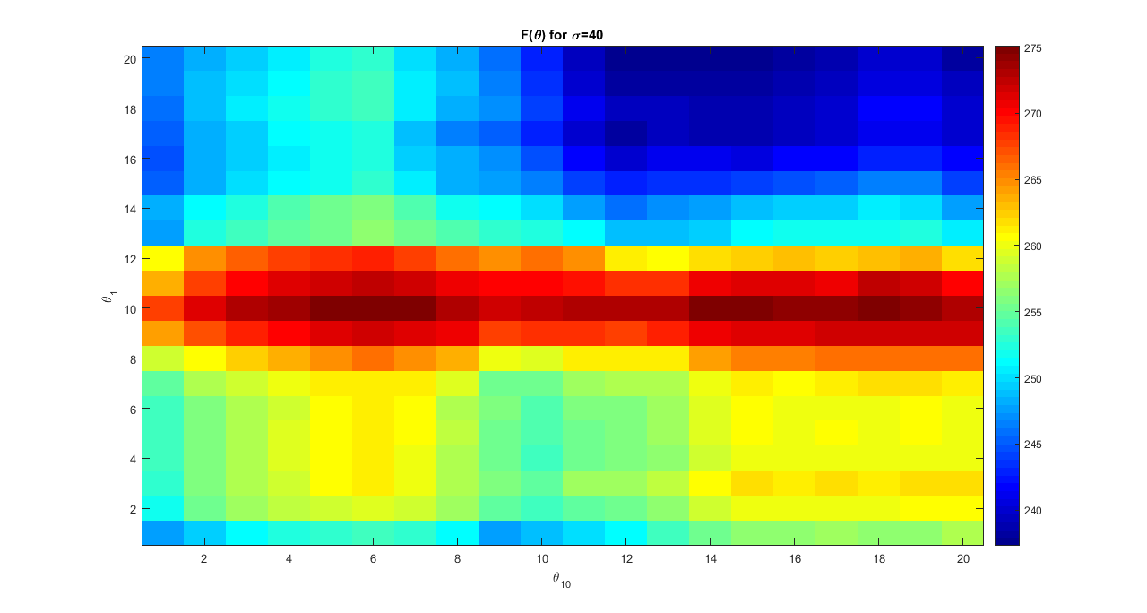
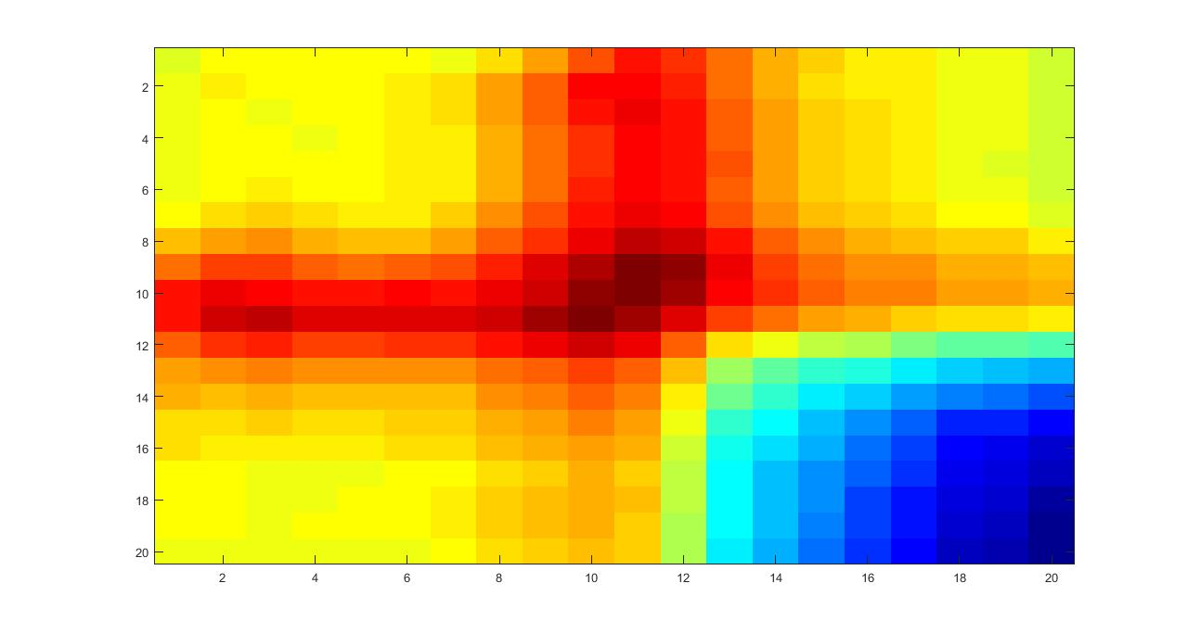

Slide 57
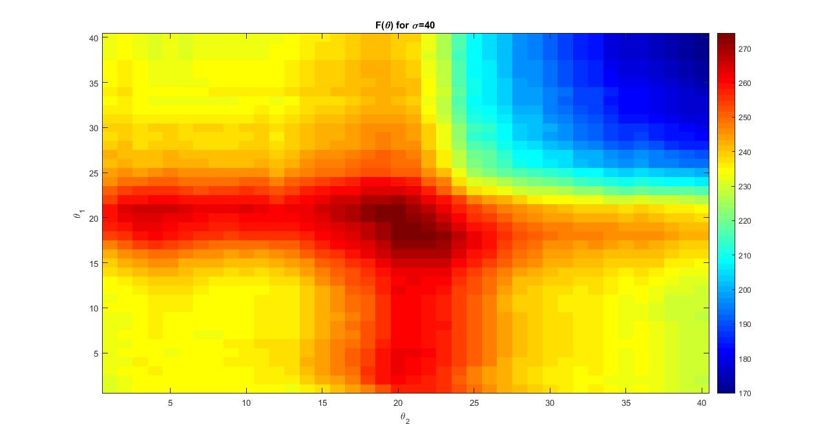

Slide 58
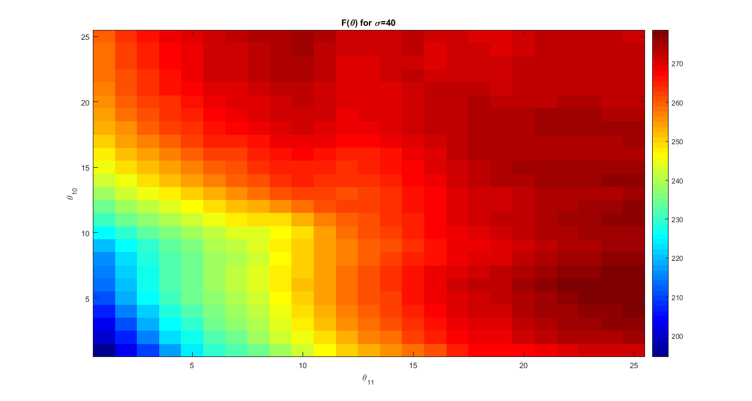

Slide 59
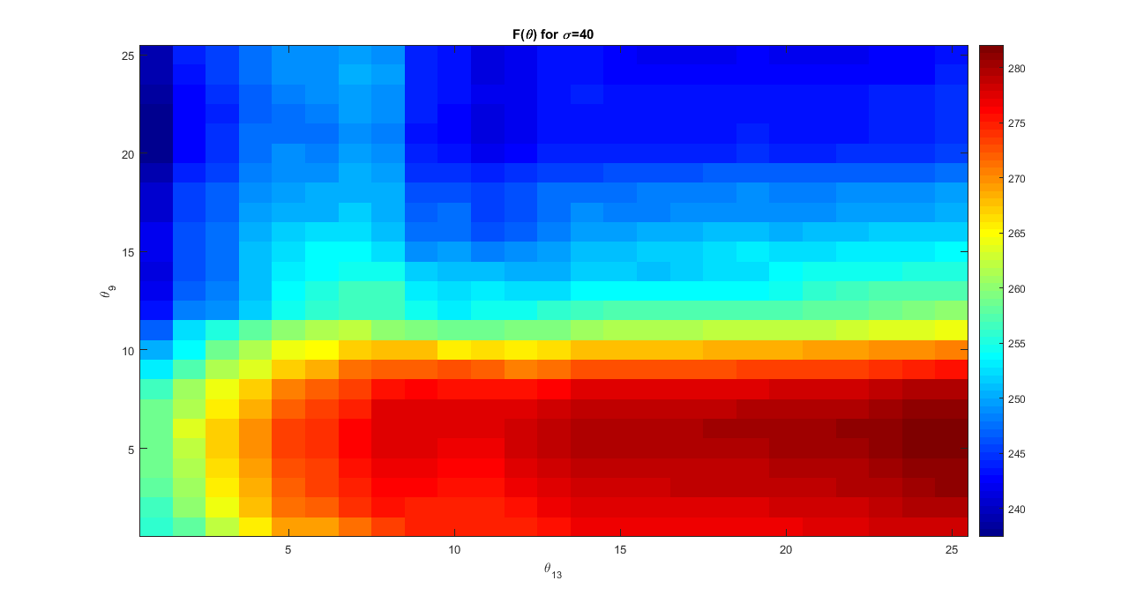

Slide 60
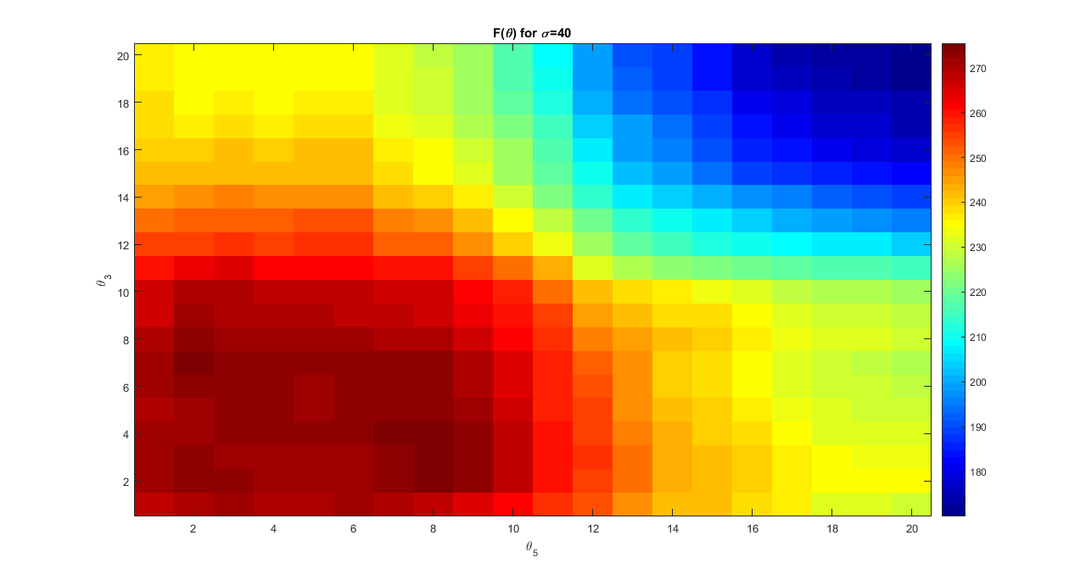

Slide 61
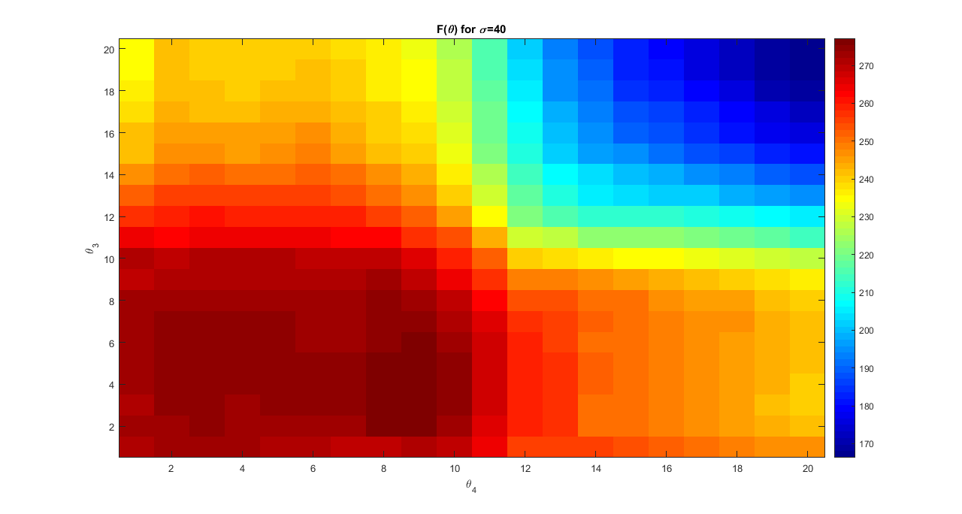

Slide 62
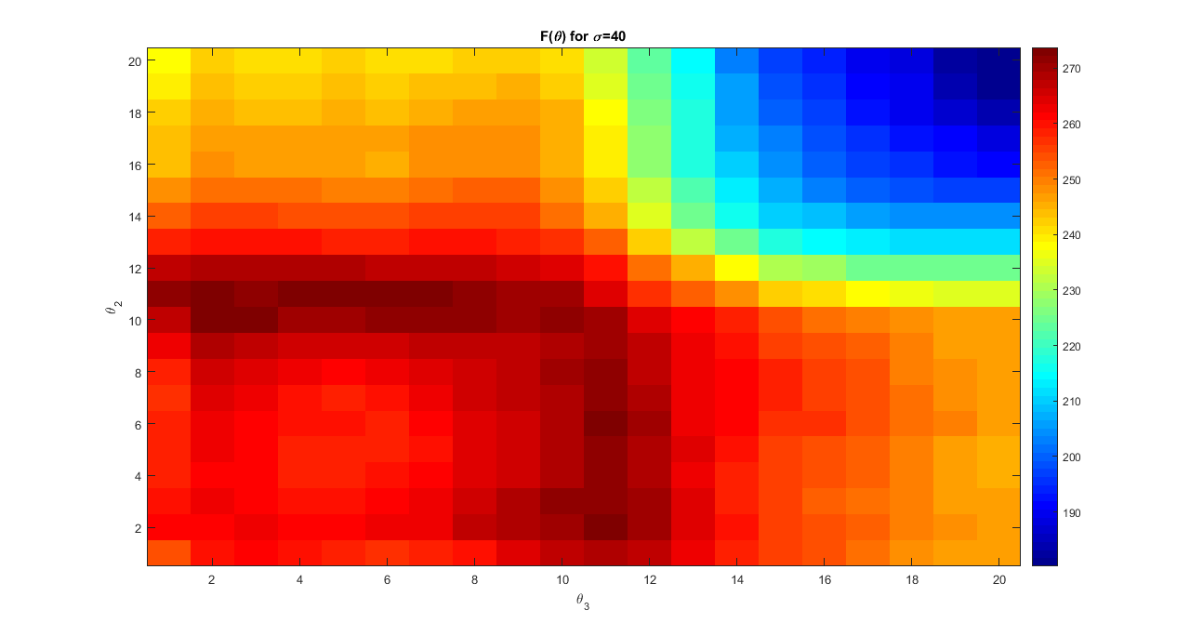

Slide 63
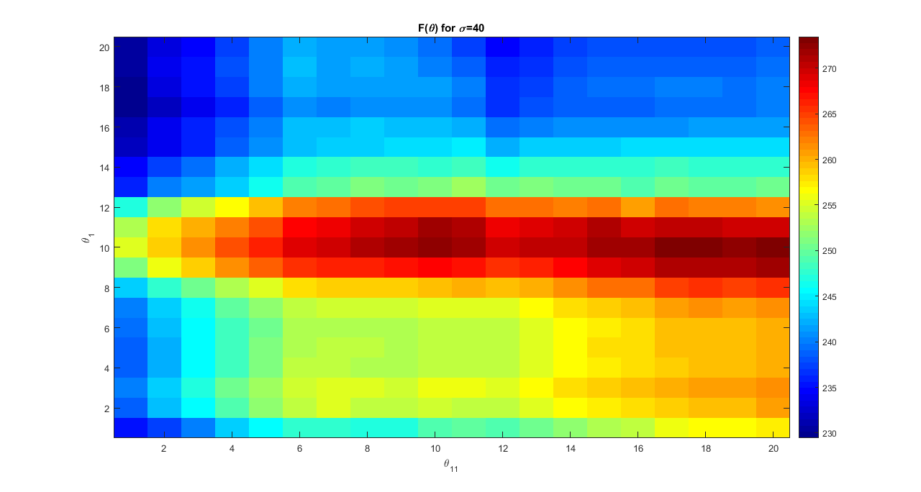

Slide 64
Any policy may work best

Slide 65
An energy storage problem
Consider a basic energy storage problem:
  We are going to show that with minor variations in the characteristics of this problem, we can make each class of policy work best.

Slide 66
An energy storage problem
We can create distinct flavors of this problem:
  Problem class 1 – Best for PFAs
    Highly stochastic (heavy tailed) electricity prices
    Stationary data
  Problem class 2 – Best for CFAs
    Stochastic prices and wind (but not heavy tailed)
    Stationary data
  Problem class 3 - Best for VFAs
    Stochastic wind and prices (but not too random)
    Time varying loads, but inaccurate wind forecasts
  Problem class 4 – Best for deterministic lookaheads
    Relatively low noise problem with accurate forecasts
  Problem class 5 – A hybrid policy worked best here
    Stochastic prices and wind, nonstationary data, noisy forecasts.

Slide 67
An energy storage problem
The policies
  The PFA:
    Charge battery when price is below p1
    Discharge when price is above p2
  The CFA
    Optimize over a horizon H; maintain upper and lower bounds (u, l) for every time period except the first (note that this is a hybrid with a lookahead).
  The VFA
    Piecewise linear, concave value function in terms of energy, indexed by time.
  The lookahead (deterministic)
    Optimize over a horizon H (only tunable parameter) using forecasts of demand, prices and wind energy
  The lookahead CFA
    Use a lookahead policy (deterministic), but with a tunable parameter that improves robustness.

Slide 68
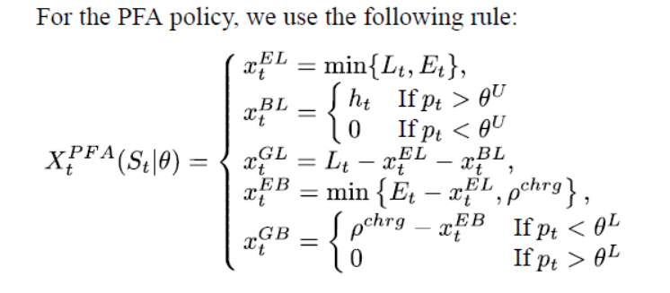
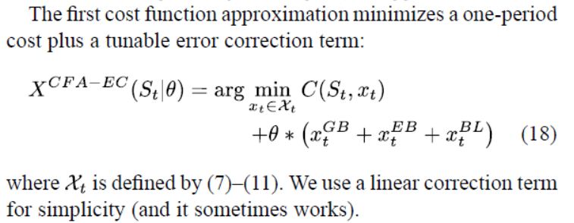
PFA:
CFA:

Slide 69

VFA:

Slide 70

DLA:

Slide 71

Hybrid DLA-CFA
  Use the DLA with two new constraints:
  These are designed to avoid allowing the storage to hit upper and lower bounds so that it can respond to sudden bursts or gaps in the energy from wind.

Slide 72

An energy storage problem
Each policy is best on certain problems
  Results are percent of posterior optimal solution
  … any policy might be best depending on the data.
Joint research with Prof. Stephan Meisel, University of Muenster, Germany.

Slide 73

An energy storage problem
From the paper:

Slide 74
Extension
Active learning

Slide 75

An energy storage problem
Types of learning:
  No learning ($θ^{′}s$ are known)
  Passive learning (learn $\overline{θ}s$ from price data)
  Active learning (“bandit problems”) – What we learn depends on the decisions $x_{t}^{GB}$

Slide 76
An energy storage problem
Transition function
L
E
B
G

Slide 77

Learning in stochastic optimization
Updating the demand parameter
  Let $p_{t+1}$ be the new price and let
  We update our estimate ${\overline{θ}}_{t}$ using our recursive least squares equations:

Slide 78
An energy storage problem
Types of learning:
  No learning ($θ^{′}s$ are known)
  Passive learning (learn $\overline{θ}s$ from price data)
  Active learning (“bandit problems”) – What we learn depends on the decisions $x_{t}^{GB}$
Buy/sell decisions

Slide 79

Revenue management
Earning vs. learning
  You earn the most with prices near the middle.
  You learn the most with extreme prices.
  Challenge is to strike a balance.

Slide 80

Notes
  We started with a pure stochastic optimization problem with no learning.
  The previous slide (optimizing prices) is a pure learning problem.
  We can also have a mixed problem.
  With the last model, our decisions to charge/discharge energy from/to the grid affects our learning of ${\overline{θ}}_{t3}.$
  The model (e.g. state variables) are the same.
  We would expect the choice of best policy (or the best parameters for a parameterized policy) would change when there is active learning, but how much depends on the relative value of information.

