Slide 1
.
Sequential decision analytics and modeling
ORF 411
Fall, 2018
Warren Powell
Princeton University
http://www.castlelab.princeton.edu
© 2017 Warren B. Powell, Princeton University

Slide 2

Week 5 – Wednesday
Energy storage II

Slide 3

Policy search for PFAs
Derivative-based stochastic search

Slide 4
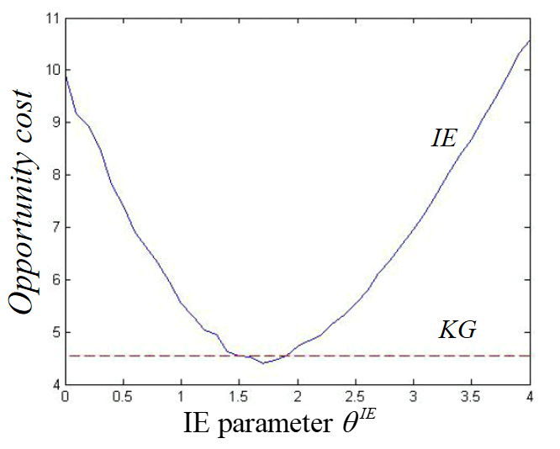

Cost function approximations
Optimizing the policy
  We optimize $θ^{IE}$ to maximize:
  Policy search matters:
Regret

Slide 5
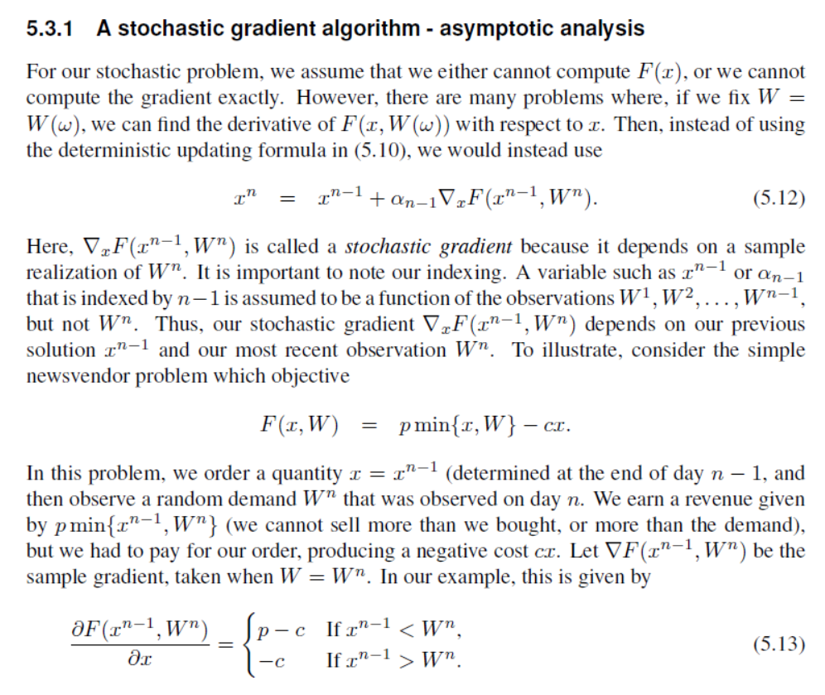
Policy function approximations
Derivative-based
  Consider basic newsvendor problem
  If we can compute the gradient
  Then we can use a stochastic gradient algorithm

Slide 6
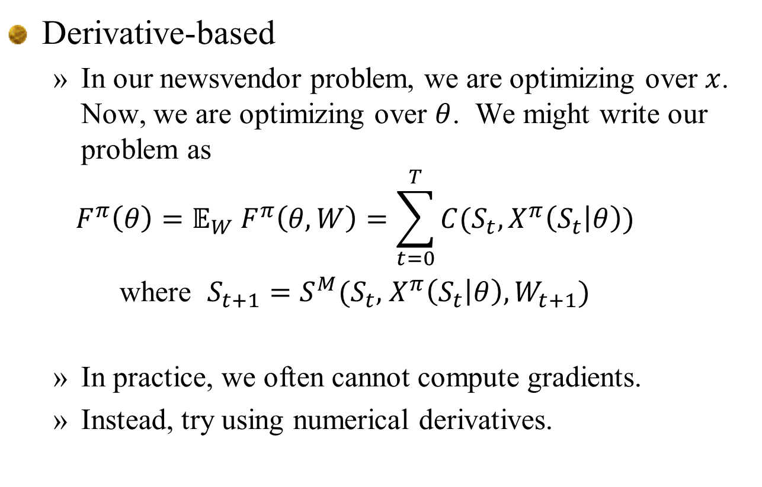
Policy function approximations
Derivative-based
  In our newsvendor problem, we are optimizing over $x$. Now, we are optimizing over $θ$. We might write our problem as
  $$F^{π}\left(θ\right)=𝔼_{W}{ F}^{π}\left(θ,W\right)=\sum_{t=0}^{T}{C(S_{t},X^{π}\left(S_{t} | θ\right))}$$
  where $S_{t+1}=S^{M}(S_{t},$ $X^{π}\left(S_{t} | θ\right),W_{t+1})$
  In practice, we often cannot compute gradients.
  Instead, try using numerical derivatives.

Slide 7
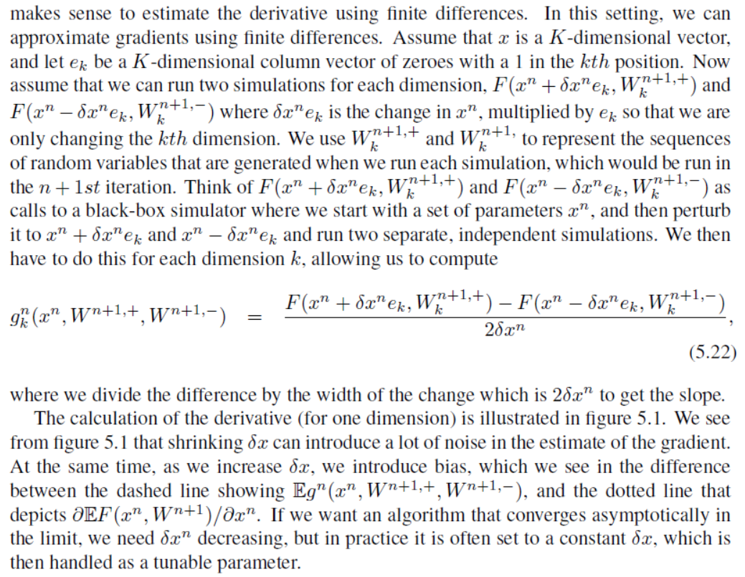
Derivative-based stochastic search
Finite differences

Slide 8
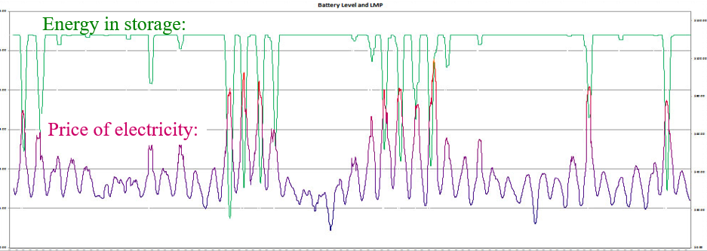
Derivative-based stochastic search
Finite differences
  We can just simulate the policy (even in a spreadsheet):

Slide 9
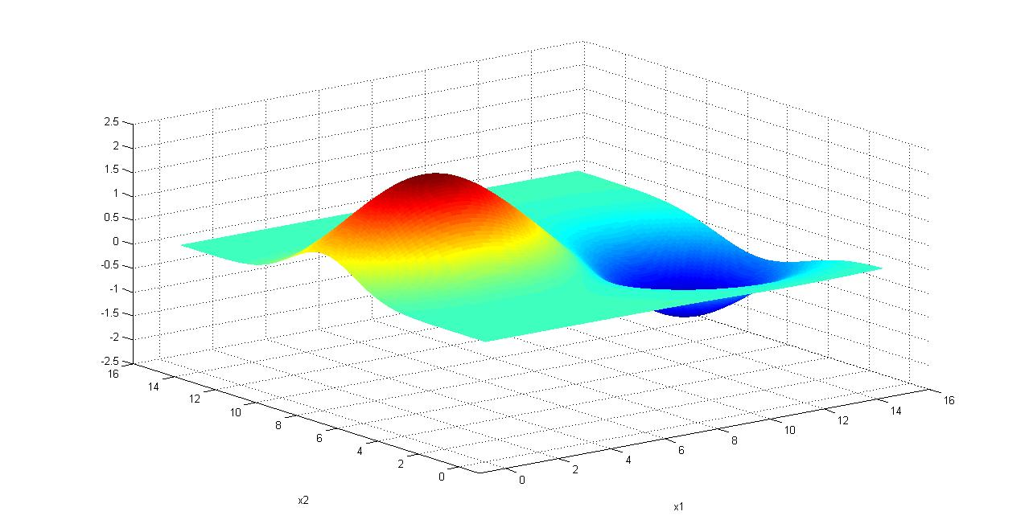
Derivative-based stochastic search
Finding the best policy
  We need to maximize
  We cannot compute the expectation, so we run simulations:
Notes:
9

Slide 10
Simulating the numerical derivative

Slide 11
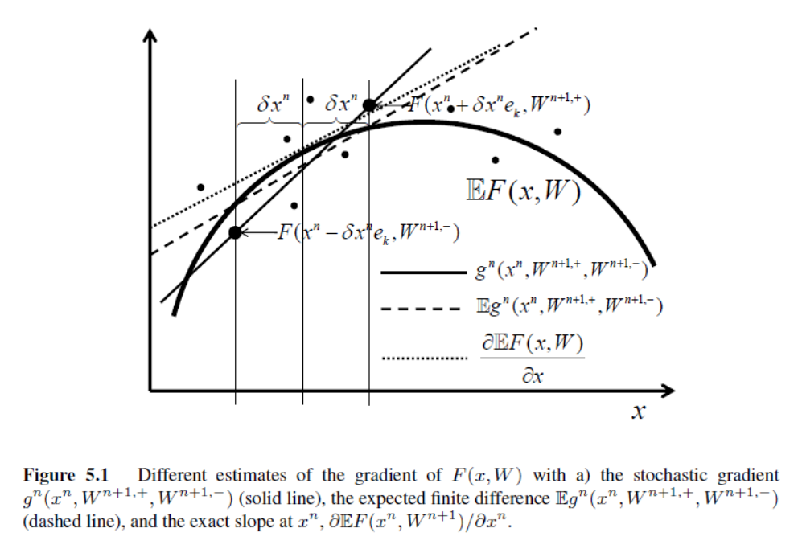

Derivative-based stochastic search
Finite differences
Replace $x^{n}$ with $θ^{n}$

Slide 12
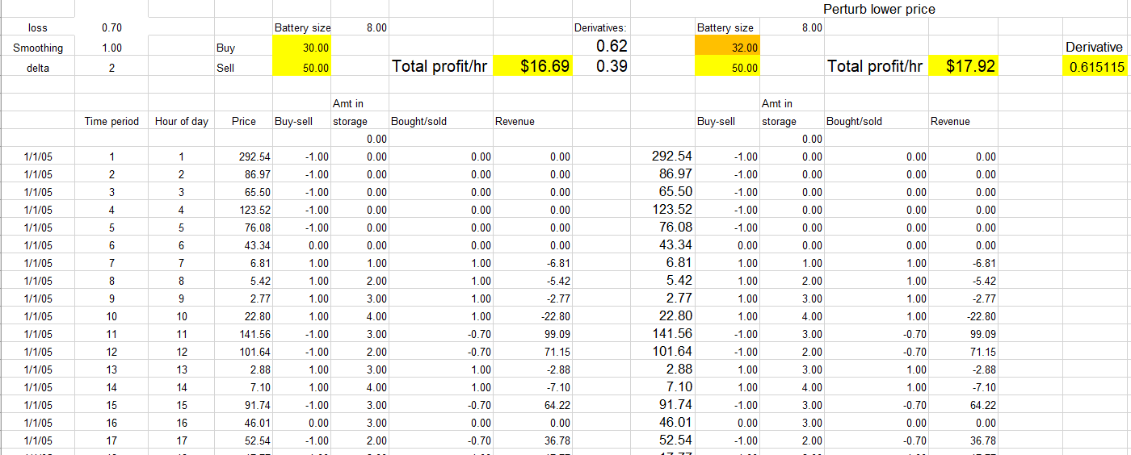
Finite-difference estimate of derivative

Slide 13
Stochastic gradient algorithm
13
Steepest ascent for a deterministic problem
Notes:
13

Slide 14
Stochastic gradient algorithm
14
How a stochastic gradient algorithm may behave
Notes:
14

Slide 15
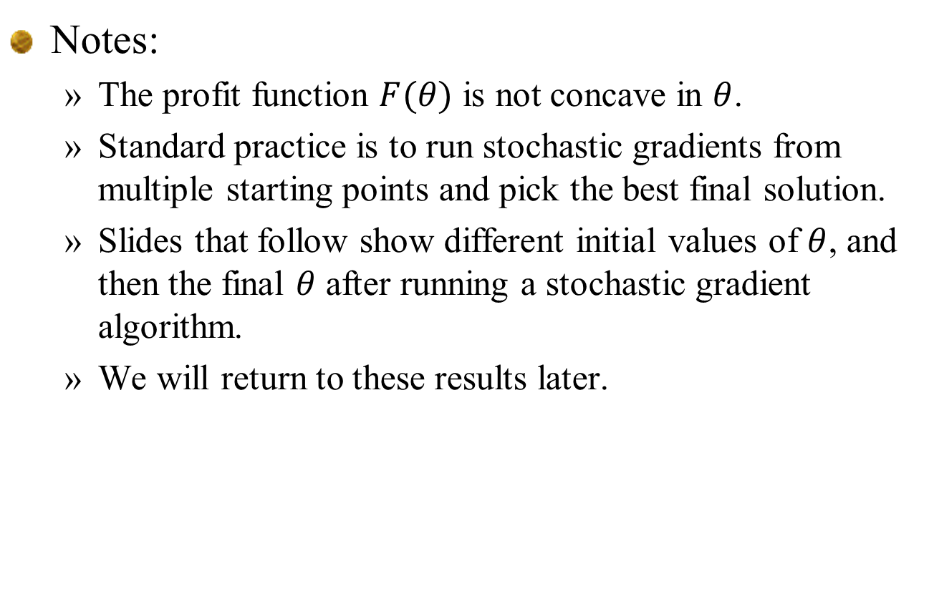
Notes:
  The profit function $F(θ)$ is not concave in $θ$.
  Standard practice is to run stochastic gradients from multiple starting points and pick the best final solution.
  Slides that follow show different initial values of $θ$, and then the final $θ$ after running a stochastic gradient algorithm.
  We will return to these results later.

Slide 16
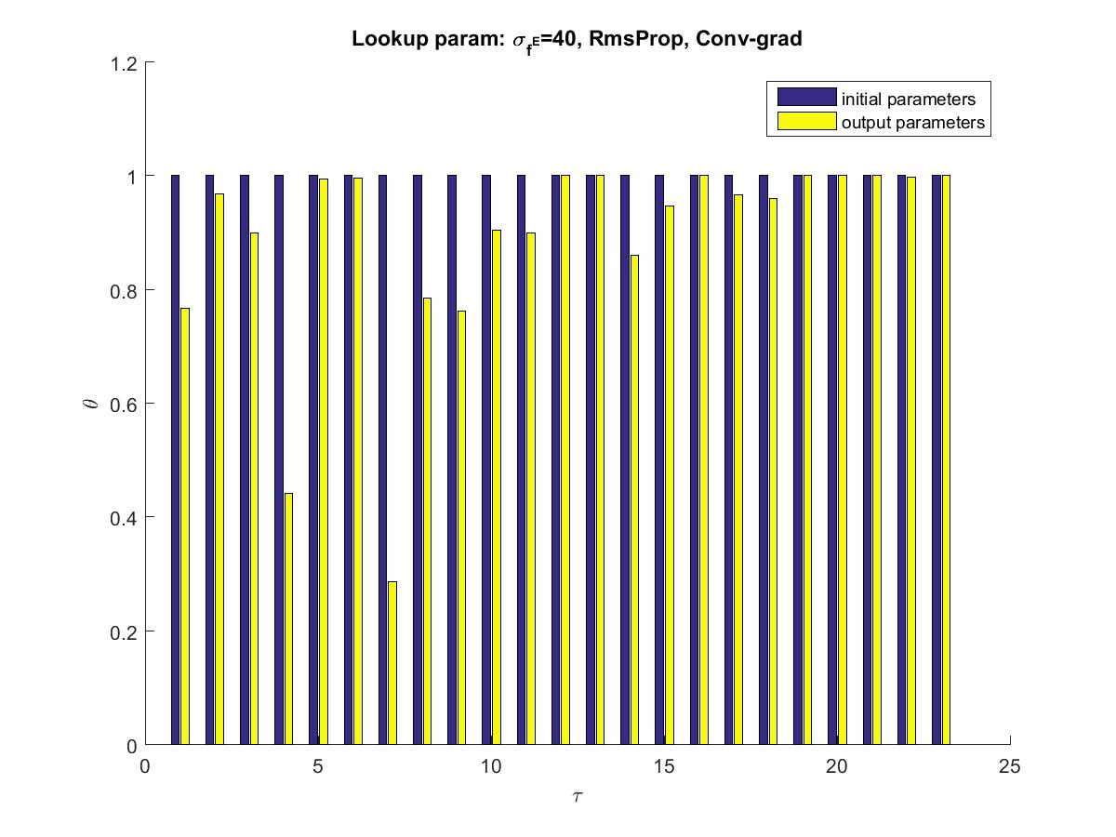

Slide 17
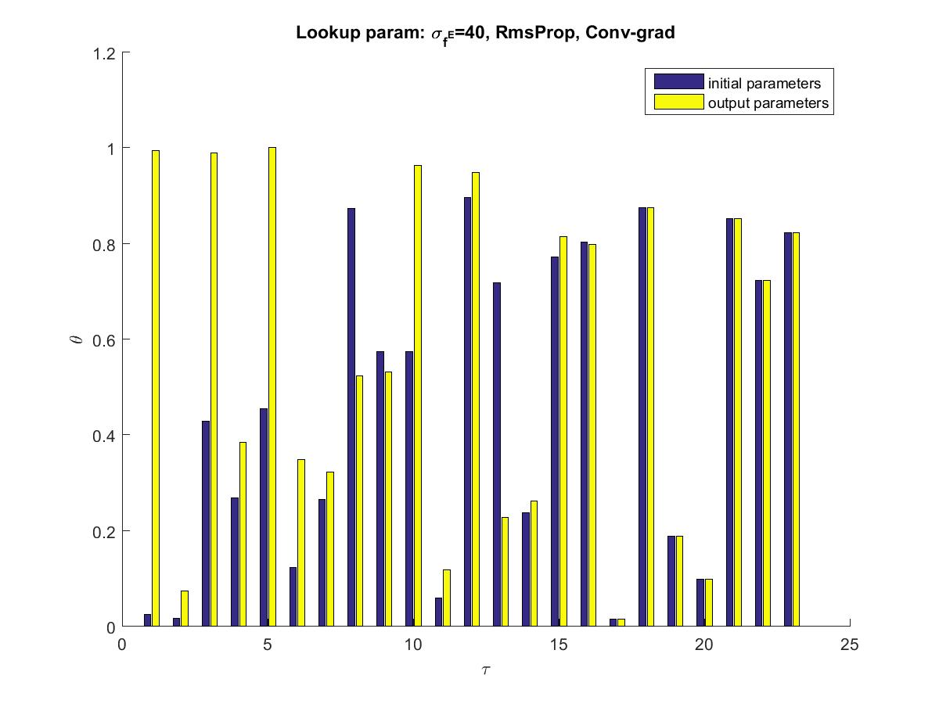

Slide 18
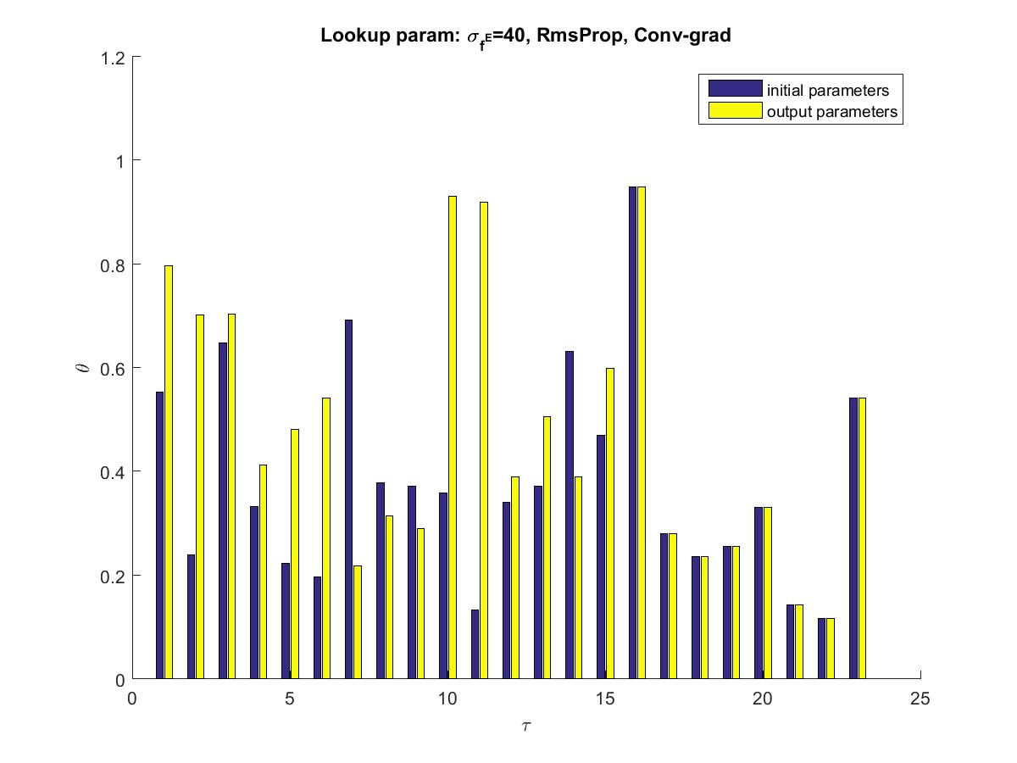

Slide 19
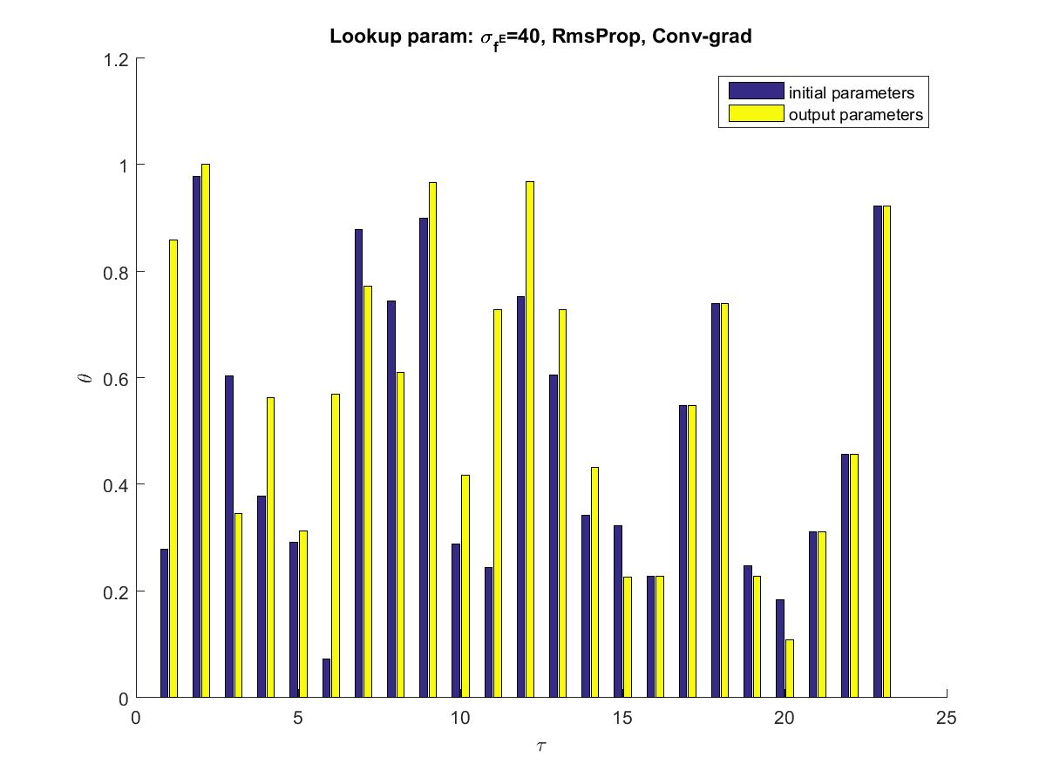

Slide 20
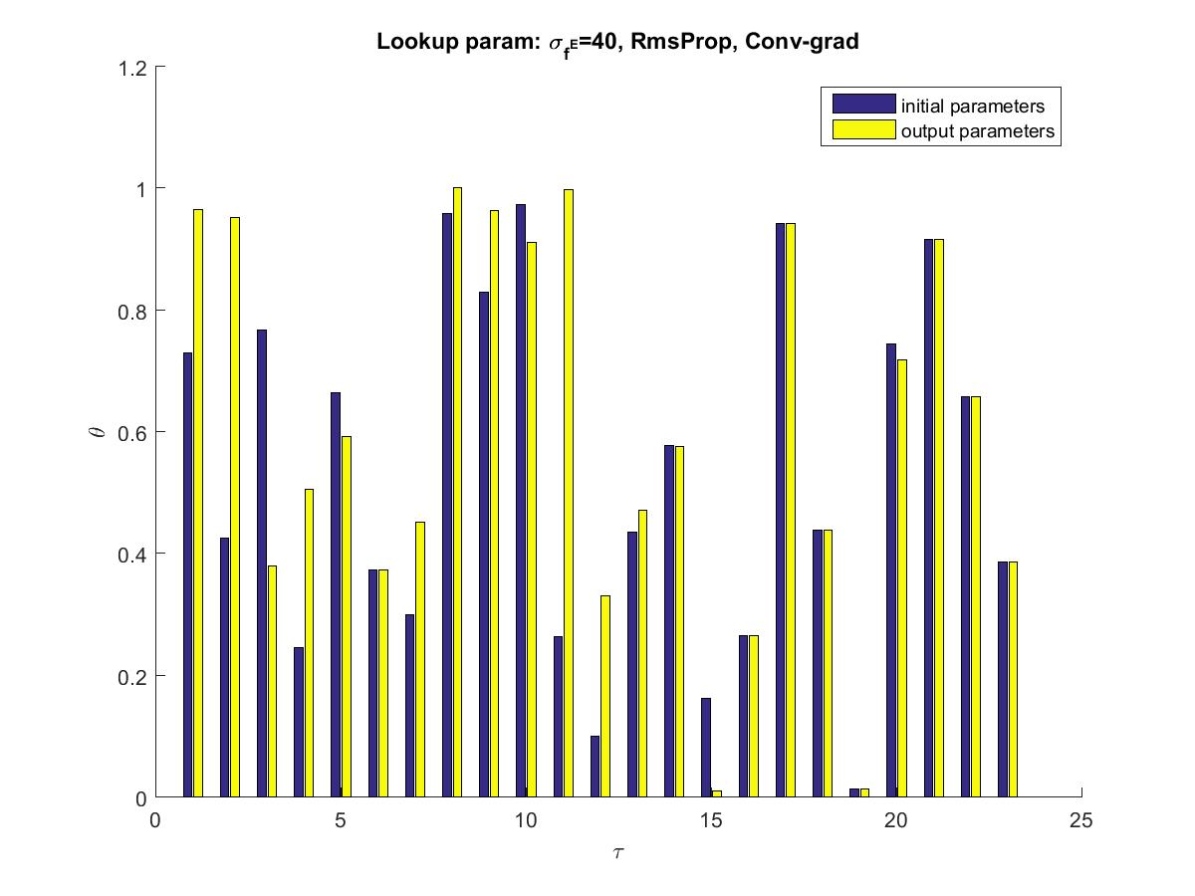

Slide 21
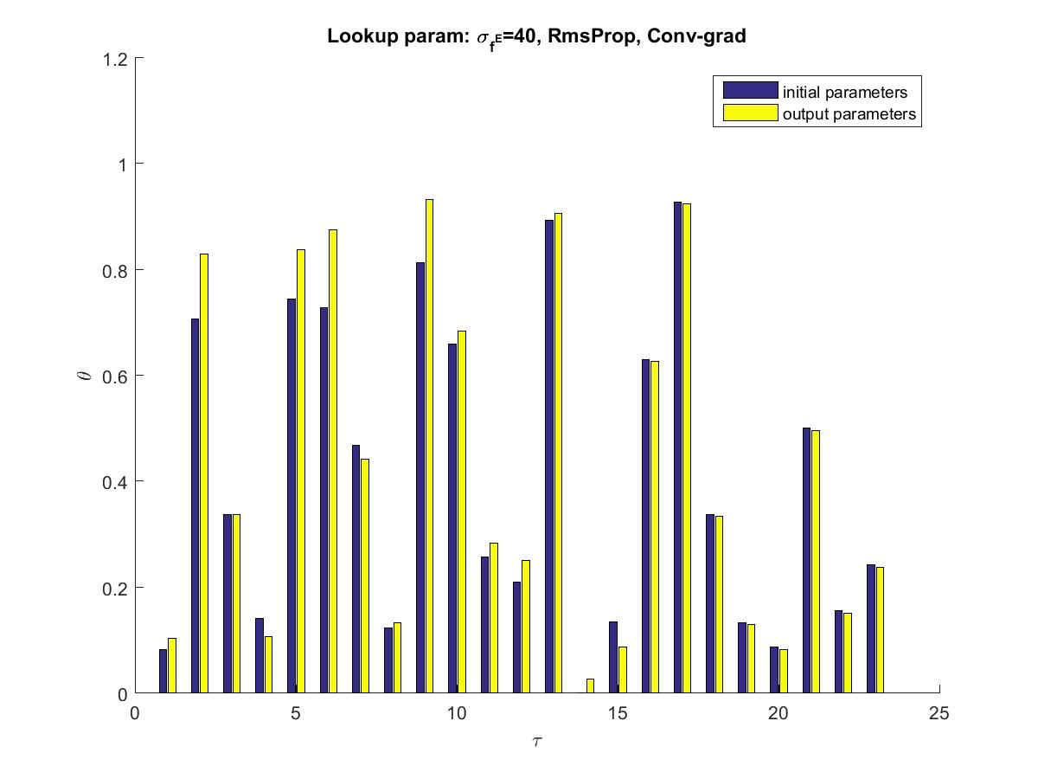

Slide 22
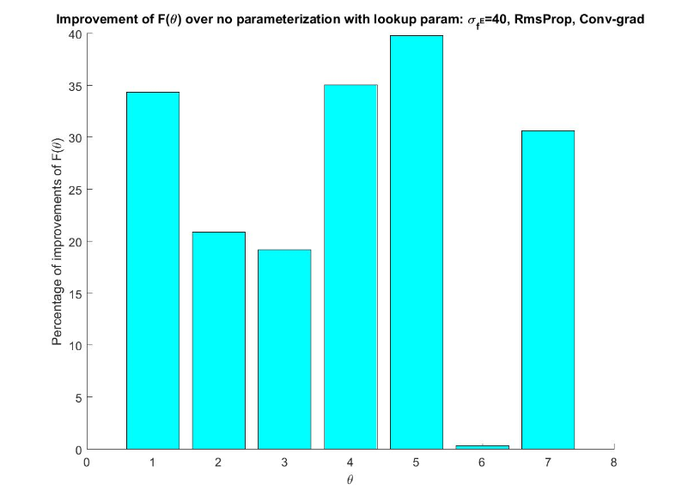
Improvement between final solution and initial starting point

Slide 23
Policy search for PFAs
Derivative-free stochastic search

Slide 24
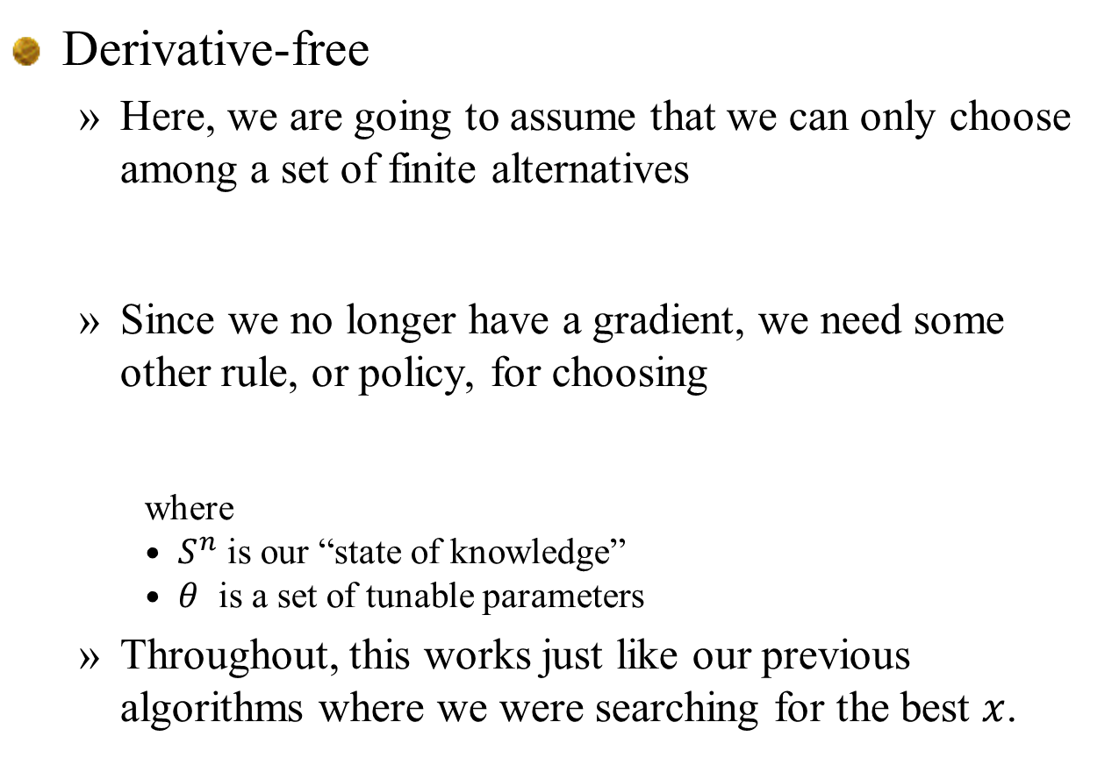
Derivative-free policies
Derivative-free
  Here, we are going to assume that we can only choose among a set of finite alternatives
  Since we no longer have a gradient, we need some other rule, or policy, for choosing
    where
    $S^{n}$ is our “state of knowledge”
    $θ$ is a set of tunable parameters
  Throughout, this works just like our previous algorithms where we were searching for the best $x$.

Slide 25
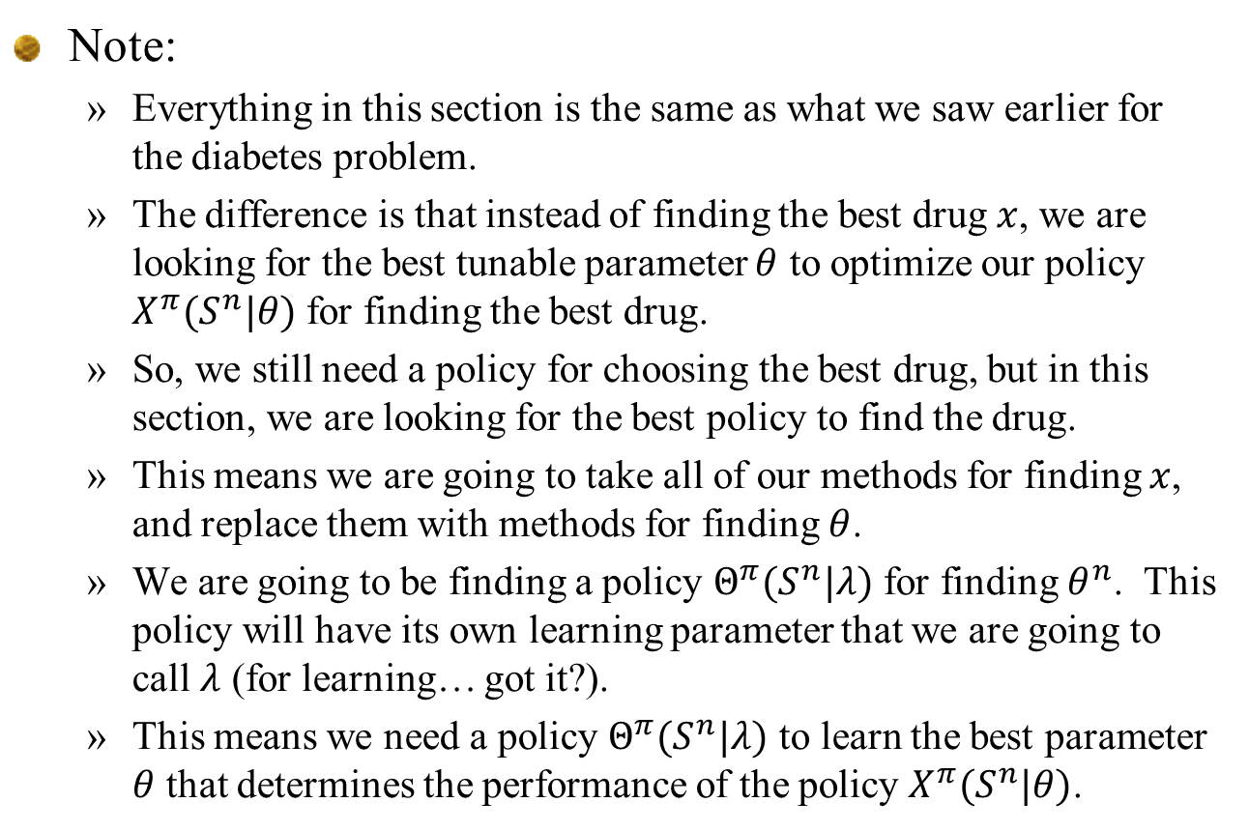
Note:
  Everything in this section is the same as what we saw earlier for the diabetes problem.
  The difference is that instead of finding the best drug $x$, we are looking for the best tunable parameter $θ$ to optimize our policy $X^{π}(S^{n}|θ)$ for finding the best drug.
  So, we still need a policy for choosing the best drug, but in this section, we are looking for the best policy to find the drug.
  This means we are going to take all of our methods for finding $x$, and replace them with methods for finding $θ$.
  We are going to be finding a policy $Θ^{π}(S^{n}|λ)$ for finding $θ^{n}$. This policy will have its own learning parameter that we are going to call $λ$ (for learning… got it?).
  This means we need a policy $Θ^{π}(S^{n}|λ)$ to learn the best parameter $θ$ that determines the performance of the policy $X^{π}(S^{n}|θ)$.

Slide 26
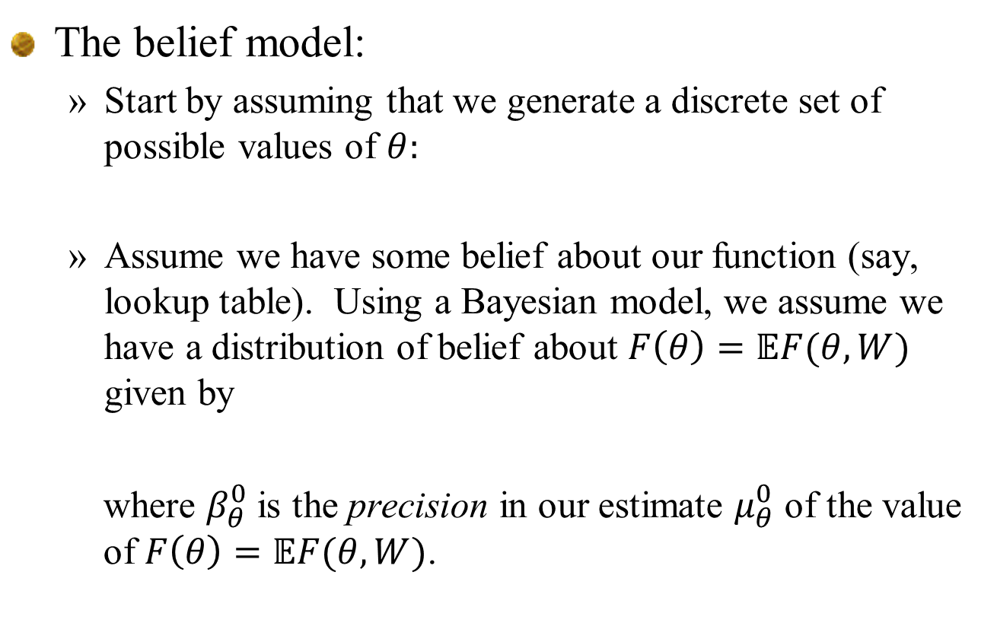
Derivative-free policies
The belief model:
  Start by assuming that we generate a discrete set of possible values of $θ:$
  Assume we have some belief about our function (say, lookup table). Using a Bayesian model, we assume we have a distribution of belief about $F\left(θ\right)=𝔼F(θ,W)$ given by
  where $β_{θ}^{0}$ is the precision in our estimate $μ_{θ}^{0}$ of the value of $F\left(θ\right)=𝔼F(θ,W)$.

Slide 27

Derivative-free policies
Belief state for ranking and selection
  S is our “state of knowledge”
1
2
3
4
5
Different values of $θ$
Notes:
27

Slide 28
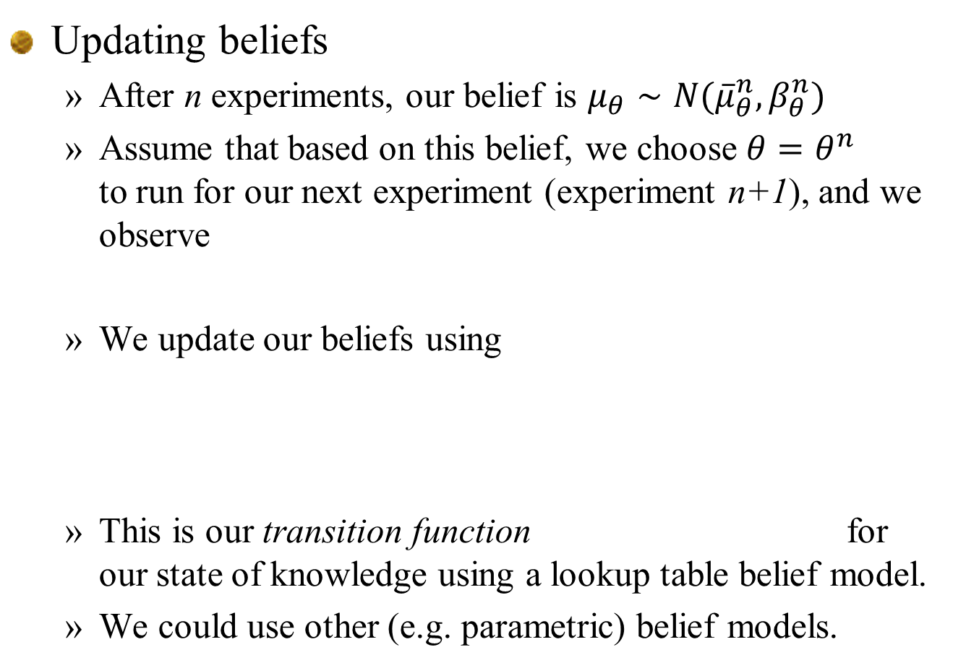
Derivative-free policies
Updating beliefs
  After n experiments, our belief is $μ_{θ}∼N({\overline{μ}}_{θ}^{n},β_{θ}^{n})$
  Assume that based on this belief, we choose $θ=θ^{n}$ to run for our next experiment (experiment n+1), and we observe
  We update our beliefs using
  This is our transition function for our state of knowledge using a lookup table belief model.
  We could use other (e.g. parametric) belief models.

Slide 29
Derivative-free policies
Notes:
  With derivative-based optimization, we have tended to use the language of algorithms:
    Choosing a decent vector
    Choosing a stepsize rule
    We then study the behavior of this “algorithm.”
  With derivative-free optimization, we have to use a belief model that captures what we know about a problem, and a policy that guides us in how to make the next decision.
  In practice, we model both using the language of finding the best “policy.”

Slide 30
Derivative-free policies
Derivative-free policies
  Some examples of policies are:
    Interval estimation:
    Upper confidence bounding
    Thompson sampling:

Slide 31
Derivative-free policies
How do we find the best policy?
  We use our objective function
  However, this compact form is not very useful. We need to go back to the full form:
  Now, we just simulate each policy, generating many sample paths and taking an average.
  The first formulation is the most compact, but you need to understand that it translates to the nested formulation.

Slide 32
Tests of a derivative-free policy search procedure
  Work of Michael Li ‘20

Slide 33
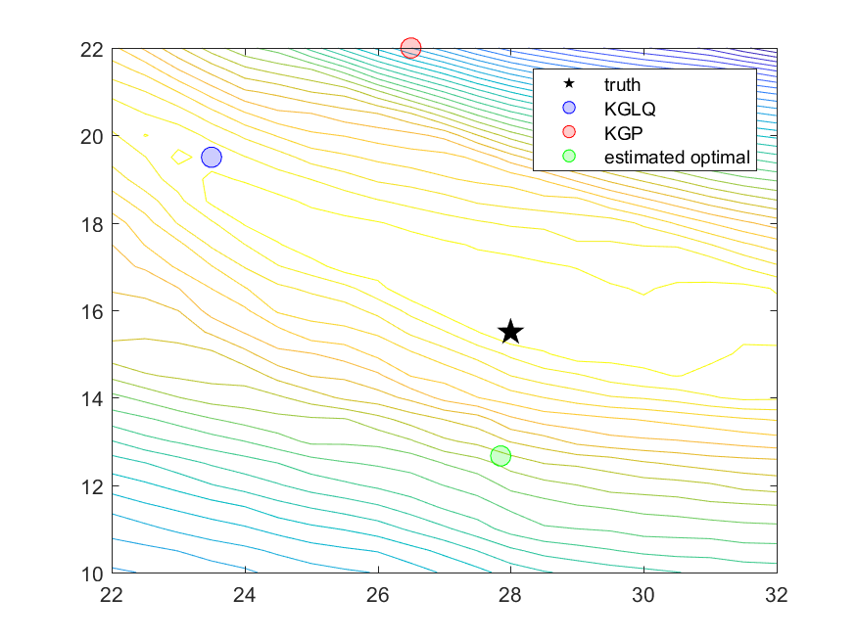

Slide 34
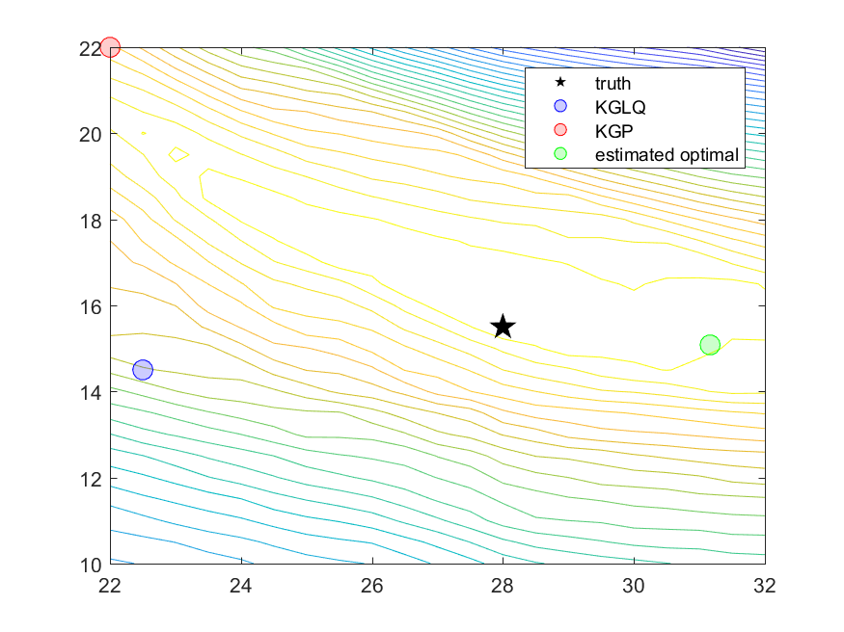

Slide 35
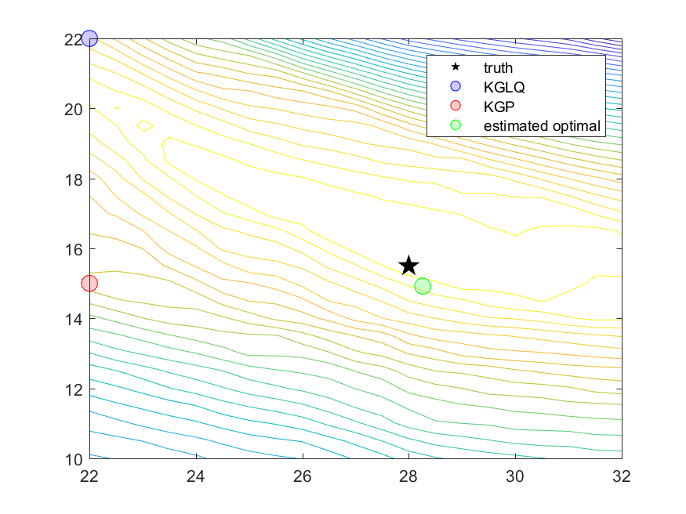

Slide 36
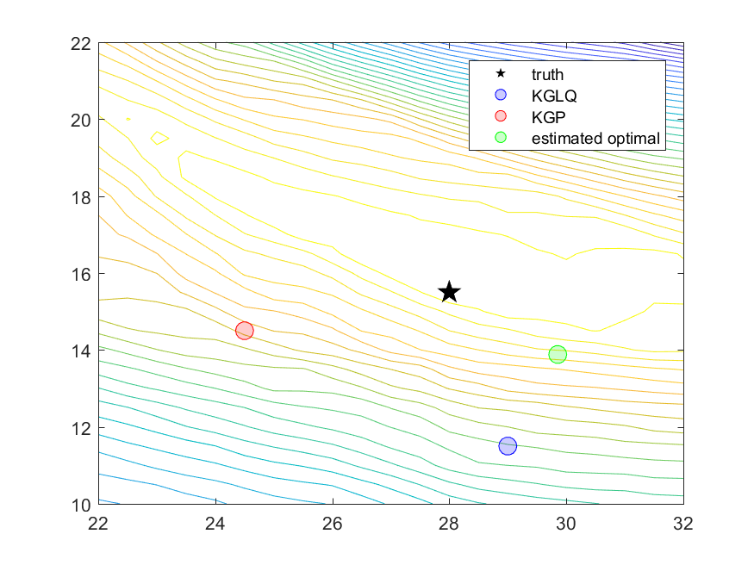

Slide 37


Slide 38
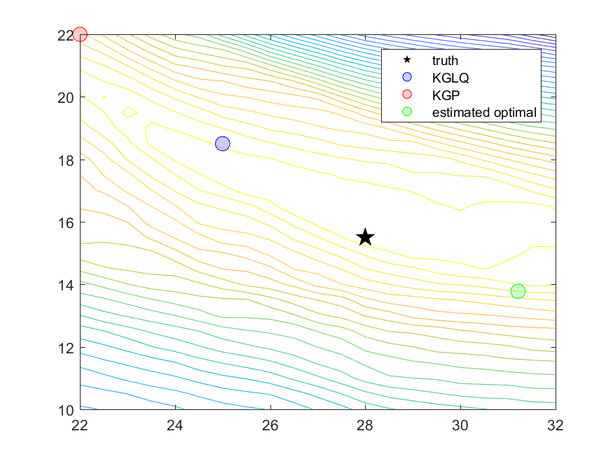

Slide 39
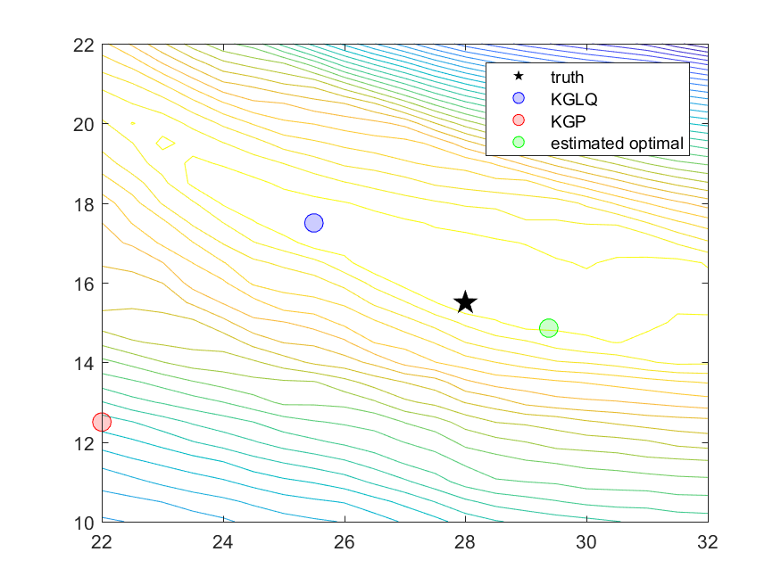

Slide 40
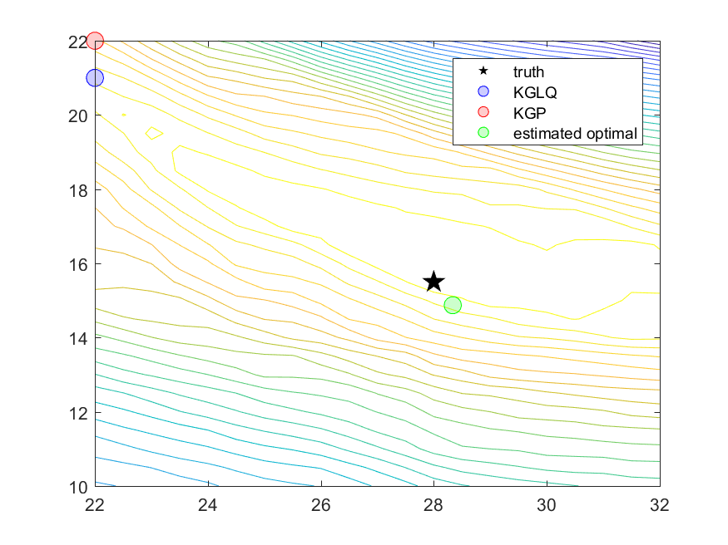

Slide 41
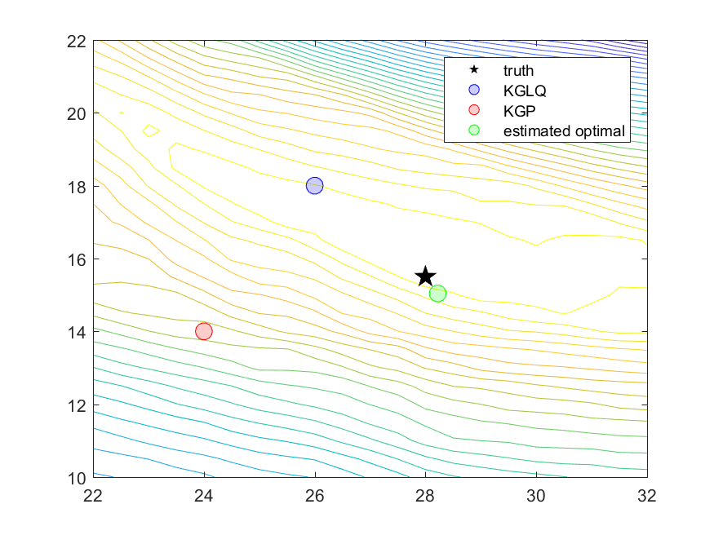

Slide 42
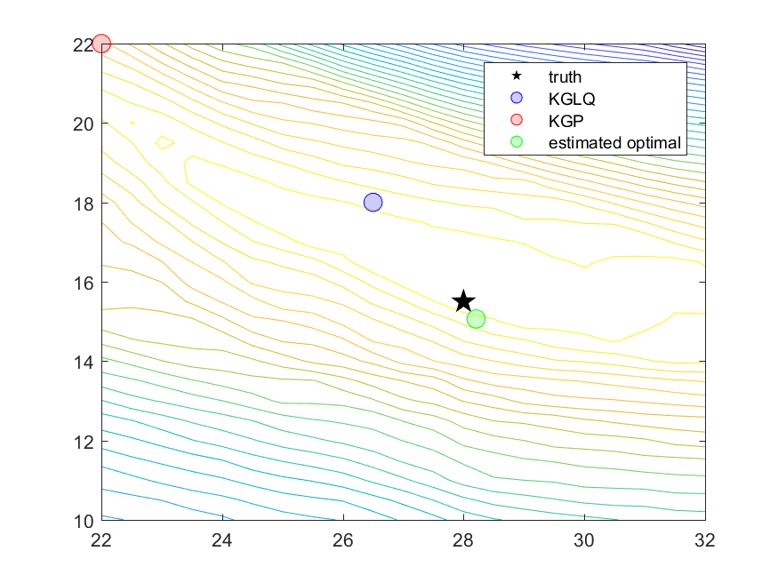

Slide 43


Slide 44


Slide 45


Slide 46


Slide 47
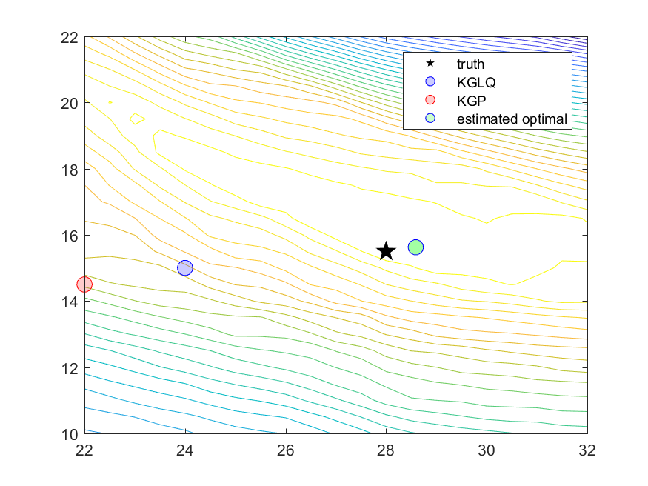

Slide 48
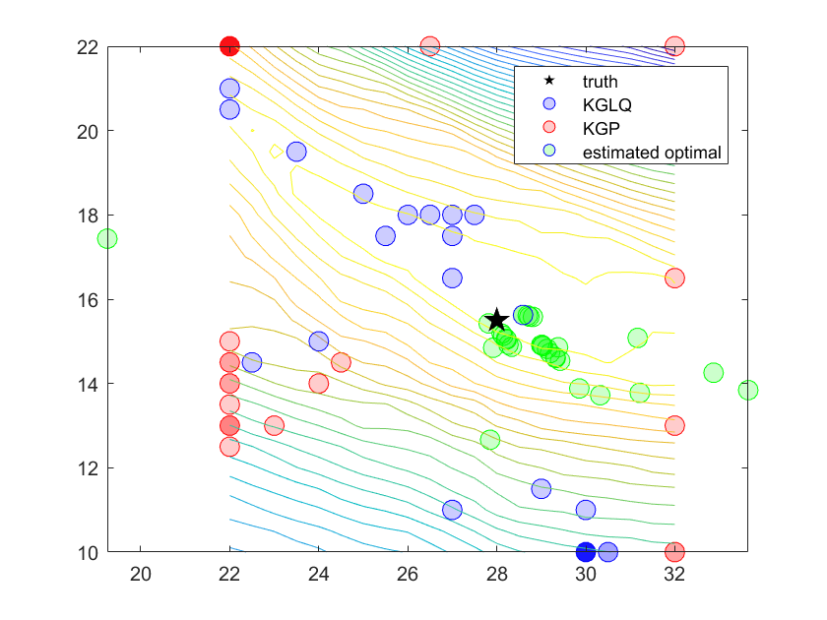

Slide 49
Closing notes:
  Making decisions over time, under uncertainty, is the universal problem. Absolutely guaranteed you will have to do this in a professional setting.
  “Policy search” policies are the simplest, so they are the ones that you are going to most likely encounter in practice (or which you might make up on your own).
  The price of simplicity is tunable parameters. Sometimes it takes a little time to recognize them, but they are there.
  Tuning is hard.

Slide 50
Designing policies
CFA (illustrative)

Slide 51
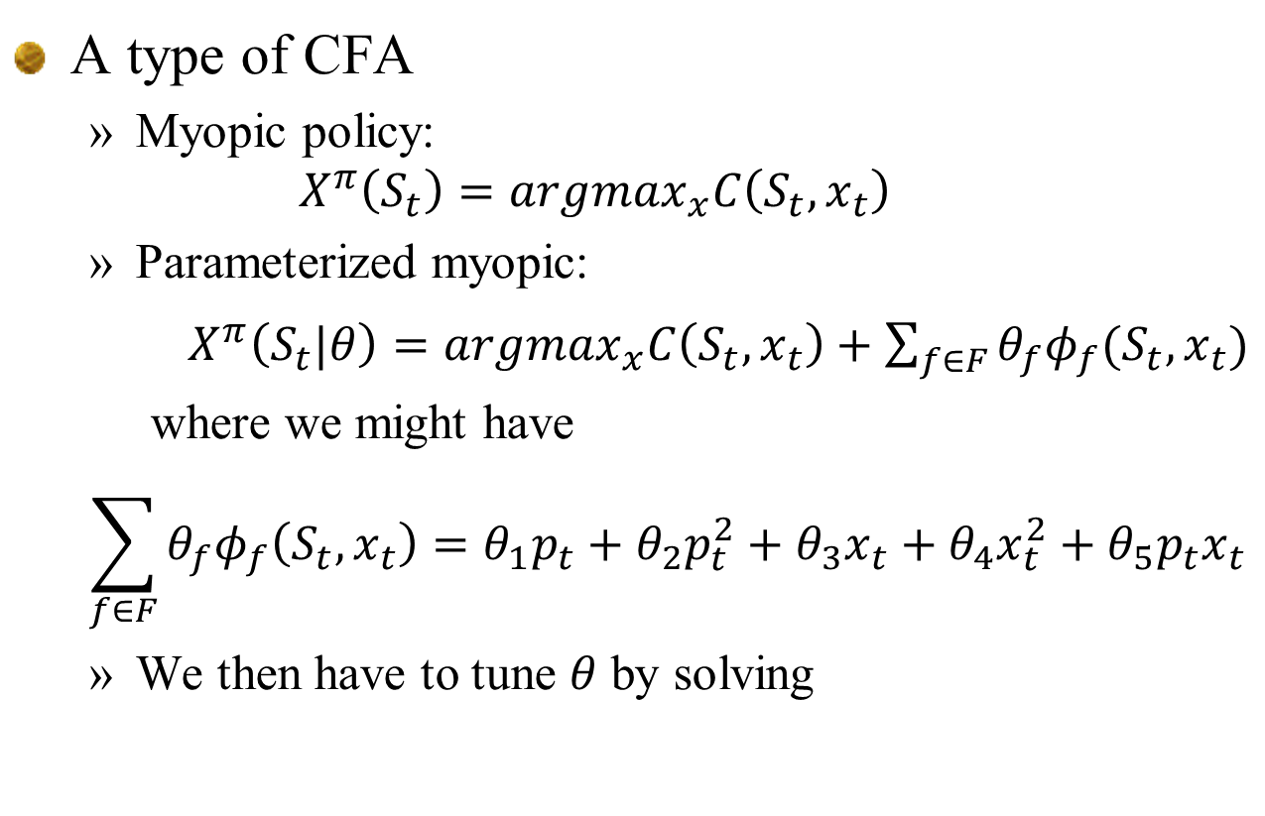
A type of CFA
  Myopic policy:
  $$X^{π}\left(S_{t}\right)=argmax_{x}C\left(S_{t},x_{t}\right)$$
  Parameterized myopic:
  $X^{π}\left(S_{t}|θ\right)=argmax_{x}C\left(S_{t},x_{t}\right)+\sum_{f∈F}{θ_{f}φ_{f}(S_{t},x_{t})}$
  where we might have
  $$\sum_{f∈F}{θ_{f}φ_{f}\left(S_{t},x_{t}\right)=θ_{1}p_{t}+{θ_{2}p_{t}^{2}+θ}_{3}x_{t}+θ_{4}x_{t}^{2}+θ_{5}p_{t}x_{t}}$$
  We then have to tune $θ$ by solving

Slide 52
Notes
  The policy does not attempt to do any form of explicit lookahead. We will do this later.
Derivative-free stochastic search
  Use same search methods as with basic PFA. The presence of the “arg max” within the policy does not affect how you perform policy search.

Slide 53
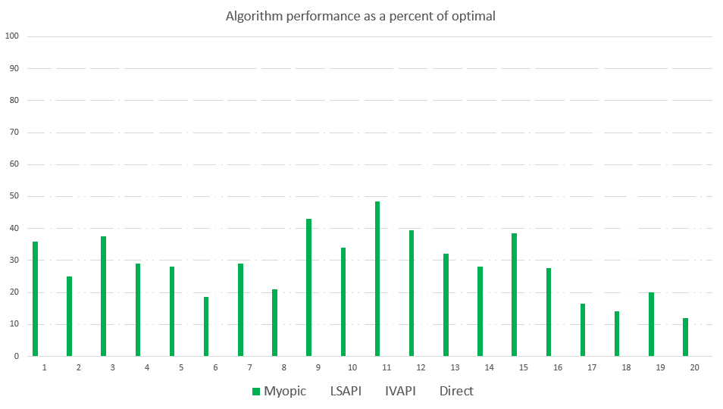
Optimizing storage
Percent of optimal
Myopic policy
For benchmark datasets, see: http:www.castlelab.princeton.edu/datasets.htm

Slide 54
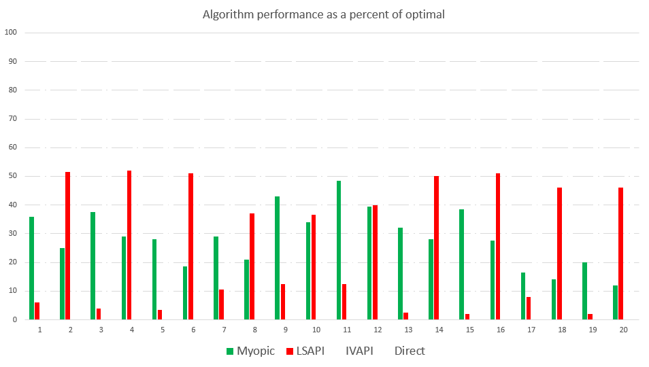
Optimizing storage
Percent of optimal
Myopic policy
LSAPI
For benchmark datasets, see: http:www.castlelab.princeton.edu/datasets.htm

Slide 55
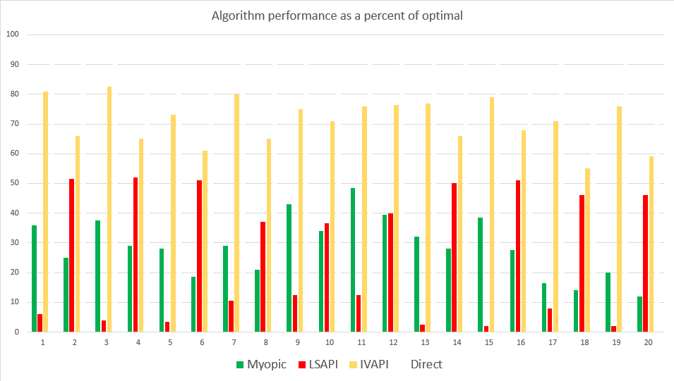
Optimizing storage
Percent of optimal
Myopic policy
LSAPI
LSAPI-Proj
For benchmark datasets, see: http:www.castlelab.princeton.edu/datasets.htm

Slide 56
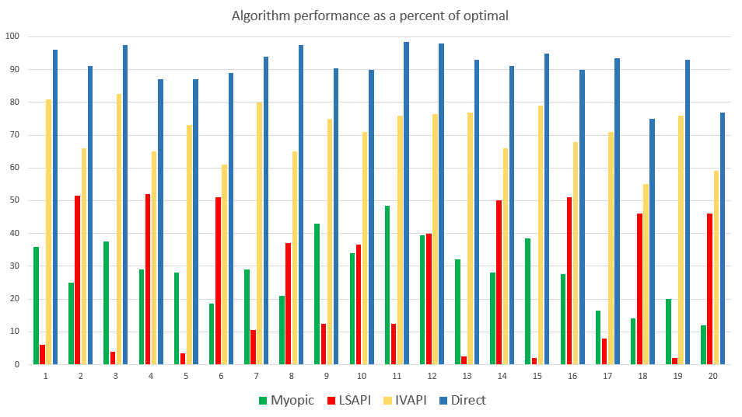
Policy search
Percent of optimal
Policy search.
For benchmark datasets, see: http:www.castlelab.princeton.edu/datasets.htm

Slide 57
Designing policies
Review from last week

Slide 58
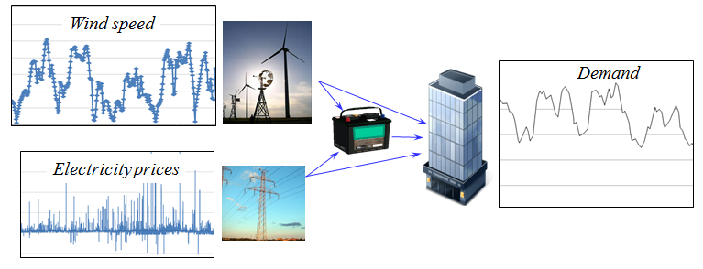
An energy storage problem
Consider a basic energy storage problem:
  We are going to show that with minor variations in the characteristics of this problem, we can make each class of policy work best.

Slide 59
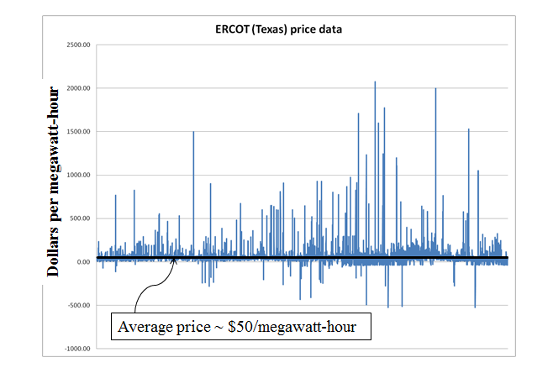

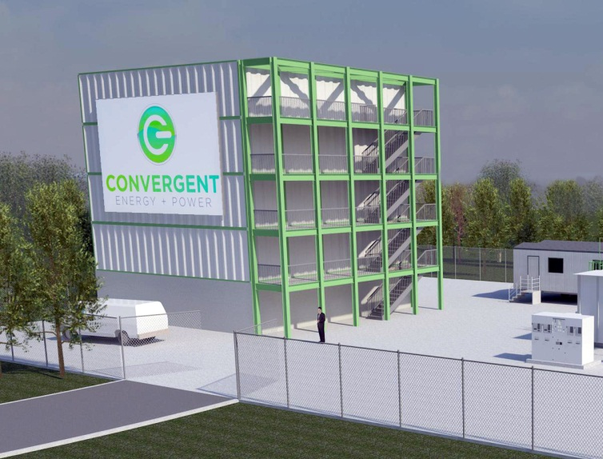
Policy function approximations
Battery arbitrage – When to charge, when to discharge, given volatile LMPs

Slide 60
Policy function approximations
Grid operators require that batteries bid charge and discharge prices, an hour in advance.
We have to search for the best values for the policy parameters

Slide 61
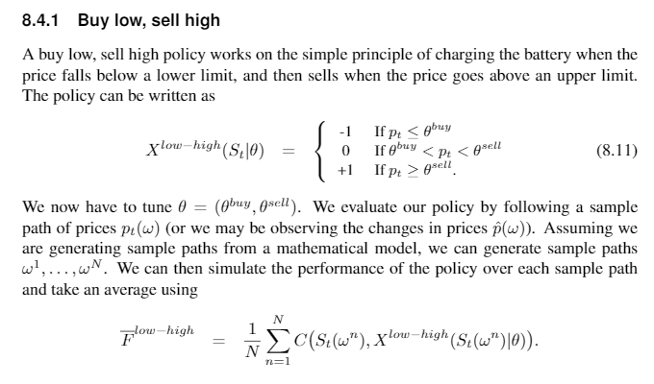
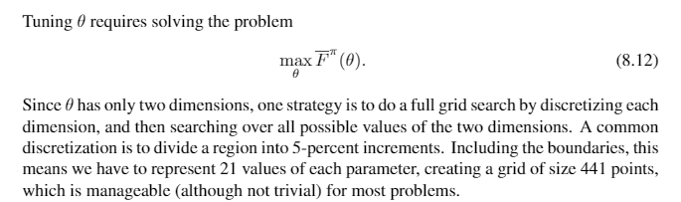

Slide 62
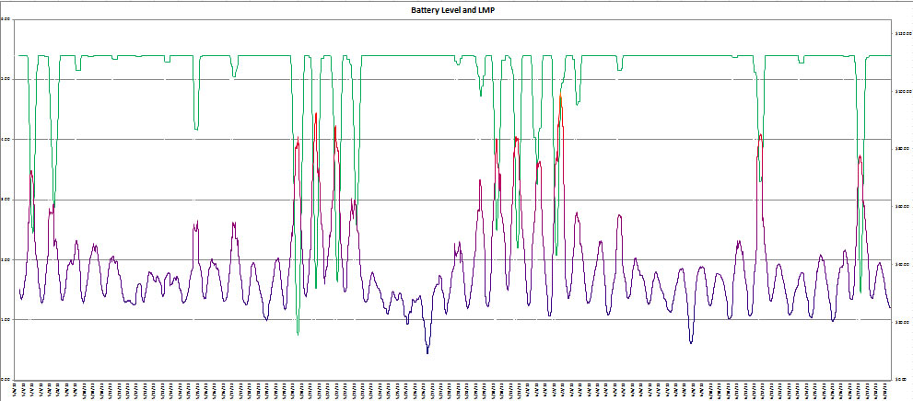
Policy function approximations
Our policy function might be the parametric model (this is nonlinear in the parameters):
Energy in storage:
Price of electricity:

Slide 63
Policy function approximations
Finding the best policy
  We need to maximize
  We cannot compute the expectation, so we run simulations:
Notes:
63

Slide 64
Derivative-free policies
Derivative-free policies
  Some examples of policies are:
    Interval estimation:
    Upper confidence bounding
    Thompson sampling:

Slide 65
A type of CFA
  Myopic policy:
  $$X^{π}\left(S_{t}\right)=argmax_{x}C\left(S_{t},x_{t}\right)$$
  Parameterized myopic:
  $X^{π}\left(S_{t}|θ\right)=argmax_{x}C\left(S_{t},x_{t}\right)+\sum_{f∈F}{θ_{f}φ_{f}(S_{t},x_{t})}$
  where we might have
  $$\sum_{f∈F}{θ_{f}φ_{f}\left(S_{t},x_{t}\right)=θ_{1}p_{t}+{θ_{2}p_{t}^{2}+θ}_{3}x_{t}+θ_{4}x_{t}^{2}+θ_{5}p_{t}x_{t}}$$
  We then have to tune $θ$ by solving

Slide 66
Designing policies
VFA-backward MDP

Slide 67
A storage problem
Bellman’s optimality equation

Slide 68
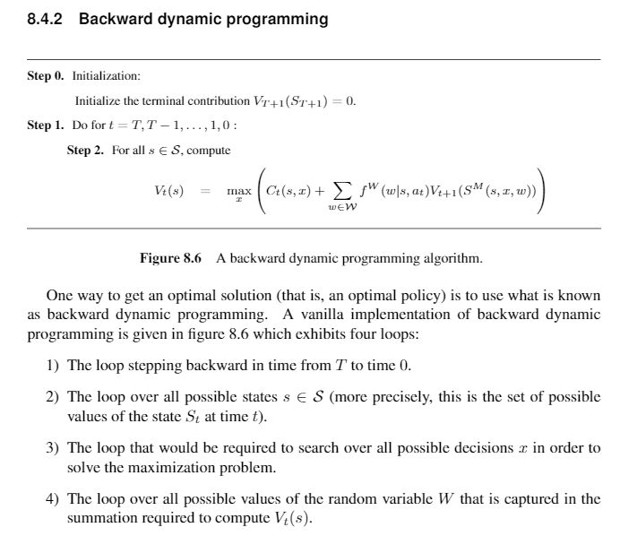

Slide 69
Optimizing a one-dimensional problem
Backward dynamic programming in one dimension

Slide 70
Optimizing a multi-dimensional problem
Dynamic programming in multiple dimensions

Slide 71
Dynamic programming
Notes:
  There are potentially three “curses of dimensionality” when using backward dynamic programming:
    The state variable – We need to enumerate all states. If the state variable is a vector with more than two dimensions, the state space gets very big, very quickly.
    The random information – We have to sum over all possible realizations of the random variable. If this has more than two dimensions, this gets very big, very quickly.
    The decisions – Again, decisions may be vectors (our energy example has five dimensions). Same problem as the other two.
  Some problems fit this framework, but not very. However, when we can use this framework, we obtain something quite rare: an optimal policy.

Slide 72
Dynamic programming
Strategies for computing/approximating value functions:
  Backward dynamic programming
    Exact using lookup tables
    Backward approximate dynamic programming:
      Linear regression
      Low rank approximations
  Forward approximate dynamic programming
    Pure forward pass (online or offline)
    Double pass – Forward simulation with backward learning

