Slide 1
.
Sequential decision analytics and modeling
ORF 411
Fall, 2018
Warren Powell
Princeton University
http://www.castlelab.princeton.edu
© 2017 Warren B. Powell, Princeton University

Slide 2

Week 0 - Wednesday
Illustrations of sequential decision problems
Modeling frameworks
An asset selling problem
Modeling uncertainty
Designing and evaluating policies

Slide 3

Illustrations of sequential decision problems

Slide 4


Learning the market in Africa
How do African consumers respond to energy pricing strategies for recharging cell phones?
  Cell phone use is widespread in Africa, but the lack of a reliable power grid complicates recharging cell phone batteries.
  A low cost strategy is to encourage an entrepreneurial market to develop which sells energy from small, low cost solar panels.
  We do not know the demand curve, and we need to learn it as quickly as possible.

Slide 5

Roomsage.com
Robert Wojciechowski ‘98

Slide 6
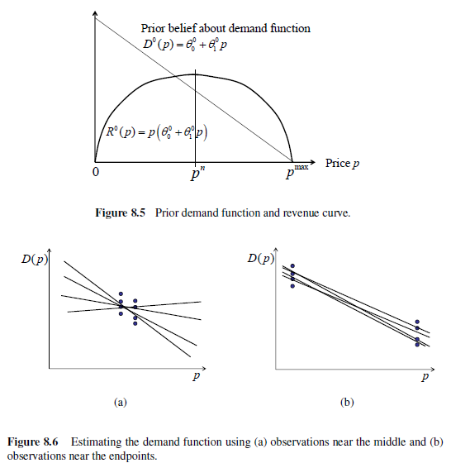
Revenue management
Earning vs. learning
  You want to maximize revenues, but you do not know how demand responds to price.
You earn the most with prices near the middle, but you do not learn anything.
You learn the most by sampling endpoints, but then you do not earn anything.

Slide 7
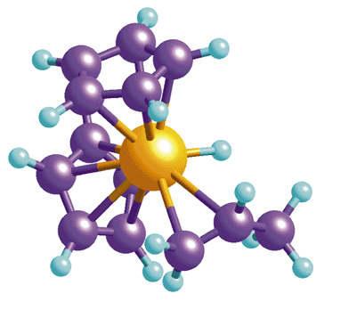
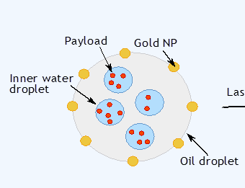
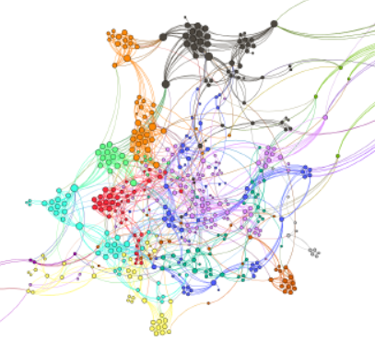
Health applications
Health sciences
  Sequential design of experiments for drug discovery
  Drug delivery – Optimizing the design of protective membranes to control drug release
  Medical decision making – Optimal learning for medical treatments.

Slide 8
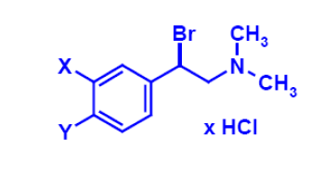

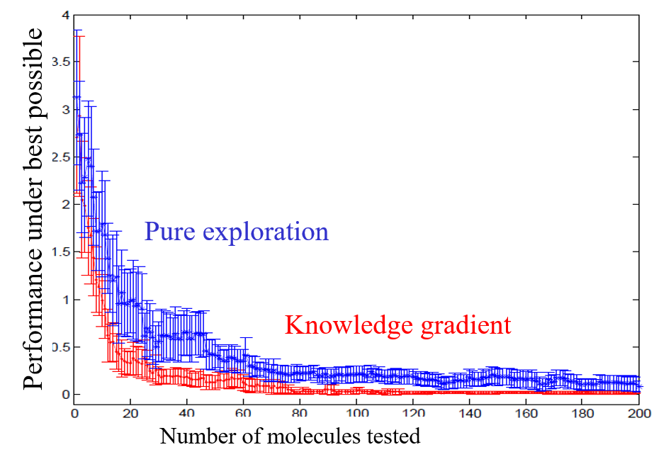
Drug discovery
Optimizing the configuration of molecules
Design of effective policies can accelerate the search process for new drugs.

Slide 9
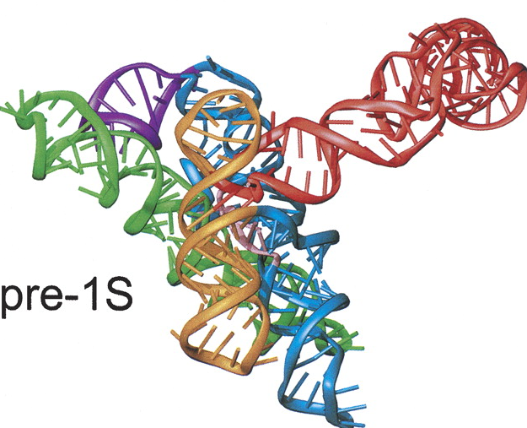
Accessibility of an RNA molecule
Can we efficiently learn the accessible regions of an RNA molecule?
The accessibility of a region of an RNA molecule mediates interaction with other molecules.
Depends on how you define interactions, resulting in several methods for accessing accessibility.
  Mechanical
  Energetic
A-C-C-G-U-A-C-U-G
Mechanically accessible region
Well-protected region = inaccessible
Image courtesy Adams et al., RNA (2004)
Contreras Group, UT Austin

Slide 10
Binding Probe/Reporter Complex
New Methodology: attempt to bind probe/reporter complex with fluorescent marker. If bound, we observe strong fluorescence signal.
Probe/Reporter complex
If a probe cannot bind, then we get no fluorescence signal, indicating inaccessibility.
If probe can bind, we get fluorescence signal, indicating accessibility.
Image courtesy Adams et al., RNA (2004)
Contreras Group, UT Austin

Slide 11
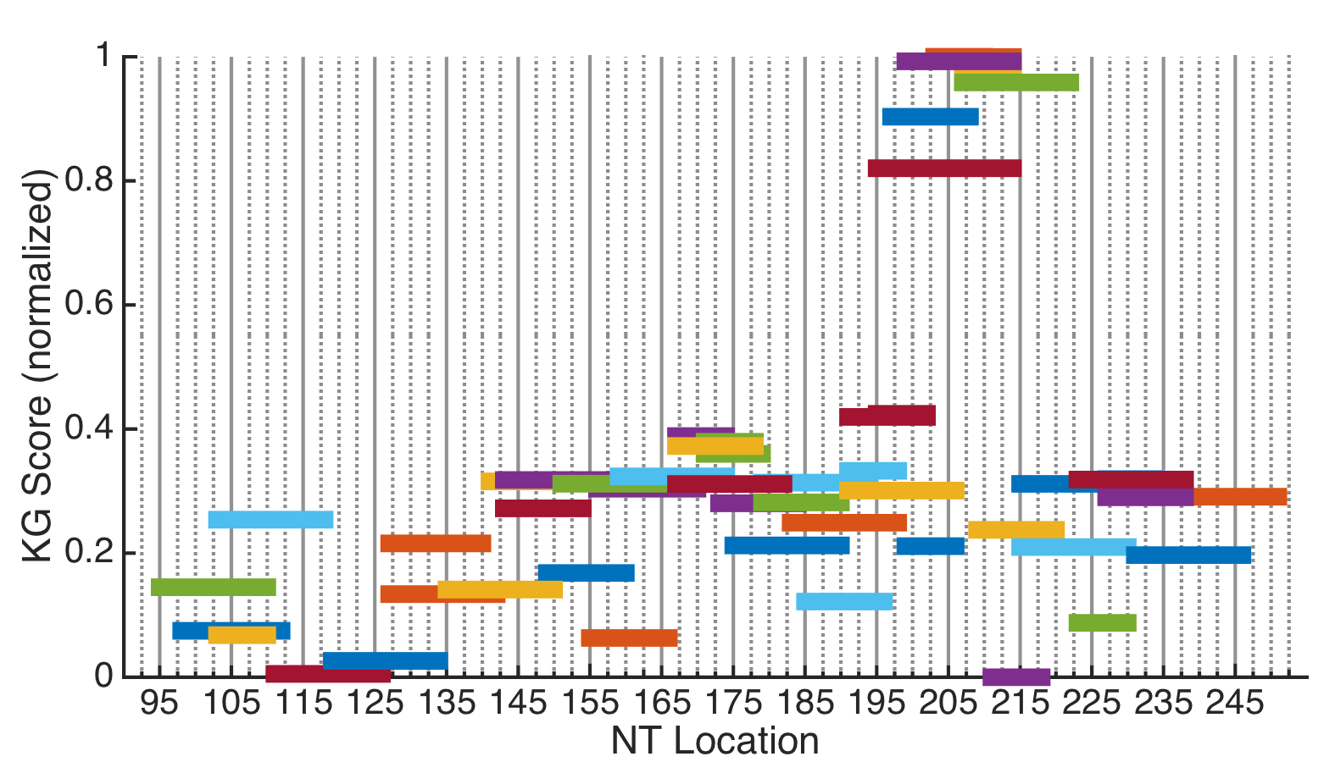
Knowledge Gradient scores
Use KG scores as a guideline to picking the next experiment.
The primer for this highest scoring probe need to be ordered
But we have this primer in stock, and it has a reasonably large KG value.
Contreras Group, UT Austin

Slide 12


Slide 13
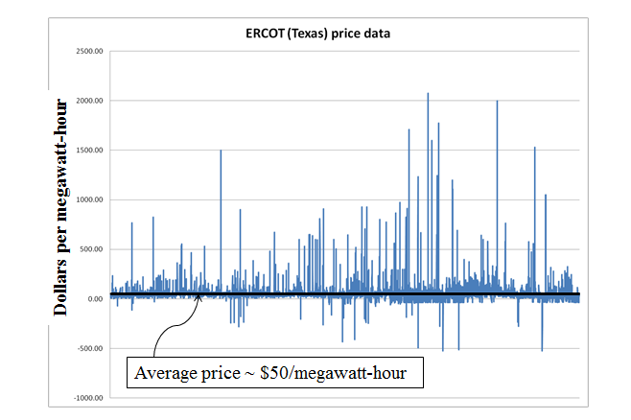

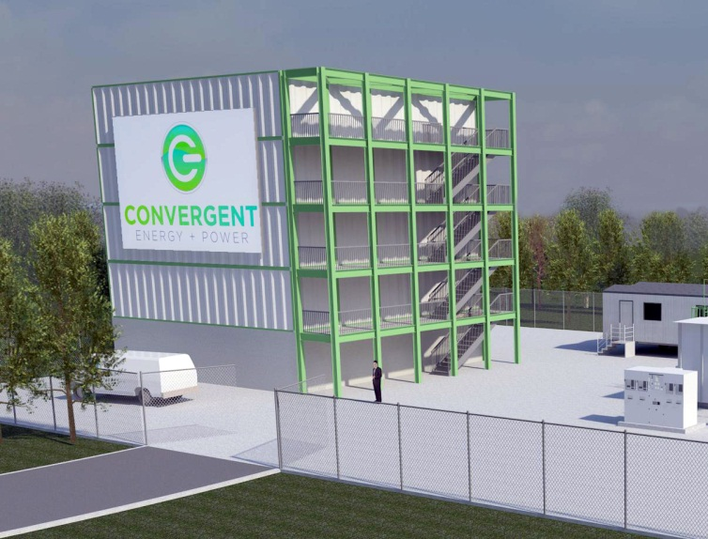
Energy arbitrage
Battery arbitrage – When to charge, when to discharge, given volatile LMPs

Slide 14
Policy function approximations
Grid operators require that batteries bid charge and discharge prices, an hour in advance.
We have to search for the best values for the policy parameters

Slide 15
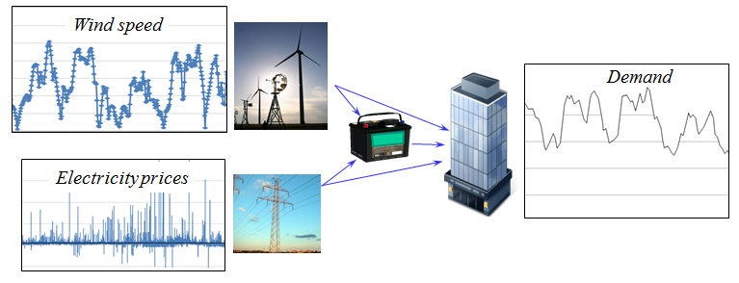
Energy storage
How much energy to store in a battery to handle the volatility of wind and spot prices to meet demands?

Slide 16
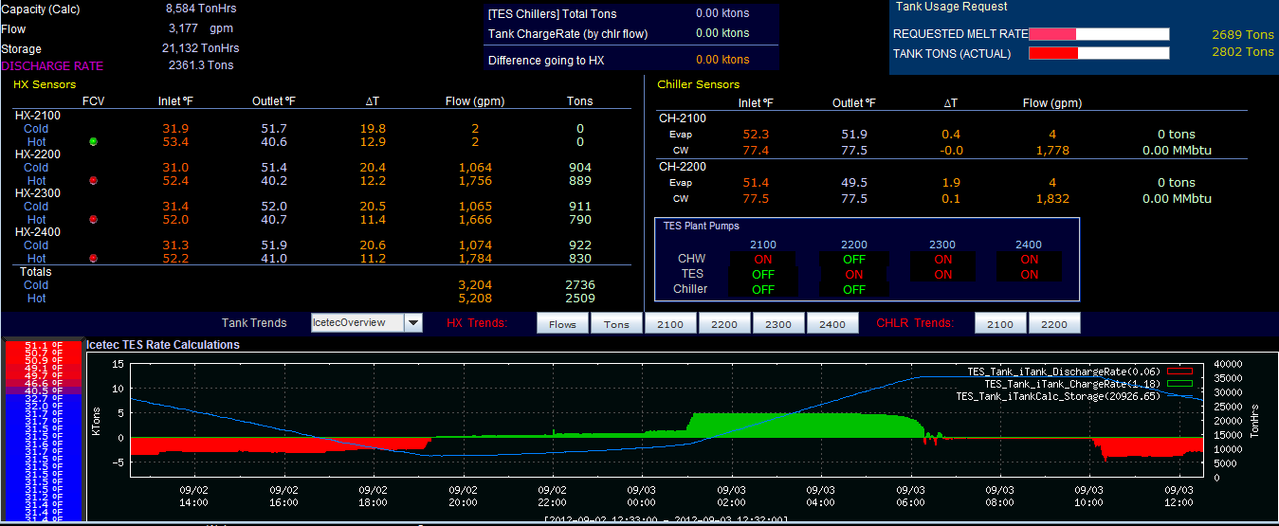
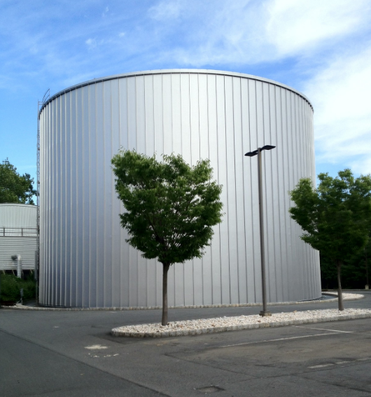
Energy usage management
Chilled water management at Princeton University
  Major issue is how much to store in chilled water tank

Slide 17
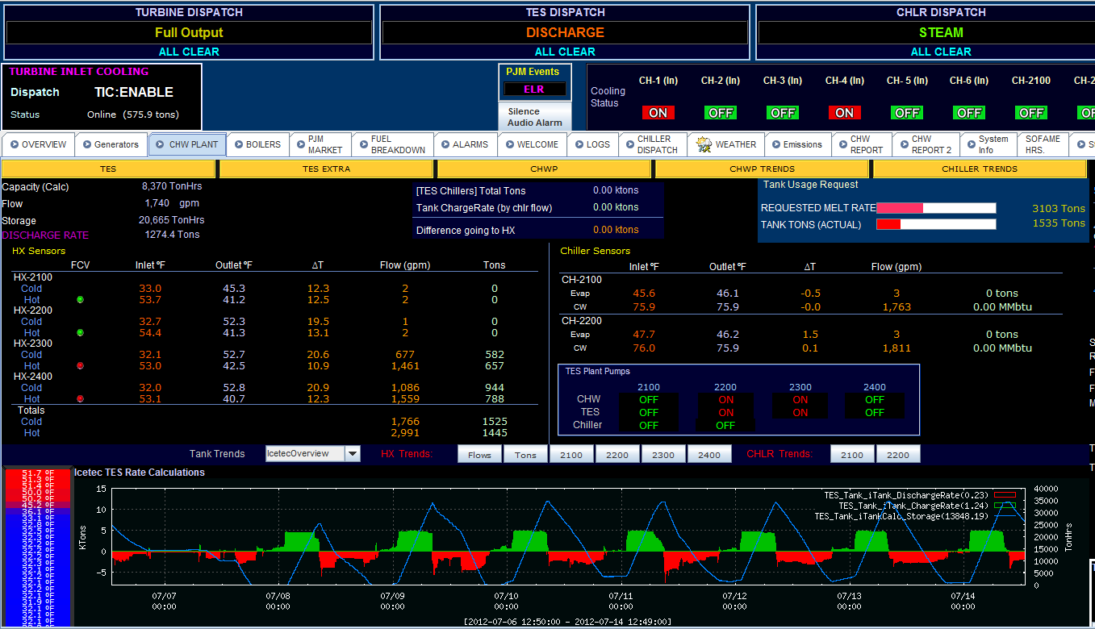
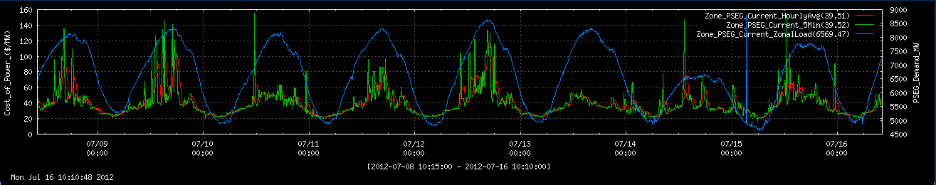
Energy usage management
Real time spot prices
Green line is real-time (5 minute) electricity spot prices

Slide 18
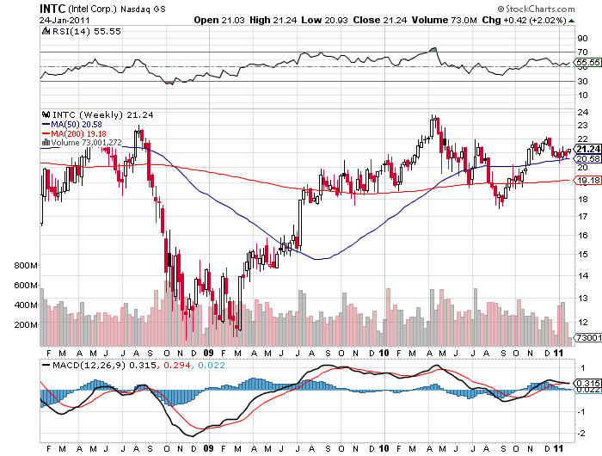


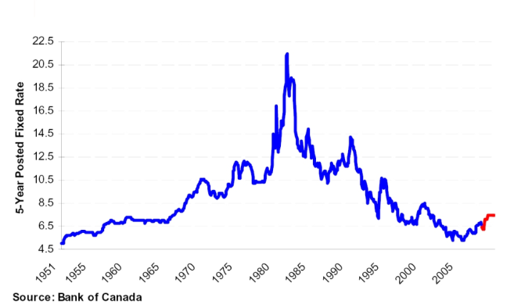
Planning cash reserves
How much money should we hold in cash given variable market returns and interest rates to meet the needs of a business?
Stock prices
Bonds

Slide 19
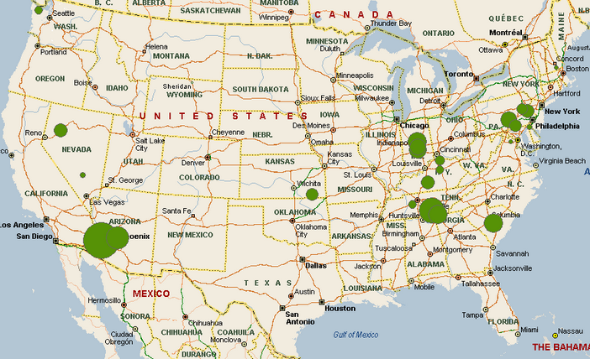
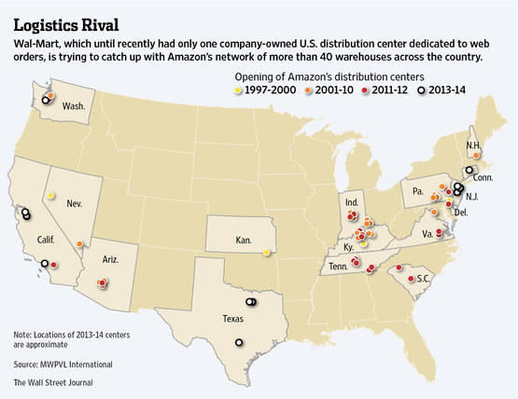
Amazon distribution network
  Small number of DC’s
  Uses UPS, FedEx, for final distribution
Walmart distribution network
  Extensive retail network
  Limited need for distribution centers
  Increasing role of internet sales

Slide 20

Amazon
First supply chain logistics conference in 2015
Still running off of spreadsheets developed by Jeff Bezos
Numerous instances where uncertainty is an important element.
Exclusively using deterministic optimization tools at that time.

Slide 21
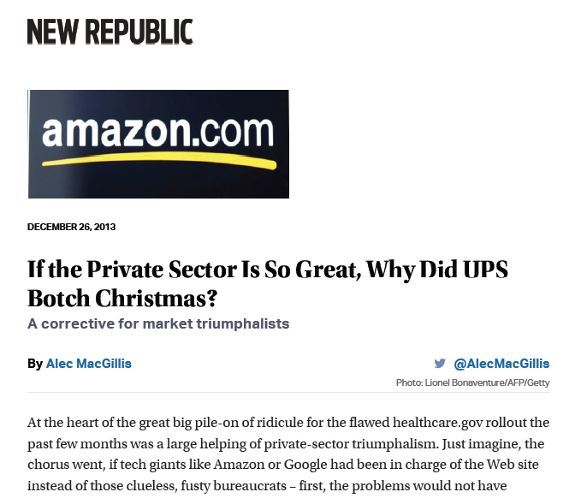
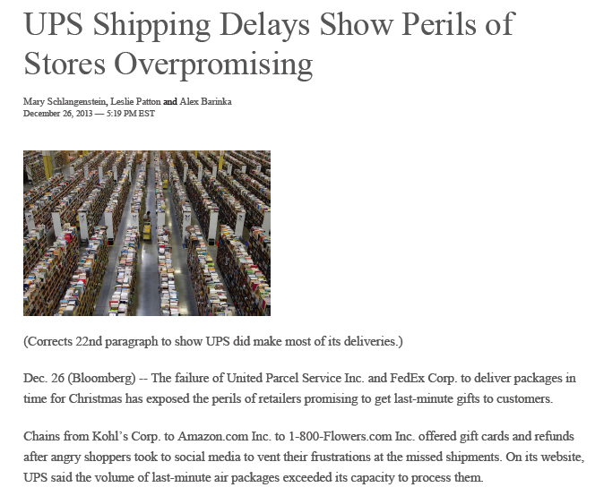
Supply chain management
Amazon-UPS meltdown, Christmas, 2013
  Amazon promised 2-day service (based on UPS service guarantees). UPS was overwhelmed.

Slide 22
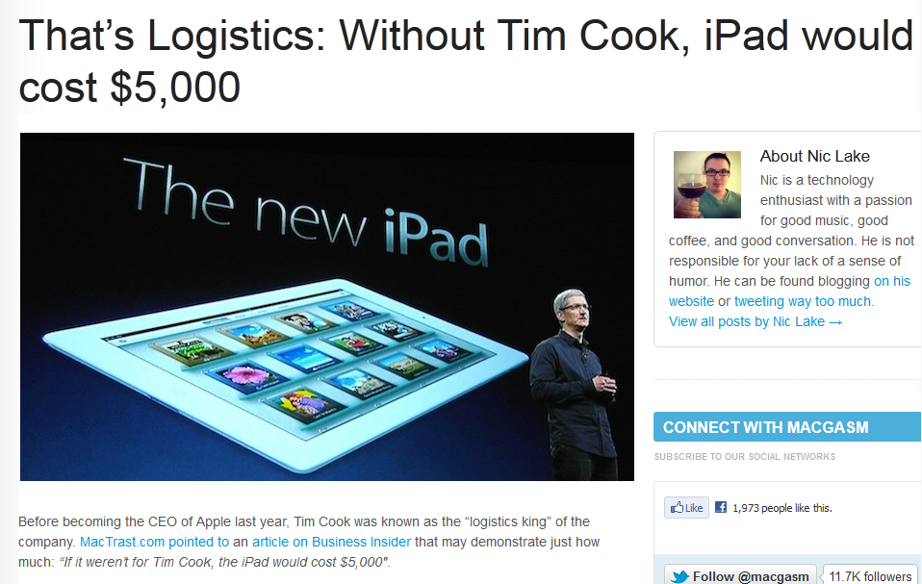

Notes:
http://www.macgasm.net/2012/03/24/logistics-tim-cook/

Slide 23
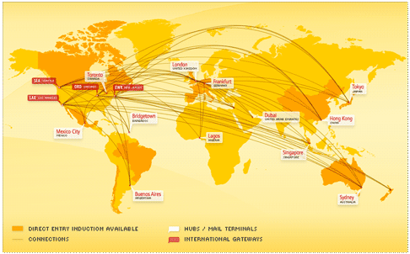
Global logistics
Apple, Inc.
Notes:
Who is Tim Cook – CEO of Apple
What was his job before taking over from Steve Jobs? Head of global logistics
Apple has gained a significant advantage over its competitors through logistics, largely in the form of contracts that lock up supplies of materials and components, blocking out competitors.

Slide 24
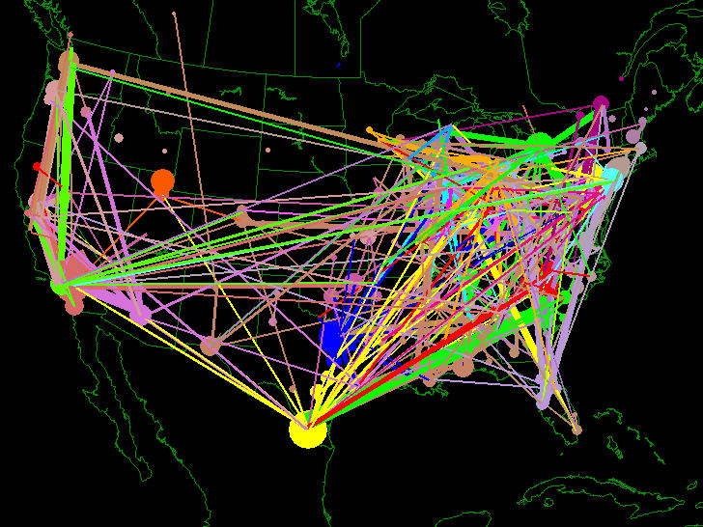
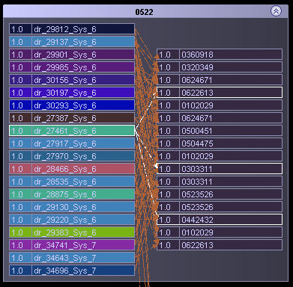
Fleet management
Fleet management problem
  Optimize the assignment of drivers to loads over time.
  Tremendous uncertainty in loads being called in

Slide 25
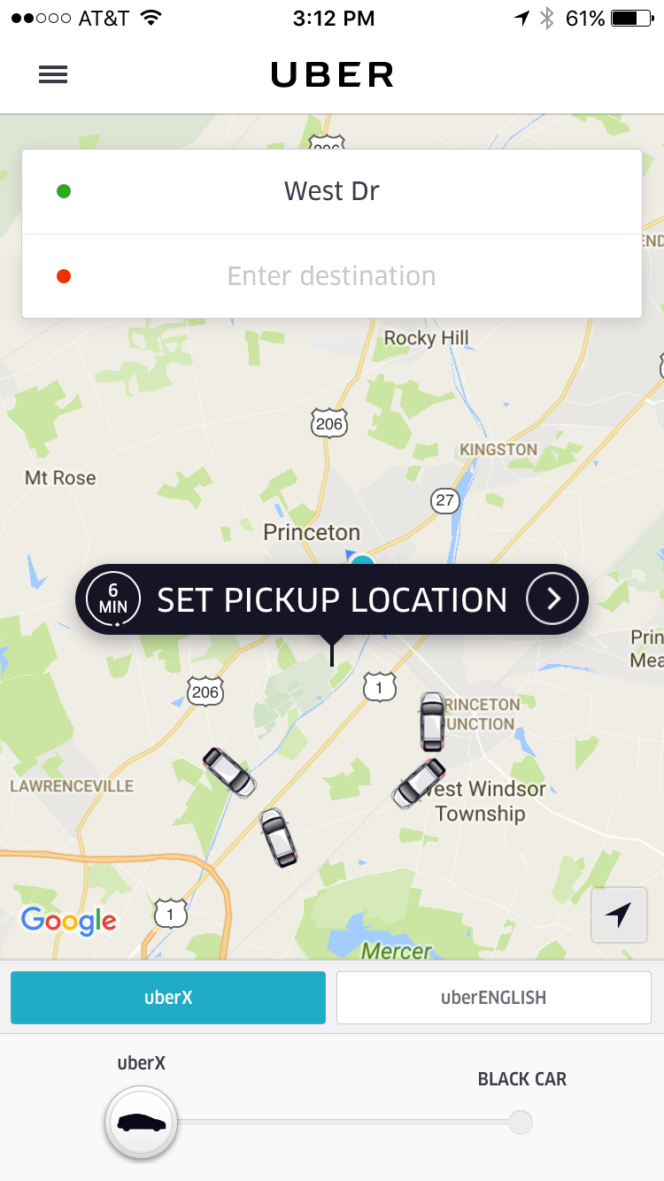
Real-time logistics
Uber
  Provides real-time, on-demand transportation.
  Drivers are encouraged to enter or leave the system using pricing signals and informational guidance.
Decisions:
  How to price to get the right balance of drivers relative to customers.
  Assigning and routing drivers to manage Uber-created congestion.
  Real-time management of drivers.
  Pricing (trips, new services, …)
  Policies (rules for managing drivers, customers, …)

Slide 26
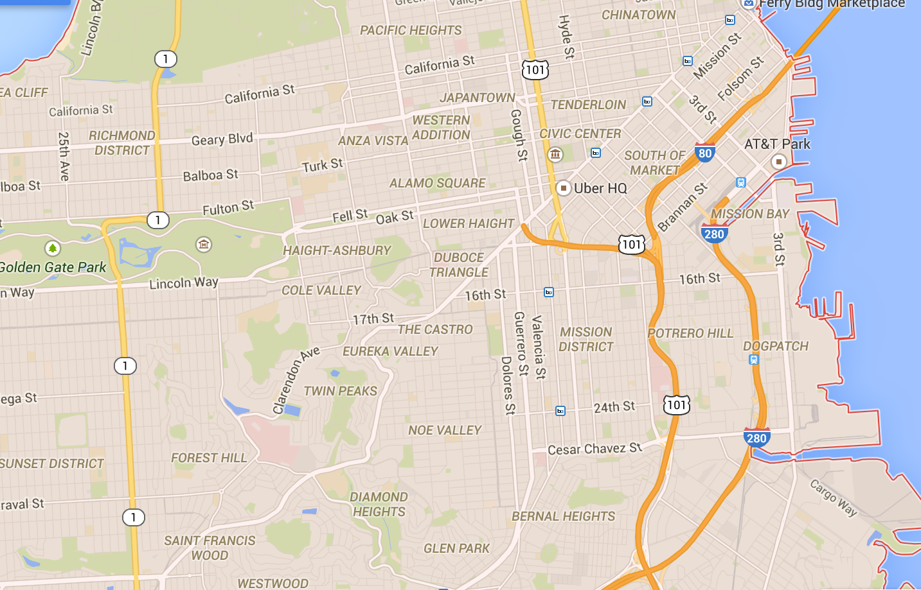

Effect of Current Decision on the Future
Assigning car in less dense area allows closer car to handle potential demands in more dense areas.
Closest car…. but it moves car away from
busy downtown area
and strands other car in low density area.

Slide 27
Cost function approximations
Cars
Riders
Notes:
… to tasks (loads, trains, flights).

Slide 28
Optimizing over time
t
t+1
t+2

Slide 29
Optimizing over time
t
t+1
t+2

Slide 30
Optimizing over time
t
t+1
t+2
The assignment of cars to riders evolves over time, with new riders arriving, along with updates of cars available.

Slide 31
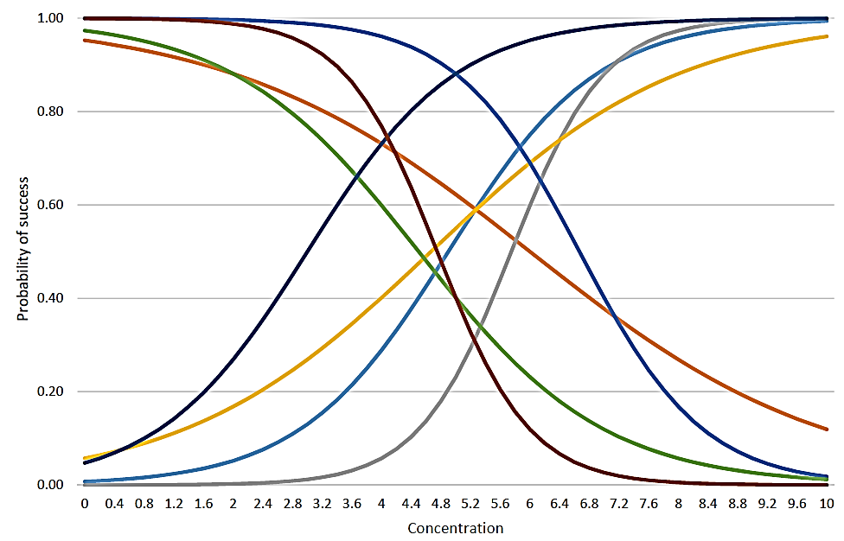
Matching buyers with sellers
Now we have a logistic curve for each origin-destination pair (i,j)
Number of offers for each (i,j) pair is relatively small.
Need to generalize the learning across hundreds to thousands of markets.
Buyer
Seller
Offered price

Slide 32
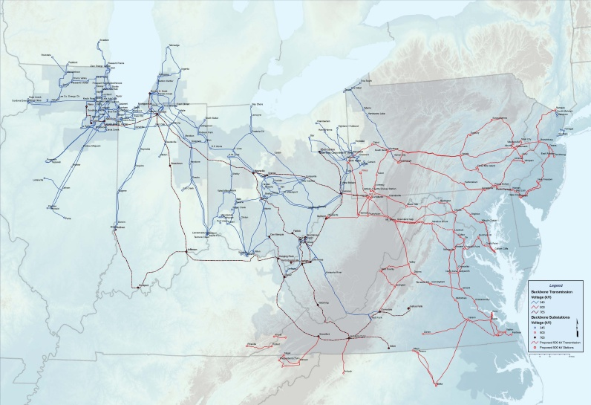

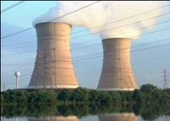
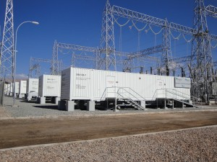
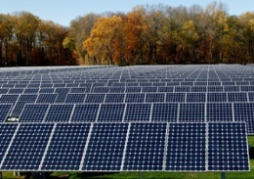
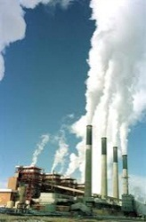
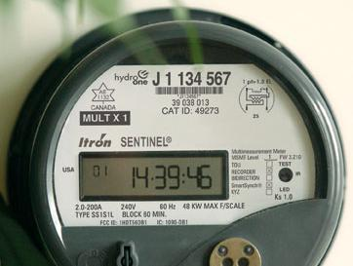
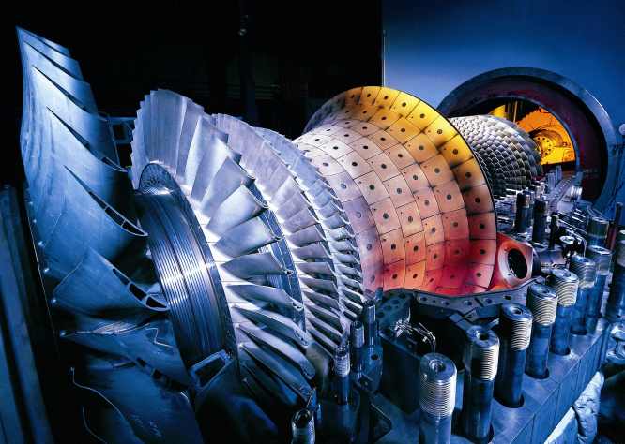
An energy generation portfolio

Slide 33
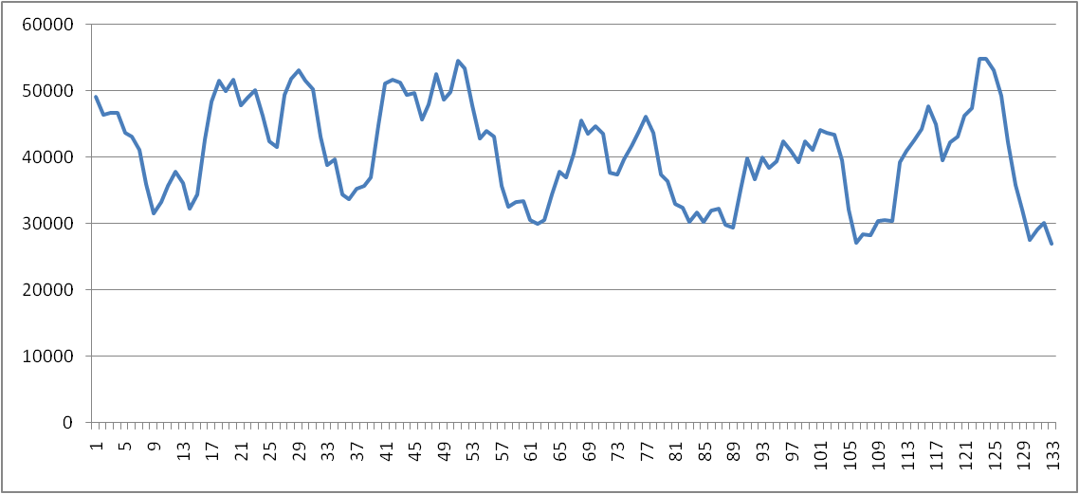
The PJM planning process
Day-ahead planning (slow – predominantly steam)
Intermediate-term planning (fast – gas turbines)
Real-time planning (economic dispatch)
Notes:
SMART-ISO is composed by three nested subsystems: a day-ahead planning model (which schedules primarily the steam generation, or the so-called “slow” generators), an intermediate-term planning model (which schedules primarily the gas turbines, or the “fast” generators), and a real-time simulation model (which corresponds to the economic dispatch).

Slide 34
The PJM planning process
The day-ahead unit commitment problem
Midnight
Midnight
Midnight
Midnight
Noon
Noon
Noon
Noon
Notes:
The day-ahead model runs at, say, noon of every day, aiming to schedule generation for the following day (midnight to midnight).

Slide 35
The PJM planning process
Intermediate-term unit commitment problem
1:00 pm
2:00 pm
3:00 pm
1:15 pm
1:45 pm
2:15 pm
2:30 pm
1:30

Slide 36
The PJM planning process
Intermediate-term unit commitment problem
1:00 pm
2:00 pm
3:00 pm
1:15 pm
1:45 pm
2:15 pm
2:30 pm
1:30

Slide 37
The PJM planning process
Intermediate-term unit commitment problem
2:00 pm
3:00 pm
Commitment
decisions
1:15 pm
1:30
Turbine 2
Ramping, but no on/off decisions.
Turbine 3
Turbine 1
Notification time

Slide 38
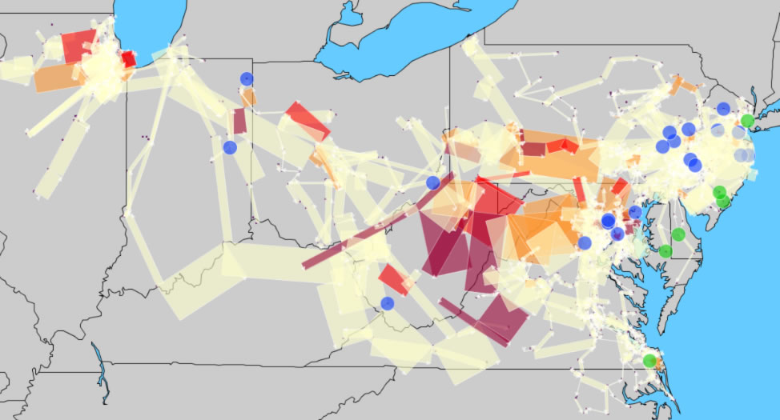
Electricity
The PJM power grid

Slide 39
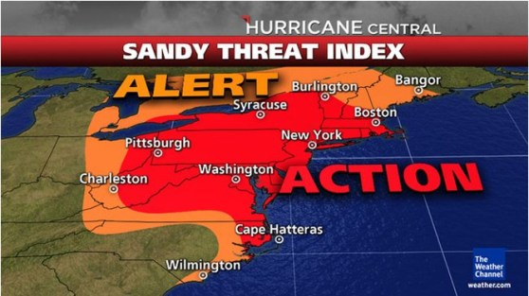
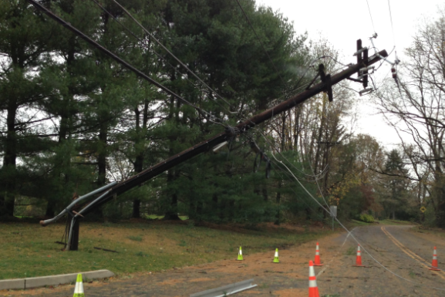
Emergency storm response
Hurricane Sandy
  Once in 100 years?
  Rare convergence of events
  But, meteorologists did an amazing job of forecasting the storm.
The power grid
  Loss of power creates cascading failures (lack of fuel, inability to pump water)
  How to plan?
  How to react?

Slide 40
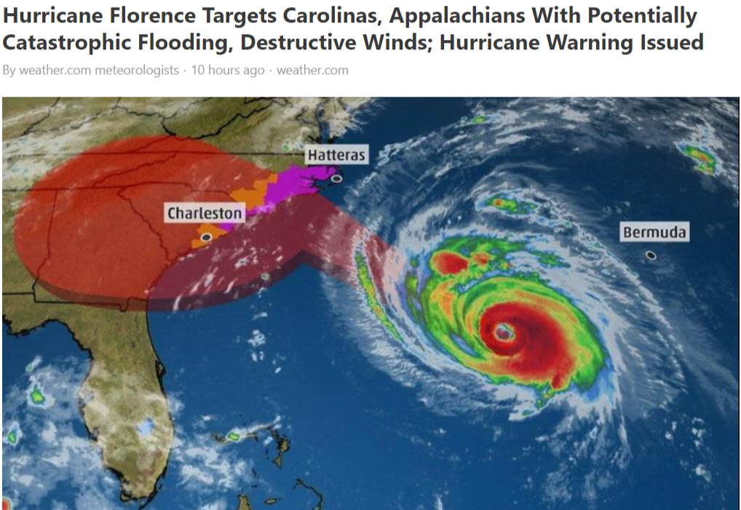

Slide 41
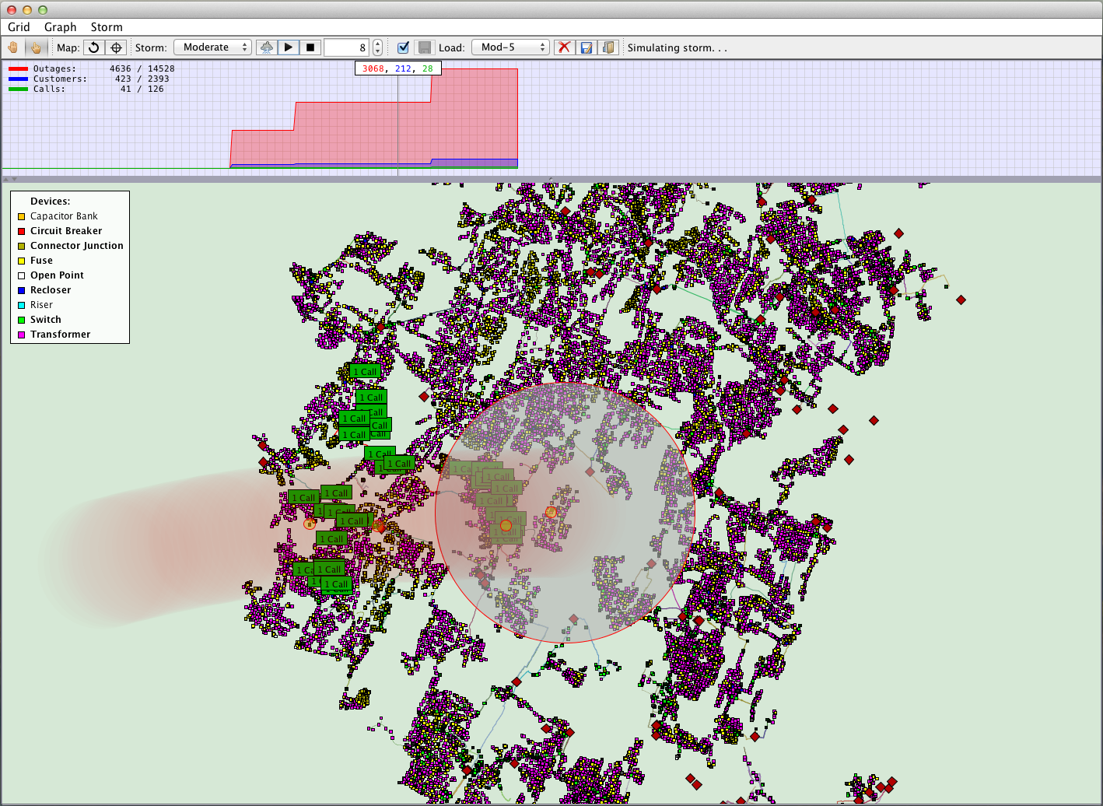
Unknown outages
Known customers in outage
Outage calls
(known)
Storm ☺
Network outages
(unknown)
Notes:
This is a screen shot of a simulator we call “SMART-Circuit” – it uses a copy of the distribution grid for the metro-north area of New Jersey (courtesy of PSE&G). It simulates storms, and simulates the process of trees damaging the lines. Then using the grid configuration, we simulate reclosers shutting down the relevant parts of the grid. Finally we simulate customers randomly calling in (PSE&G reports that only 1 percent call in). Up top, we show that we can keep track of the customers who have lost power that we know about (both from lights-out calls, as well as inferring who would have lost power based on grid configuration), as well as customers who have lost power, and there is no way we would know that they had lost power.

Slide 42
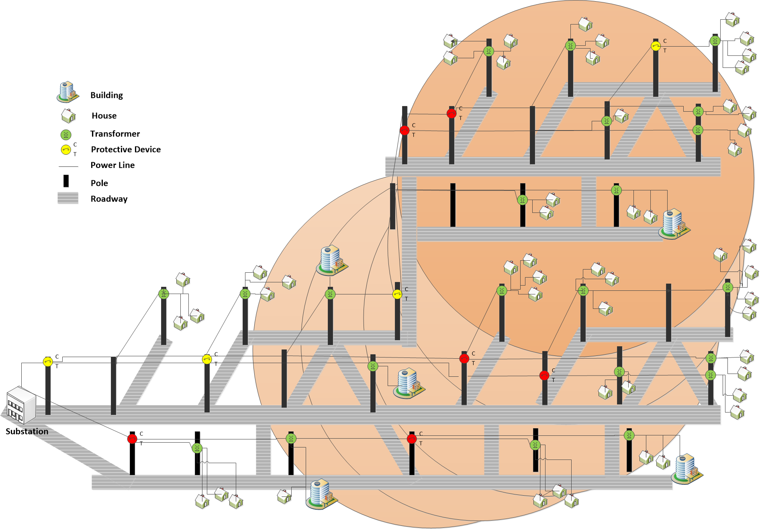
Problem Description - Emergency Storm Response
call
X
X
call
call
X
X
call
X
X
call
call
call

Slide 43
Emergency storm response
0.5
call
0.503
0.503
X
0.503
0.503
0.503
0.503
0.54
0.54
X
0.76
0.064
0.064
0.064
call
0.064
call
0.603
0.603
0.05
X
0
0.02
0.04
0.502
0.502
0
0
0.03
0.04
0.05
0.502
0.502
0.502
0.05
0.67
X
0.67
call
0.26
0.38
0.78
0.6
0.6
X
X
call
call
call

Slide 44
Emergency storm response
0.5
call
0.503
0.503
X
0.503
0.503
0.503
0.503
0.54
0.54
X
0.76
0.0604
0.0604
0.0604
call
0.0604
call
0.62
0.62
0.08
X
0
0.056
0.51
0.51
0.032
0
0
0.048
0.056
0.08
0.51
0.51
0
0.08
0.99
X
0
call
0.0
0.0
0.0
0.0
0.0
X
X
call
call
call

Slide 45
Emergency storm response
0.5
call
0.503
0.503
X
0.503
0.503
0.503
0.503
0.54
0.54
X
0.76
0.06
0.06
0.06
call
0.06
call
0
0
0.0
X
0
0.0
0
0
0.0
0
0
0.0
0.0
0.0
0
0
0
0.0
0
X
0
call
0.0
0.0
0.0
0.0
0.0
X
X
call
call
call

Slide 46


Modeling
“To do good modeling, all you have to do is listen.”
Click here for decisions.

Slide 47
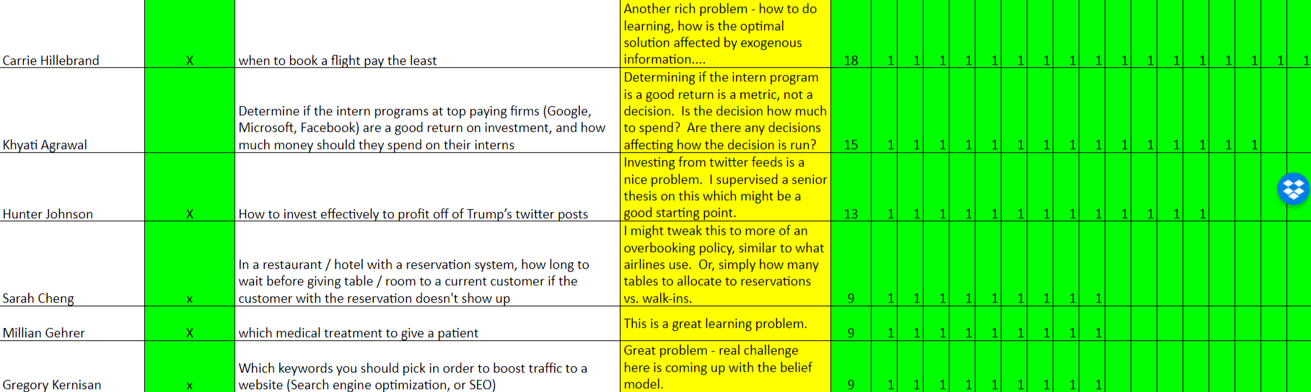
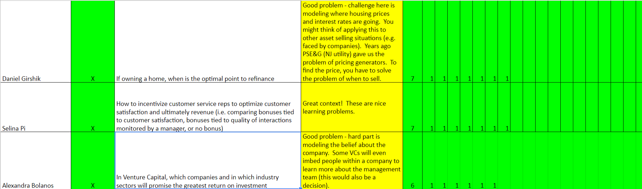

Slide 48
Modeling frameworks

Slide 49
Modeling stochastic, dynamic problems
Before we can solve complex problems, we have to know how to think about them.
The biggest challenge when making decisions under uncertainty is modeling.
Min E {Σ cx}
Ax = b
x > 0
Organize class
libraries, and set up
communications and
databases
Mathematician
Software

Slide 50

Stochastic
programming
Approximate
dynamic
programming
Robust
optimization
Decision
analysis
Simulation
optimization
Optimal
learning
Dynamic
Programming
and
control
Model
predictive
control
Stochastic
search
Optimal
control
Bandit
problems
Reinforcement
learning
Online
computation
Markov
decision
processes
Stochastic
control
Simulation
optimization
Notes:
Clearing the Jungle of Stochastic optimization – Professor Warren Powell in the Department of Operations Research and Financial Engineering has developed a unified framework for modeling virtually every problem involving optimization under uncertainty. More than just a purely theoretical characterization, he has identified four (meta)classes of policies which provide a clear path to computation (although there is still a lot of work to do for most problems). The framework has identified new problem classes, as well as novel computational strategies. For example, modeling and algorithmic strategies that have long been viewed as competitive (for example, dynamic programming versus stochastic programming) are actually complementary. By building on this integrated framework, we can spend less time focusing on optimizing (making decisions), and more time on an overlooked dimension of stochastic optimization, which is modeling uncertainty.

Slide 51




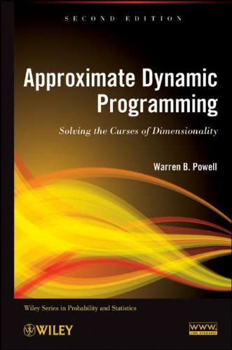
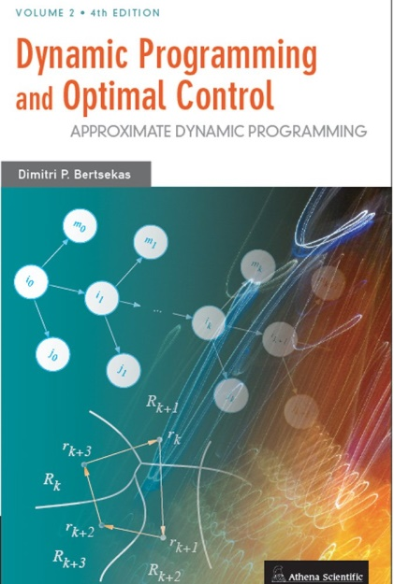


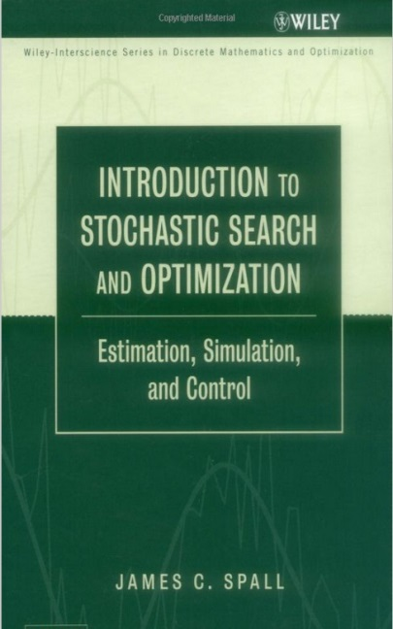



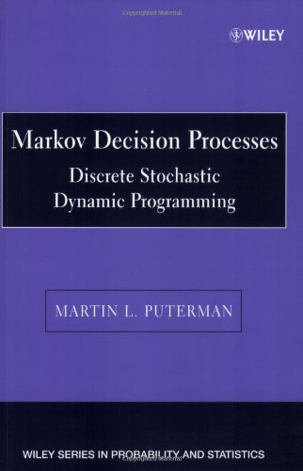



Stochastic
programming
Approximate
dynamic
programming
Robust
optimization
Decision
analysis
Simulation
optimization
Optimal
learning
Dynamic
Programming
and
control
Model
predictive
control
Stochastic
search
Optimal
control
Bandit
problems
Reinforcement
learning
Online
computation
Markov
decision
processes
Stochastic
control
Simulation
optimization
Notes:
Clearing the Jungle of Stochastic optimization – Professor Warren Powell in the Department of Operations Research and Financial Engineering has developed a unified framework for modeling virtually every problem involving optimization under uncertainty. More than just a purely theoretical characterization, he has identified four (meta)classes of policies which provide a clear path to computation (although there is still a lot of work to do for most problems). The framework has identified new problem classes, as well as novel computational strategies. For example, modeling and algorithmic strategies that have long been viewed as competitive (for example, dynamic programming versus stochastic programming) are actually complementary. By building on this integrated framework, we can spend less time focusing on optimizing (making decisions), and more time on an overlooked dimension of stochastic optimization, which is modeling uncertainty.

Slide 52
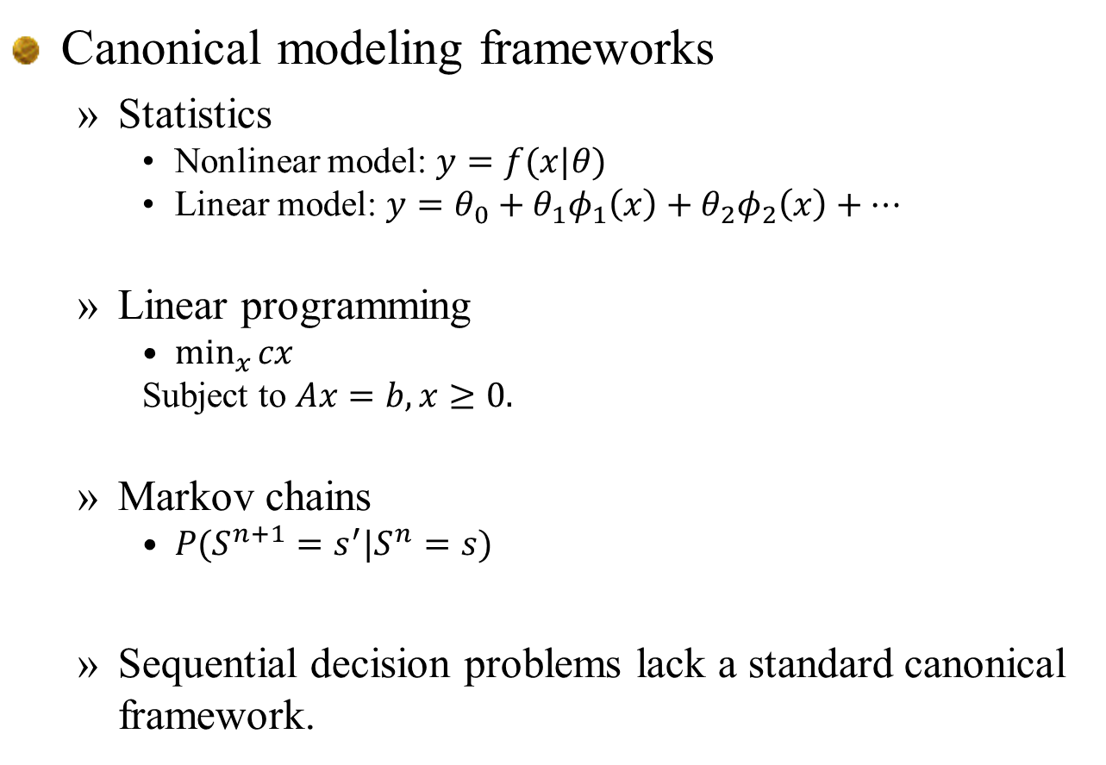
Canonical modeling frameworks
  Statistics
    Nonlinear model: $y=f(x|θ)$
    Linear model: $y=θ_{0}+θ_{1}φ_{1}\left(x\right)+θ_{2}φ_{2}\left(x\right)+…$
  Linear programming
    $\min_{x}{cx}$
    Subject to $Ax=b, x≥0.$
  Markov chains
    $P(S^{n+1}=s^{′}|S^{n}=s)$
  Sequential decision problems lack a standard canonical framework.

Slide 53
Modeling dynamic systems
Almost all sequential decision problems can be modeled using five core components:
  State variables
    What is in the state variable? What do we need to know at time t?
  Decision variables
    What are our decisions?
  Exogenous information
    What do we learn for the first time between t and t+1?
  Transition function
    How does the problem evolve from t to t+1.
  Objective function
    What are we minimizing and how?

Slide 54
Board setup:
  List all five elements across upper two boards
  Then work through each element providing notation and description.
  Erase and do uncertainty modeling on left, then design policies on the right.
  For asset selling, start over with all five elements, and move organically through the problem.

Slide 55
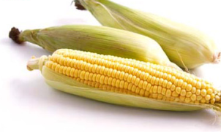


Modeling dynamic problems
The state variable:
Notes:
55

Slide 56

Modeling

Slide 57

State variables (cont’d)

Slide 58

State variables (cont’d)

Slide 59
Modeling dynamic problems
Decisions:
Notes:
59

Slide 60


Slide 61
The decision variables
Styles of decisions
  Binary
  Finite
  Continuous scalar
  Continuous vector
  Discrete vector
  Categorical

Slide 62
Modeling dynamic problems
Exogenous information:
Note: Any variable indexed by t is known at time t. This convention, which is not standard in control theory, dramatically simplifies the modeling of information.
Notes:
62

Slide 63


Slide 64
Modeling dynamic problems
The transition function
Also known as the:
“System model”
“State transition model”
“Plant model”
“Plant equation”
“State equation”
“Transfer function”
“Transformation function”
“Law of motion”
“Model”
“transition function”
For many applications, these equations are unknown. This is known as “model-free” dynamic programming.
Notes:
64

Slide 65



Slide 66
Modeling stochastic, dynamic problems
Objective functions
  Performance metrics:
    Rewards, profits, revenues, costs, contributions, rewards (business)
    Gains, losses (engineering)
    Strength, conductivity, diffusivity (materials science)
    Tolerance, toxicity, effectiveness (health)
    Stability, reliability (engineering)
    Risk, volatility (finance)
    Utility (economics)
    Errors (machine learning)
    Time (to complete a task)

Slide 67
Modeling stochastic, dynamic problems
Objective functions
  Uncertainty metrics:
    Expectations
    Risk measures
      Variance
      Quantiles
      Expected semi-deviations
      Var, CVaR, …
    Robust (worst-case)

Slide 68

Modeling stochastic, dynamic problems
Objective functions
  Cumulative reward (“online learning”)
    Policies have to work well over time.
  Final reward (“offline learning”)
    We only care about how well the final decision $x^{π,N}$ works.
  Risk

Slide 69
The modeling process:
  The narrative
    This is a plain English description of the problem. This should be fairly short, but should give the audience a sense of the problem.
  The model
    This consists of the five elements:
  The modeling process
    Filling in the elements of the model is not linear. State variables are built up as part of the process.
States Decisions Exogenous Transition Objective
information function function

Slide 70
The modeling process
Modeling real applications
  I conduct a conversation with a domain expert to fill in the elements of a problem:
State
variables
Decision
variables
New
information
Transition
function
Objective
function
Performance metrics
How the state variables evolve
What we didn’t know
when we made our decision
What we control
What we need to know
(and only what we need)

Slide 71
Modeling
Deterministic
  Objective function
  Decision variables:
  Constraints:
    at time t
    Transition function
Stochastic
  Objective function
  Policy
  Constraints at time t
  Transition function
  Exogenous information

Slide 72
An asset selling problem

Slide 73

The narrative

Slide 74


State variables
  Highlight:
    Physical state $R_{t}$
    Information state $p_{t}$

Slide 75



Slide 76

Exogenous information
  We could drill into the probability model, but we are going to put “uncertainty modeling” after the basic model.

Slide 77


Slide 78



Slide 79


Slide 80


Slide 81
Modeling uncertainty

Slide 82


Exogenous information
Guessing what is happening in the real world
  Is the stock market going (further) down?
  What do you think?

Slide 83


Exogenous information
Guessing what is happening in the real world
  What about the price of the barrel of crude oil?

Slide 84
Exogenous information
  We could drill into the probability model, but we are going to put “uncertainty modeling” after the basic model.

Slide 85
Exogenous information
We need a system for indexing time. In particular, it is important to know the mapping between discrete and continuous time.
Continuous
time
Discrete
time
It is useful to think of information as arriving continuously over time. Functions (states, decisions) are measured at a point in time.
At time t, anything t’ <= t is known, anything t’ > t is unknown.

Slide 86
Exogenous information

Slide 87


Slide 88



Slide 89


Slide 90
The probability model

Slide 91
Discuss:
  How to simulate a normally distributed random variable
  Simulating other distributions

Slide 92
Evaluating policies

Slide 93

Modeling simulations
  Introduce $ω$ notation
  Concept of a sample path
    Purely exogenous information
    $$W_{1}\left(ω\right), W_{2}\left(ω\right), …, W_{T}(ω)$$
    Full process with states, actions and new information.
    $\left(S_{0},x_{0},W_{1},S_{1},x_{1},W_{2},S_{2},…,S_{t},x_{t},W_{t+1},…\right)$
    where $x_{t}=X^{π}\left(S_{t}\right)$
    We can also write with iteration $n$:
    $\left(S^{0},x^{0},W^{1},W^{1},x^{1},W^{2},S^{2},…,S^{n},x^{n},W^{n+1},…\right)$

Slide 94


Slide 95


Slide 96



Slide 97
Designing policies

Slide 98



Slide 99
Discuss:
  Tuning parameters of a policy is actually its own sequential decision problem. ☺
  For now, let’s just do an ad-hoc search. As the course unfolds, we will be able to do a better job of this.

Slide 100
The objective function
Search for the best value of beta (click here for spreadsheet)

Slide 101

Asset selling exercise
  Click on image for spreadsheet

Slide 102
The objective function
Simulated price process

Slide 103
Extensions

Slide 104


Slide 105

Basket of assets
  Imagine that we sell based on an index that reflects a basket of assets, each of which are evolving on their own.
  Now the price $p_{t}$ becomes a vector $p_{t}=\left(p_{ti}\right), i=1, …, N$

